Slide 1
Experiences Building
Research Tools
Andrew Eisenberg
&
Terry Hon

Slide 2
Building Research Tools in Eclipse
Linked Editing (Terry)
  good and bad
Mapping graphical editor to source code (Andrew)
  works well
Weaving into Eclipse (Andrew)
  not ideal
Using GEF as a text editor (Andrew)
  works, but messy
Notes:
Andrew and I are going to talk about our experiences from building eclipse tools for our research. We will focus on four main topics. The first one is eclipse’s text editor – in particular the linked editing feature of the editor. The second is mapping graphical editor to source code. Andrew is going to talk a little about how he implemented the mapping for the graphical editor that he is building. The third thing is using aspectj to alter the eclipse core code. And finally we’ll talk about using GEF as a text editor.

Slide 3
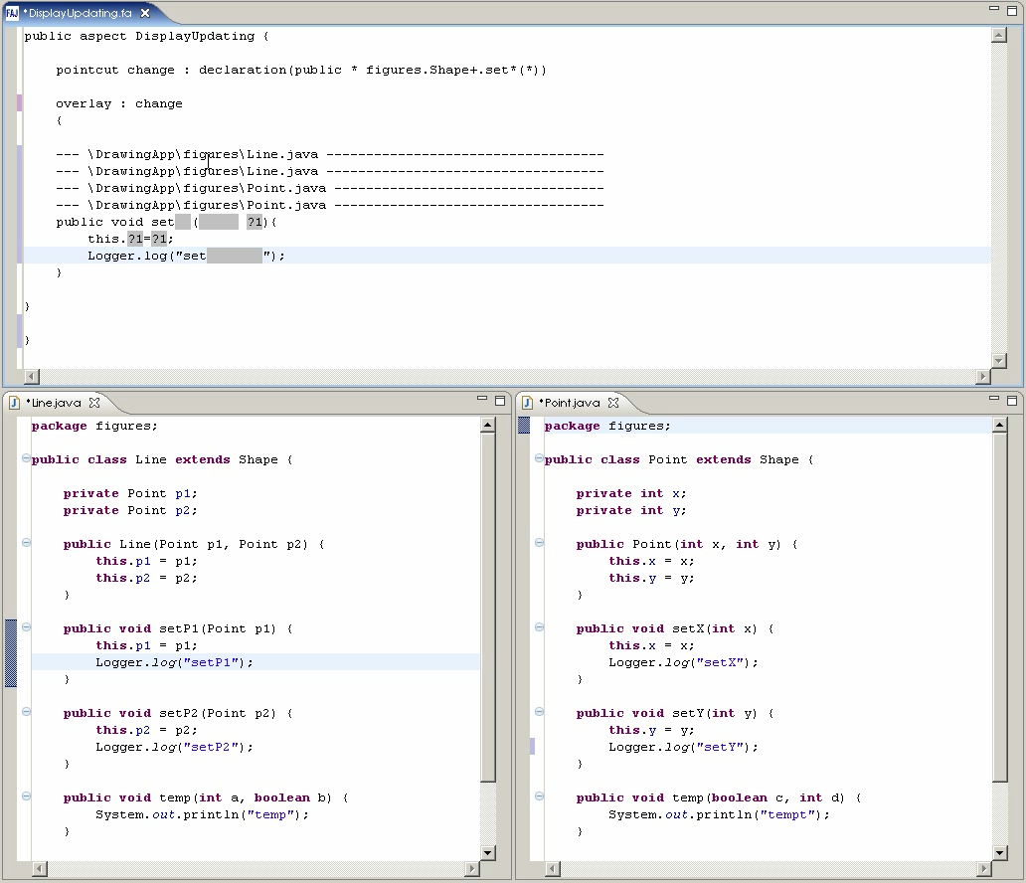
Notes:
Here is a screenshot of the prototype that I built for my research. The top is the fluid aspect editor that I built by extending the basic text editor. Right now it is showing an overlay which is a representation of 4 methods. The 2 files containing the 4 methods are displayed in the bottom. The idea is that user can edit and read the code in the overlay and the changes will be propagated to the files where the methods actually reside. Here you can see key stroke changes in the overlay log method is also changing the code in the line and point classes.

Slide 4
Linked Editing
Supported
  Linking multiple positions in files
  Simultaneous changes for all linked positions
Not supported
  Cursor updates
  Linking different code
Notes:
We used linked editing to implement this and it was very easy to start getting it to work. I just need to locate the positions that correspond to the methods and install a linked position model with those positions. Eclipse will then keep track of all keystroke change in any of the linked positions and propagate the same changes to the rest of the positions. So I was able to get simultaneous changes working very quickly. I did encounter a few problems or difficulties along the way. One of them is that the cursor does not update properly. If I am linking together 2 methods in the same file. Editing the 2nd method, for example typing an additional character in the 2nd method, actually causes the cursor to move back. The reason is because 2 characters have actually been inserted, one in the 1st and one in the 2nd method, so the cursor should move forward 2 places instead of one. The 2nd problem I encountered was that the code must be identical to be linked together. This is problematic since small white spaces changes cause an error to be thrown. Finally linked editing only works for files that are opened, which means it is not very scalable.

Slide 5
Good, Bad, and Ugly
Graphics <==> Source mapping (good)
Weaving into the Eclipse framework (bad)
Using GEF as a text editor (ugly)

Slide 6
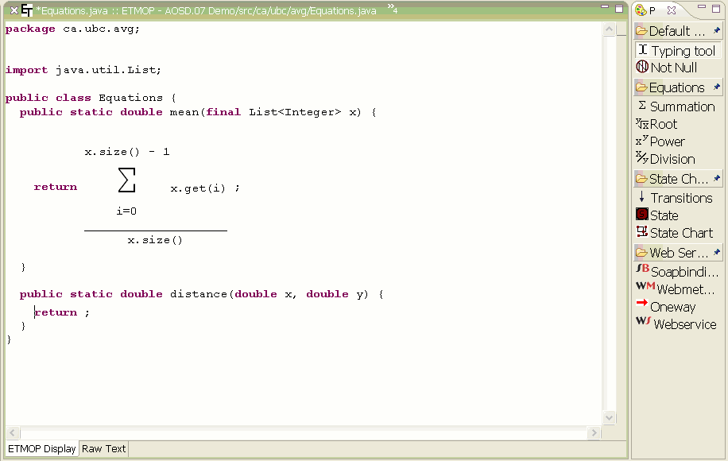
Editing Equations

Slide 7
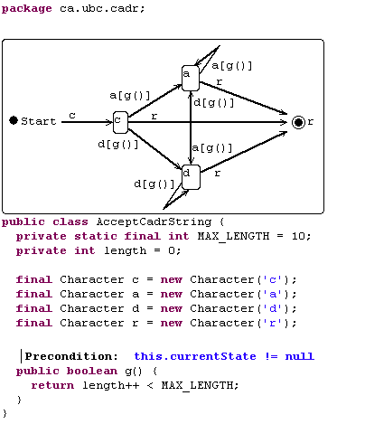
Mapping from a non-textual display
@StateChart(...)
public class AcceptCadrString {
...
char c = 'c';
char a = 'a';
char d = 'd';
char r = 'r';
char x = 'x';
public boolean g() {
return
length++ < MAX_LENGTH;
}
}
Render
Compile
<Class Ship>
Stored
Source
Display
<Field int x>
<Field int y>
<@CombineRight>
<@Get…>
<@Set…>
<Type int>
<Name X>
Good
...
<Field int y>
...
<@Previous>
...
Byte code/
Expanded AST

Slide 8
Good results
Once it worked…it worked
Got lots for free:
  syntax highlighting
  error highlighting
  clicks on different views
  refactoring

Slide 9
Weaving into JDT core
ajc does not work
  OSGi classloading issues
Ajeer (dynamic weaver for Eclipse)
  performance issues
Used ant scripts
  extracted original JDT core jar
  weaved
  recreated jar
  copied to new location
Overall, fairly restrictive
Bad

Slide 10
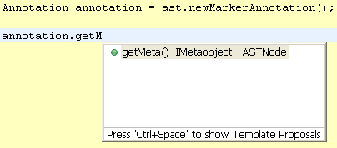
Works, with restrictions
ITDs Accessible Through Content Assist
Advice can be applied internally only
Cannot access pointcuts externally

Slide 11
Quirkiness: GEF as Text Editor
Arrow keys (Ctrl/Shift behavior)
Mouse behavior
Tabs not displayed
Artifacts with selection
Ugly

Slide 12
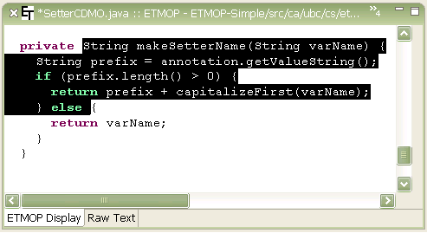
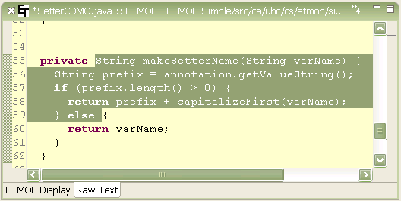
Artifacts with selection
My Editor
(ETMOP Editor)
JDT Editor

Slide 13
Overall
Eclipse is extensible, but only in some limited defined ways
If you are willing to get your hands dirty
  Lose forward/backward compatibility if internal APIs used

