Slide 1
Cyber-Physical Systems:
Aspects as a Basis for
Robustness and Openness
John A. Stankovic
Department of Computer Science
University of Virginia
March 2009

Slide 2


Slide 3
Outline
What are Cyber Physical Systems (CPS)
Aspects in CPS (cross cutting concerns)
  Logging
  (Reactive) Security
  Robust Localization
  Power Management
  Feedback Control

Slide 4
Acknowledgments/Info
CPS Program (3 years in the making)
  Initiated with core of about 10 people
  Expanded to more than 30 researchers
  Expanded to 100s of researchers
  NSF CPS CFP ($30,000,000 year 1)
  PCAST 2007 report: #1 priority for Federal Investment
  Expanding to other agencies
  European Union - $7B

Slide 5
Definition
CPS is the co-joining of computation and communication with physical processes.
CPS exhibits an intimate coupling between the cyber and physical that manifests itself from the nano world to large-scale wide-area systems of systems.

Slide 6


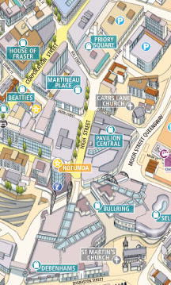





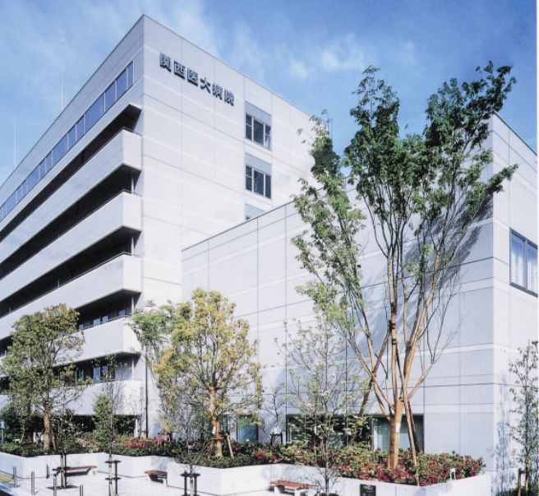


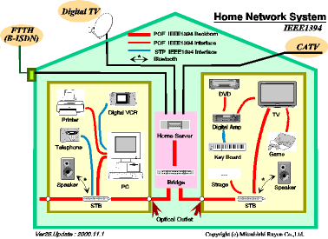
Computing in Physical Systems
Road and Street
Networks
Environmental
Networks
Heterogeneous
Wireless Networks with
Sensors and Actuators
Industrial
Networks
Battlefield
Networks
Building
Networks
Vehicle
Networks
Body
Networks
Notes:
Defining a physical network
Objection: everybody is going to run TCP/IP…

Slide 7
What’s New
Scale
Systems of systems
Confluence of physical, wireless and computing
Human Participation
Open

Slide 8
CPS
Are CPS simply embedded systems on steroids?
  Interact with the physical world
  Constraints on cpu, power, cost, memory, bandwidth, …
  Control actuators

Slide 9
Is the Internet just a LAN on steroids?
Confluence of the right technologies at the right time can result in
  Fundamental paradigm shift
  Totally new systems
  Revolutionize business, science, entertainment, …
  Transform how we interact with the physical world

Slide 10
Confluence of Four Key Areas
Cost
Form Factor
Severe Constraints
Small Scale
Closed
Open
Degree of
Uncertainty
Scheduling
Fault Tolerance
Wired networks
Wireless
Degree of
Uncertainty
Real-Time
Embedded
Systems
Architecture
Principles
Wireless Sensor
Networks
Control
Linear
Adaptive
Distributed
Decentralized
Open
Human Models
Noisy C.
Sensing
Scale
Real-Time/Actuation
Open

Slide 11
Motivating Example
Cyber – Physical Interactions
  Influence on each other
  Cross disciplinary

Slide 12
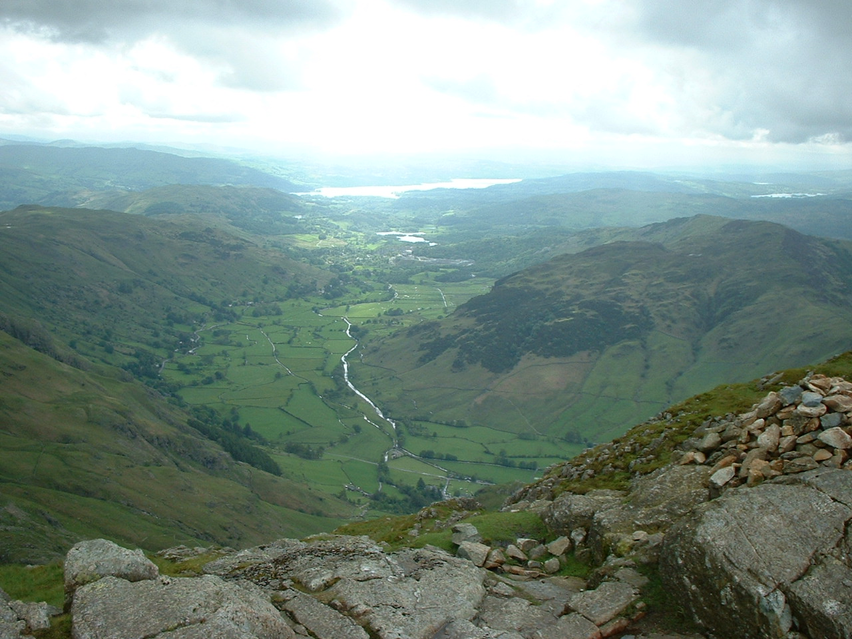
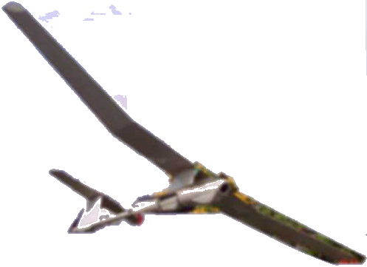
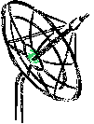

Energy Efficient Surveillance System
1. An unmanned plane (UAV) deploys motes
Ad-Hoc Network
Neighbor Discovery
Time Synchronization
Parameterization
Sentry Selection
Coordinate Grid
Data Aggregation
Data Streaming
Group Management
Leader Election
Localization
Network Monitor
Power management
Reconfiguration
Reliable MAC
Leader Migration
Scheduling
State Synchronization
……
Zzz...
Sentry
3. Sensor network detects vehicles and wakes up the sensor nodes
2. Motes establish an sensor network with power management
Notes:
I want to illustrate the use of sensor network in a typical military application ( wake up big brother), which we have worked on for about one year for the NEST project. Many students have contributed to this project, here I use it to provide a context for my talk. In wake up big brother scenario, an unmanned plan will deploy motes from the air. Those mote are air-droppable. When they reach the land, they self-organized into an ad hoc network. They also establish sentry service to conserve energy. Some motes remain active for a period of time as a sentry. While Some other motes go to sleep to save energy. When a tank enters into surveillance area. The active motes wakes up other motes and relay the detection back to the base station. This scenario seems very simple and straight forward, however it takes many efforts to make it a reality.

Slide 13
Tracking Example (1)
Sensing:
  Magnetic sensor takes 35 ms to stabilize (affects real-time analysis) (affects sleep/wakeup logic)
  Physical properties of targets affect algorithms and time to process (uncertainty fundamental)
    Use shape, engine noise, …
Sensor Fusion:
  Sensor fusion to avoid false alarms, but power management may have sensors in sleep state (affects fusion algorithms and real-time analysis)
  Location of nodes, target properties and environmental conditions affect fusion algorithms

Slide 14
Tracking Example (2)
Wireless:
  Missing and delayed control signals alters FC loops
  Impossibility results for hard real-time guarantees (new notions of guarantees)
Humans:
  Don’t follow nice trajectories; active avoidance attempts
  Social models, human models

Slide 15
Realistic (Integrated) Solutions
CPS must tolerate
  Failures
  Noise
  Uncertainty
  Imprecision
  Security attacks
  Lack of perfect synchrony
  Disconnectedness
  Scale
  Openness
  Increasing complexity
  Heterogeneity
R
O
B
U
S
T
N
E
E
S

Slide 16
Aspects in CPS
Logging
(Reactive) Security
Robust Localization
Power Control
FC Loops

Slide 17
Themes
Requirements of Robustness and Openness
  Minimal capacity devices
Adaptive Systems (Dynamic Aspects)
Produce Consistent Changes Across
  Protocols
  Nodes
  Control Loops

Slide 18
VigilNet
1. An unmanned plane (UAV) deploys motes
Zzz...
Sentry
3. Sensor network detects vehicles and wakes up the sensor nodes
2. Motes establish a sensor network with power management
Notes:
I want to illustrate the use of sensor network in a typical military application ( wake up big brother), which we have worked on for about one year for the NEST project. Many students have contributed to this project, here I use it to provide a context for my talk. In wake up big brother scenario, an unmanned plan will deploy motes from the air. Those mote are air-droppable. When they reach the land, they self-organized into an ad hoc network. They also establish sentry service to conserve energy. Some motes remain active for a period of time as a sentry. While Some other motes go to sleep to save energy. When a tank enters into surveillance area. The active motes wakes up other motes and relay the detection back to the base station. This scenario seems very simple and straight forward, however it takes many efforts to make it a reality.

Slide 19
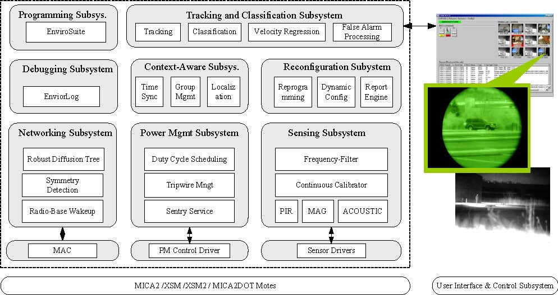
VigilNet Architecture

Slide 20
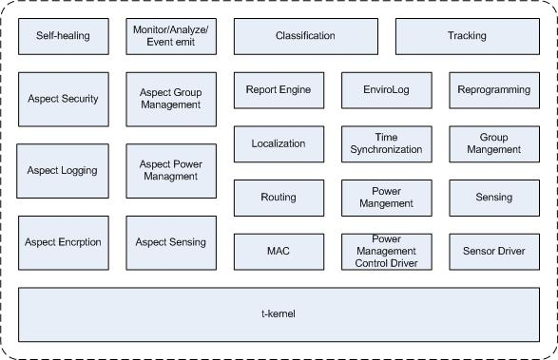
Dynamic Aspect Architecture
Notes:
In our self-healing architecture, all the system components, such as those described for VigilNet, run atop the t-kernel, a lightweight OS that supports dynamic linking and VM. A monitor evaluates the security and performance of the system, and can trigger automatic self-healing using known transformations, called aspect advice, residing on the mote. Transformations are applied that cut across multiple functional components of the system.

Slide 21
Logging
Open and noisy/uncertain environments
Limited storage and energy (must be selective)
Examples:
  Activate (logging) advice at all MAC and routing protocol entries when E2E comm. performance drops
  Activate periodically to assess state of system

Slide 22
Logging
Surprising performance
  Routes used?
  Congestion and why?
  Current topology?
  Hotspots?
  How much traffic generated by a node?
  …
Turn on/off
  Coordinated across CPS to get coverage
  By area

Slide 23
Security - VigilNet
1. An unmanned plane (UAV) deploys motes
Zzz...
Sentry
3. Sensor network detects vehicles and wakes up the sensor nodes
2. Motes establish a sensor network with power management
Notes:
I want to illustrate the use of sensor network in a typical military application ( wake up big brother), which we have worked on for about one year for the NEST project. Many students have contributed to this project, here I use it to provide a context for my talk. In wake up big brother scenario, an unmanned plan will deploy motes from the air. Those mote are air-droppable. When they reach the land, they self-organized into an ad hoc network. They also establish sentry service to conserve energy. Some motes remain active for a period of time as a sentry. While Some other motes go to sleep to save energy. When a tank enters into surveillance area. The active motes wakes up other motes and relay the detection back to the base station. This scenario seems very simple and straight forward, however it takes many efforts to make it a reality.

Slide 24
VigilNet Architecture

Slide 25
Security Issues
Every one of the 30 services can be attacked
Too expensive to make every service attack-proof
Attacks will evolve anyway
Cannot collect, re-program, and re-deploy
MICAz mote:
8 MHz 8-bit uP
128 MB code
4 KB data mem
250 Kbps radio

Slide 26
Security Approach
Operate in the presence of security attacks
  Robust decentralized protocols
  Runtime control of security vs. performance tradeoffs
Self-healing architecture
Evolve to new, unanticipated attacks
Lightweight solutions required due to severe constraints

Slide 27
Self-Healing Architecture
Notes:
In our self-healing architecture, all the system components, such as those described for VigilNet, run atop the t-kernel, a lightweight OS that supports dynamic linking and VM. A monitor evaluates the security and performance of the system, and can trigger automatic self-healing using known transformations, called aspect advice, residing on the mote. Transformations are applied that cut across multiple functional components of the system.

Slide 28
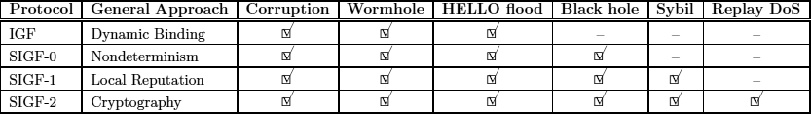
SIGF: Secure Routing
The SIGF family provides incremental steps between stateless and shared-state protocols.
SIGF allows efficient operation when no attacks are present, and good enough security when they are.

Slide 29
Dynamic Aspects
Mechanism for implementing the “right defense at the right time” strategy
  Switch consistently
  Choose the correct keys

Slide 30
Other Security Issues
Encrypt all control messages when attack suspected
  Time sync, localization, power management
Across nodes: Double the key lengths and increase message size

Slide 31
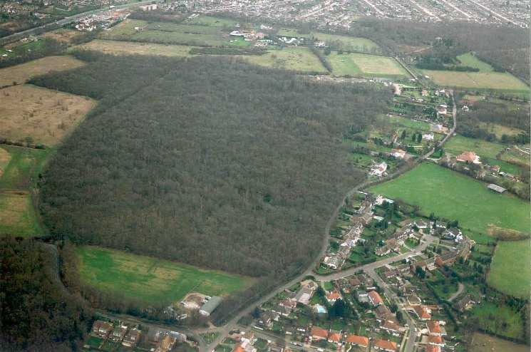
Robust Localization
Accurate Node Location in Complex Environments

Slide 32
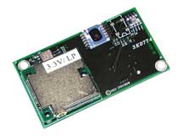
GPS
- Not Cost Effective
- Line of Sight

Slide 33
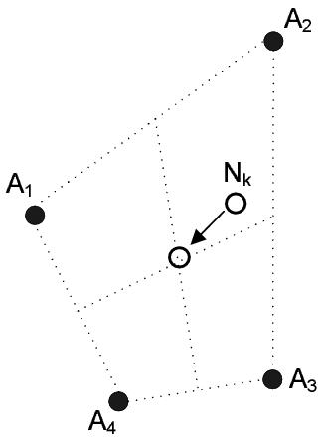

Range Free
Centroid
APIT
High Anchor Density
Inaccurate
Large Areas without anchors

Slide 34
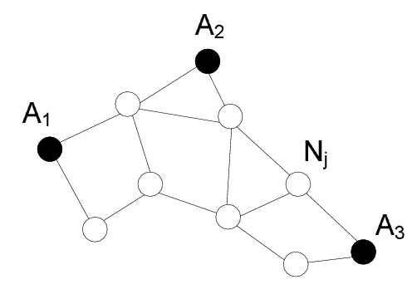
Range Free
DV-Hop
Inaccurate

Slide 35
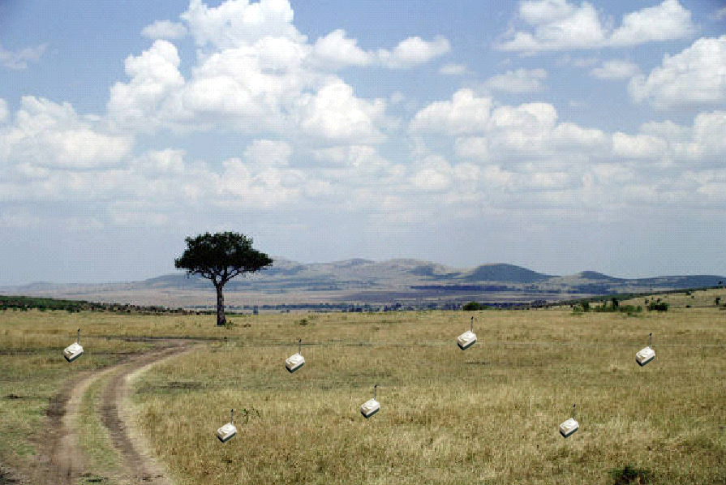


Low Cost - Accurate
Spotlight
(X₁, Y₁, R₁) at T₁
(X₂, Y₂, R₂) at T₂
Line of Sight
(X₂, Y₂, R₂)
(X₁, Y₁, R₁)

Slide 36
CPS
Complex physical properties of environments render “individual” solutions brittle

Slide 37
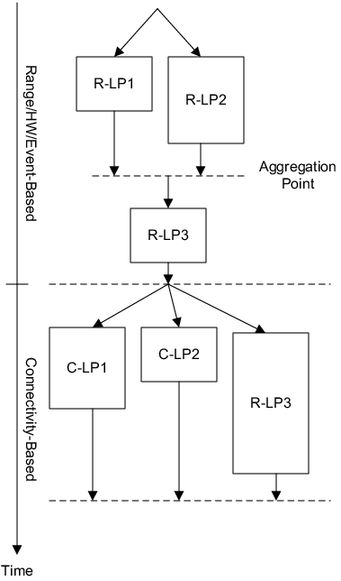
Hierarchical Framework
Choose best / Weighted average
If not localized – try another algorithm
All nodes have a location at this point.

Slide 38
Evaluation
TOSSIM
  400 nodes in 300x300ft2
  200x200ft² obstructed area
  50ft radio range
  10% nodes have GPS
  15% nodes in open area can’t be localized

Slide 39
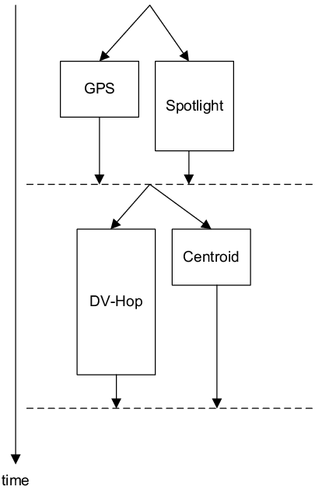
Evaluation

Slide 40
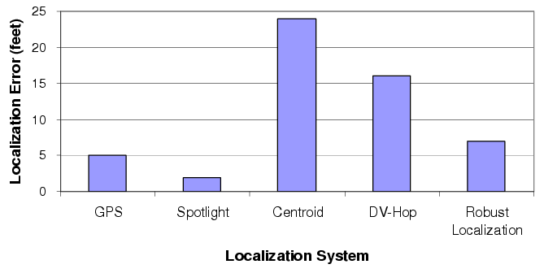
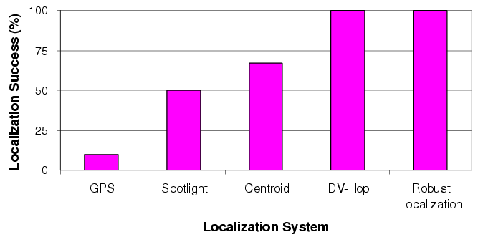
Evaluation
All nodes are localized

Slide 41
Dynamic Aspects
Weave in new localization protocols as required

Slide 42
Power Management
Power Management in the Small
  Individual protocols: MAC, Routing, Clock Sync, Localization
Power Management in the Large
  Overarching protocols for additional power savings
    Sentry Service
    Tripwire Management Service
    Duty Cycle
    Differential Surveillance

Slide 43
Sentry Duty-Cycle Scheduling
A common period p and duty-cycle β is chosen for all sentries, while starting times T_{start} are randomly selected
Non-sentries
Sentries
A
t
B
t
Target Trace
C
A
D
t
E
C
D
B
t
E
0
p
2p
t
Awake
Sleeping

Slide 44
Differentiated Surveillance Solution
DOC = 1
DOC = 2
Dynamic
DOC = Degree of Coverage

Slide 45
Aspects
Sets of coordinated changes (pointcuts in)
  In MAC
  In Routing
  In Clock Sync
  For duty cycle
  Turn off/on tripwire section

Slide 46
Feedback Control
Node Level
Neighborhood Level
System Level
Systems of Systems Level
Explicit and Implicit Interactions Across FC loops

Slide 47
Component-Based
(today - mostly)
Component
Reuse
Modularity
Portability
Reconfigure
Beginning to consider
performance

Slide 48
Component-Based (Tomorrow)
Sensors
Support for control; reflect
the physical
Actuators
Reflective Information
Support for
cross cutting performance
security
mobility
dependability
costs
real-time
power
dynamics
openness
Component

Slide 49
Interaction Among FC Loops
“n” controllers increase/decrease control parameter in same direction
  overshooting
“n” controllers fight each other
  Change parameters in opposite directions

Slide 50
Examples
Real-Time: monitor E2E delay
  Change sleep cycle (PM), backoff times (MAC), congestion thresholds (Routing), packet aggregation amounts (Middleware), sensing rates (SP), …
Power Control: monitor voltage
  Change duty cycle, coverage, sector policy, message rates

Slide 51
Final Thoughts (1)
CPS - Enabler for Dramatic Innovation
  New global-scale, personal medical delivery systems
  New paradigms for scientific discovery
  Smart (Micro) Agriculture
  Towards the end of terrorism
  (Mostly) Wireless Airplanes
  Next Generation Internet

Slide 52
Final Thoughts (2)
Connection to the physical world will be so pervasive that systems will be open even if you think they are not
Degree of uncertainty is high
Flexibility offered by (Dynamic) AOP has great potential

