Slide 1



Feature Modularity
Jo Atlee • Modularity • March 2015
David R. Cheriton School of Computer Science
University of Waterloo
Notes:
Want to talk about features from a different perspective than this community is used to dealing with them
Feature interaction community, where there is a greater emphasis on feature modularity and small interfaces between features

Slide 2
feature-oriented software development
Cruise Control
Cruise Control
Stability
Control
Anti-
Theft
Stability Control
Anti-Theft
Cruise
Control
stakeholders’
mental model of system
feature-oriented
software system
Notes:
The behavior of software is almost always described in terms of features. A feature of a software system is an optional or incremental unit of functionality. A feature-oriented description consists of a base description and feature modules, each of which describes a separate feature. The set of possible system behaviors is determined by applying a feature-composition operator to the base description and these modules.
The big attraction of feature-oriented description is behavioral modularity, which makes it possible to change the system’s behavior easily. With perfect behavioral modularity, it would be possible to make any desired change to the behavior of a system by adding a new feature module to the existing system description; it would never be necessary to change existing modules.
Even though perfect modularity will never be achieved, it must be approximated to a significant degree. For example, it is extremely common to create an exception to an existing feature by adding a new feature rather than by changing the existing feature.
PZ
=========
In software engineering, we think a lot about how to decompose a system development task into smaller subproblems: whether they are called components, modules, workpieces that can be tackled more easily. An increasingly popular strategy is feature-based decomposition, which is a type of functional decomposition of the system.
Good way to think about features
functional requirement
unit of functionality” [Hall,2000]
some identifiable unit of added value in the product
Examples: Voice Mail in telephony, Cruise control In automotive software
Several Benefits to a feature-oriented view of software
Criteria for decomposing complex system into fragments that can be considered, developed, evolved independently
- addresses system complexity through decomposition
- feature decomposition has the added benefit that features are fragments that are understood by multiple stakeholders (users, marketers) in a way that other software fragments, like modules, objects, are not
(2) Criteria for identifying and assigning development tasks
- supports incremental development (particularly important)
- parallel development of multiple features
- multi-vendor feature development
(3) Benefit over other approaches to decomposition is that features also serve as shared vocabulary among diverse stakeholders (marketing, customers, developers, non software engineers) in a way that “objects”, “components” and other types of software units don’t. Features they understand because they provide visible functionality, added value

Slide 3
what is a feature?
“unit of functionality” [Hall,2000]
- additive / incremental
- optional
“a modification of or an addition to a service, and does not stand on its own” [Bellcore1992]
“a tariffable unit” [Bellcore1992]
“a unit of variability”
“a requirement” [Zave2015]
“a characteristic / property / quality / aspect / profile / concern of the system”
Notes:
First some terminology
You may or may not be surprised to learn just how much time the FOSD and FI communities have spent discussing and debating the definition of the word “feature”
One significant distinction between the definitions of feature here and the definition of feature in PL is the emphasis on incrementality.
features represent variability; in product lines, some features may be optional – used to distinguish between different derived products
features are the increments of system enhancement / evolution; they do not represent stand-alone functionality
There is some product-lining in telephony, with respect to customization of switches for different countries or for different service providers. But for the most part, should think about the system comprising some common base (= mandatory features) augmented by set of add-on features. System evolution = feature development. Most features are available to most customers, by way of subscription or are pay-per-use. So the set of features on a call will vary depending on the parties’ feature subscriptions, and may vary dynamically based on the parties’ actions during the call (e.g., call waiting, 3-way calling).

Slide 4
feature-oriented software development
feature : a requirement
Cruise Control
Cruise Control
Stability
Control
Anti-
Theft
Stability Control
Anti-Theft
Cruise
Control
stakeholders’
mental model of system
feature-oriented
software system
Notes:
The behavior of software is almost always described in terms of features. A feature of a software system is an optional or incremental unit of functionality. A feature-oriented description consists of a base description and feature modules, each of which describes a separate feature. The set of possible system behaviors is determined by applying a feature-composition operator to the base description and these modules.
The big attraction of feature-oriented description is behavioral modularity, which makes it possible to change the system’s behavior easily. With perfect behavioral modularity, it would be possible to make any desired change to the behavior of a system by adding a new feature module to the existing system description; it would never be necessary to change existing modules.
Even though perfect modularity will never be achieved, it must be approximated to a significant degree. For example, it is extremely common to create an exception to an existing feature by adding a new feature rather than by changing the existing feature.
PZ
=========
In software engineering, we think a lot about how to decompose a system development task into smaller subproblems: whether they are called components, modules, workpieces that can be tackled more easily. An increasingly popular strategy is feature-based decomposition, which is a type of functional decomposition of the system.
Good way to think about features
functional requirement
unit of functionality” [Hall,2000]
some identifiable unit of added value in the product
Examples: Voice Mail in telephony, Cruise control In automotive software
Several Benefits to a feature-oriented view of software
Criteria for decomposing complex system into fragments that can be considered, developed, evolved independently
- addresses system complexity through decomposition
- feature decomposition has the added benefit that features are fragments that are understood by multiple stakeholders (users, marketers) in a way that other software fragments, like modules, objects, are not
(2) Criteria for identifying and assigning development tasks
- supports incremental development (particularly important)
- parallel development of multiple features
- multi-vendor feature development
(3) Benefit over other approaches to decomposition is that features also serve as shared vocabulary among diverse stakeholders (marketing, customers, developers, non software engineers) in a way that “objects”, “components” and other types of software units don’t. Features they understand because they provide visible functionality, added value

Slide 5
feature interactions
feature interaction: a feature behaves differently in the presence of another feature than it behaves in isolation
  nondeterministic
  conflicting actions
  violate global correctness property
  emergent behaviours
Notes:
Such an exception is an example of a feature interaction. A feature interaction is some way in which a feature modifies or influences another feature in describing the system’s behavior set.
In general, features might interact by causing their composition to be incomplete, inconsistent, nondeterministic, or unimplementable in some specific sense. Or the presence of a feature might simply change the meaning of another feature with which it interacts.
Feature-oriented description emphasizes individual features and makes them explicit. It also de-emphasizes feature interactions, and makes them implicit in the effects of the feature-composition operator.
PZ
==========
That’s the upside of feature orientation. The downside of feature modularity is integration.
While system is thought of as collection of features, must eventually integrate modules into a coherent whole application.
Problem is that features are often not truly separate, nonoverlapping concerns
A feature interaction occurs when the features of a product influence one anothers’ behaviour, such that a feature behaves differently in the presence of another feature than it behaves in isolation
Conflicts between actions of features over a shared context (e.g., multiple automotive features that control a car’s speed or steering)
Features will behave well when executing in isolation, but may violate some global correctness property when they execute together (e.g., telephony features, when executed together, violate a constraint on the number of calls that a person can participate in simultaneously)
Interactions manifest themselves as emergent behaviours (not present in any of the individual features)

Slide 6
hybrid brakes ⨁ anti-lock breaking
2010 Toyota Prius
hybrid brake system
  (normal) hydraulic brake system
  regenerative braking system
    converts loss of vehicle momentum into electrical energy
    stored in on-board batteries
anti-lock brake system (ABS)
  maintains stability, steerability during panic braking
interaction
  braking force after ABS actuation reduced
  vehicle stopping distance is increased
  62 reported crashes, 12 injuries
Notes:
Does anyone have a 2010 Toyota Prius? Was your car recalled?
braking force after ABS actuation reduced compared to braking force before ABS actuation, when brakes were applied on rough or slick road surfaces (winter driving)
many drivers experienced this phenomena, particularly in winter, where it was confirmed that drivers may maintain a fixed brake pedal stroke in winter driving
Almost 1500 complaints
62 crashes
12 injuries
Number of vehicles potentially affected: ~150,000
defect report refers to the controller for the Prius hybrid brakes as being sophisticated and difficult to get correct. The fix for this interaction was to reprogram the ABS unit with improved software that addresses this particular situation.

Slide 7
cruise control ⨁ traction control
cruise control
  vehicle set to maintain driver-specified speed
traction control
  brake fluid applied when wheels slip
interaction
  engine power is increased (to maintain speed)
  driver senses “sudden acceleration”
    vehicle becomes difficult to control
resolution
    advise drivers not to use cruise control on slippery roads
Notes:
brake fluid applied when wheels slip in rough or slippery road conditions
general interaction – not particular to any specific automotive make or model
general advice is to not use cruise control when the road is slippery

Slide 8
not all interactions are bad!
intended interactions
advanced cruise-control variants override basic cruise control
prohibit navigation overrides navigation
prohibit-navigation override overrides prohibit-navigation
unintended but harmless interactions
call screening prevents activation of caller id
(planned) resolutions to conflicts
brake override overrides (acceleration ⨁ braking)
Notes:
Two points about feature interactions are frequently misunderstood, despite extensive research on this subject :
1) While many feature interactions are undesirable, many others are desirable or necessary. Not all feature interactions are bad!

Slide 9
all interactions require work
verify intended interactions
detect unexpected interactions
analyze them for undesired interactions
fix undesired interactions
  faulty feature
  disallow feature combination
  resolve interaction using exceptions / new features
test the fixes
Notes:
To be safe, software developers need to analyze the consequences of all possible feature interactions, in order to find and fix the bad interactions. Once interactions are known, need to do something about them. Need to modify the features to eliminate the undesired interactions. Perfect interaction resolution (common in safety-critical systems, like telephony) requires the design and implementation of a resolution for every undesired interaction.
Herein lies the feature interaction problem. The Feature Interaction Problem is that the number of interactions to consider (to identify, and manage) is exponential in the number of features. Thus, development of a new feature involves not only the implementation of that feature’s core functionality, but also a number of exceptions that capture how that feature ought to behave in the presence of other features

Slide 10
feature modularity vs. interactions
FOSD emphasizes features
de-emphasizes interactions
but still must detect, analyze, fix, test interactions
  this is exactly the chore that feature-orientation was meant to avoid!
Notes:
Feature interaction problem under-appreciated in the FOSD community.
Feature-oriented software development emphasizes individual features and makes them explicit. It also de-emphasizes feature interactions, and makes them implicit (the outcome of feature composition) or exceptional (as exceptions within features).
Which cancels out most or all of the benefits from taking a feature-oriented approach in the first place. Instead of being able to focus on the individual features, development is dominated by dealing with feature interactions (which consider behaviours of feature combinations)
Feature-oriented software development will remain popular because is makes individual features easy to understand. But is easy to abuse by ignoring feature interactions altogether.

Slide 11
what this talk is about
history of feature modularity
  representing features as isolated modules
  (some) information hiding
addressing feature interactions
  scalable to large numbers of features
  supports third-party development
Notes:
This talk looks at different strategies for addressing the FI problem.

Slide 12
approach #1: feature module = co-location of feature’s code

Slide 13
interactions resolved using exceptions
F₁ = f₁ + e_{f2} + e_{f3} + … + e_{fn}
+ e_{f2f3} + e_{f3f4} + …
+ e_{f2f3…fn}
Notes:
I would argue that these exceptions represent the extra lines of code that arise as the number of modules increase.
I would also argue that these extra lines of code are much harder to write than the lines of code in f1. the f1 code represents the sunnyday essential behaviour of the feature being implemented. But the exceptions require the engineer to revisit the requirements of each of the interacting features, and tweak the requirements of each of the interacting features. And tweak the requirements of combinations of features
=============
Second biggest misunderstanding
2) The Feature Interaction Problem, as defined in the literature and experienced in practice, is not that features interact! The Feature Interaction Problem is that the number of interactions to consider is exponential in the number of features. Thus, development of a new feature involves not only the implementation of that feature’s core functionality, but also a number of exceptions that capture how that feature ought to behave in the presence of other features
Death by exceptions
Substantially complicates the task of feature development, because although the functionality of any individual feature is relatively small and simple, the final specification and implementation includes a series of exceptions of how the feature behaves in the presence of other features (or worse, other feature combinations).
As a result, a software team finds that its work in developing new features is dominated by the tasks to detect, analyze, and verify interactions. Would take 2 years to bring a new feature to market, between specification, interaction analysis and resolution, implementation, and testing.
In this respect, the feature interaction problem is not so much one of software quality in the sense of FIs being a source of errors in released products as it is a problem of programmer productivity. That is, the feature interactions problem isn’t that features interact -- it is that there are so many features and interactions and resolutions to deal with.
How big a problem is it really? In mean, the fact that the number of interactions is exponential might not be a problem if there aren’t many features

Slide 14
lots of features
e.g., telephony has 1000+ features per system
device’s
features
provider’s
features
PBX
features
provider’s
features
device’s
features
a system of feature-rich systems
  features from multiple providers
  multiple active versions of the same feature
Notes:
Some systems have a thousand features or more.
By the time that the telecommunications industry raised the call for help their systems were along the sizes of a thousand features in a single switch. Complexity of adding a new feature to a system that already implements 1000 features.
Moreover, the notion of a call may involve multiple systems, each contributing features to the call. Smart phones offer calling features (address book, redial, etc.). Your telephone provider wants to sell you features. You might forward a call to another number (e.g., your work number), so that you have access to those features on a call. Imagine a scenario where a call involves 4-5 different collections of features that the call parties have subscribed to.
- multiple providers
- multiple versions (e.g., address machine, provider voice mail, work voice mail)
OK, there can be lots of features – but that doesn’t mean that there are lots of interesting interactions that actually require attention

Slide 15
lots of interactions
results of the second feature interaction contest
Notes:
Telecommunications is extreme in this way. Telecommunications features are highly interrelated because they all extend a small base system and operate over a small set of shared variables and protocol signals. Inevitably, each signal (e.g., pressing “#”, busy-signal) has a large number of different meanings, depending on the context in which it is being used.
In this respect, telecommunications systems is extreme but not unique. E-mail (27 interactions among 10 features) Automotive software, which is another case of software being a system of networked systems, that are provided by multiple vendors looks like it will have similar problems, where sensors and actuators are being overloaded to serve multiple purposes,
====
Still exist subsystems
- call setup
- call
- billing
- personalization
- conference calling
- failure treatments

Slide 16
lots of types of interactions
control-flow
data-flow
data modification
data conflict
control conflicts
assertion violation
resource contention
one feature affects the flow of control in another feature
one feature affects (deletes, alters) a message destined for another feature
shared data read by one feature is modified by another feature
two features modify the same data
two features issue conflicting actions
one feature violates another feature's assertions or invariants
the supply of resources is inadequate, given the set of competing features
Notes:
Data interaction
Control interaction
Resource interaction
Which makes it difficult to create a single method for detecting interactions

Slide 17
introduced in several phases
Bowen, SETSS’89
[req] understanding / specifying how features ought to interact
[req] the number of interactions (and resolutions) to consider grows exponentially with the number of features
[design] more interactions introduced during design due to sharing of resources, I/O devices, protocol signals, etc.
[imp] near-commonalities among features leads to questions about how to effectively reuse software components
[test] the sheer number of interactions and resolutions to be tested lengthens the testing phase
Notes:
Complexity introduced by the FIP to the feature-specification phase is inherited by the design, implementation, and testing phases because all of the specified interactions must be accounted for.
Additionally, the design and implementation phases may introduce more interactions (not present at the specification phase) because the sharing of I/O devices and software components creates another channel for interaction.
Got to the point that it would take two years to develop a new feature (where a feature itself is relatively small)

Slide 18
feature interaction problem
death by exceptions [Zave]
F₁ = f₁ + e_{f2} + e_{f3} + e_{f4} + e_{f5} + e_{f6} + e_{f7}
+ e_{f8} + e_{f9} + e_{f10} + e_{f11} + e_{f12}
+ e_{f13} + e_{f14} + e_{f15} + e_{f16} +…+ e_{fn}
interactions
dominate feature development
complicate third-party feature development
Notes:
Second biggest misunderstanding
2) The Feature Interaction Problem, as defined in the literature and experienced in practice, is not that features interact! The Feature Interaction Problem is that the number of interactions to consider is exponential in the number of features. Thus, development of a new feature involves not only the implementation of that feature’s core functionality, but also a number of exceptions that capture how that feature ought to behave in the presence of other features
Death by exceptions
Substantially complicates the task of feature development, because although the functionality of any individual feature is relatively small and simple, the final specification and implementation includes a series of exceptions of how the feature behaves in the presence of other features (or worse, other feature combinations).
As a result, a software team finds that its work in developing new features is dominated by the tasks to detect, analyze, and verify interactions. Would take 2 years to bring a new feature to market, between specification, interaction analysis and resolution, implementation, and testing.
In this respect, the feature interaction problem is not so much one of software quality in the sense of FIs being a source of errors in released products as it is a problem of programmer productivity. That is, the feature interactions problem isn’t that features interact -- it is that there are so many features and interactions and resolutions to deal with.
How big a problem is it really? In mean, the fact that the number of interactions is exponential might not be a problem if there aren’t many features

Slide 19
approach #2:
feature module = black box

Slide 20
feature modules
features are independent entities that are oblivious to the presence of other features
each module’s interface is simply its inputs and outputs to a shared environment
inputs
outputs
enables third-party feature development
simplifies detection of interactions
Notes:
Behaviour requirements are modelled as state machines that sense and control their environment
Can think of the feature executing independently, in parallel
This won’t be true of all features – some features are expressed as extensions of existing features, so they are effectively add-ons to the existing feature. But features specified as machines are effectively executing independently

Slide 21
detecting feature interactions
feature
requirements of feature
(property)
F₁ ⨁ F₂ ⨁ ••• ⨁ F_{n} ⊭ Φ₁ ∧ Φ₂ ∧ ••• ∧ Φ_{n}
F_{1 ⊨} Φ₁
F_{2 ⊨} Φ₂
F_{n ⊨} Φ_{n}
•••
feature composition
Notes:
The essence of a feature interactions is that a feature’s specification is violated (or some global safety property)
features in isolation meet their specifications, but when combined with other features the specifications (or global safety property) are violated
This is a problem for formal methods!!!
FM community totally took up the challenge!

Slide 22
call forward vs. voice mail
CFNA call is forwarded to new directory number
VM message is from the caller is recorded
?
+
CFNA VM forward call ∧ record message
Notes:
Reconsider our simple example from earlier.
What happened???
feature requirements are not guaranteed to be preserved under composition

Slide 23
nonmonotonic resolutions
(Veldhuijsen’95)
adding a new feature can change the requirements of existing features:
nonmonotonic extensions
  e.g., Freephone changes billed party
changes to definitions of terms
  e.g., refinement of the notion of being busy
  e.g., evolution of a call
  e.g., evolution of directory numbers; of private numbers
violation of invariants / assumptions
  “I have not been able to think of a single interesting assertion that would be true of a system incorporating all [features of the public switched telephone network].” [Zave’01]
Notes:
The introduction of new features don’t just interact with the BEHAVIOUR of existing features. They change the REQUIREMENTS of existing features.
Freephone feature changes who should be billed for caller; original service should no longer bill the caller
Call Screening changes absoluteness of whether dialing leads to a set-up attempt; in some cases, original service should terminate call attempt
Invariants are another way of expressing correctness criteria. In verifying feature-oriented systems, invariants have the benefit of expressing correctness criteria in that is free from the context of the specific features in the system. In the same way, they can be used to constrain system behavior without mentioning any features explicitly.
One difficulty is obvious: the behavior of a feature-oriented system changes, sometimes radically, with the addition of every feature. Many feature interactions occur because the specification of an early feature reliated on assumptions no longer true when the later feature was conceived. As such, an assertion that is true of today’s system but not true of tomorrow’s has little value. The gravity of this situation cannot be overestimated. Taking into account all the features of the public switched telephone network (PSTN) that I have seen proposed or implemented, I have not been able to think of a single interesting assertion that would be true of a system incorporating all of them.
Call Waiting introduces different versions of the busy state: the original one, where a called party is busy and the caller hears a busy tone, and a new one where the called party may be busy (in another call) and the caller hears a ring tone and there is an attempt to establish the connection. Multiple busy treatments: call waiting, call forwarding on busy, voice mail.
Original system supported two-party call paid for by caller. Features such as conference, transfer, and drop let users add and delete parties to an ongoing call, so that the conversation continues while its membership changes completely. The ultimate in dynamic calls is the chat line, an ongoing public call that parties can enter and leave at will. Who pays for calls (conference calls, forwarded calls, chat lines)? -> multi-party call, call configurations that change dynamically (split, merge), call forwarding, chat lines
Once upon a time, there was a one-to-one correspondence between telephones and directory numbers. Then one-to-many. Then many-to-many. The notion of private number has changed over the years. Originally meant that the number didn’t appear in public telephone directory. As features were added to display number, definition broadened to mean that the number is never revealed (not revealed by features that display number of the caller, not revealed in bills, etc.)
This problem always existed – not as evident until studying black box approach

Slide 24
feature interaction problem
death by “interaction features”
F₁ + F₂ + F₃ + … + F_{n}
+ F₁#F₂ + F₁#F₃ + … F_{n-1}#F_{n}
+ F₁#F₂#F₃ + F₁#F₂#F₄ +
+ F₁#F₂#F₃#...#F_{n}
aiming for perfect resolution of interactions doesn’t scale
Notes:
Modularizes the resolutions as separate features. Better modularity. Enables third-party development of features and resolutions.
Doesn’t really address the issue of having to consider and resolve an exponential number of possible feature interactions, having to write the difficult “interaction features”.
Aiming for perfect resolution of interactions doesn’t scale.
Second biggest misunderstanding
2) The Feature Interaction Problem, as defined in the literature and experienced in practice, is not that features interact! The Feature Interaction Problem is that the number of interactions to consider is exponential in the number of features. Thus, development of a new feature involves not only the implementation of that feature’s core functionality, but also a number of exceptions that capture how that feature ought to behave in the presence of other features
Death by exceptions
Substantially complicates the task of feature development, because although the functionality of any individual feature is relatively small and simple, the final specification and implementation includes a series of exceptions of how the feature behaves in the presence of other features (or worse, other feature combinations).
As a result, a software team finds that its work in developing new features is dominated by the tasks to detect, analyze, and verify interactions. Would take 2 years to bring a new feature to market, between specification, interaction analysis and resolution, implementation, and testing.
In this respect, the feature interaction problem is not so much one of software quality in the sense of FIs being a source of errors in released products as it is a problem of programmer productivity. That is, the feature interactions problem isn’t that features interact -- it is that there are so many features and interactions and resolutions to deal with.
How big a problem is it really? In mean, the fact that the number of interactions is exponential might not be a problem if there aren’t many features

Slide 25
best resolution not always obvious
X
Y’s features
Z’s features
VM
CF
VM
X calls Y, which forwards the call to Z, and the call attempt fails.
whose VM should react?
what if Y is a sales group and Z is a sales representative?
what if Y is on a long leave of absence?
Notes:
Seems that determining the desired behaviour is easier for individual features than it is for combinations of
features; may be context specific. The correct resolution of an interaction may depend on the context. Consider two DNs A and B, each of which subscribes to some features, such as voice mail, that are failure treatments. A particular call to A is forwarded by some feature of A’s to number B. Then, the attempt to reach B fails. Whose failure treatments ought to be applied?
This scenario can occur in a variety of contexts, each of which might justify a different answer:
A is the address of a sales group, and B is the address of a sales representative in the group. In this case, A’s failure treatments should be applied, so that they can find another representative or record voice mail that is accessible by anyone in the group.
In a different case, A and B may be the numbers of coworkers. The worker with address A is on a leave of absence. In this case, B’s failure treatments should be applied because they will respond promptly, whereas voice mail for A may not be received for a very long time.
Any resolution decision that we make will be wrong in many circumstances. Trying to make the system absolutely correct is fruitless. Making it predictable and unambiguous, so that users will know how to operate it may be a more appropriate approach.

Slide 26
approach #3:
feature modules with interfaces

Slide 27
interfaces and information hiding
interface advertises what services a module provides to the rest of the system, and how they can be accessed
information hiding encapsulates a design decision inside a module, whose interface reveals only externally visible properties [Parnas’72]

Slide 28
interfaces
feature interface defines what services a feature provides to the rest of the system and how other features can access those services
family
interface
public interface
inputs /
outputs
extension
points
accessors
mutators
less
expressive
more
expressive

Slide 29
feature families
CruiseControl
SpeedLimitCC
CurveCC
HeadwayControl
+ CC#SLCC
+ CC#CCC + SLCC#CCC + CC#SLCC#CCC
+ CC#HC + SLCC#HC + CCC#HC…
Anti-theft
Climate Control
Lighting
Power Windows

Slide 30
minimal public interface
most inter-feature references are to high-level common modes of operation
examples
  FeatureX_Fail flag is set to true when FeatureY is in fail state
  FeatureQ is enabled only if FeatureP is enabled

Slide 31
minimal public interface
most inter-feature references are to high-level common modes of operation
Failed
public
interface
Inactive
Active
private
Monitoring
Controlling
Monitoring
Monitoring

Slide 32
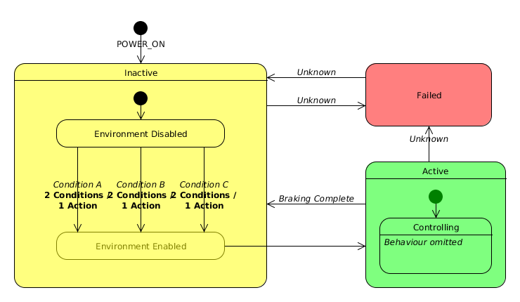
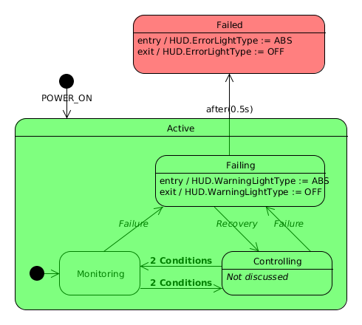
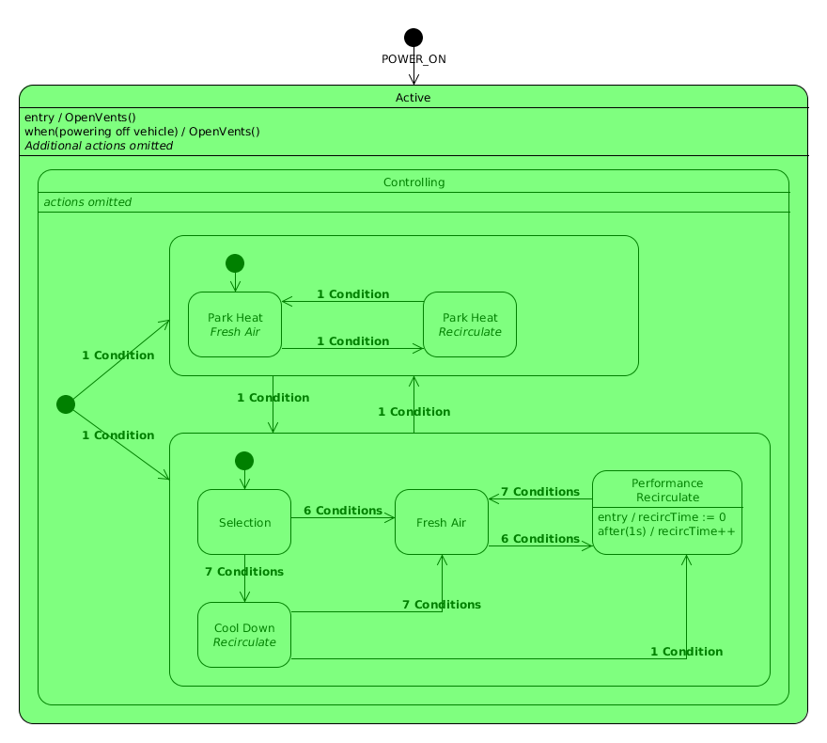
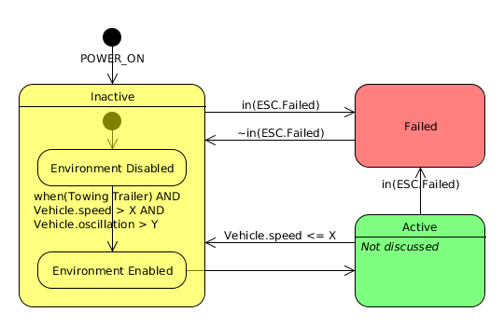
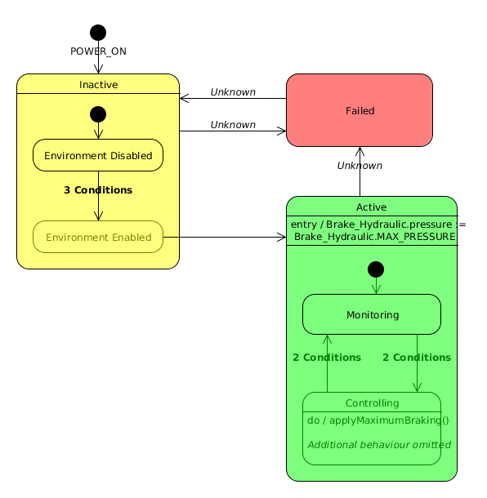
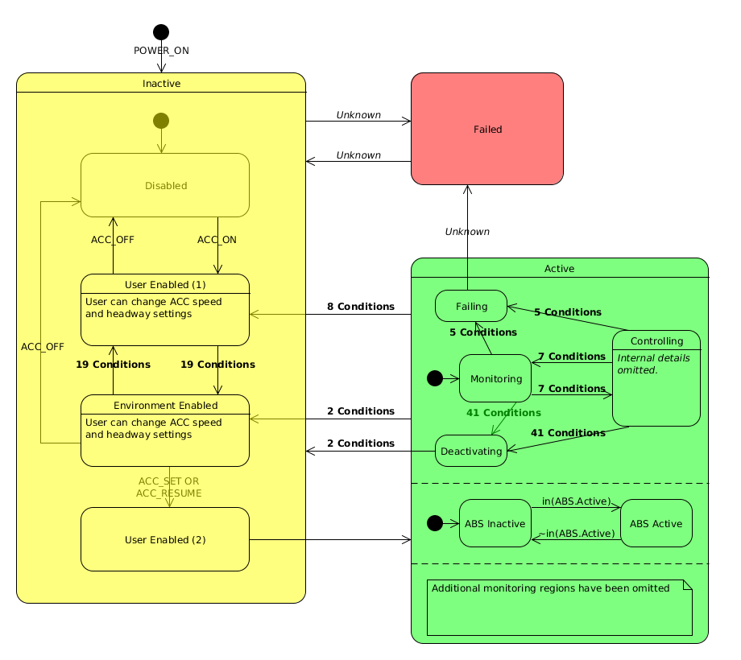
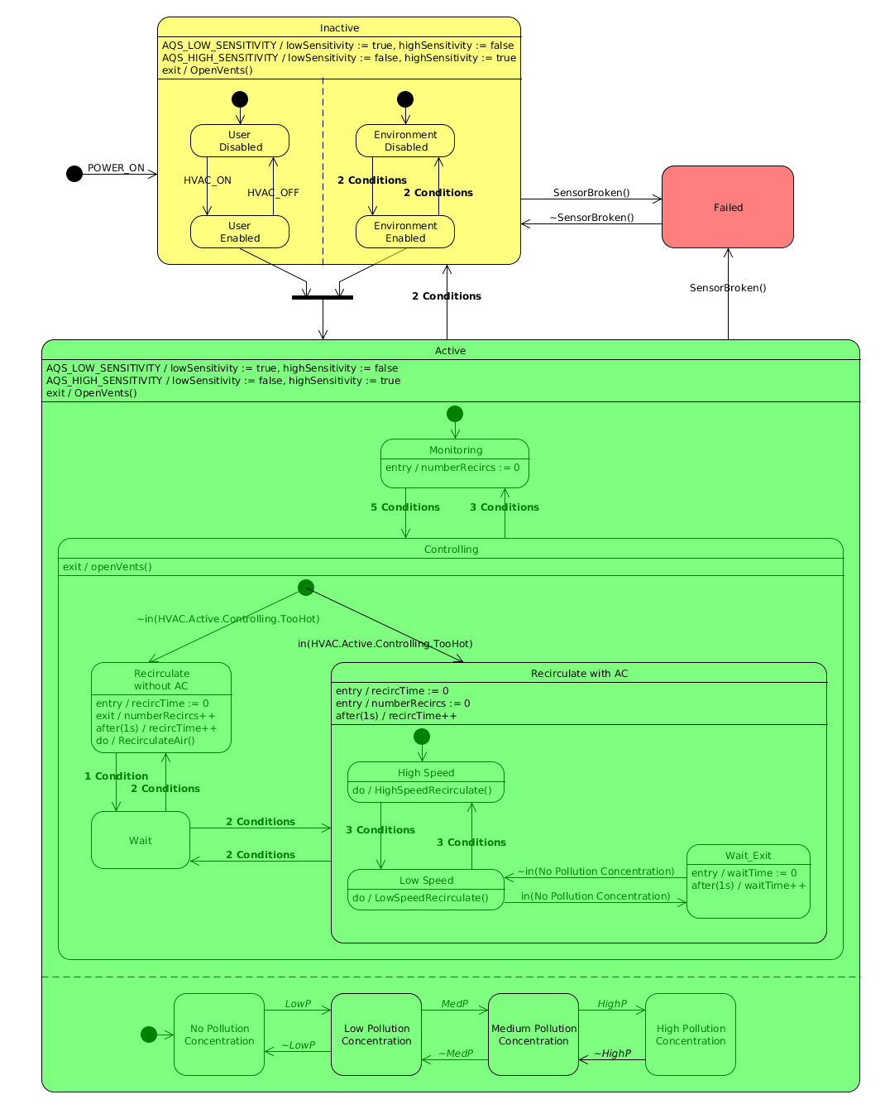
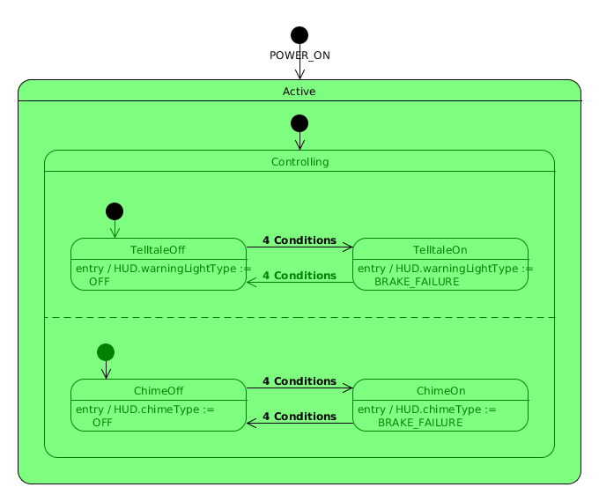
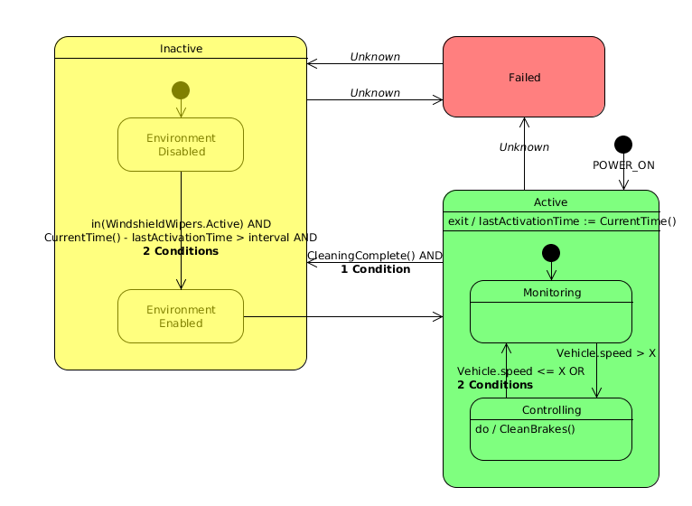
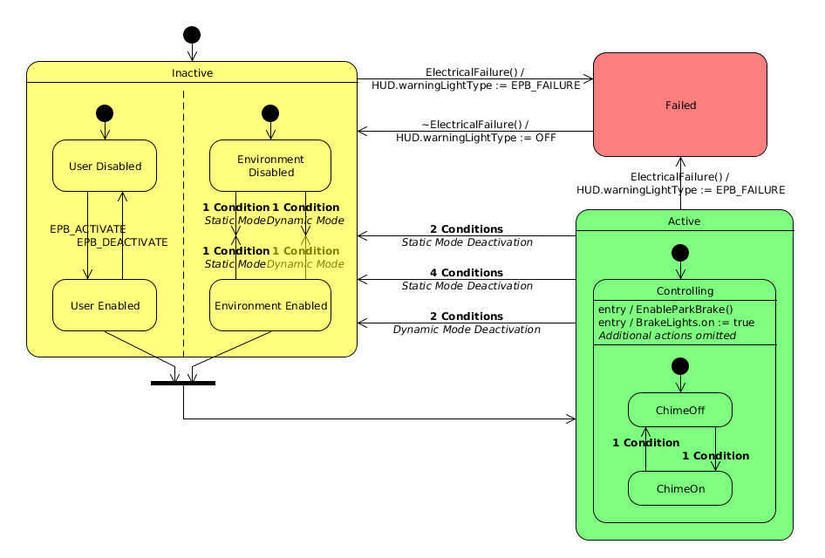
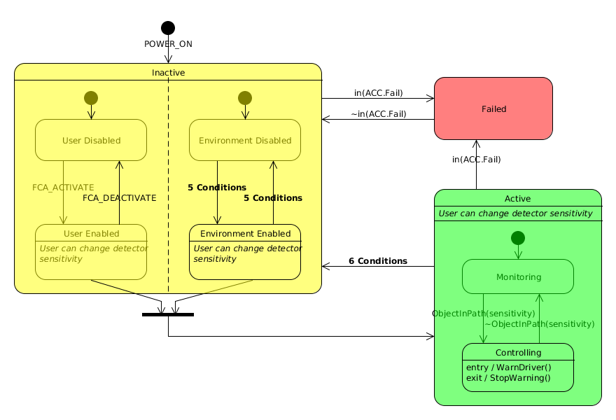
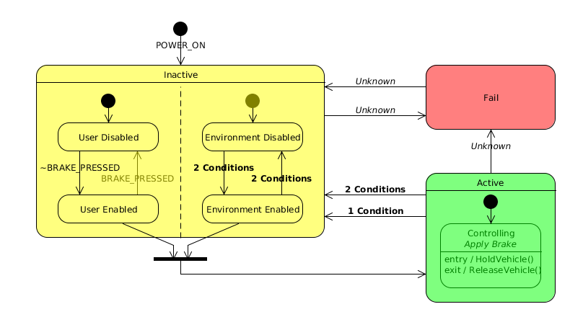
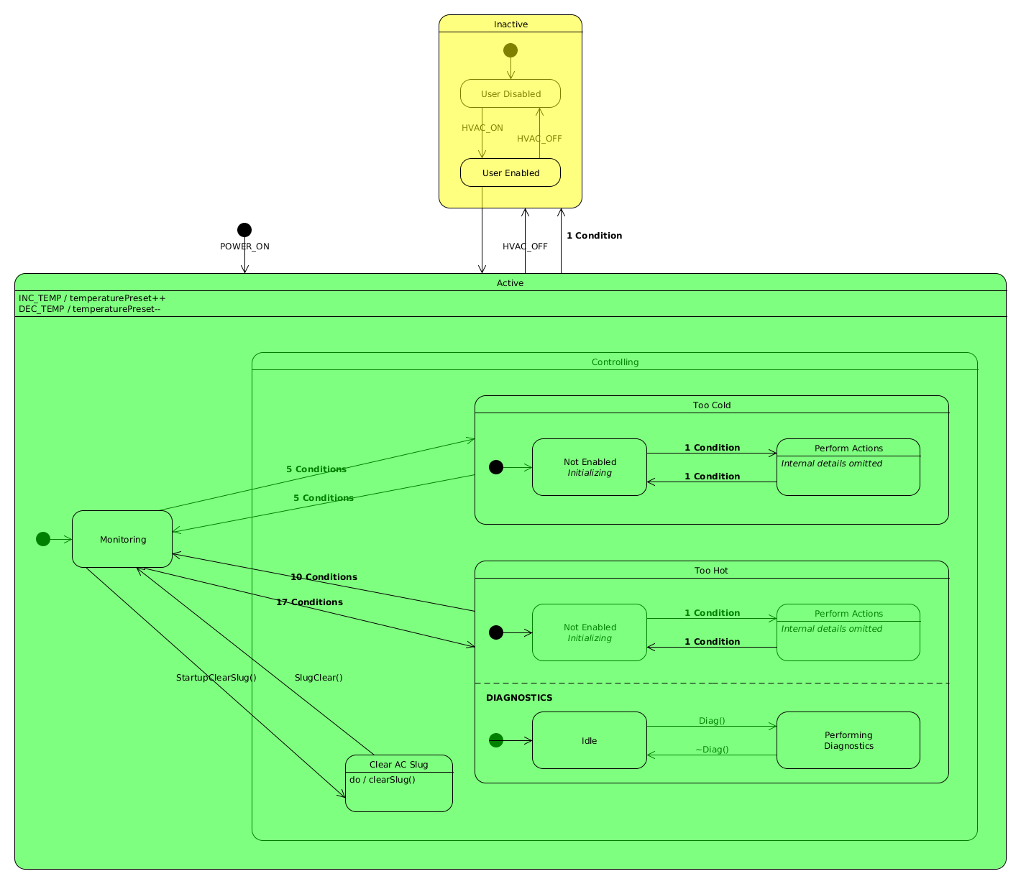
generic public interface
modes of operation can serve as criterion for structuring feature modules

Slide 33
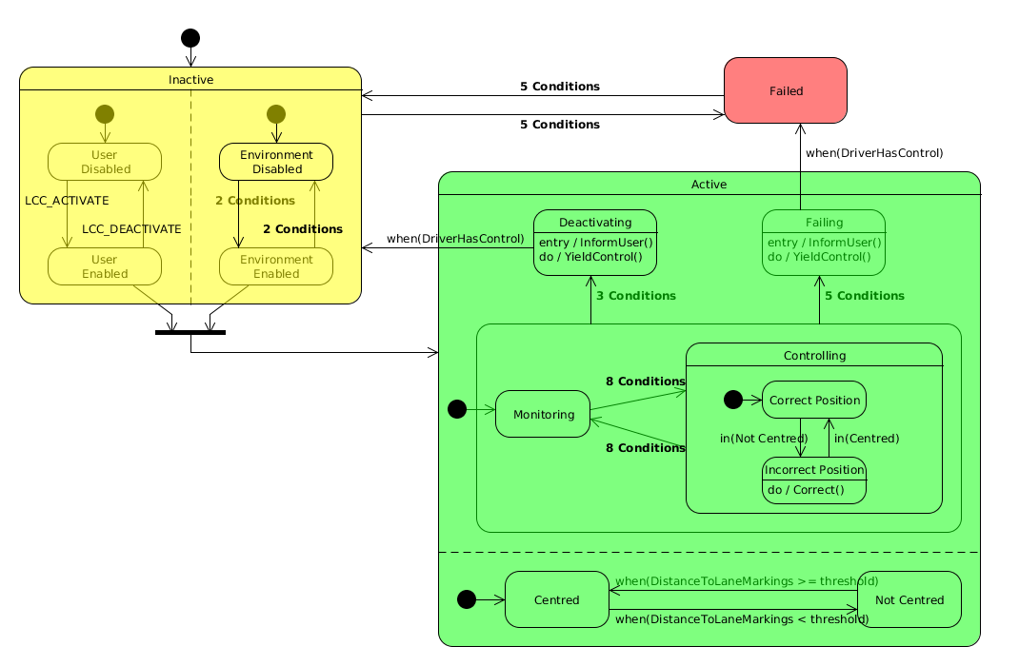
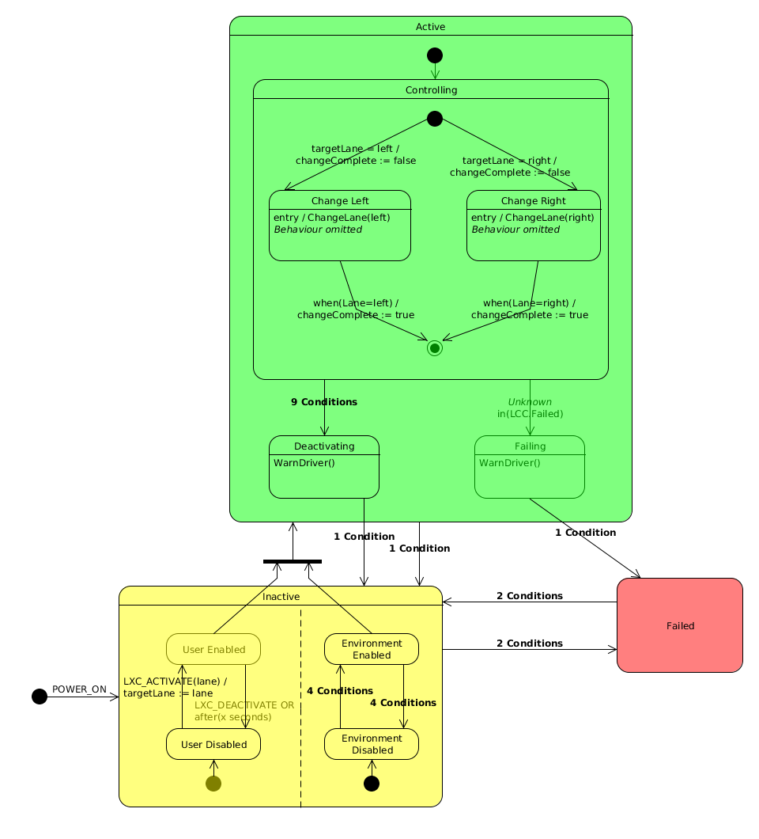
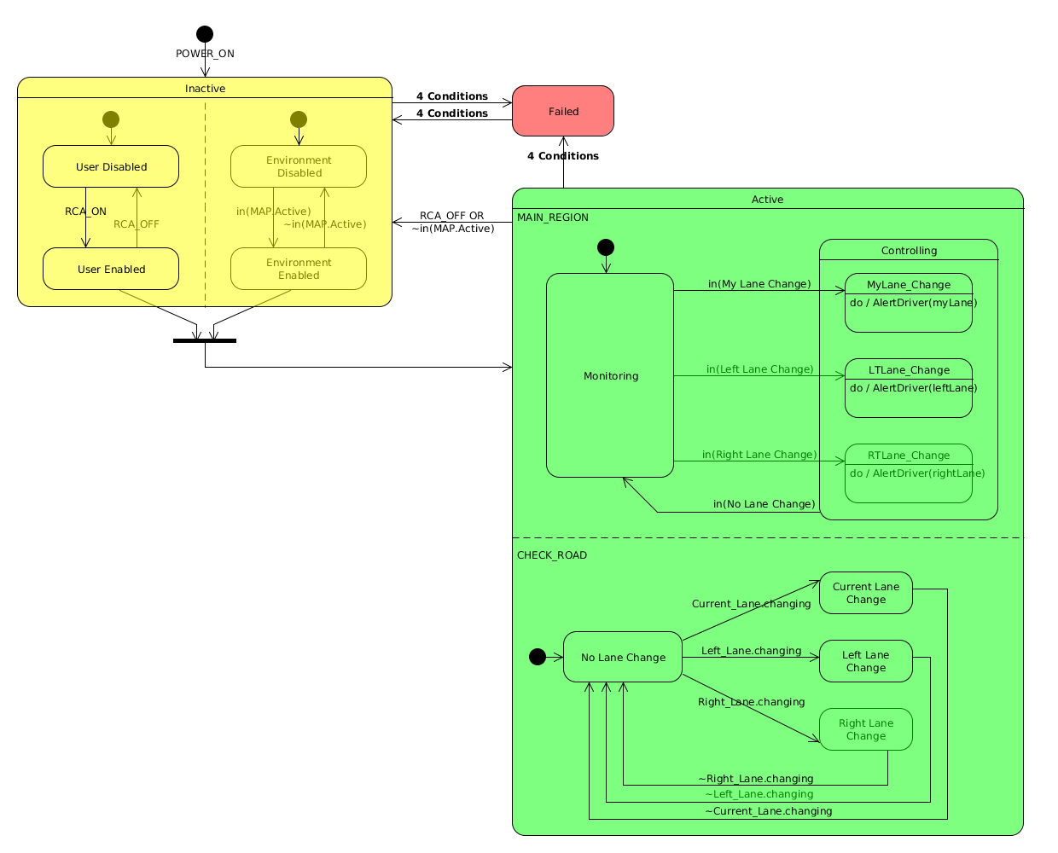
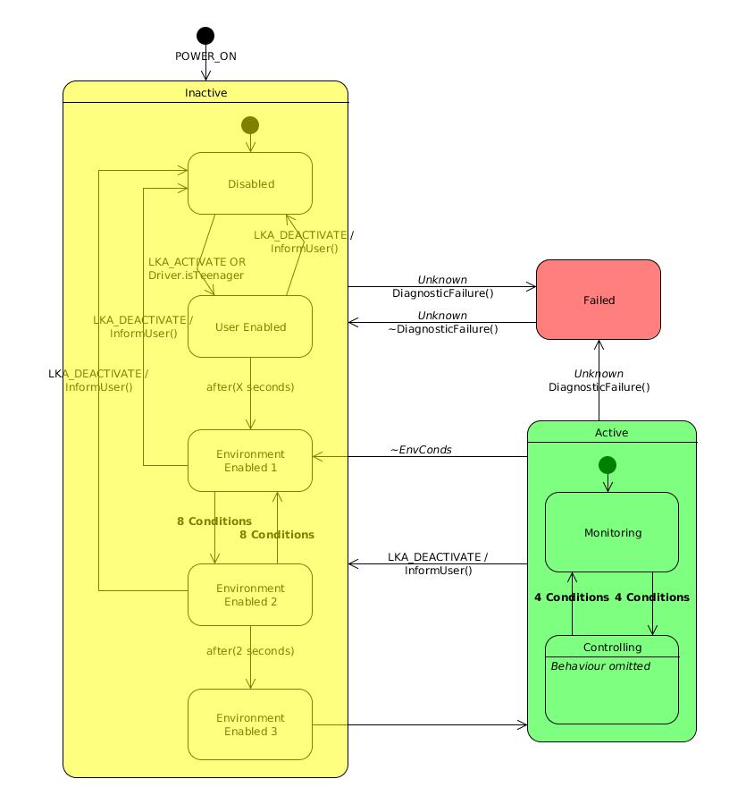
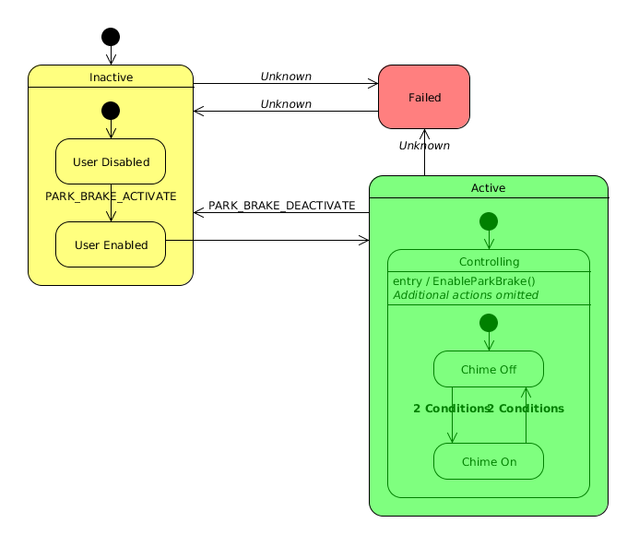
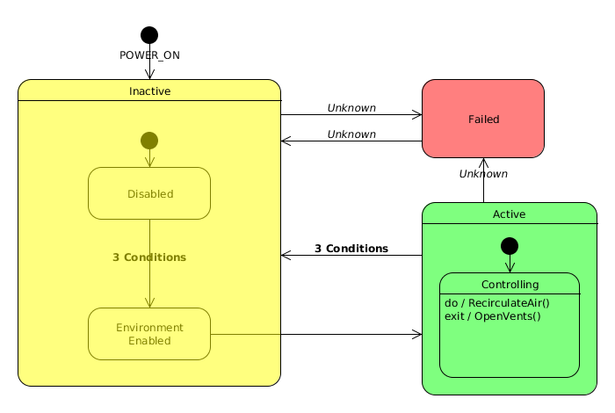
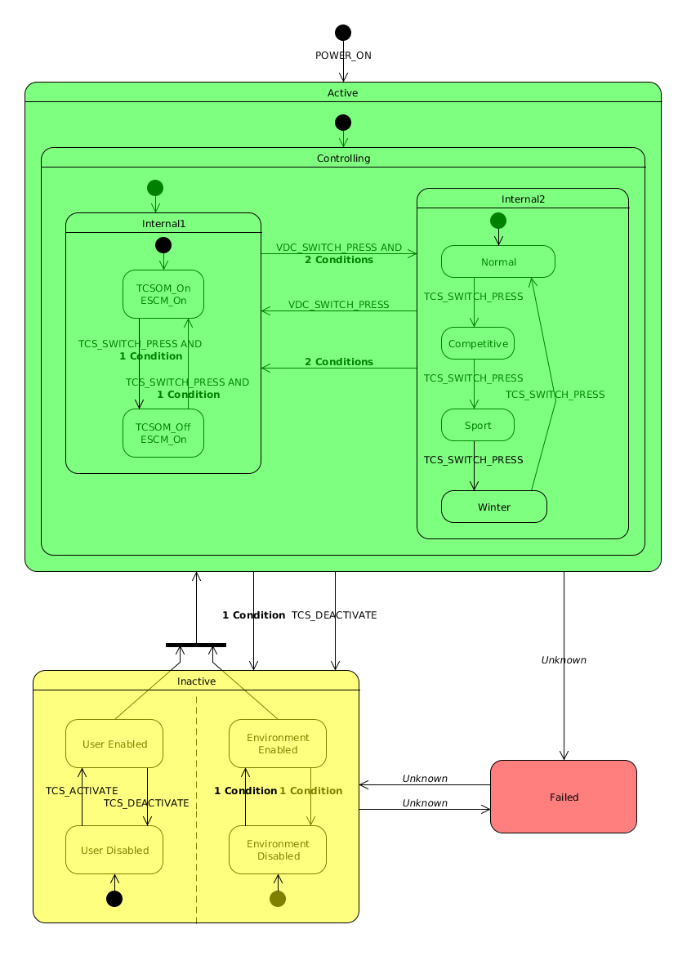
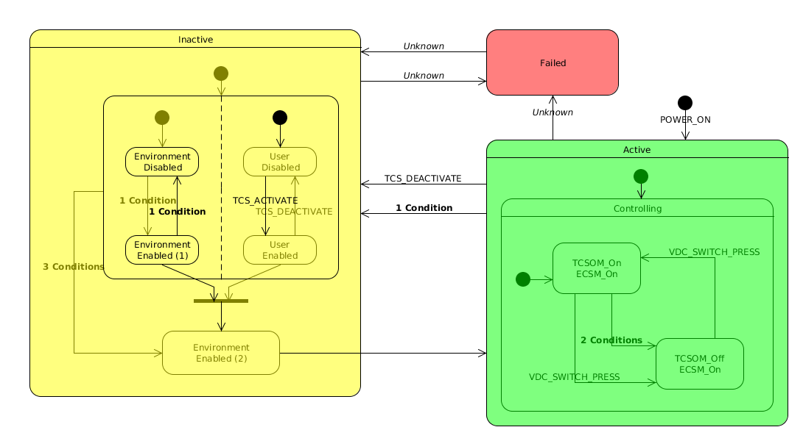
generic public interface (2)

Slide 34
2 strategies for resolving interactions
feature families
resolve interactions within a feature family perfectly (e.g., new “interaction” features)
unrelated features
handle unexpected interactions between unrelated features using default resolution strategies

Slide 35
resolving interactions between unrelated features

Slide 36
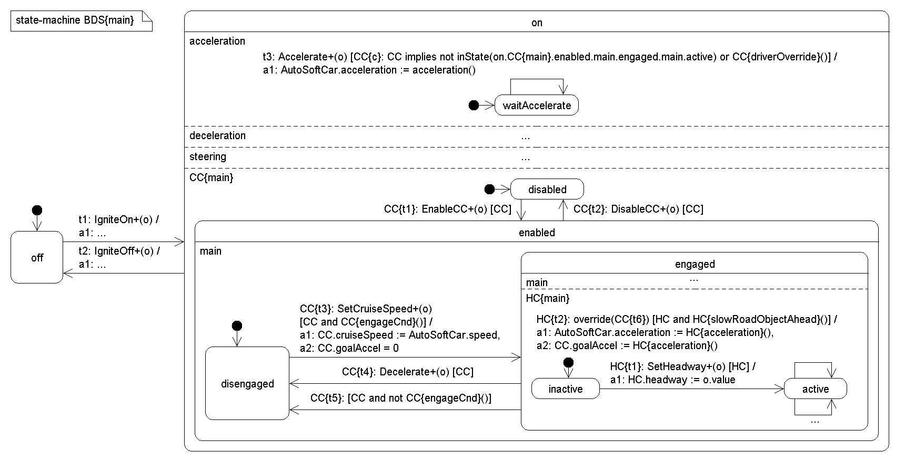
feature coordination
  given a collection of feature families, each with a minimal public interface…
  … want to coordinate the features’ executions such that entire classes of interactions are resolved by default
inputs
outputs
Notes:
Architecture and design conventions can be designed to prevent entire classes of interactions by constraining and coordinating features’ executions and access to shared variables and resources.
Relaxing the goal of “correctness” or optimal resolution of interactions, because no such thing. Feature requirements change, and become conditional on the presence of other features. Best solution is context specific. Instead looking for general strategies that approximate correctness to a significant degree.
Much of the most successful work is on approaches that reduce the number of cases that need special treatment

Slide 37
serializing features
Distributed Feature Composition [Jackson, Zave, TSE’98]
  pipeline architecture
    features make no assumptions about other features
    avoids simultaneous reactions to the same event
    conflicts are resolved through serialization
    feature ordering realizes a priority scheme
    resolution is implicit
Notes:
More than open architectures, which promote interoperaability (i.e., interface matching) provide a service architecture that constrains designers to provide ”safe” arrangement of features
Among the best work is in this area is DFC
- pipe and filter architecture
- features react to signals that flow back and forth; feature execution constrained: features react in sequence
- avoids simultaneous reactions to the same event
- affect is serialize features reactions to events
categorizing and ordering features by category can help to preserve properties (of authentication, billing, privacy, screening, etc.)
+ messages act as tokens that serialize features’ actions
+ placement of features in sequence realizes priority scheme
may not resolve constraint interactions
implements one resolution strategy – precedence
A well-designed DFC feature box has the properties of transparency, autonomy, and context-independence

Slide 38
parallel execution (resolution modules)
Resolver o1
output
inputs
Resolver o2
output
Resolver o3
output
    features make no assumptions about other features
    conflicting actions are resolved by resolution modules
    all actions are considered in resolution
    resolution strategies can be variable-specific

Slide 39
feature coordination
fixed set of features
pre-determined selection of features
static integration
perfect coordination possible
fixed set of features
semi-configurable selection of features
set of static integrations
perfect coordination possible, but impractical
unlimited features
user-defined selection of features
dynamic integration
loose coordination
Notes:
These are general strategies that resolve entire classes of interactions – by imposing a generic resolution to all cases, rather than imposing a perfect resolution to each individual cases. Addressing the scalability problem by sacrificing ideal behaviour.
Where these kinds of safe composition operators will be useful are systems or product lines where the developers have less control over the feature set.
(2) Perfect coordination is possible, but becomes increasingly impractical as the number of features grows
general strategies that deal with classes of interactions
rather than considering interactions case-by-case
willing to relax goal of “correctness” in favour of feature-orientation

Slide 40
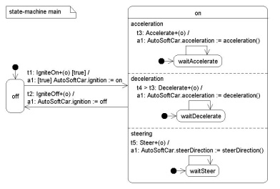
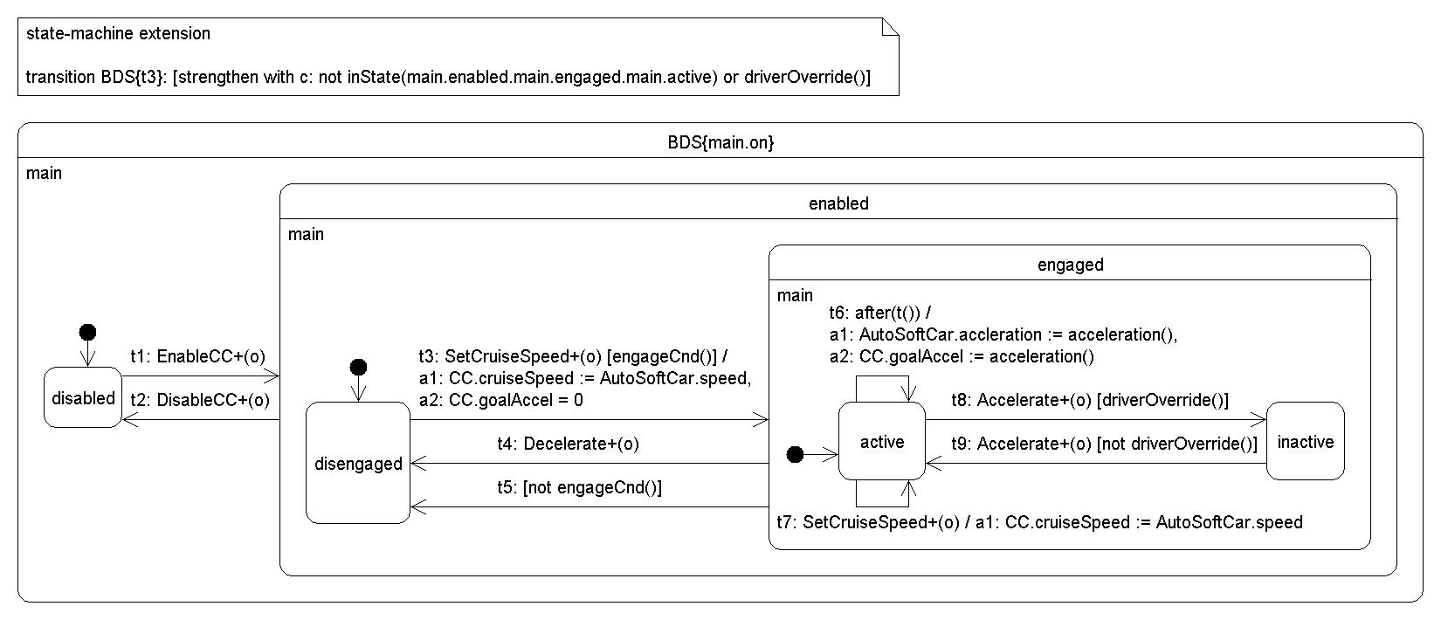
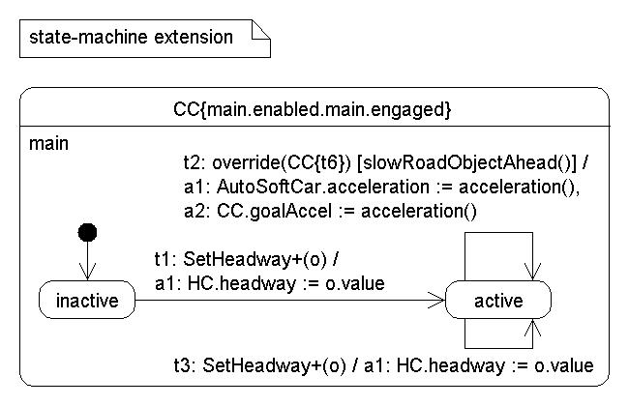
summary
(looser) coordination of unrelated features
feature interfaces
default resolution
relax “correctness”
modular features
tight integration of feature families
no interfaces
perfect resolution
(looser) coordination of unrelated features
feature interfaces
default resolution
relax “correctness”
+
=
[CC implies
[CC]
[CC]
Resolver O₁
[CC and
[HC] and
+
[CC and
[CC]
[HC]
[CC implies
…
[CC]
[CC]
[CC and
[HC] and
[CC and
[CC]
[HC]
Resolver O_{n}
[CC implies
[CC]
[CC]
[CC and
[HC] and
[CC and
[CC]
[HC]
Notes:
Future work / challenges:
More and better strategies for rsolving classes of interactions through composition.
Combining resolution strategies
Improving scalabiity of analysis techniques

