Slide 1
SignalR

Slide 2
What is SignalR?
API for RPC (Server to Client)
uses WebSockets, Long Polling, Server Sent Events, Forever Frame etc.
automatic Connection Management (connect, disconnect, grouping)
Broadcasts or Messages to specific Clients
persistent Connections
Logging: $.connection.hub.logging = true;

Slide 3
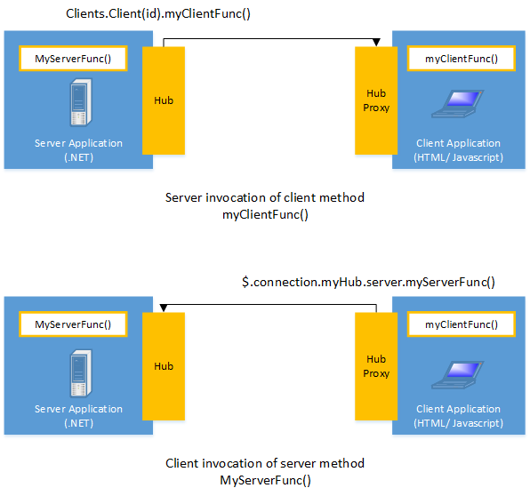

Slide 4
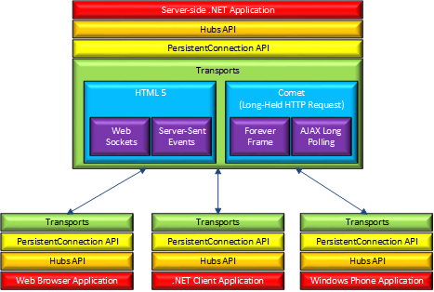

Slide 5
Supported Server OS
Windows Server 2012
Windows Server 2008 r2
Windows 8
Windows 7
Windows Azure

Slide 6
Supported IIS Versions
IIS 8 or IIS 8 Express.
IIS 7 and 7.5 with support for extensionless URLs is required.
IIS must be running in integrated mode; classic mode is not supported. Message delays of up to 30 seconds may be experienced if IIS is run in classic mode using the Server-Sent Events transport.
The hosting application must be running in full trust mode.

Slide 7
Supported Browsers
Attention: jQuery version 1.6.4 or major later versions (such as 1.7.2, 1.8.2, or 1.9.1) required!
Transport | Internet Explorer | Chrome (Windows or iOS) | Firefox | Safari (OSX or iOS) | Android
WebSockets | 10+ | current - 1 | current - 1 | current - 1 | N/A
Server-Sent Events | N/A | current - 1 | current - 1 | current - 1 | N/A
ForeverFrame | 8+ | N/A | N/A | N/A | 4.1
Long Polling | 8+ | current - 1 | current - 1 | current - 1 | 4.1

Slide 8
Demo

Slide 9
Using SignalR (Server)
add SignalR NuGet package
add Startup class & configure SignalR
add hub class
add SignalR self host NuGet package
add host class & start WebApp

Slide 10
Using SignalR (Client)
add SignalR Client NuGet package
create hub connection
create hub proxy from connection
start connection
register events to listen for with Proxy.On
call server methods with Proxy.Invoke

