Slide 1
Shelf Product Detection and Inventory Intelligence
Capstone Project Demo | Group 1
YOLO + CLIP for Product Detection, Classification, and Counting
Planogram-Aware Stock Estimation with Streamlit Demo Interface
Academic Year 2026

Slide 2
Problem Statement
Why this project matters
Manual shelf audits are slow, repetitive, and error-prone
Stockouts happen because shelf visibility is not continuously tracked
Retail teams need a fast way to convert shelf images into actionable inventory data
Goal: Automate detection, counting, and reorder insights from shelf photos

Slide 3
Project Objectives
Detect products on shelf images using YOLO
Classify each detected region with CLIP label prompts
Generate product-wise counts and export CSV/JSON reports
Support inventory updates and planogram-based quantity estimation
Provide operator-friendly web interface for real-time usage

Slide 4
System Architecture
End-to-end processing pipeline
Input Image
YOLO Detection
Crop Regions
CLIP Classification
Count Aggregation
Planogram + Inventory
Auto profile selection chooses Beverage vs Shampoo labels
Outputs include annotated images, count summaries, and reorder indicators

Slide 5
Technology Stack
Language: Python 3.11
Detection: Ultralytics YOLO (best.pt)
Classification: OpenAI CLIP (clip-vit-base-patch32)
Web App: Streamlit (Detection Studio + Inventory Center)
Data and Reporting: Pandas, JSON, CSV, Pillow

Slide 6
Methodology
1. Detect product bounding boxes with confidence and NMS thresholds
2. Crop each detection and run CLIP text-image similarity
3. Apply corrections and non-product filtering prompts
4. Aggregate counts by Category | Product
5. Optionally sync counts into inventory records

Slide 7
Planogram-Based Quantity Estimation
Detected facings = d, Expected facings = e
Compliance ratio r = min(1, d / e)
Estimated units = round(r x full_stock_units)
Reorder qty = max(0, reorder_level - estimated_units)
Needs reorder if estimated_units < reorder_level

Slide 8
Sample Results
Current run summary from project outputs
Category | Product | Count
Soft Drinks | Coca-Cola | 17
Soft Drinks | Fanta | 6
Soft Drinks | Sprite | 5
Soft Drinks | 7UP | 2

Slide 9
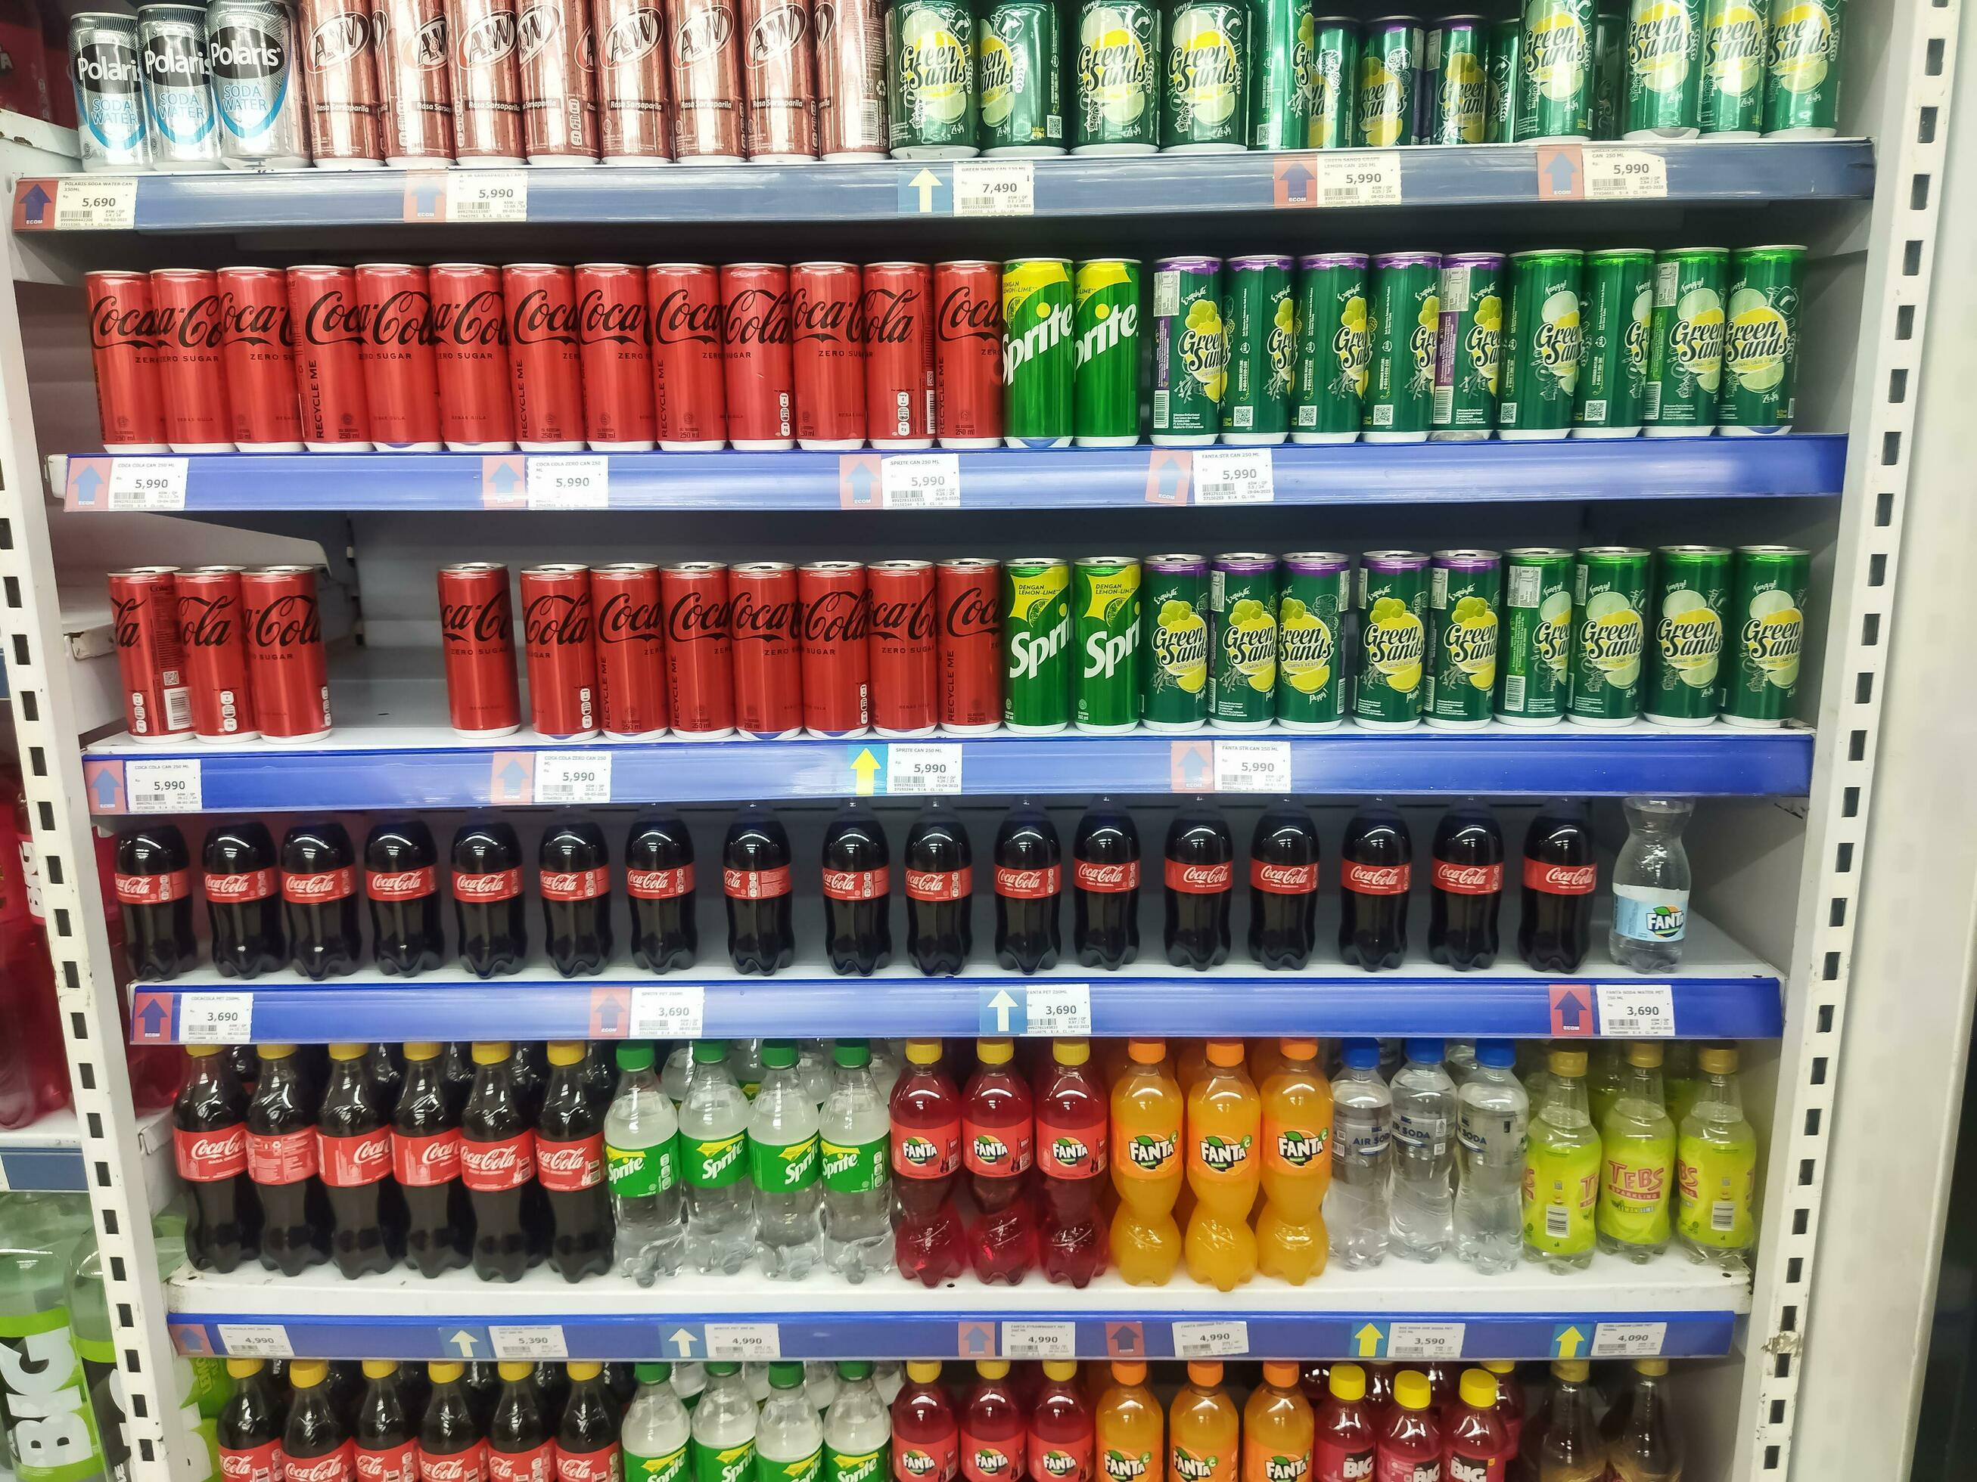

Visual Output
Input image and annotated detection result
Input
Annotated Output

Slide 10
Live Demo Interface (Streamlit)
Detection Studio: upload/camera input, run inference, view counts
Inventory Center: manage stock, reorder levels, and low-stock alerts
Planogram Setup: expected facings, full-stock units, reorder thresholds
One-click actions: reconcile stock from detection or planogram estimate

Slide 11
Limitations and Future Enhancements
Current accuracy depends on image quality and product occlusions
Similar packaging can still cause classification confusion
Future: video tracking, stronger brand-specific fine-tuning
Future: slot-level planogram constraints and trend dashboards

Slide 12
Conclusion
The project delivers an end-to-end retail shelf intelligence workflow
YOLO + CLIP enables automated detection, counting, and reporting
Planogram-aware estimation bridges computer vision with inventory decisions
Thank You - Questions and Discussion

