Slide 1

RETAIL SHELF PRODUCT RECOGNITION
Capstone Project Review
July 5, 2026
Team(Group: 10) : Moorthy, Nikhil, Sivakanth, Surabhi
Mentor: Pratyusha
Professor: Anoop

Slide 2
RETAIL SHELF PRODUCT RECOGNITION
A Three-Stage Computer Vision Pipeline
1
YOLOv8 & YOLOv26 Detection
2
CLIP Category Classification
3
CLIP SKU Library Match
WHERE are the products?
WHAT category is each crop?
WHICH exact SKU is it?
YOLOv8 + openai/clip-vit-base-patch32 + FastAPI + React | Capstone Project | July 2026

Slide 3
The Problem
Manual audits are slow & costly
Solution Goal
Shelf checks across stores take hours. Errors are frequent.
Detect every product on a shelf image
Identify each product category
Thousands of SKUs — hard to scale
Training a classifier per product is infeasible at retail scale.
Match known SKUs via embedding library first
Deliver annotated results + inventory summary
Out-of-stocks go undetected
Gaps and planogram violations are invisible without automated vision.
Three-Stage CV Pipeline -->

Slide 4
Three-Stage Pipeline
Each stage answers a different question - known products skip Stage 2 via library shortcut
[IMG]
Shelf Image
STAGE 1
STAGE 2
STAGE 3
[OK]
SKU
ID
YOLOv8 & YOLOv26
Detection
CLIP Category
Classification
CLIP SKU
Library Match & Planogram
WHERE are
the products?
WHAT category
is each crop?
WHICH exact
SKU is it?
->
->
->
->
89.7%
Implemented: 38 categories
Tested: 3 Categories
>= 0.82
mAP@50 SKU110K
4 prompts each
cosine similarity cutoff
known products matched via CLIP embedding. Only unmatched items proceed to LLM matching & Manual.

Slide 5


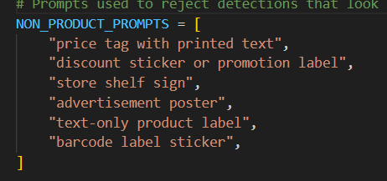
Stage 1 — YOLOv8 & Yolov26 Object Detection
Fine-tune a YOLOv26n model on SKU110K to localize every product bounding box on a shelf image — a single generic "product" class, independent of brand.
We ensured that real time some additional stickers are not identified.
Why detect first?
Shelf images are densely packed — dozens of products per frame.
A single-class detector generalizes across brands without per-SKU labels.
Each detected box becomes an isolated crop for the classifier.
Base model | YOLOv26 — fast, lightweight
Training epochs | 10
Training data | 100% of SKU110K train split
Retrain control | FORCE_RETRAIN flag
Skip logic | Reuses sku110k_best.pt if already trained
Tunable at inference
YOLO_CONF = 0.10 • YOLO_IOU = 0.45
Lower confidence threshold favors recall on small, tightly packed shelf items.
Real time scenario we eliminated these tags for identification.
Retail Shelf Product Recognition | YOLOv8 + CLIP
6

Slide 6
Stage 1 — Validation Metrics
Reported automatically by yolo_model.val() after training
89.70 %
54.10 %
89.59 %
83.77 %
mAP@50
mAP@50-95
Precision
Recall
Detection accuracy at 50% IoU
Averaged across IoU thresholds
Share of detections that are correct
Share of true products detected
Retail Shelf Product Recognition | YOLOv8 + CLIP
7

Slide 7
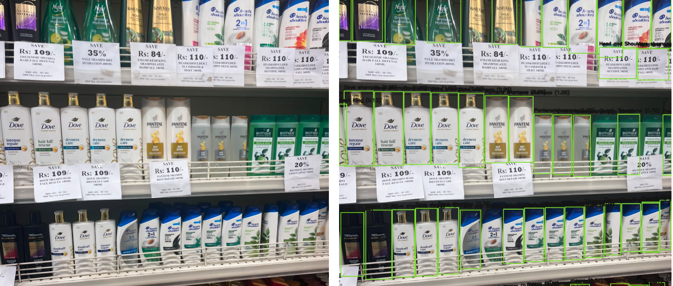
Stage 1 — Output Screenshot

Slide 8
STAGE 2
CLIP Category Classification
How CLIP Classifies
38 Product Categories x 4 Prompts Each
Crop Image
Image
Encoder
Beverages
Snacks & Chips
->
-> embedding
Dairy Products
Cereals
38 x 4
Prompts
Text
Encoder
->
-> embedding
Personal Care
Cleaning Supplies
cosine similarity
Frozen Foods
Condiments
Best Category Match (e.g. Beverages: 0.91)
Bakery Items
Candy & Chocolate
+ more categories (extensible by editing PRODUCT_CATEGORIES)

Slide 9
STAGE 3
CLIP SKU Library Matching
How Library Matching Works
[SEARCH]
Query Crop
CLIP encoder
-> 512-dim
vector
Product Library (DB)
Cosine
Similarity
Pepsi 500ml [0.23, 0.87 ...]
->
Coke 330ml [0.91, 0.12 ...]
->
v
Lays BBQ 80g [0.45, 0.63 ...]
Score >= 0.82?
Oreo 200g [0.71, 0.34 ...]
Each row = one reference image + CLIP embedding
[OK] Yes -> SKU matched
[>>] No -> forward to Stage 2
[FLASH] Known products are identified instantly via embedding lookup -- no LLM or heavy inference needed
Queries LLM if there is no library matchings.

Slide 10
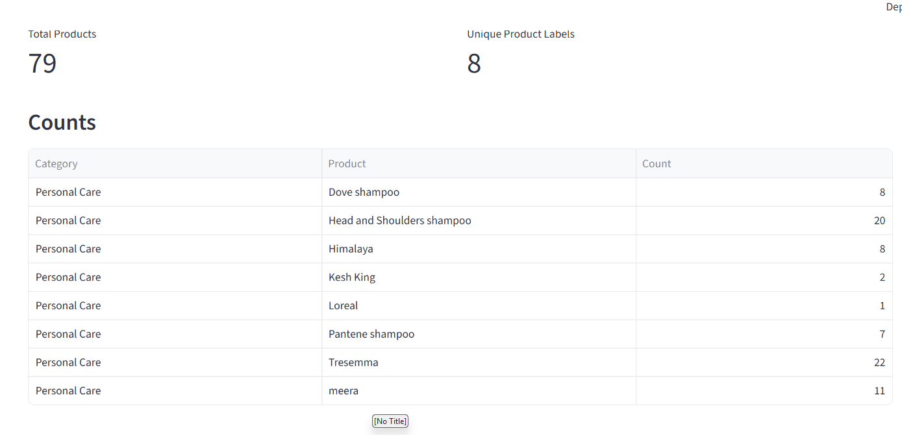
Stage 2 — Output Screenshot

Slide 11
Results & Deliverables
Annotated Images
Results CSV
[IMG]
[CSV]
Bounding boxes drawn per product, labeled with CLIP category and confidence -- exported per test image.
Per-object row: box coordinates, YOLO confidence, CLIP label + top-3 alternate categories.
Inventory Summary
Web App + REST API
[BOX]
[WEB]
Category-level count chart, out-of-stock gap detection, planogram variance report.
FastAPI backend + React frontend -- upload shelf image, view detections, manage product library in real-time.

Slide 12
Future Roadmap
1
2
3
Improve Quantity count accuracy
Add additional products for classification
Improve & Implement for real time Business intelligent Scenarios
Retail Shelf Product Recognition | YOLOv8 + CLIP
14

