Slide 1
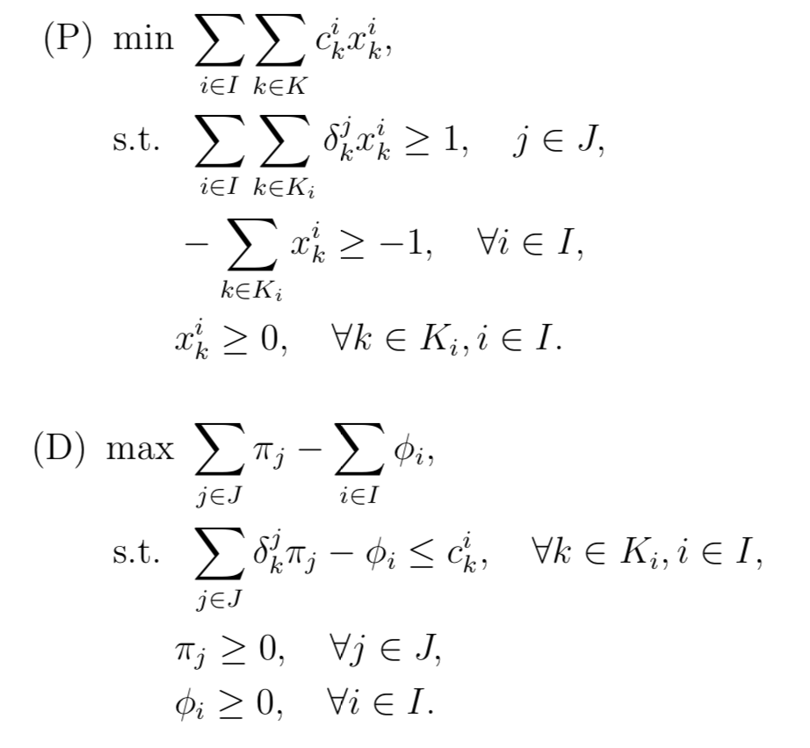
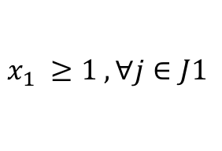
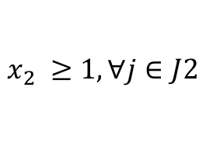
J
J1
$x_{1} ≥1 , ∀j∈J1$
J2
$$x_{2} ≥1, ∀j∈J2$$

