Slide 1
Quick Tips To Write a Clean Code

Slide 2
Meaningful Names
Choose descriptive and meaningful names for variables, functions, classes, and modules. Clear names make the code self-documenting and easier to understand.
01

Slide 3
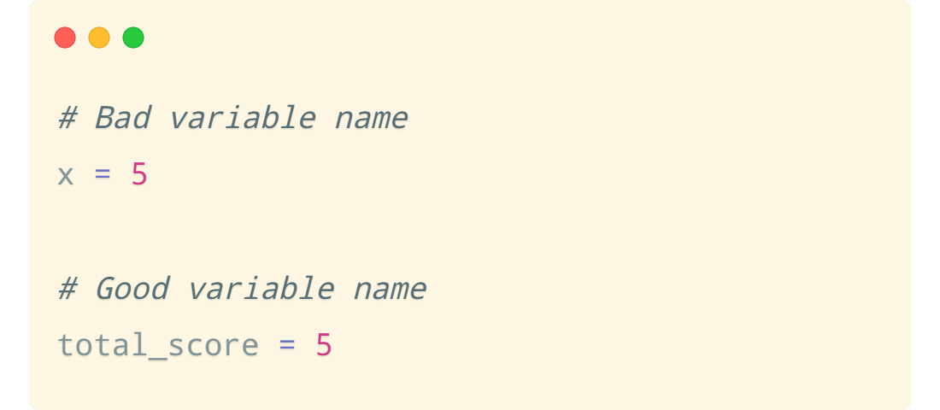

Slide 4
Functions
Keep functions small and focused on a single responsibility. Functions should do one thing and do it well. Use descriptive function names and avoid side effects.
02

Slide 5
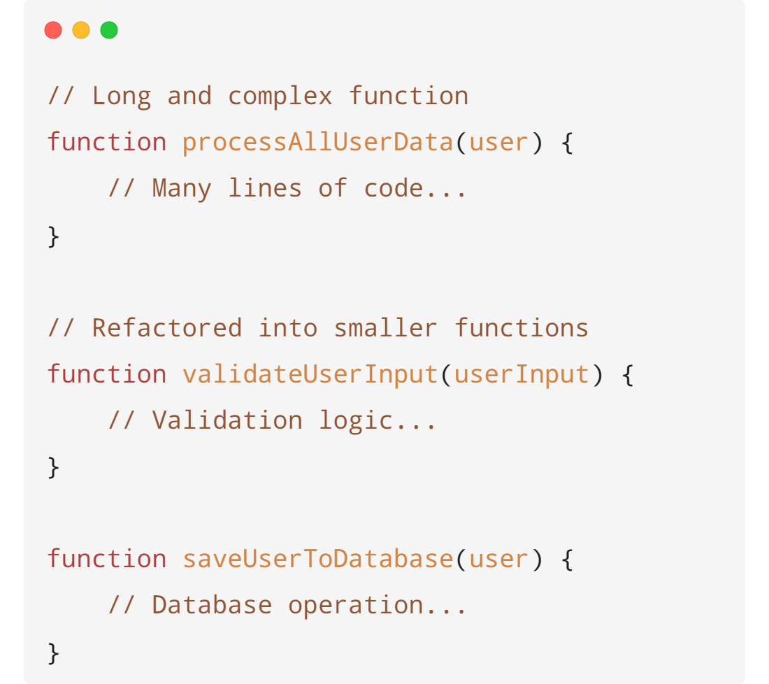

Slide 6
Comments
Comments should be used sparingly and only when necessary to explain non-obvious code. You must do the best to make the code itself as clear and self-documenting as possible.
03

Slide 7
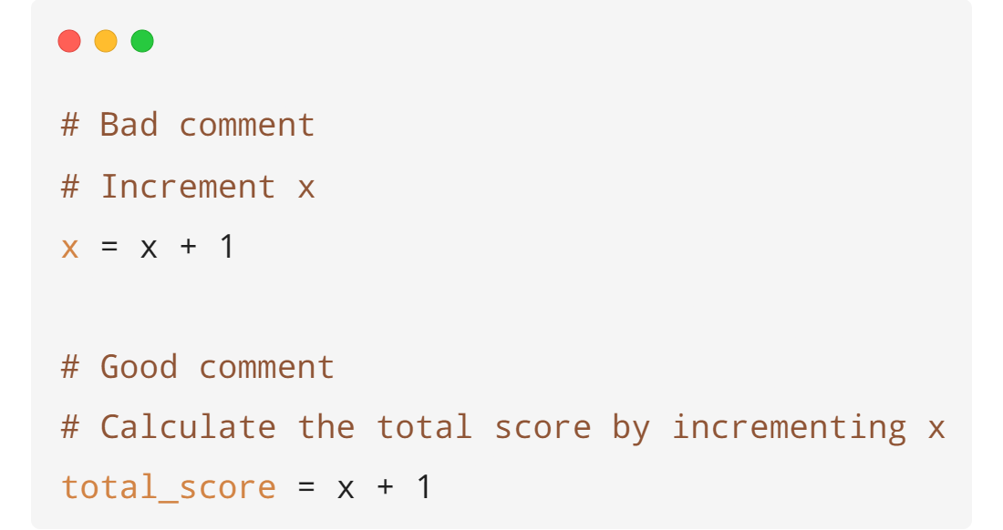

Slide 8
Formatting
Follow a consistent code style and formatting throughout the project. Use indentation and whitespace to make code more readable.
04

Slide 9
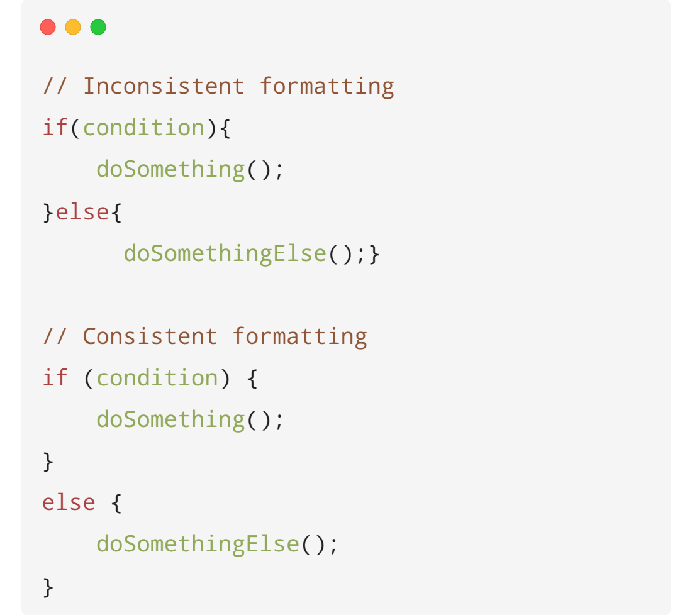

Slide 10
Objects and Data Structures
Objects should hide their data and display operations (encapsulation). Encapsulate data with methods in classes and avoid displaying data directly. Accessing data in a data structure using its method that you create.
05

Slide 11
Error Handling
Implement proper error handling to ensure robustness. Use meaningful error messages and handle exceptions gracefully. Handling errors gracefully and providing meaningful error messages is recommended
06

Slide 12
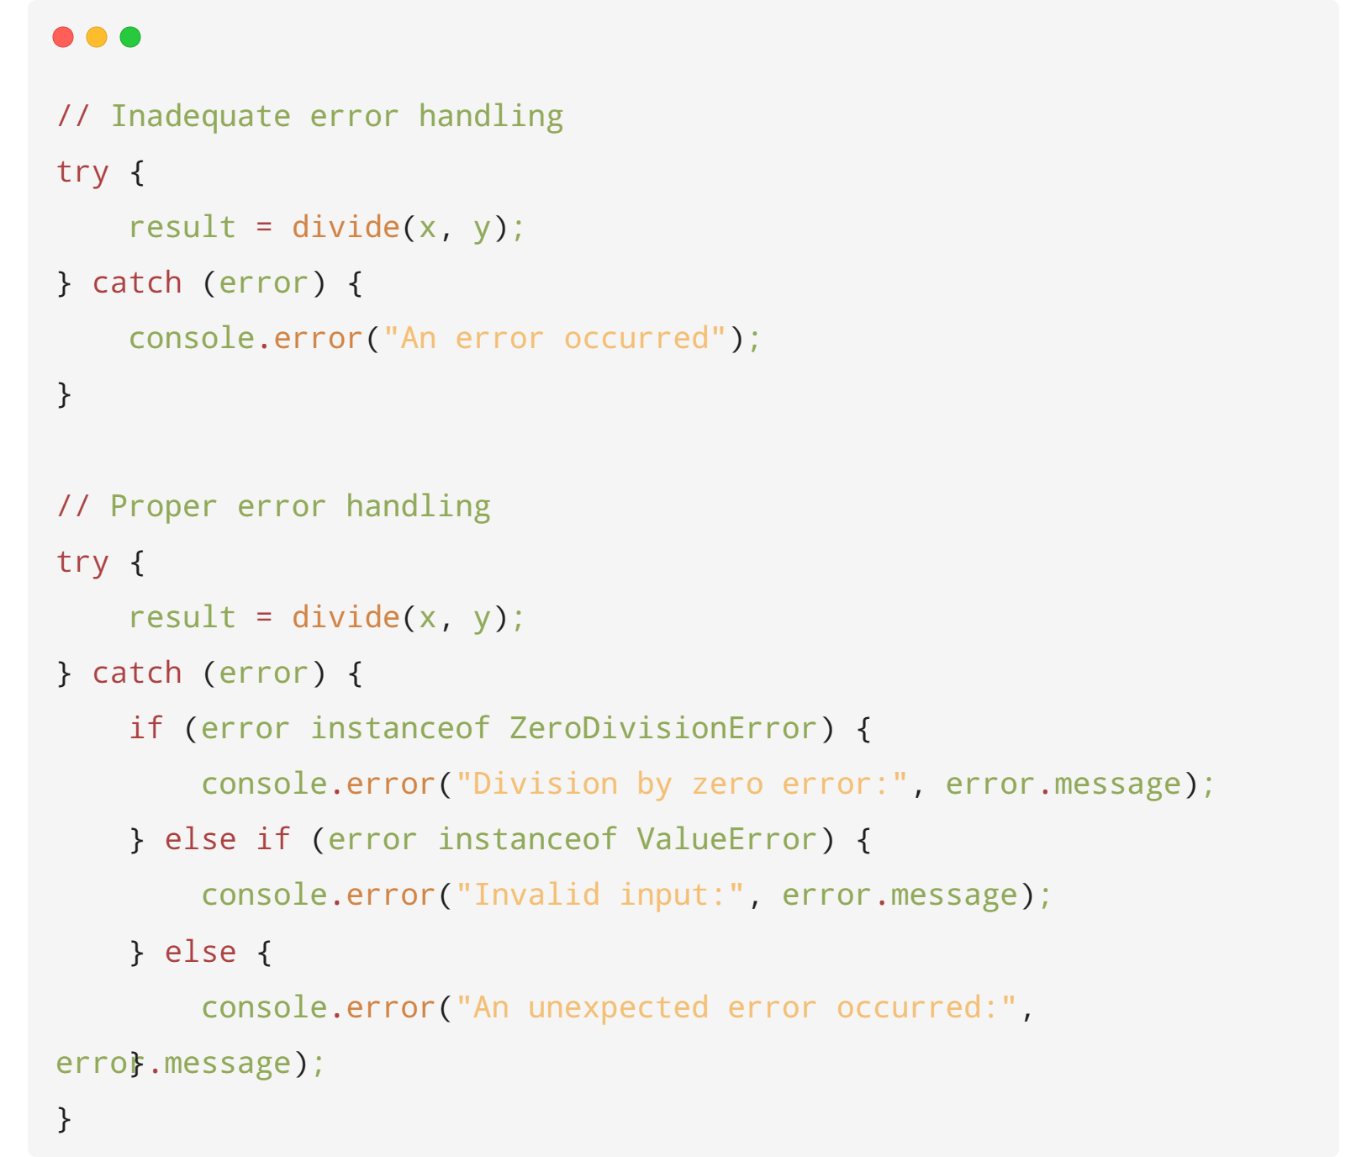

Slide 13
Testing
Write comprehensive unit tests to ensure code correctness and make changes with confidence. Test-driven development (TDD) is a valuable approach to ensure code quality
07

Slide 14
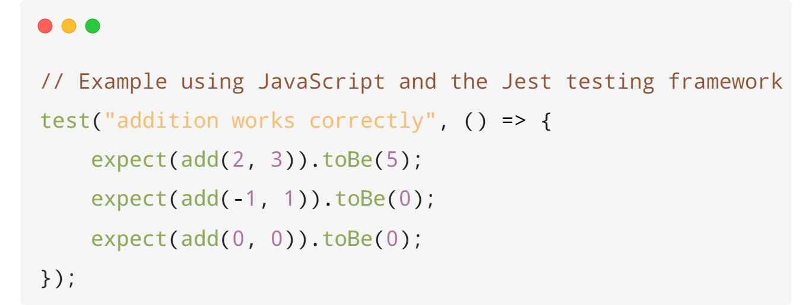

Slide 15
Single Responsibility Principle (SRP)
Each class and module should have only one reason to change. Keep responsibilities separate and well-defined.
08

Slide 16
Open/Closed Principle (OCP):
Code should be open for extension but closed for modification. Allow for new functionality to be added through extensions rather than changing existing code.
08

Slide 17
DRY (Don't Repeat Yourself)
Avoid code duplication by encapsulating common functionality into functions, classes, or modules.
09

Slide 18
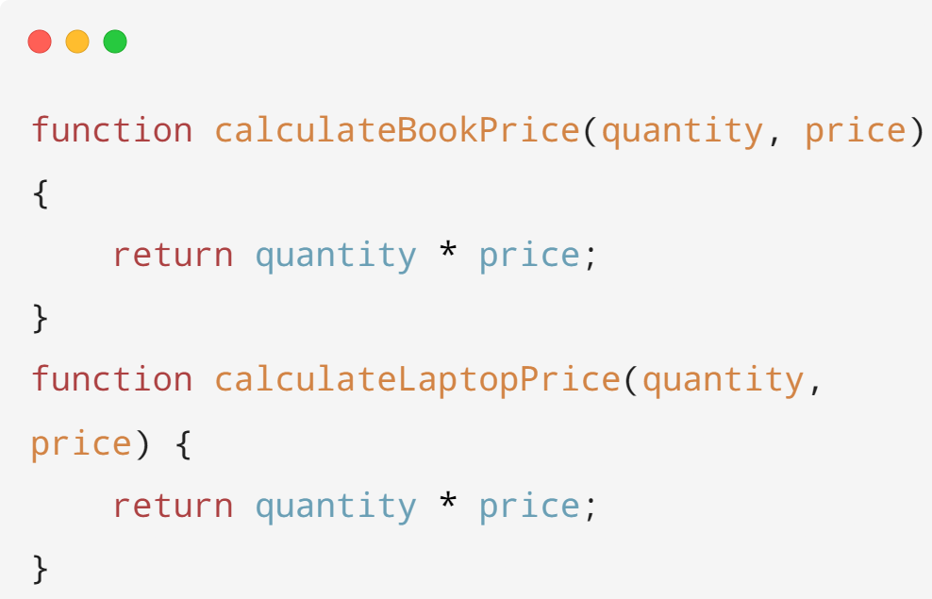
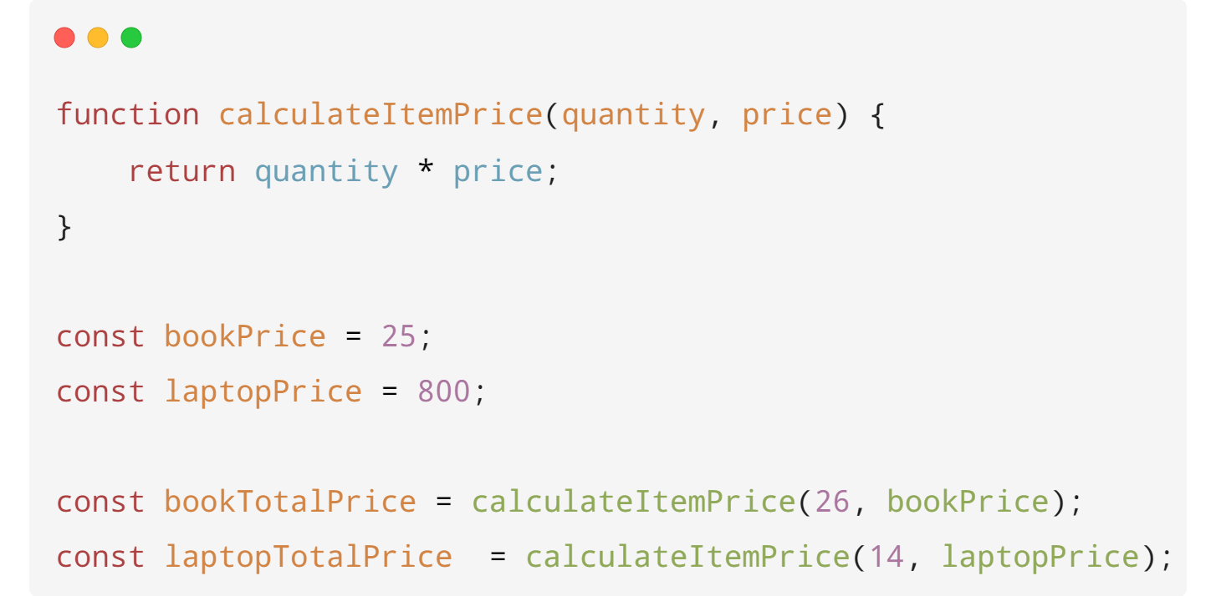

Slide 19
Interface Segregation Principle
Clients should not be forced to depend on interfaces they do not use. Keep interfaces small and focused on the needs of the clients.
10

Slide 20
Keep It Simple
Strive for simplicity in code design. Avoid unnecessary complexity and keep code as simple and straightforward as possible.
11

