Slide 1
TangleLens
IOTA Advanced Explorer for Eclipse aeriOS · Challenge 2 (O-CEI)

Slide 2
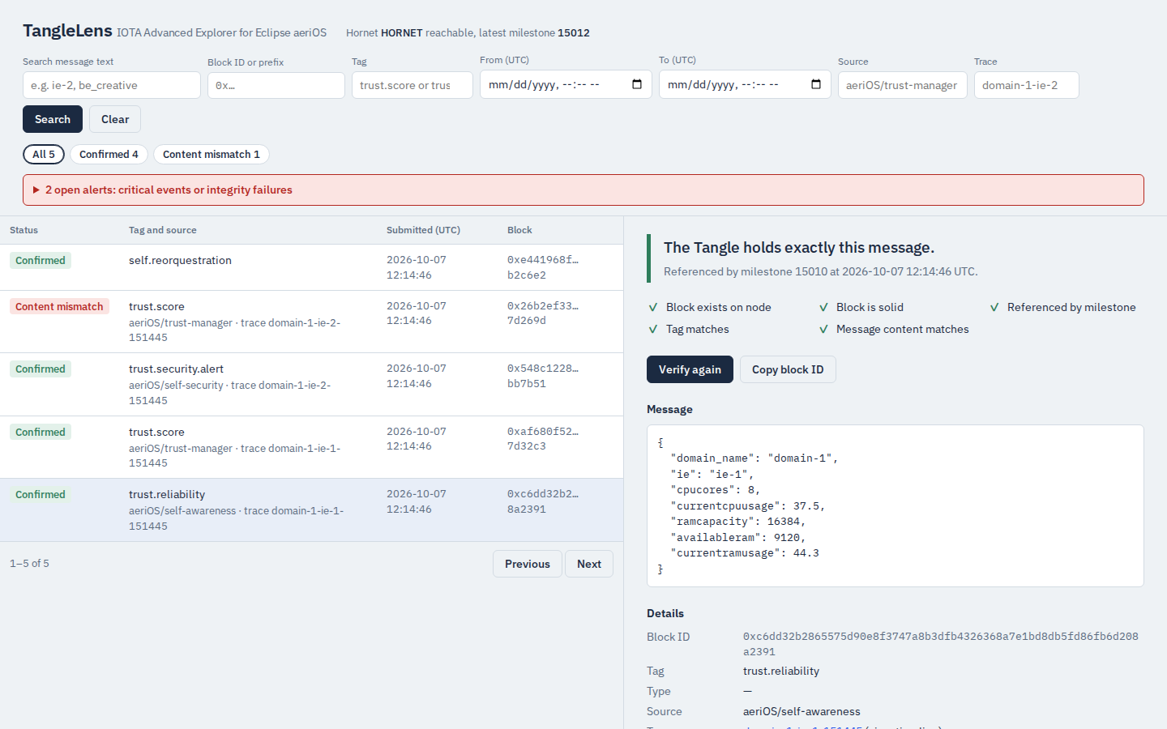
GitHub repo
GitHub repo: https://github.com/moe-a-m/tanglelens
Licence: Apache-2.0, including modified Eclipse aeriOS code (see NOTICE)
Run it: start the aeriOS tangle (iota-tangle/), then make up · make demo · make test
Evidence: raw Hornet responses, test summaries and clean-clone runs in reports/
Stack: Python, FastAPI, Flask, PostgreSQL, Mosquitto MQTT, HORNET 2.0.2, Docker Compose

Slide 3
Summary
What: a searchable, continuously verified copy of every message Eclipse aeriOS writes to its private IOTA Tangle. The Tangle stays the authority.
App 1, extended aeriOS Messages API: same /upload contract and HTTP 200; after Hornet accepts a block it forwards the block id and the exact bytes sent, over HTTP and MQTT.
App 2, Advanced Explorer: PostgreSQL copy enriched with readable metadata; REST API and web UI search by block id, date and tag, plus source, text, status and trace.
Validation: every block is checked with Hornet's GET block metadata (solid, milestone-referenced, conflicting) and GET block (content compared as hex, decoded JSON and SHA-256).
Audit: append-only history of every check; all messages re-audited every 5 minutes, so later tampering is caught.
Runs on the real aeriOS private tangle (HORNET 2.0.2) with Docker Compose; tested from a fresh clone.

Slide 4
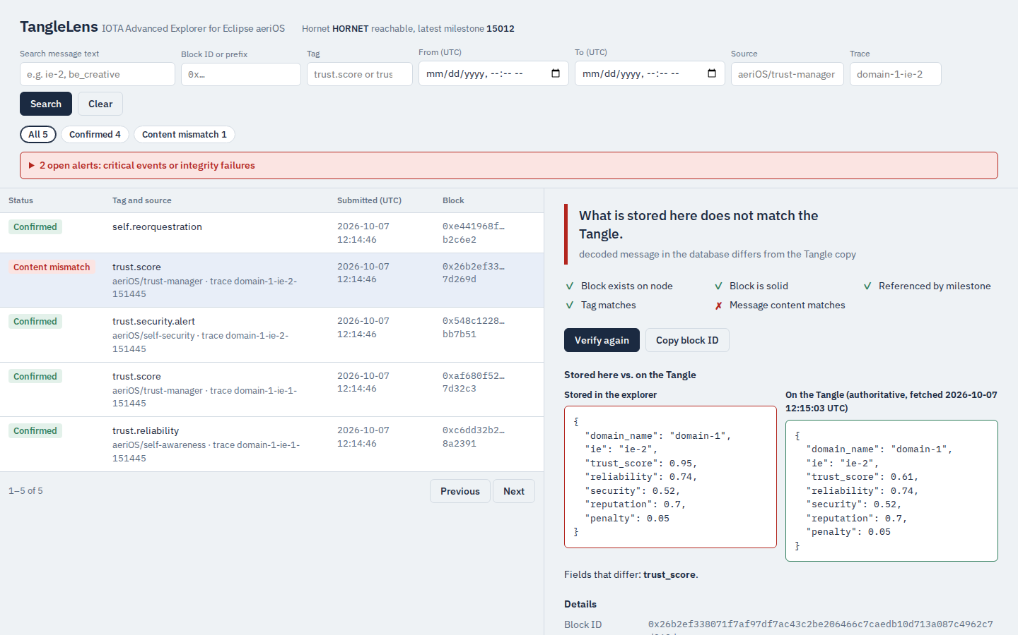
Highlights
Tampering is caught: an IE's trust score inflated from 0.61 to 0.95 in the database is flagged, shown next to the Tangle copy and alerted.
Solid is not confirmed: 8 explicit states; measured on the real node: solid within 20 ms, milestone median 3.3 s.
Beyond the brief (UPV ideas #1, #3, #4): trace timelines, alerts (UI, webhook, MQTT), MQTT live feed.
Survives outages: explorer or database down for 25 s, no record lost.
Evidence first: 115 automated tests (SQLite + PostgreSQL), live smoke test, every Hornet behaviour backed by a saved raw response.

