Slide 1

Recruitment Assignment
BASMA

Slide 2
Exploring The Data Set
Data Source: Recruitment Assignment _Business Analyst .xlsx
Data Cleaning: After reviewing the data set in Excel, I observed that the data has been cleaned of errors (nulls, duplicate rows, different data types in the same column, typos). I just defined the datatypes to fit each column.
Data Exploration: I decided to use PowerBi to visualize this data, so I imported the Excel file into PowerBi.
Data Modeling: adding some tables to make a full data model for a beneficial analysis

Slide 3
Let's Talk About The Data Set:
This data set shows that BASMA is trying to reach potential customers through different campaigns in two regions (KSA and the UAE) in 2020.
They tried to use four different platforms to reach their potential customers. they provide us with several data columns to analyze their performance over time and channel based on 6 numerical factors that are crucial to any company in this field.

Slide 4
Data Model
I saw that working with a full data model is more beneficial in analysis, especially using PowerBi to visualize the data set, so I decided to add a campaign demonstration table (campaign_dim) and platform_table, which are derived from the fact table. The main reason behind this is to index the campaign name and platform columns and remove them from the initial data table, which is campaign_fact, to achieve the best practice of not having any categorical data type in the fact table. Also, I found that it is beneficial to add a table that contains only the 2 regions and make its relationship with the campaign_dim table and this step is important to add the region slicer to my dashboard. Adding to that I didn't ignore adding a calendar table to have full data model
All these steps are done inside the power query editor

Slide 5
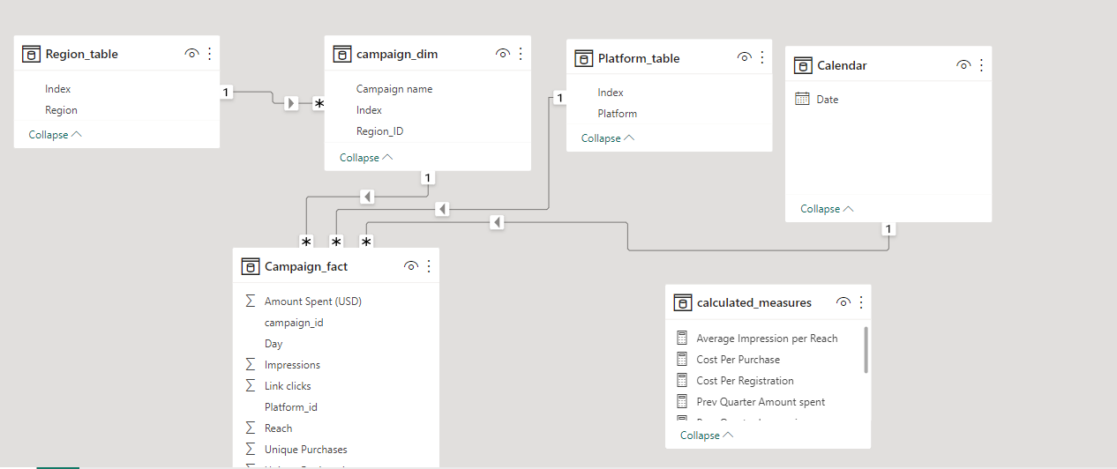

Slide 6
VISUALIZATIONS
Charts and Explanation

Slide 7
The Full Dashboard

Slide 8
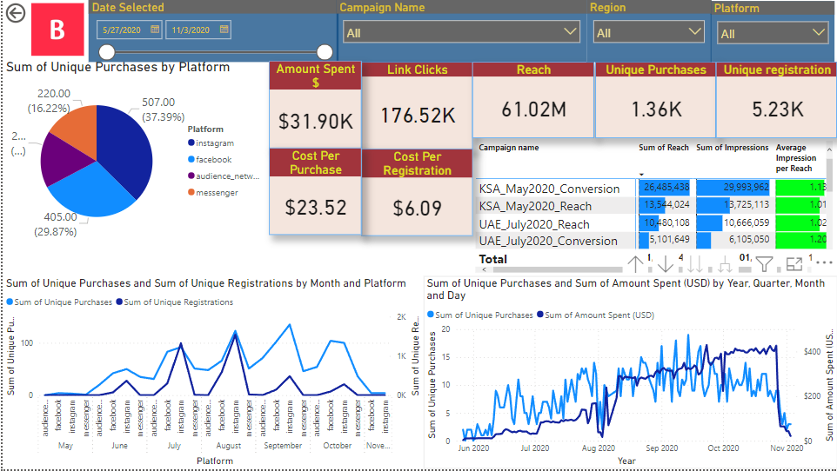

Slide 9
Topline Performance
In this step of the work, I started adding slicers that filter every chart in the dashboard in order to view data at different levels.
The pie chart represents the reach by platform as a sum of total
Adding cards showing the sum of different data is very important to take a closer look at what is happening, especially when using filters.

Slide 10
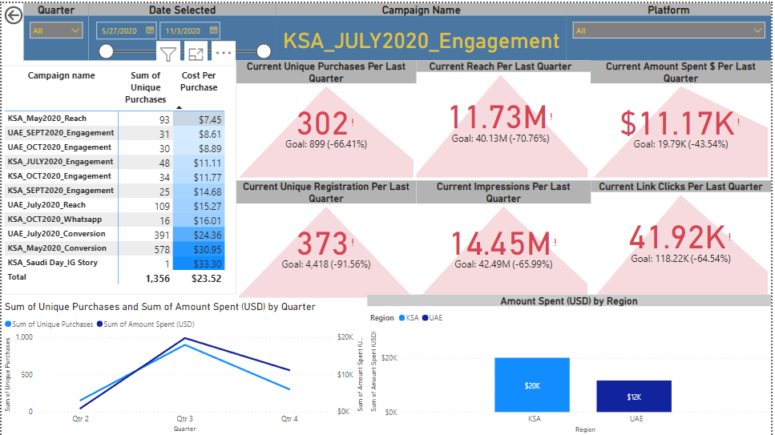

Slide 11
Analyzing and comparing
Facebook and Instagram have the highest number of unique purchases, registrations and reach over time.
August, September, and October are the months with the highest number of unique purchases.
July and August have the highest number of unique registrations.

Slide 12
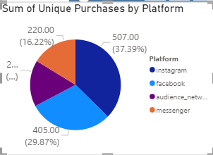
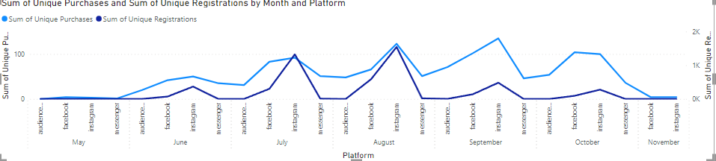

Slide 13
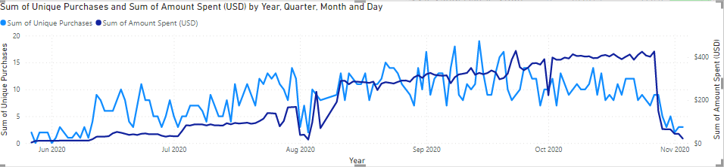
Purchases and Amount spent
The line chart shows that there is a positive relationship between the amount spent and purchases; as the amount spent increases, the purchases increase.

Slide 14
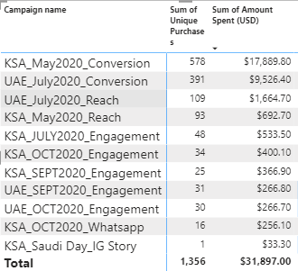
Market vs Purchases
KSA_May2020_Conversion and UAE_July2020_Conversion highest number of unique purchases and the amount spent over time.

Slide 15
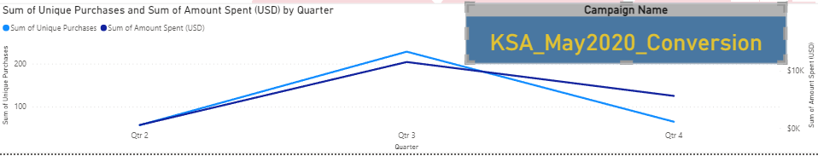
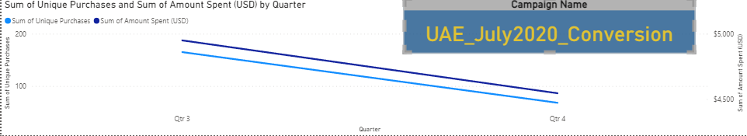
KPI’s Using Drill Through
Platforms: Instagram and Facebook: KSA_May2020_Conversion and UAE_July2020_Conversion:
An obvious decline in all the KPIs in the 4th quarter compared with the last quarter.
The line charts show a strong relationship between spending and purchases.

Slide 16
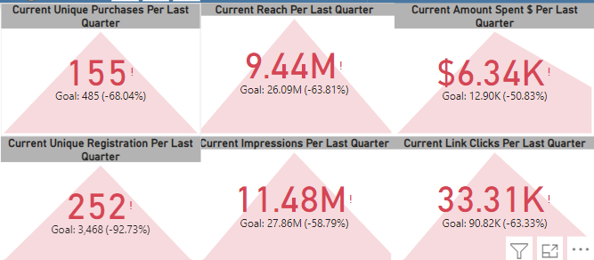
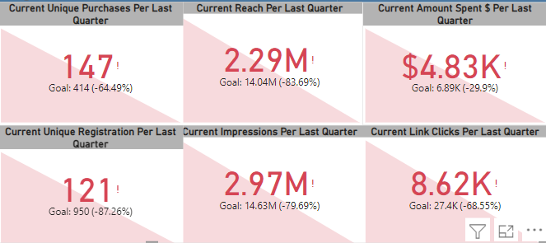
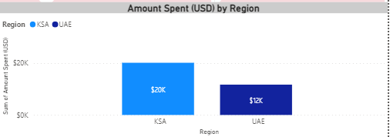
Filtering By Region
KSA UAE
We can observe that BASMA is focusing on spending more money in the KSA market than the UAE market, as the KPIs and the bar chart show.

Slide 17
Data-driven Insights
Insights and recommendations

Slide 18
Sharing The Finds
After analyzing and visualizing the data set provided, what comes to the forefront is that money spending is crucial and essential for Basma to achieve its potential customers and profit maximization. all charts show that spending more money leads to more purchases and registration.
For example, BASMA spends more on Instagram and Facebook than other platforms, so these two platforms have the highest reaches, registrations, and purchases. Also, spending more on regions and campaigns leads to better results.
On the other side, when looking closer at the regional level, we see that the campaign also plays a big role in reaching audience. In KSA, it is clear that KSA_May2020_Conversion is the best campaign by purchases and reach, while in the UAE, the best campaign to reach the audience is UAE_July2020_reach, knowing that the money spent on UAE_July2020_Conversion is more.

Slide 19
Recommendations
It is recommended to spend more money on campaigns and platforms, especially Instagram and Facebook, because these two platforms are more popular.
Make a customer experience survey that collects customer feedback and recommendations and try to provide the customer with high levels of satisfaction.
Offer discounts or promotions to attract and retain customers.

Slide 20
Expanding
As a recommendation for the third market expansion, Qatar would be an ideal choice due to various reasons. Despite being a small country, Qatar has a wealthy population, which presents a promising opportunity for BASMA's services. Furthermore, the country's small size can offer an advantage for collecting accurate data, enabling the company to stand out from the competition. Qatar's business environment is also investor-friendly, with a focus on attracting foreign investment. The fact that Qatar is a neighboring country with a similar culture and population to the UAE and KSA can provide additional benefits for BASMA's expansion strategy. Overall, expanding to Qatar presents a lucrative opportunity for BASMA's growth and success.

Slide 21
Business Development Opportunities
Basma can offer additional services in some related fields, such as:
cosmetic dentistry that focus on person's smile
Creating a toothpaste that establishes its brand identity would be a favorable beginning for a business venture.

Slide 22
Thank You
Mohammad Haidar

