Slide 1
Linked Lists
Data Structures using Java

Slide 2
Objectives
Learn about linked lists
Become aware of the basic properties of linked lists
Explore the insertion and deletion operations on linked lists
Discover how to build and manipulate a linked list

Slide 3

Linked List
Definition: a list of items, called nodes, in which the order of the nodes is determined by the address, called the link, stored in each node

Slide 4
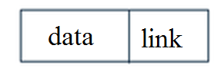
Node
A Linked List is made of one or more nodes.
A Node has two components
data: to store relevant information
link: to store address of next node in list

Slide 5
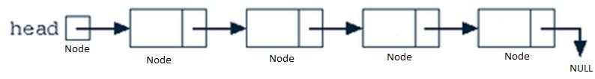
Build a Node
Each Node points to another Node
Data types
info;
link;
Object
Node

Slide 6
The Node class
public class Node {
private Object info=null; // Private ??
public Node link=null; // public? Should it be private? What is the difference?
public Node(Object newElement) {
info = newElement;
}
public Node( Object newElement, Node n ) {
info = newElement;
link = n;
}
public Object getData( ) {
return info ;
}
}

Slide 7
Build MyLinkedList
A LinkedList is created by defining the head
public class MyLinkedList{
private Node head = null;
public Node getHead() {
return head;
}
public void setHead(Node head) {
this.head = head;
}
} // class

Slide 8
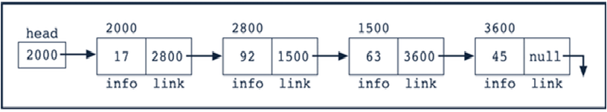
Insert Node in front of List
public void insertAtFront(Object obj) {
Node newNode = new Node(obj);
if (head == null) { // Case of empty list
head = newNode;
}
else {
newNode.link =head;
head = newNode;
}
}

Slide 9
Delete the first Node of List
public Object removeAtFront() {
if (head == null)
return null;
else {
Node temp = head;
head = head.link;
return temp.getData();
}
}

Slide 10
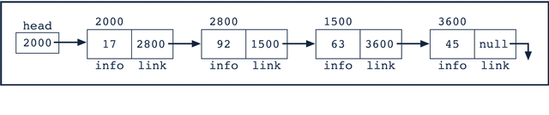
Linked List Traversal
 | Value
head | 2000
head.info (can we do this?) | 17
head.link (can we do this?) | 2800

Slide 11
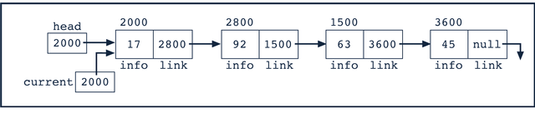
Linked List Traversal
current = head
 | Value
current | 2000
current.info | 17
current.link | 2800

Slide 12
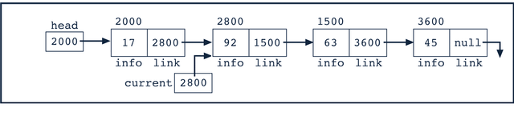
Linked List Traversal
current = current.link
 | Value
current | 2800
current.info | 92
current.link | 1500

Slide 13
Printing a list
public void print() {
Node current;
current =head;
while(current != null)
{
System.out.print(current.getData()+" ");
current=current.link;
}
System.out.println();
}

Slide 14
Test MyLinkedList
import java.util.*;
public class TestProgram {
public static void main(String[] args) {
Scanner input =new Scanner(System.in);
Object x;
MyLinkedList L1 =new MyLinkedList();
for (int i=1;i<=3;i++)
{
x=input.nextInt();
L1.insertAtFront(x);
}
L1.print();
}
}

Slide 15
Exercise
Write a method in MyLinkedList class that returns the length of the LinkedList, i.e. the number of nodes in the List. Test it in the main
public int count() {}
Add the necessary code to main to print the 2nd element of the list but when this is done the list should contain the same elements.
Redo 2 but this time a write method part of Mylinked list class. Test it in the main.

Slide 16
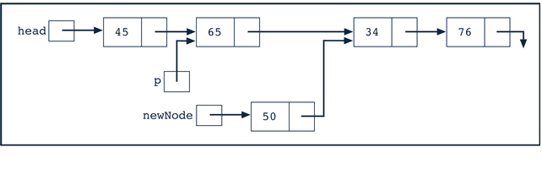
Insertion
Code Sequence
newNode.link = p.link
p.link = newNode;

Slide 17
Insertion
Write a program to insert an object into a particular location in the Linked List.
public void insertHere(Object obj, int pos) {
if (this.size() < pos) {
throw new RuntimeException("Position bigger than List size!");
}
Node current = head;
Node n = new Node(obj);
if (pos == 0){
n.link=head;
head = n;
} else {
for (int y = 1; y <= pos - 1; y++) {
current = current.link;
}
n.link=current;
current.link=n;
}
}

Slide 18
Deletion
Write a Java method to delete a node in a particular position.

Slide 19
Search
Write a Java method to search for an object in MyLinkedList.
public boolean search (Object obj){
}

Slide 20
Reverse a List
public void reverseList() {
Node curr = head;
Node next = heah.link;
Node prev = null;
while (next != null) {
curr.link= prev;
prev = curr;
curr = next;
next = curr. link;
}
head = curr;
head.link=prev;
}

Slide 21
Traverse Linked List
Write a Java method to find how many even numbers are there in a List.
Member of the class MyLinkedList
Non Member

Slide 22
Traverse to a Node in the List
public Node getNode(int pos) {
Node tmp = head;
if (pos > this.size()) {
return null;
} else {
for (int i = 0; i < pos; i++) {
tmp = tmp.link;
}
}
return tmp;
}

Slide 23
Swap two nodes
public void swapNodes(int pos1, int pos2) {
Node t1,t2;
Object obj1,obj2;
t1=getNode(pos1);
obj1=t1.getData();
t2=getNode(pos2);
obj2=t2.getData();
t2.setData(obj1);
t1.setData(obj2);
}

Slide 24
Sort MyLinkedList
Trace this method
public void selection????LL() {
int minIndex, tmp;
int n = this.size();
for (int i = 0; i < n - 1; i++) {
minIndex = i;
for (int j = i + 1; j < n; j++) {
if ((Integer) this.getNode(j).getData() < (Integer) this.getNode(minIndex).getData()) {
minIndex = j;
}
}
if (minIndex != i) {
this.swapNodes(i, minIndex);
}
}
}

Slide 25
LinkedList
Java provides the LinkedList class.
java.util.LinkedList
Various methods are provided to manage the list
Create a LinkedList
LinkedList javaList = new LinkedList();
The class provides methods to add, remove, get etc.

Slide 26
Methods to Add to LinkedList
Add element in the beginning
javaList.addFirst(“A”);
Add element to the end
javaList.addLast(“Z”);
Add element to a position
javaList.add(1, “B”);

Slide 27
Simple Program to us the built Java list
public static void main(String[] args) {
Scanner input =new Scanner(System.in);
LinkedList list = new LinkedList();
int length;
list.addFirst("A");
list.addLast("Z");
list.add(1, "B");
length=list.size();
while(!list.isEmpty())
{
System.out.print(list.remove());
}
System.out.println();
}

Slide 28
Traverse LinkedList
The get(int i) method retrieves the node in location i
for(int i=0; i<ll.size();i++){
System.out.println(""+javaList.get(i));
}

Slide 29
Search LinkedList
The contains() method checks if an element exists in the List, which returns a boolean value.
System.out.println(javaList.contains("B"));

Slide 30
Ordered Linked List
In an ordered linked list the elements are sorted
Because the list is ordered, we need to modify the algorithms (from how they were implemented for the regular linked list) for the search, insert, and delete operations

Slide 31
Exercise
Write search method
Write the insert method
Write the delete method

Slide 32
Doubly Linked List
Every node:
has a next reference variable and a back reference variable
(except the last node) contains the address of the next node
(except the first node) contains the address of the previous node
Can be traversed in either direction

Slide 33
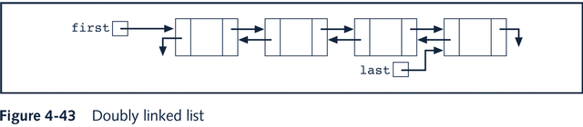
Doubly Linked List

Slide 34
Node class for Double Linked List
public class Node
{
private Object info=null;
private Node next=null;
private Node back=null;
…………………
…………………
}

Slide 35
Linked Lists with Header and Trailer Nodes
Simplify insertion and deletion by never inserting an item before first or after last item and never deleting first node
Set a header node at the beginning of the list containing a value smaller than the smallest value in the data set
Set a trailer node at the end of the list containing a value larger than the largest value in the data set

Slide 36
Linked Lists with Header and Trailer Nodes
These two nodes, header and trailer, serve merely to simplify the insertion and deletion algorithms and are not part of the actual list.
The actual list is between these two nodes.

Slide 37
Circular Linked List
A linked list in which the last node points to the first node is called a circular linked list
In a circular linked list with more than one node, it is convenient to make the reference variable first point to the last node of the list

Slide 38
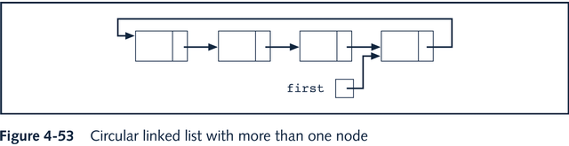
Circular Linked List

Slide 39
Summary
LinkedList is a dynamic data structure
LinkedList is made up of one or more Nodes
Each Node has data and a link
Linked Lists
Traversal
Searching
Inserting
Deleting

Slide 40
Summary
Java provides a data structure implementation for Linked List in java.util.LinkedList
Ordered Linked Lists
Doubly Linked Lists
Linked lists with header and trailer nodes
Circular linked lists

