Slide 1
Men are from blue, women are from pink
A Diachronic Study of the Differences in Association of Colours and Emotions In Literary Works of Male and Female Authors
Mareta Masaeva Mohammadreza Barati Shima Rahimi

Slide 2
data
CLMET 3.0: Corpus of Late Modern English Texts
Three periods: 1710-1780, 1780-1850, 1850-1920
British authors: male & female, all social classes
Narrative fiction, drama, letters, scientific texts
→ Our selection: narrative fiction + drama by either male or female author
 | Male | Female
1st period | 5 014 723 | 915 400
2nd period | 3 245 829 | 2 859 915
3rd period | 5 996 609 | 2 278 919

Slide 3
Colours
Red | Red, umber, scarlet, crimson, ruby, maroon
Orange | Orange, amber
Yellow | Yellow, ecru, flaxen
Green | Green, emerald
Blue | Blue, azure, turquoise
Purple | Purple, violet, indigo, mauve
Pink | Pink, carnation, magenta, cerise
White | White, creamy
Black | Black
Grey | Grey, gray, silver
Brown | Brown, tawny, khaki, russet
List of RGB colours (256 in total)
Excluded ambiguous colours + nationalities, materials
Mapped colours to their colour families
34 colours, 11 colour families

Slide 4
method
To balance tokens: shaved off tokens from beginning & end of male texts
Three classifiers: Distilbert-base-uncased-emotion, XLM-EMO and Text2Emotion
BERT: not highest accuracy, but more emotions
Different window sizes: 5, 10, 15, 20, 25 → eventually chose 20
Each classifier predicted 5 emotions (one per window size), so 15 per matched colour.

Slide 5
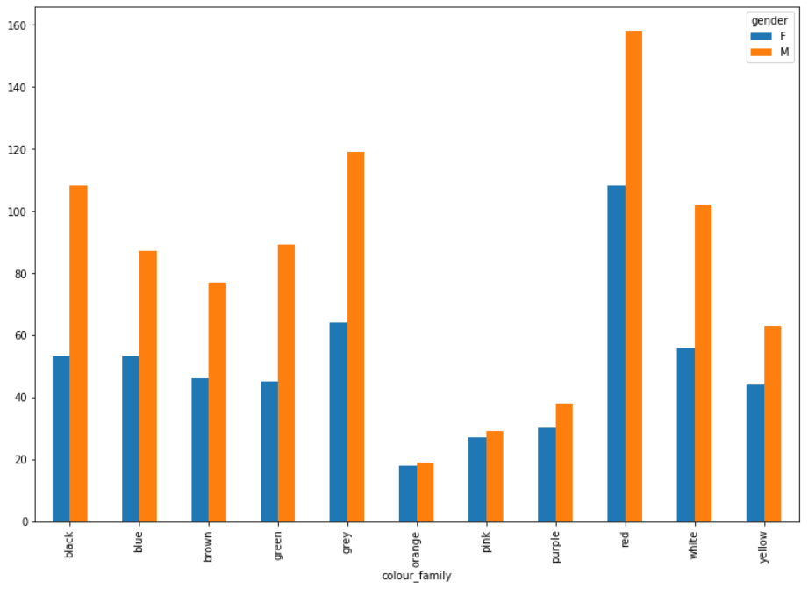
Results: gender and colour
Male authors use more colours overall
Only colour used more by female authors is pink (2nd period) and orange (3rd period)
Top colours: Red, grey, black, white

Slide 6
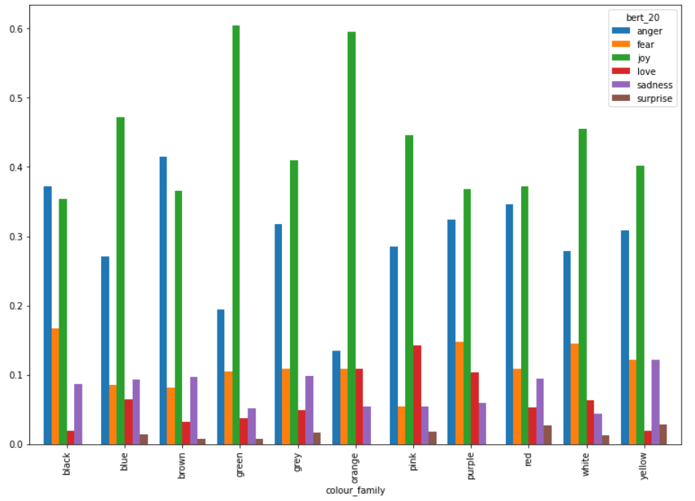
Results: colour and emotion
Joy: green, orange
Anger: brown, black
Fear: black
Love: pink, orange, purple
Sadness: yellow
Surprise: yellow

Slide 7
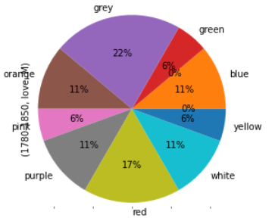
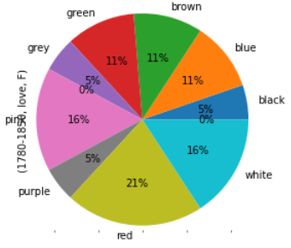
Results: colour, gender and emotion
Love conveyed by male and female authors (2nd period)
→ Males use grey, red – females use red, pink and white: different types of love

Slide 8
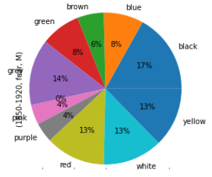
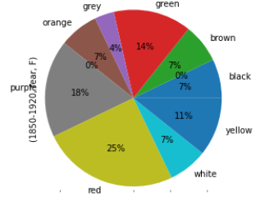
Results: colour, gender and emotion
Fear conveyed by male and female authors (2nd period)
→ Males use black, grey – females use red, purple:

Slide 9
Results: colour, gender and emotion

Slide 10
cONCLUSION
Many infrequent colours: might have clouded the analysis
E.g. Only primary/highly frequent colours, ...
Making straightforward conclusions is difficult
Nevertheless: interesting and insightful!

