Slide 1
Data processing & visualisation tasks GlaThiDa
Author
Moeen Khurram
moeen.Khurram@tum.de

Slide 2
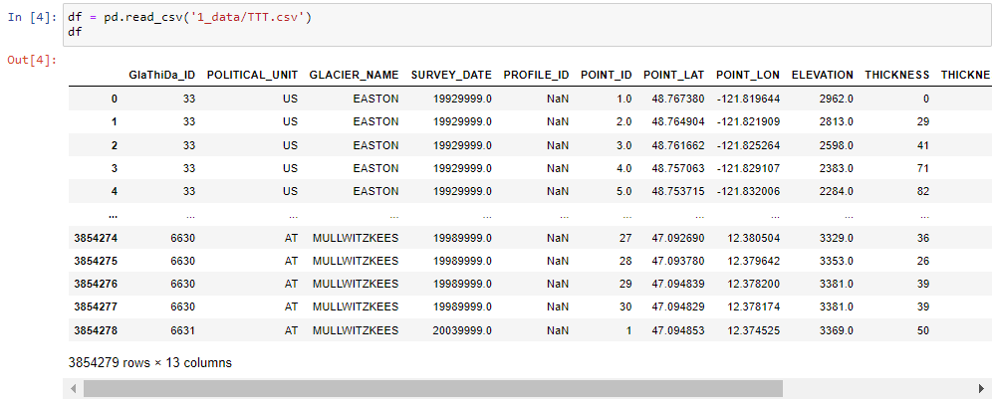
Data Pre-processing and Understanding
TTT.csv file is read with pandas and Data Frame is created
Data Points / Observations = 3 854 279
Features / Variables = 13

Slide 3
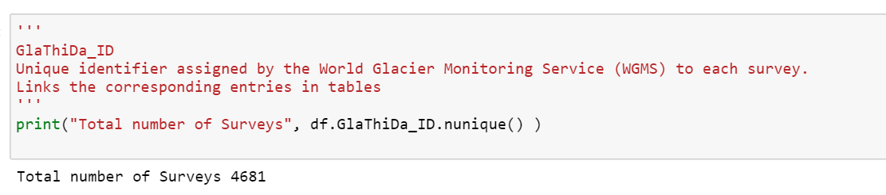
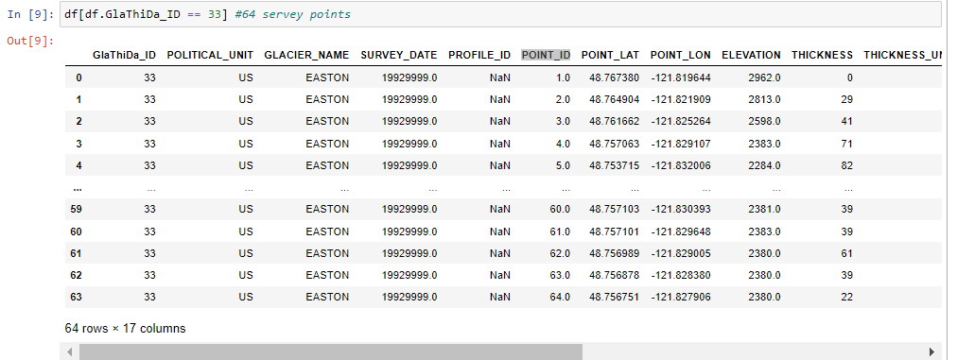
Data Pre-processing and Understanding
Total number of survey 4681
Each survey has multiple different points , indicated by POINT_ID
For example, Survey/GlaThiDa_ID == 33 has 64 points

Slide 4
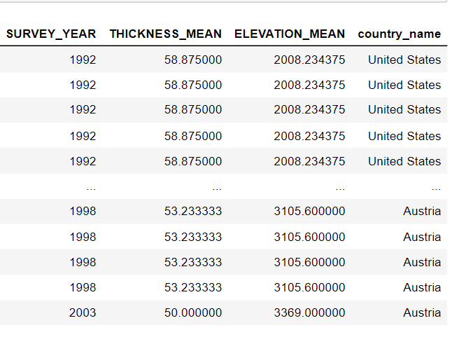
Data Pre-processing and Understanding
Created following 4 new features/variables for visualization
Converted two-character POLITICAL_UNIT
to full country name
Modification of
SURVEY_DATE
Grouped with GlaThiDa_ID calculated average Thickness and Elevation, indicating the average values in each survey

Slide 5
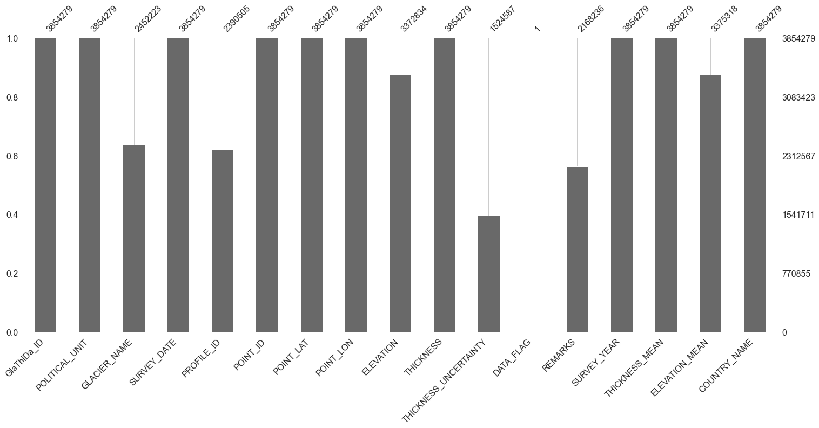
Missing Value Visualization
It is very important to understand the completeness of data before doing any analysis
7 variables has missing values, DATA_FLAG is almost null

Slide 6
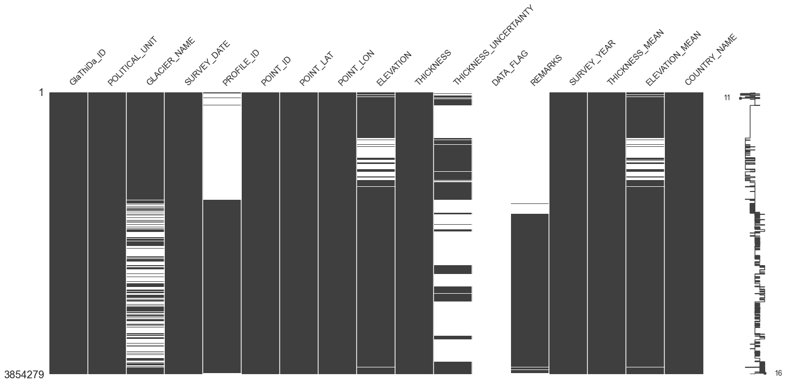
Missing Value Visualization
Another visualization for missing values, but here to see the locations of missing values in each variable

Slide 7
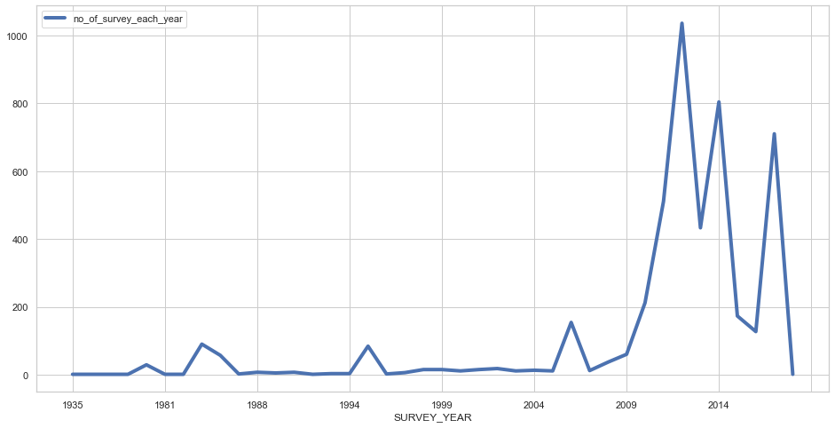
Visualization 1 - No. of survey vs Years
Following graph represent the no. of survey performed in each year since 1935
It is clearly seen that most of the surveys are performed after 2009

Slide 8
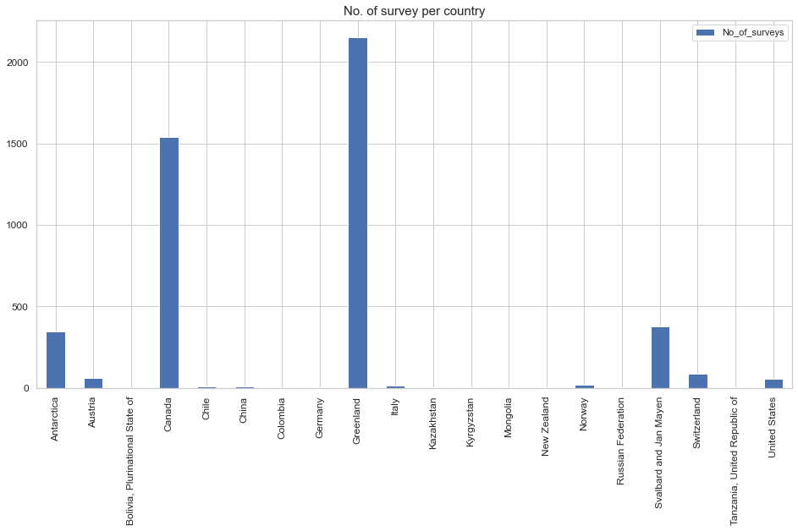
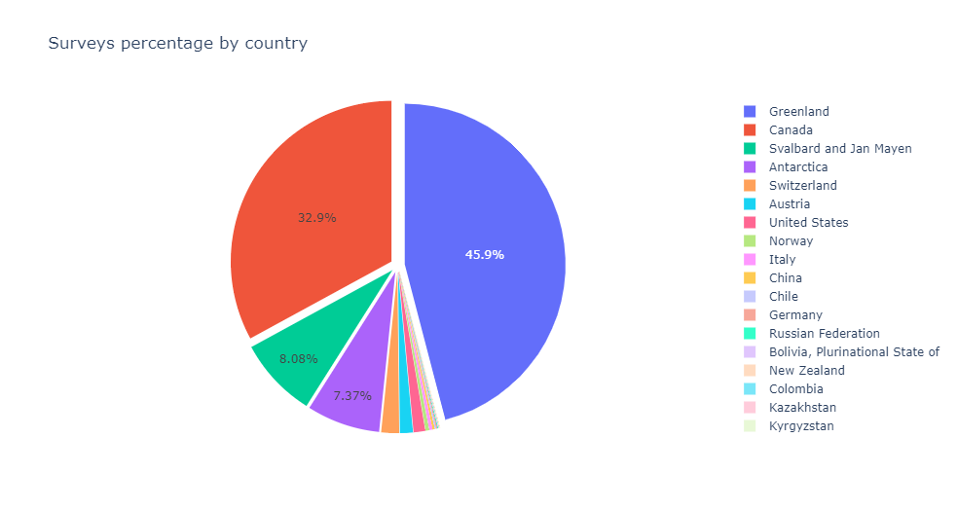
Visualization 2 - Survey proportion in each country
Visualization to identify the proportion of survey in each country
Highest number of surveys carried out in Greenland

Slide 9
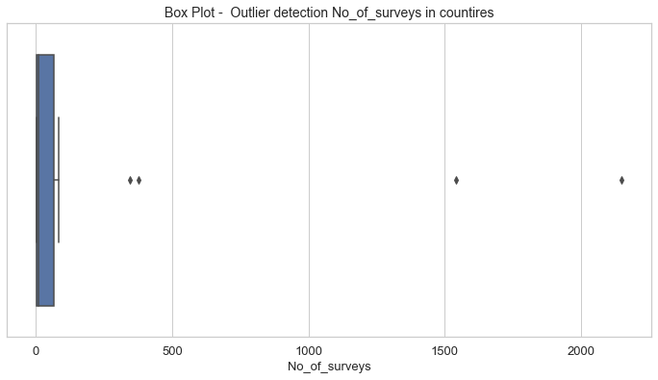
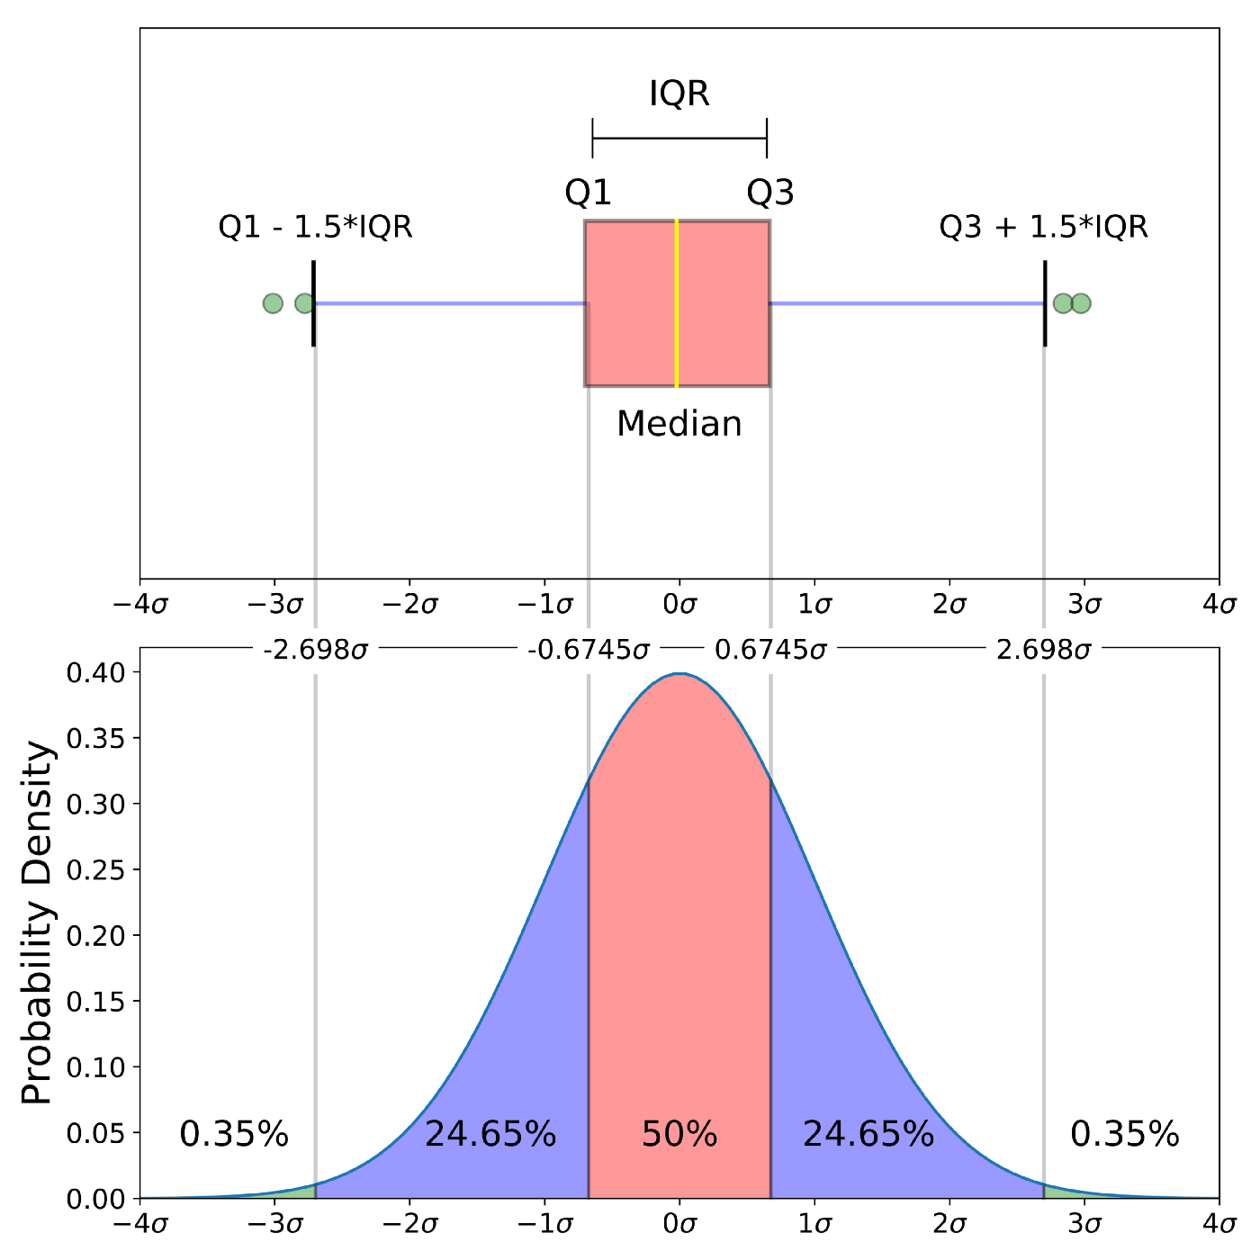
Visualization 2 - Survey proportion in each country (Outlier detection)
This box plot identifies the outliers in proportion of survey in each country
Canada, Greenland, Antarctica and Svalbard were considered as outliers as they have very high number of surveys, they lies outside of Q3 +1.5*IQR
outliers
Interpretation of box plot

Slide 10
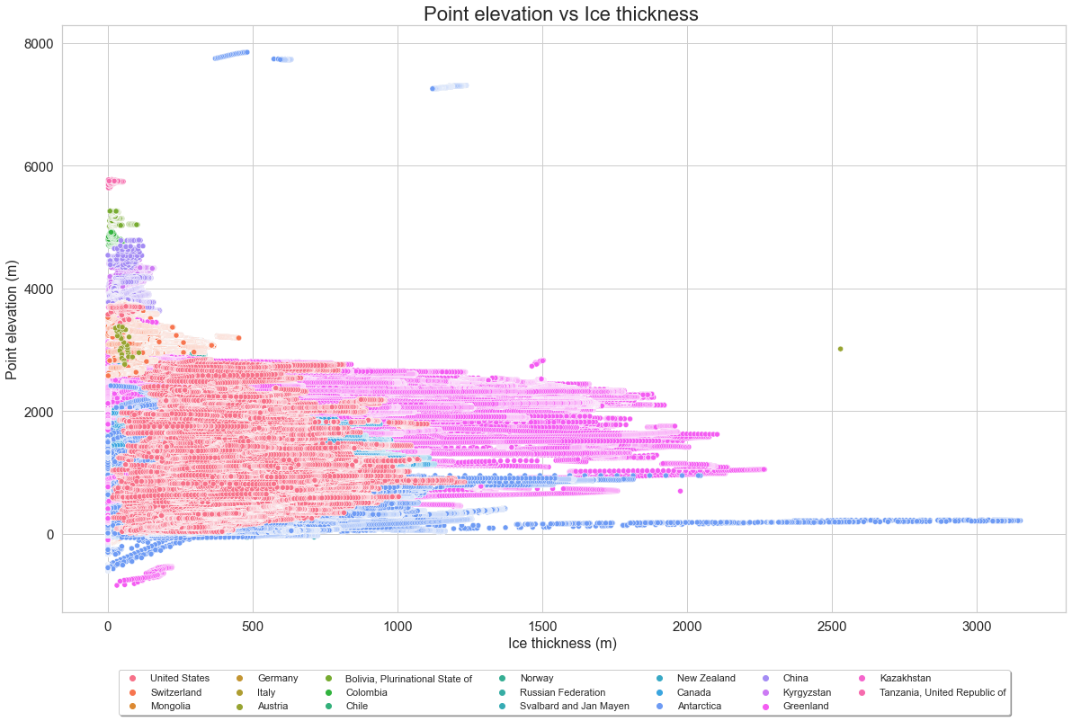
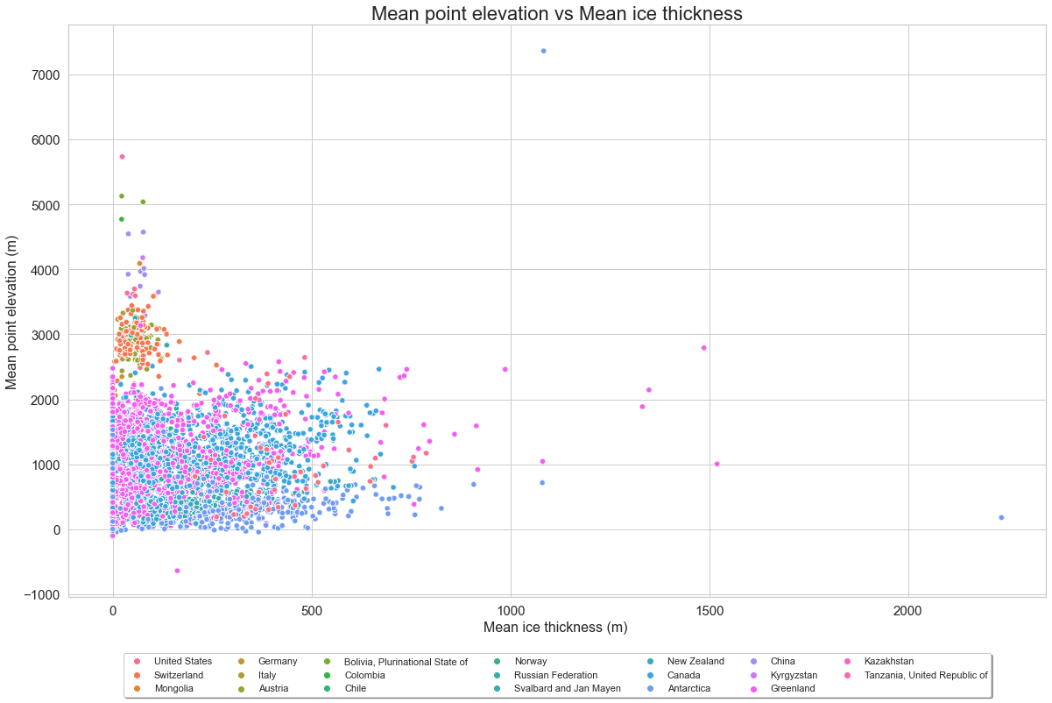
Visualization 3 - Relationship between thickness and elevation
Elevation and thickness are plotted together to see their relationship and some outliers, here we can see they are inversely proportional to each other: thickness increases elevation decreases or vice versa
To reduce noise, mean thickness and mean elevation are plotted (right plot)
outliers

Slide 11
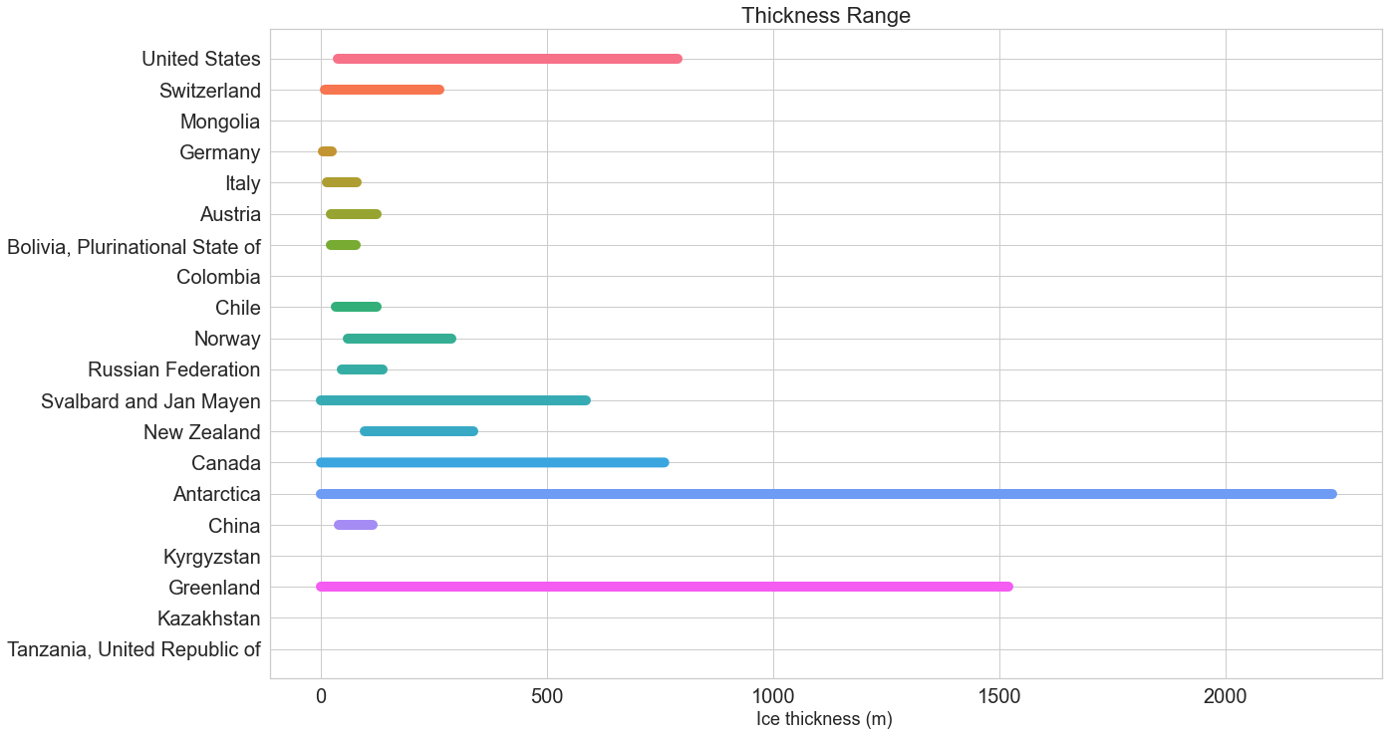
Visualization 4 – Thickness range w.r.t each country
In this visualization we can analyze range of thickness of glaciers in each country
Thickest glaciers in Greenland and Antarctica

Slide 12
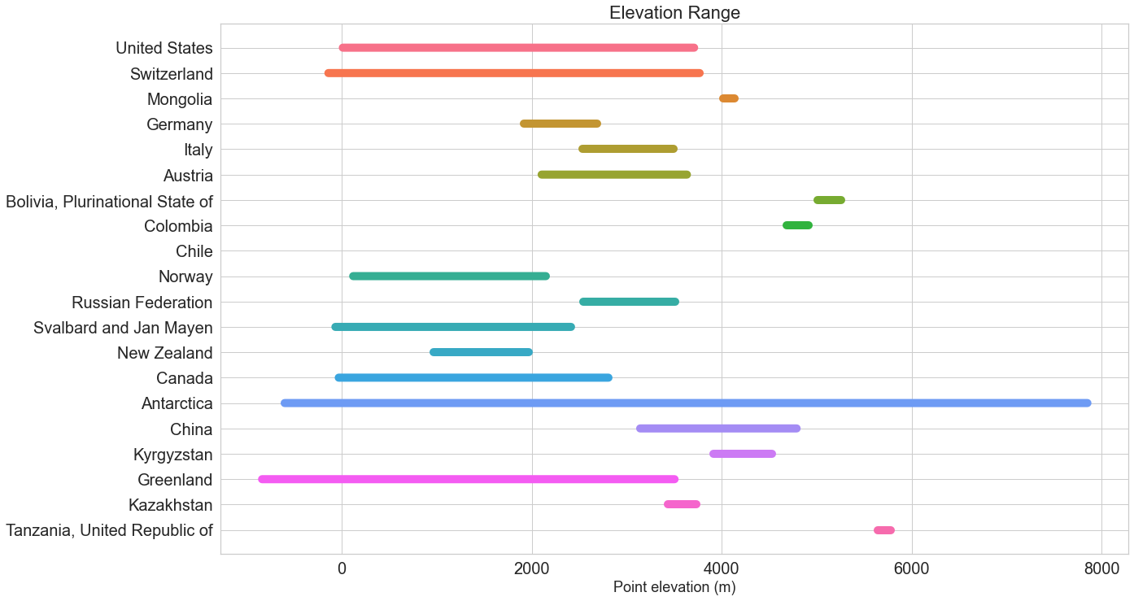
Visualization 5 – Elevation range w.r.t each country
Same visualization as previous but now for elevation

Slide 13
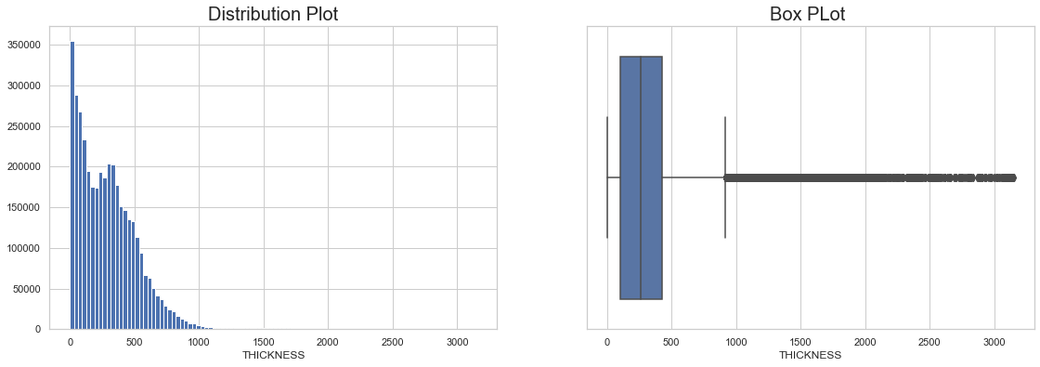
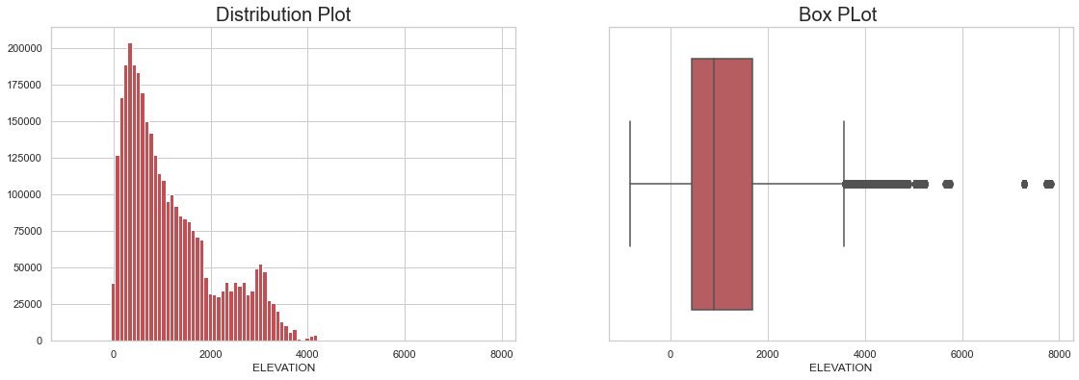
Visualization 6 – Box and distribution plot for thickness and elevation
Distribution plot and box pot is used to detect outliers and probability distribution (where most of the values lies)
Both distribution are skewed towards left indicating certain amount of outliers

Slide 14
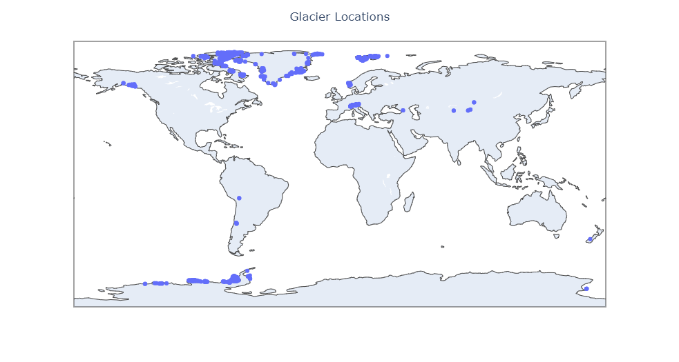
Visualization 7 – Locations of glaciers on world map
Locations of glaciers on geo map

