Slide 1

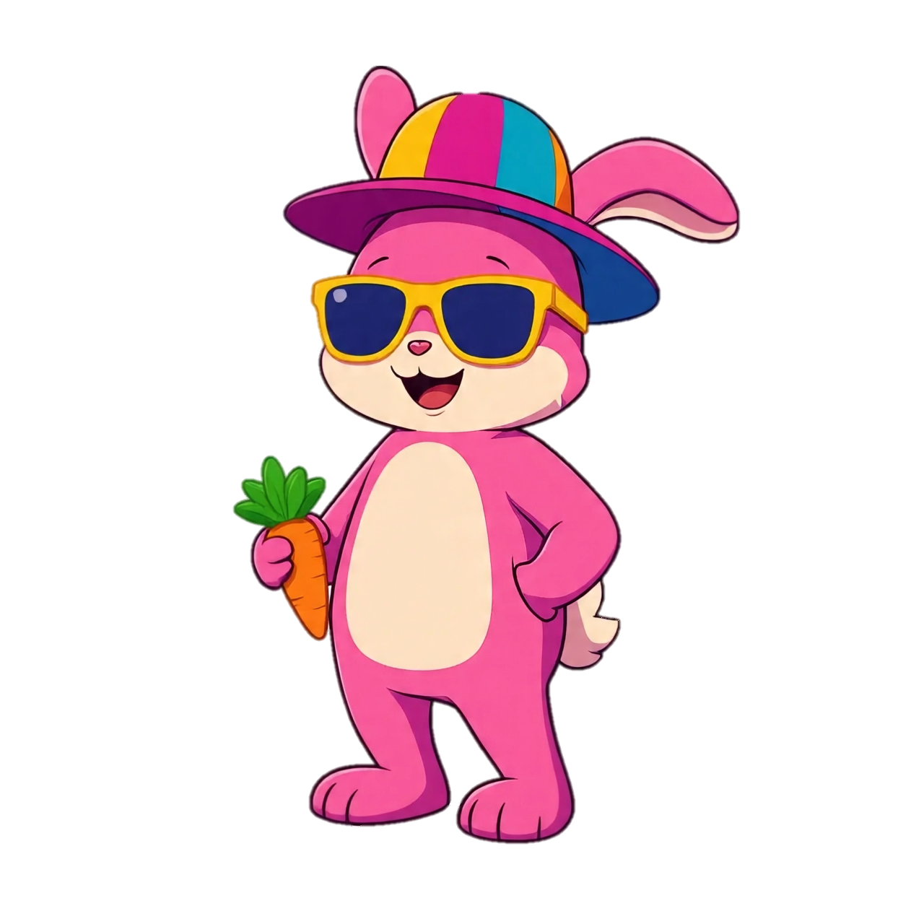
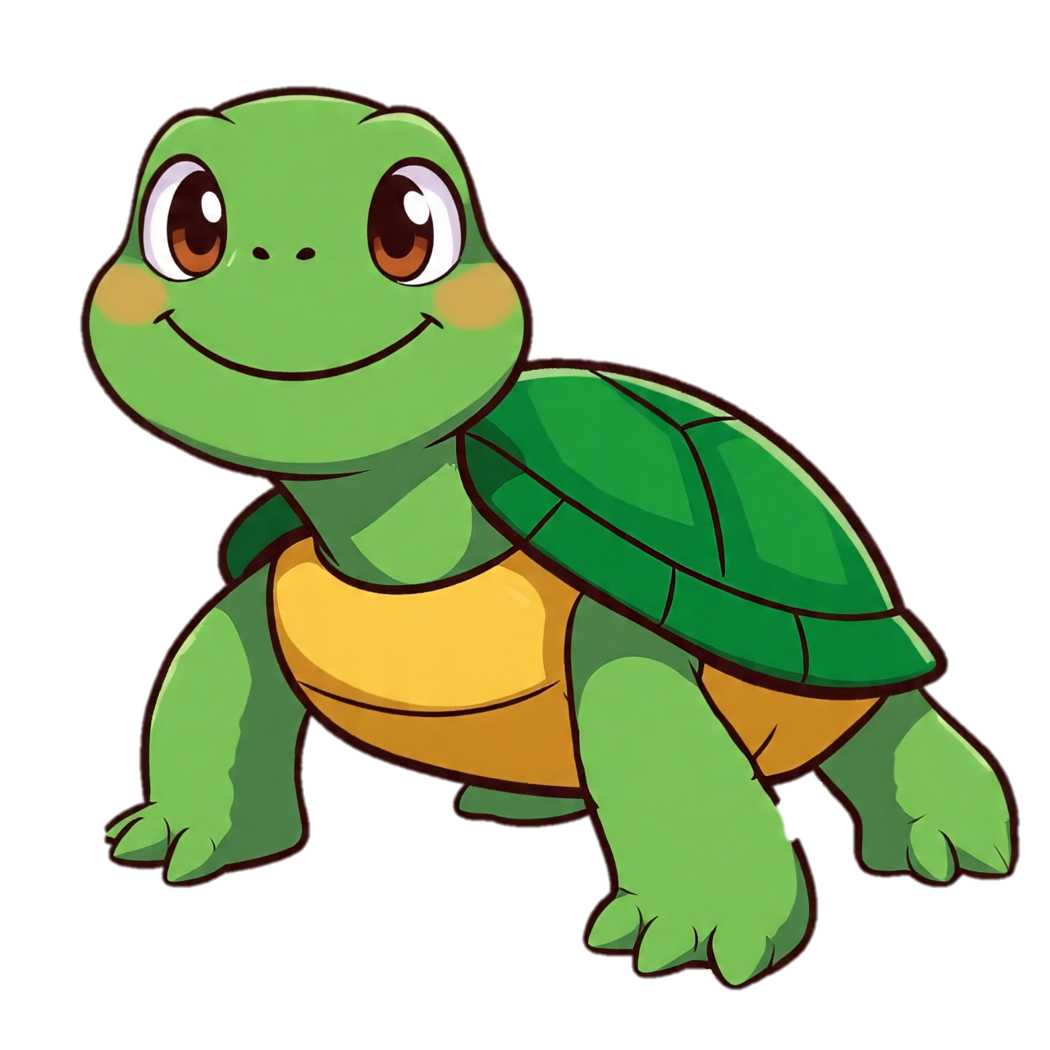
Race Between Rabbit & Turtle
A Famous Fable Where The Rabbit Wins through Rocket

Slide 2
Rabbit Bhai ja ker Sabzi la go .. Bhook lag rahi ha

Slide 3
Rabbit Bhai ja ker Sabzi la go .. Bhook lag rahi ha

Slide 4
Bhai ap khud ja ker le ao.. Mugha gajar khane do

Slide 5
Bhai la de tari speed bohat taiz ha.. Mugha time lag gae ga

Slide 6
Bhai tu sust ha to is me mari kia galti ha

Slide 7
Bhai nhi hu ma sust..
Ma apni marzi se slow chalta hu

Slide 8
Ma chahu to ma tere se bhi taiz chal sakta hu

Slide 9
Oooo acha to aja race lagate hain
????

Slide 10
Chal aja race lagae

Slide 11
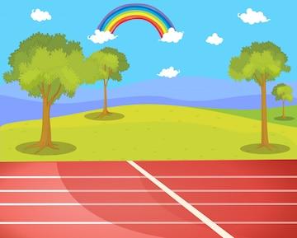
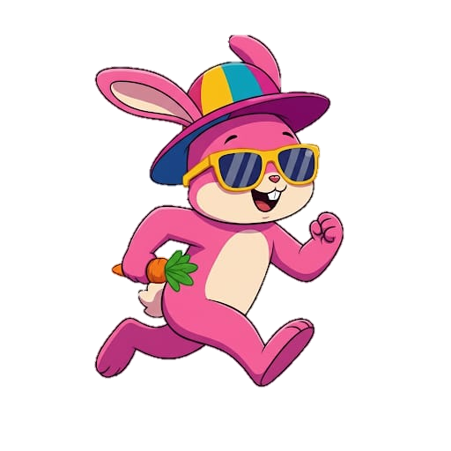

Haa bhai aa gae ho
Harne ??

Slide 12
Dakhte hain

Slide 13
Milte hain phir winning Side per

Slide 16
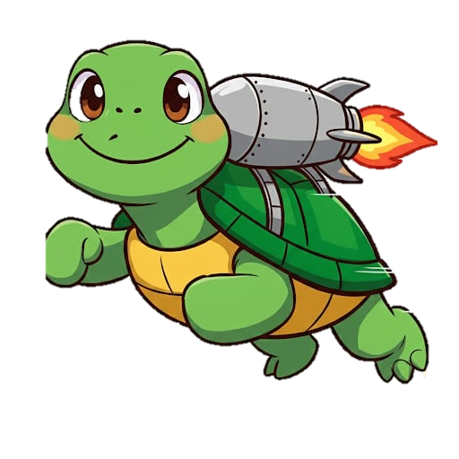

Slide 17


Slide 20
Ma jeet gia …
Tu haar gia…

Slide 21
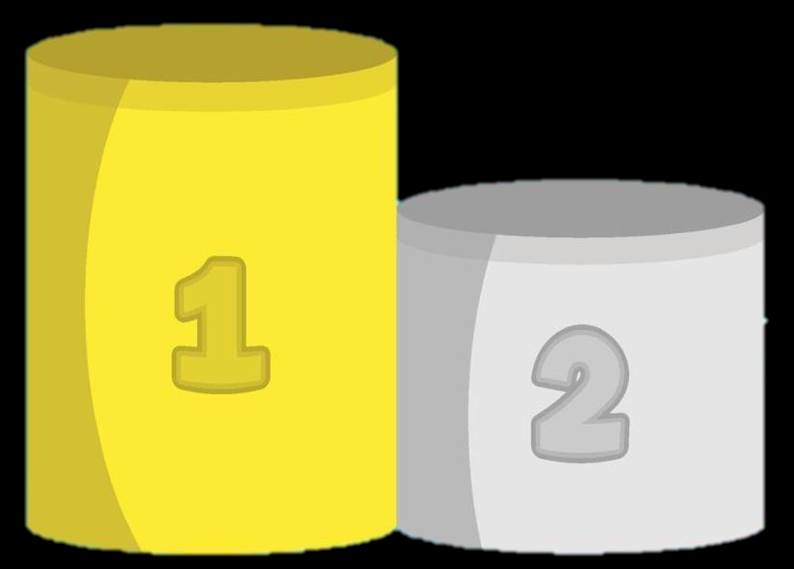
Kabhi bhi apne dushman ko kamzoor na samjho

