Slide 1
ALGORITHMS AND FLOWCHARTS
Problem Analysis
By: Ashutosh Mishra

Slide 2
ALGORITHMS AND FLOWCHARTS
A typical programming task can be divided into two phases:
Problem solving phase
  produce an ordered sequence of steps that describe solution of problem
  this sequence of steps is called an algorithm
Implementation phase
  implement the program in some programming language

Slide 3
Steps in Problem Solving
First produce a general algorithm (one can use pseudocode)
Refine the algorithm successively to get step by step detailed algorithm that is very close to a computer language.
Pseudocode is an artificial and informal language that helps programmers develop algorithms. Pseudocode is very similar to everyday English.

Slide 4
Pseudocode & Algorithm
Example 1: Write an algorithm to determine a student’s final grade and indicate whether it is passing or failing. The final grade is calculated as the average of four marks.

Slide 5
Pseudocode & Algorithm
Pseudocode:
Input a set of 4 marks
Calculate their average by summing and dividing by 4
if average is below 50
Print “FAIL”
else
Print “PASS”

Slide 6
Pseudocode & Algorithm
Detailed Algorithm
Step 1: Input M1,M2,M3,M4
Step 2: GRADE ← (M1+M2+M3+M4)/4
Step 3: if (GRADE < 50) then
Print “FAIL”
else
Print “PASS”
endif

Slide 7
The Flowchart
(Dictionary) A schematic representation of a sequence of operations, as in a manufacturing process or computer program.
(Technical) A graphical representation of the sequence of operations in an information system or program.
  Information system flowcharts show how data flows from source documents through the computer to final distribution to users.
  Program flowcharts show the sequence of instructions in a single program or subroutine. Different symbols are used to draw each type of flowchart.

Slide 8
The Flowchart
A Flowchart
  shows logic of an algorithm
  emphasizes individual steps and their interconnections
  e.g. control flow from one action to the next

Slide 9
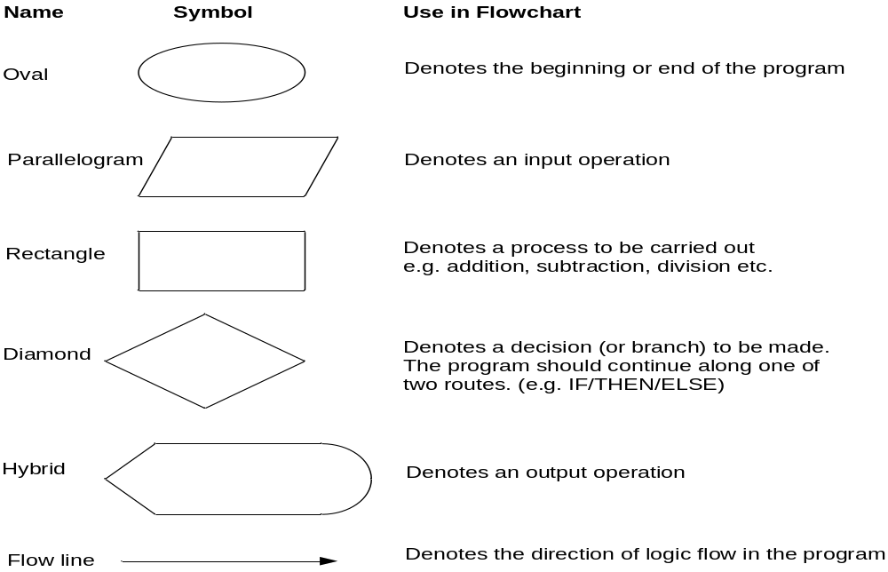
Flowchart Symbols
Basic

Slide 10
Example
START
Step 1: Input M1,M2,M3,M4
Step 2: GRADE ← (M1+M2+M3+M4)/4
Step 3: if (GRADE <50) then
Print “FAIL”
else
Print “PASS”
endif
Input
M1,M2,M3,M4
GRADE←(M1+M2+M3+M4)/4
IS
GRADE<50
N
Y
PRINT
“PASS”
PRINT
“FAIL”
STOP

Slide 11
Example 2
Write an algorithm and draw a flowchart to convert the length in feet to centimeter.
Pseudocode:
Input the length in feet (Lft)
Calculate the length in cm (Lcm) by multiplying LFT with 30
Print length in cm (LCM)

Slide 12
Example 2
Flowchart
Algorithm
Step 1: Input Lft
Step 2: Lcm ← Lft x 30
Step 3: Print Lcm
START
Input
Lft
Lcm ← Lft x 30
Print
Lcm
STOP

Slide 13
Example 3
Write an algorithm and draw a flowchart that will read the two sides of a rectangle and calculate its area.
Pseudocode
Input the width (W) and Length (L) of a rectangle
Calculate the area (A) by multiplying L with W
Print A

Slide 14
Example 3
Algorithm
Step 1: Input W,L
Step 2: A ← L x W
Step 3: Print A
START
Input
W, L
A ← L x W
Print
A
STOP

Slide 15
Flowchart – selection control structure
No
Yes
Condition
else-
statement(s)
then-
statement(s)
Principles of Programming - NI July 2005

Slide 16
Flowchart – repetition control structure
yes
Loop
Statement(s)
Condition
no
Principles of Programming - NI July 2005

Slide 17
Flowchart – example 1
Begin
Read birth date
Calculate
Age = current year – birth date
Display
age
End
Principles of Programming - NI July 2005

Slide 18
Flowchart – example 5
Begin
sum = 0
current_number = 1
NO
current_number <= 10?
print sum
YES
sum = sum + current_number
current_number = current_number + 1
End
Principles of Programming - NI July 2005

Slide 19
Exercises: Algorithm & Flowchart
1.) Create an algorithm and a flowchart that will accept/read two numbers and then display the bigger number.

Slide 20
Exercises: Algorithm & Flowchart
2.) Create an algorithm and a flowchart that will compute the area of a circle.

Slide 21
Exercises: Algorithm & Flowchart
3.) Create an algorithm and a flowchart that will compute the sum of two numbers. If the sum is below or equal to twenty, two numbers will be entered again. If the sum is above 20, it will display the sum.

Slide 22
Lab Activity: Algorithm & Flowchart
4) Create an algorithm and a flowchart that will output the largest number among the three numbers.

Slide 23
Assignment 1
Create an algorithm and a flowchart that will output for g.c.d.
Create an algorithm and a flowchart that will output the factorial of a given number.
Create an algorithm and a flowchart that will output the Fibonacci series up to a given number.
Create an algorithm and a flowchart that will output all the prime numbers between 2 numbers.

