Slide 1
8-2 Using Arrays in C
In this section, we first show how to declare and define arrays. Then we present several typical applications using arrays including reading values into arrays, accessing and exchanging elements in arrays, and printing arrays.
Topics discussed in this section:
Declaration and Definition
Accessing Elements in Arrays
Storing Values in Arrays
Index Range Checking
Computer Science: A Structured Programming Approach Using C

Slide 2
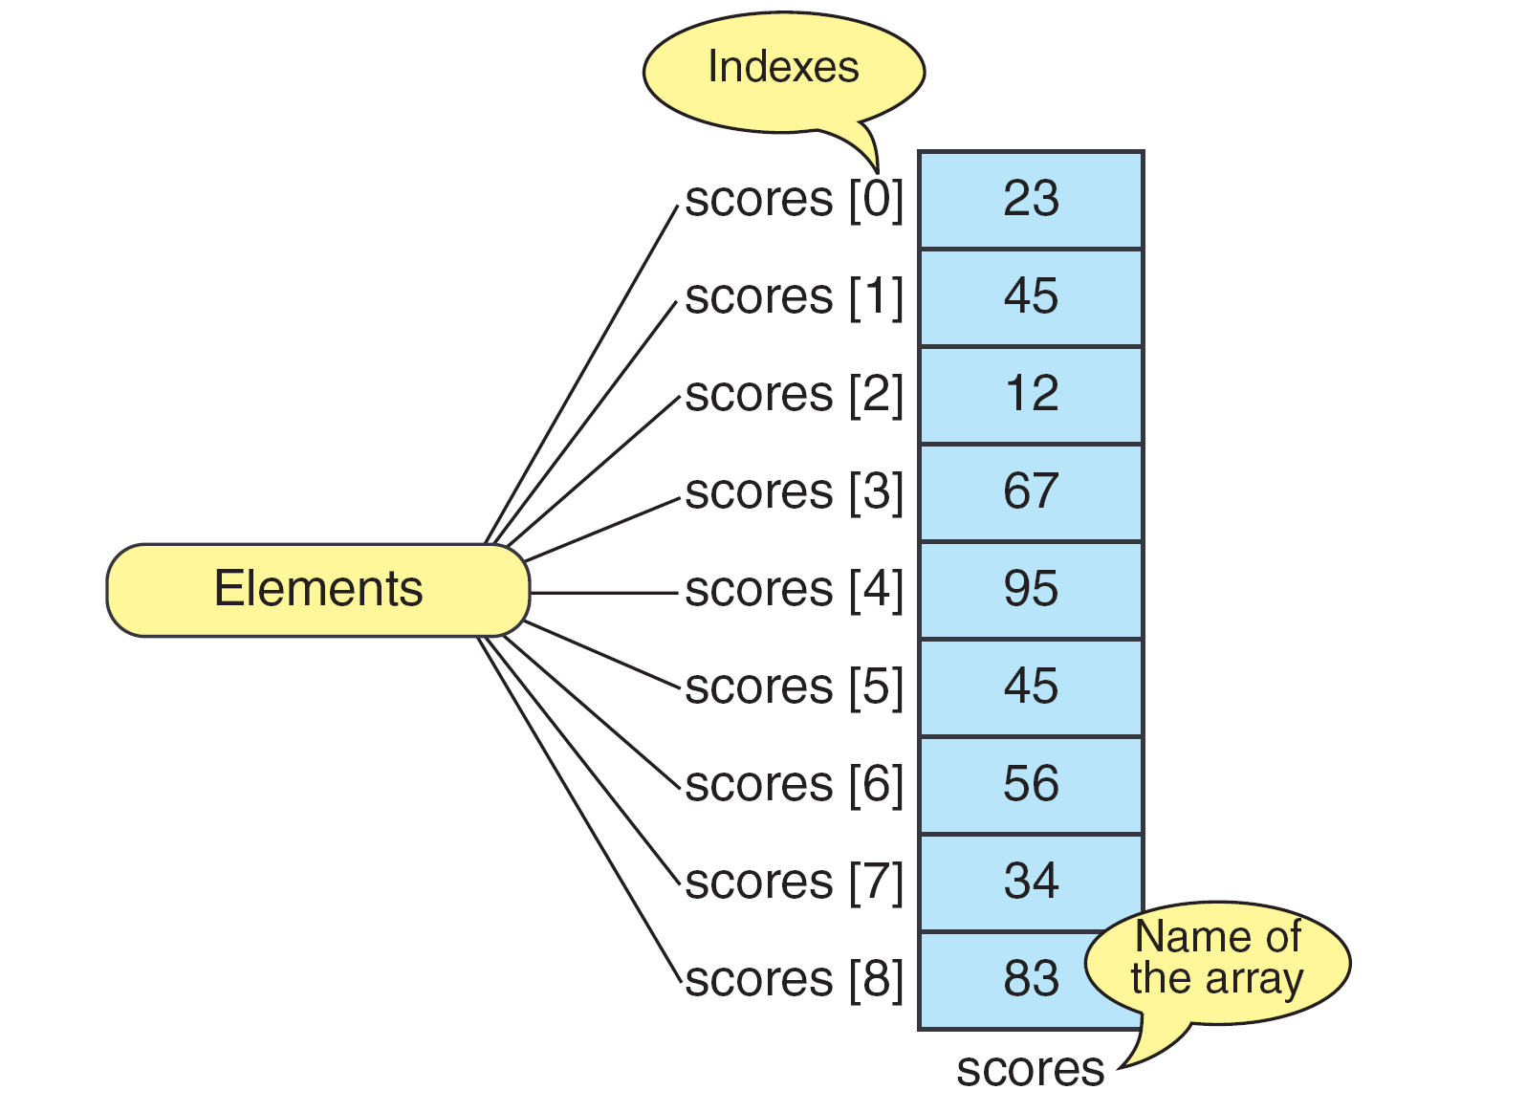
FIGURE 8-6 The Scores Array
Computer Science: A Structured Programming Approach Using C

Slide 3
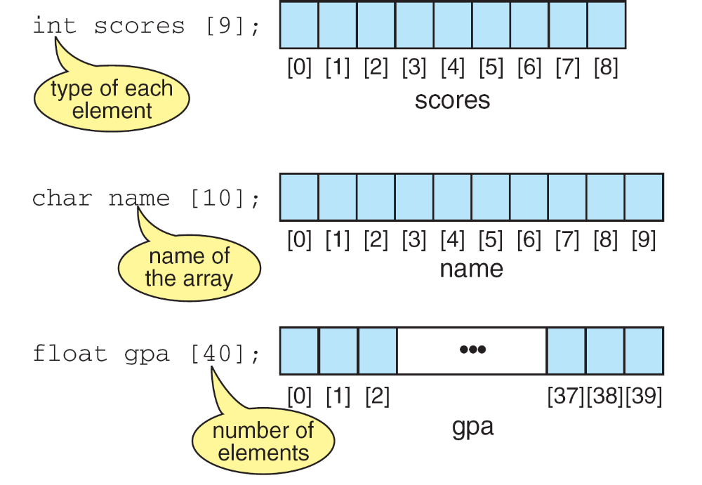
FIGURE 8-7 Declaring and Defining Arrays
Computer Science: A Structured Programming Approach Using C

Slide 4
Note
Only fixed-length arrays can be initialized when they are defined. Variable length arrays must be initialized by inputting or assigning the values.
Computer Science: A Structured Programming Approach Using C

Slide 5
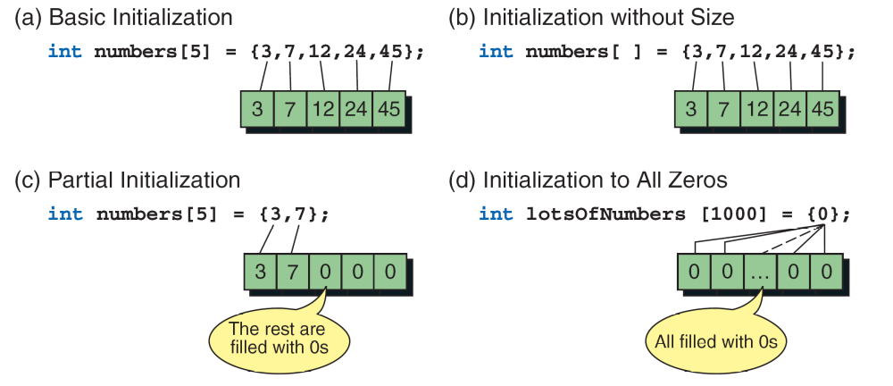
FIGURE 8-8 Initializing Arrays
Computer Science: A Structured Programming Approach Using C

Slide 6
Note
One array cannot be copied to another using assignment.
Computer Science: A Structured Programming Approach Using C

Slide 7
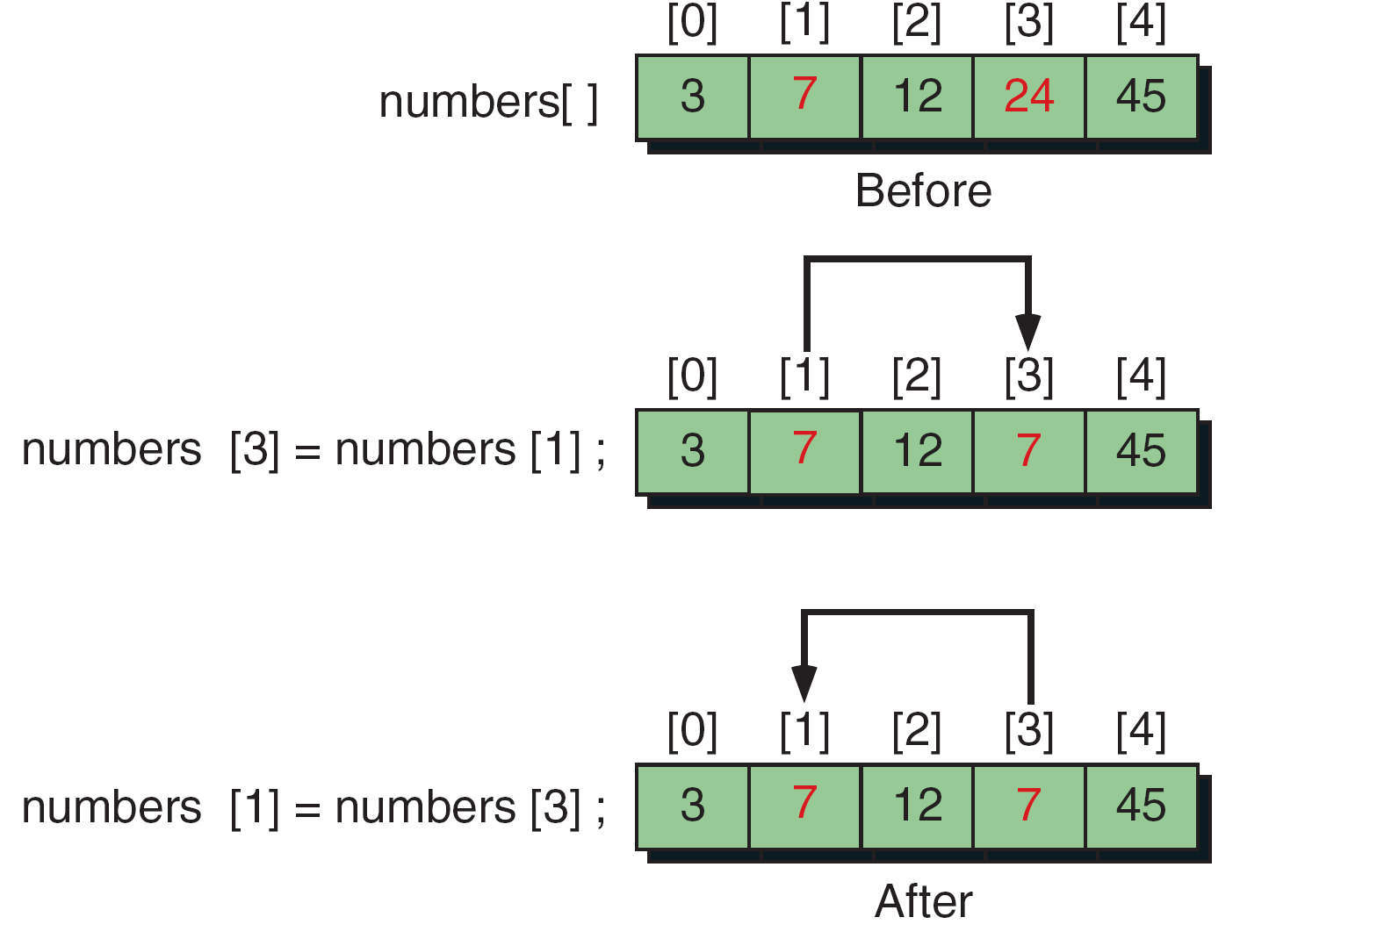
FIGURE 8-9 Exchanging Scores—the Wrong Way
Computer Science: A Structured Programming Approach Using C

Slide 8
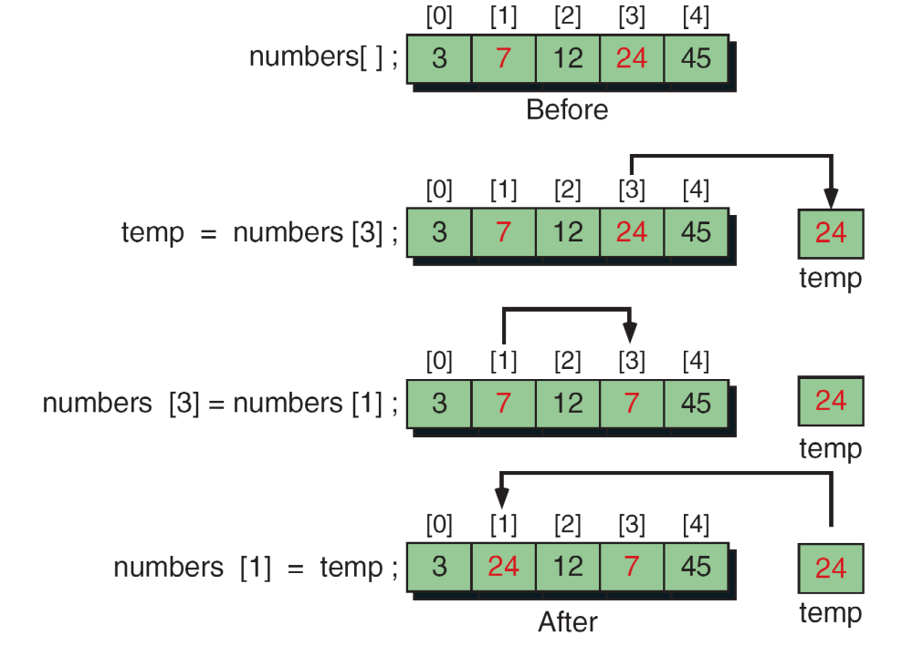
FIGURE 8-10 Exchanging Scores with Temporary Variable
Computer Science: A Structured Programming Approach Using C

Slide 9
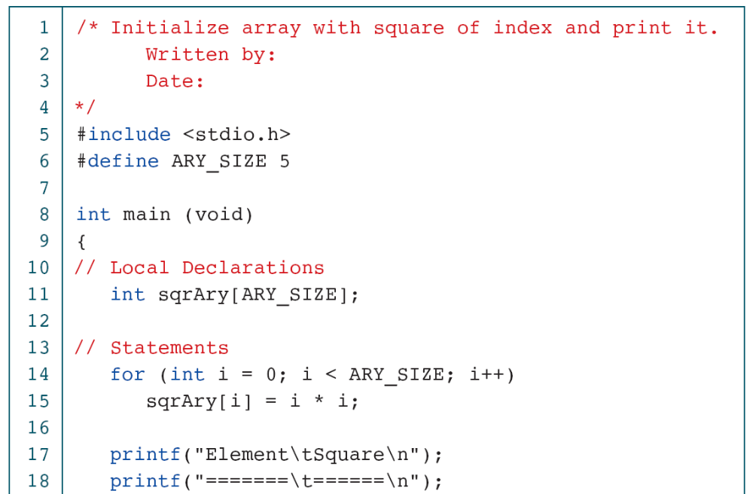
PROGRAM 8-2
Squares Array
Computer Science: A Structured Programming Approach Using C

Slide 10
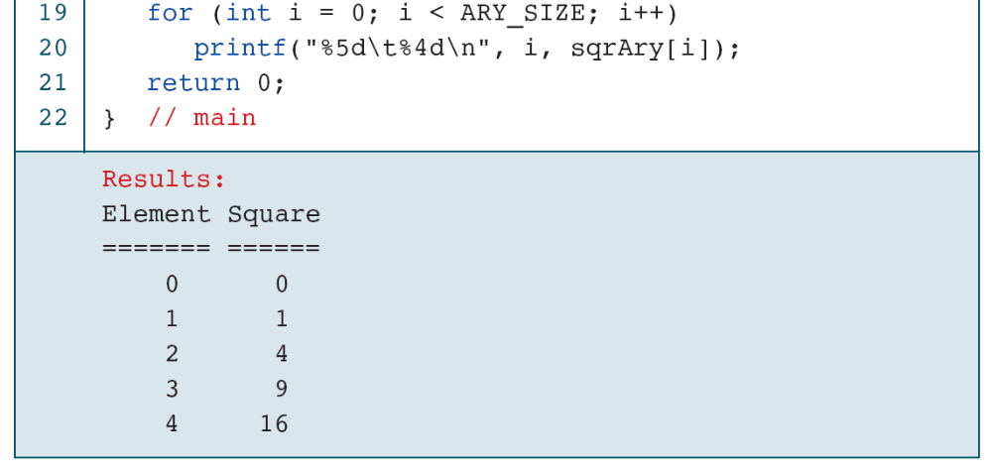
PROGRAM 8-2
Squares Array
Computer Science: A Structured Programming Approach Using C

Slide 11
8-3 Inter-function Communication
To process arrays in a large program, we have to be able to pass them to functions. We can pass arrays in two ways: pass individual elements or pass the whole array. In this section we discuss first how to pass individual elements and then how to pass the whole array.
Topics discussed in this section:
Passing Individual Elements
Passing the Whole Array
Computer Science: A Structured Programming Approach Using C

Slide 12
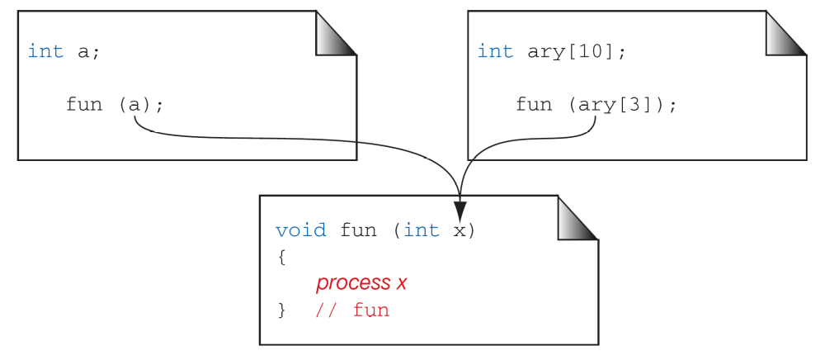
FIGURE 8-11 Passing Array Elements
Computer Science: A Structured Programming Approach Using C

Slide 13
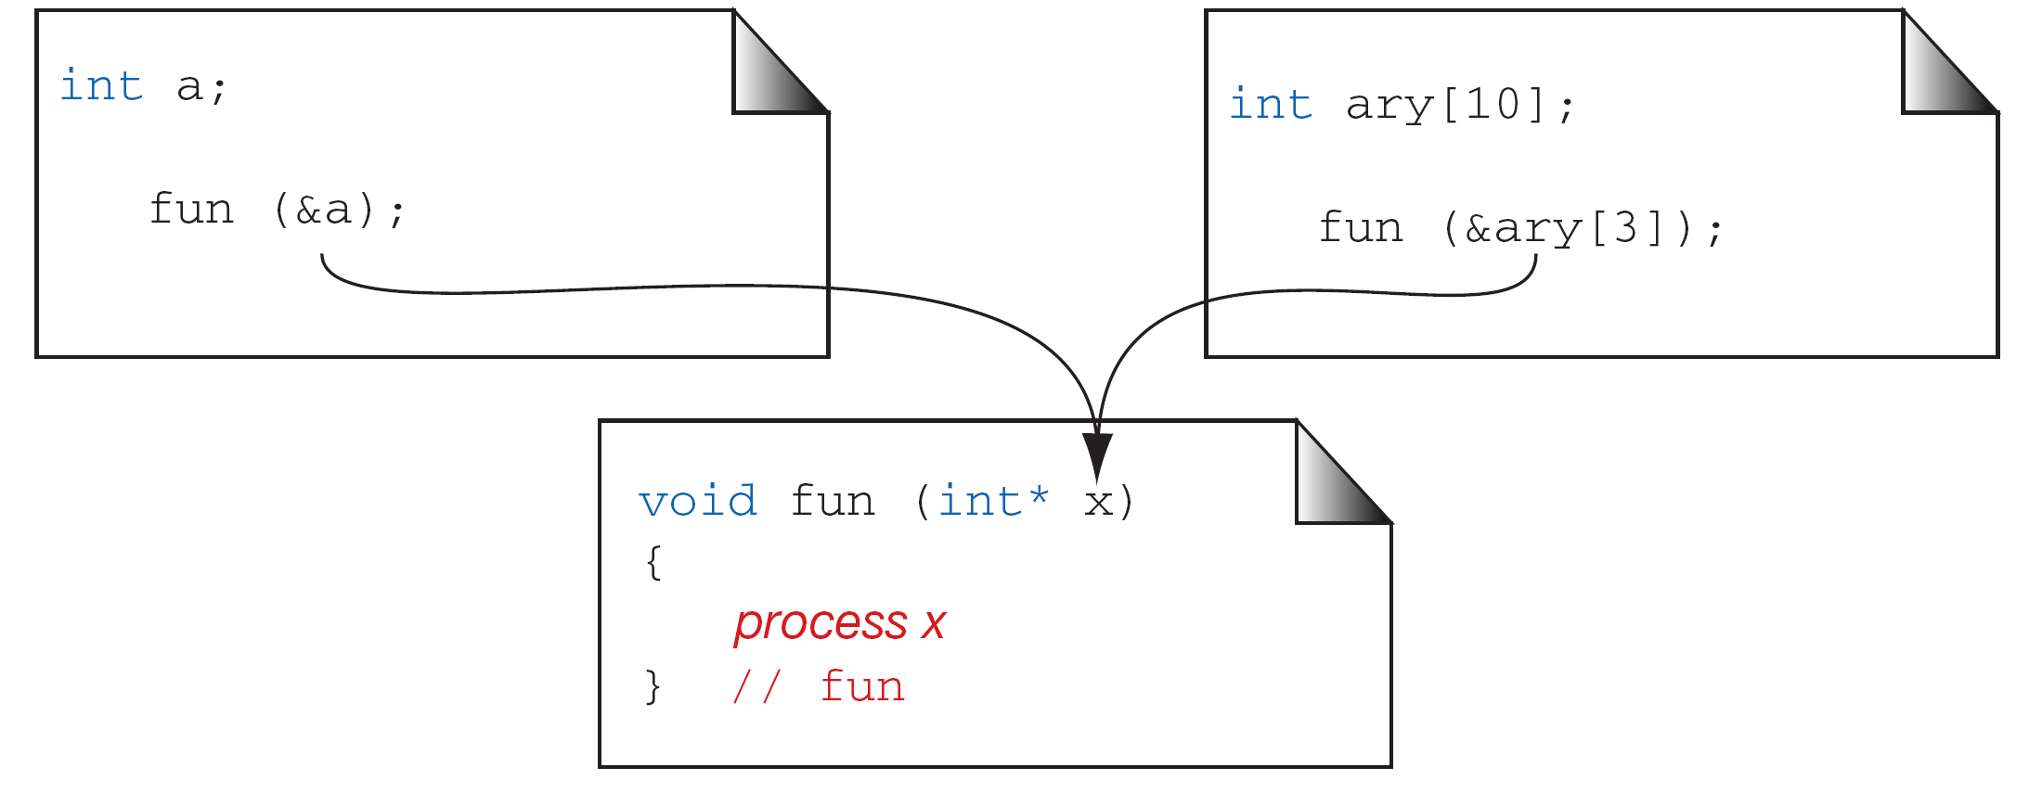
FIGURE 8-12 Passing the Address of an Array Element
Computer Science: A Structured Programming Approach Using C

Slide 14
{ // main
int arr[10];
int x;
func(arr);
}
void func( int farr[] ) {
farr[0] = 1;
}
FIGURE 8-13 Passing an array
Computer Science: A Structured Programming Approach Using C

Slide 15
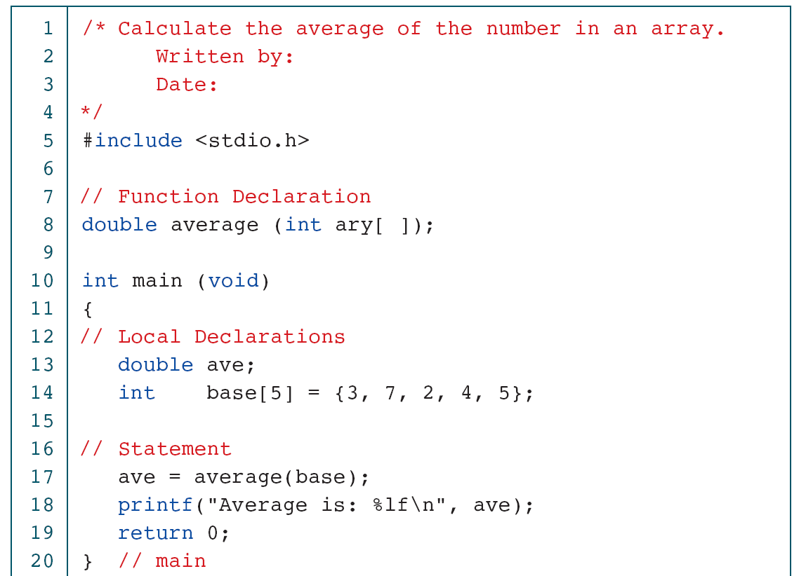
PROGRAM 8-4
Calculate Array Average
Computer Science: A Structured Programming Approach Using C

Slide 16
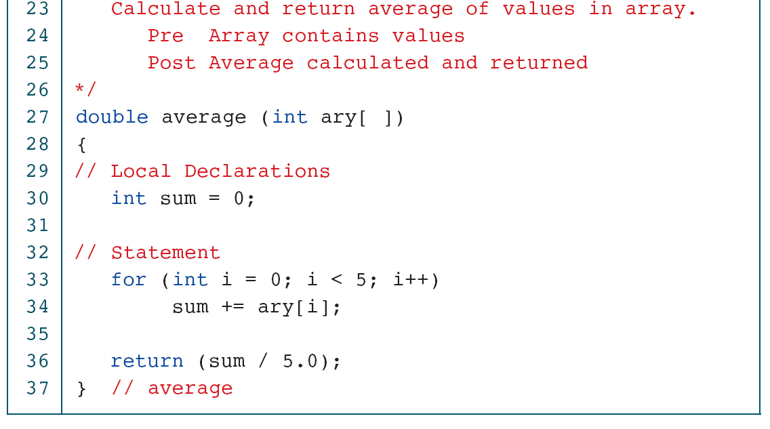
PROGRAM 8-4
Calculate Array Average
Computer Science: A Structured Programming Approach Using C

Slide 17
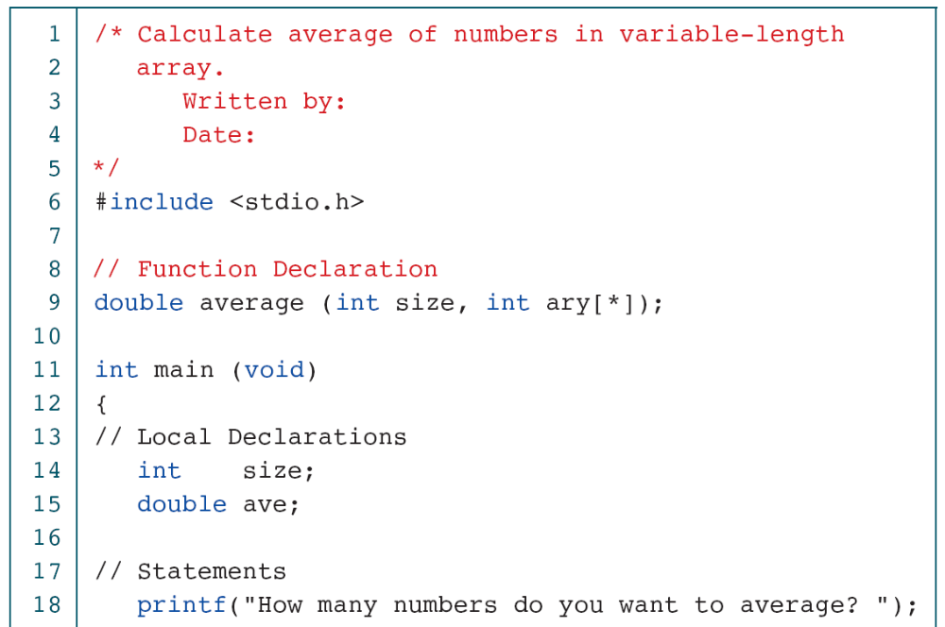
PROGRAM 8-5
Average Elements in Variable-length Array
Computer Science: A Structured Programming Approach Using C
Notes:
Don’t need *

Slide 18
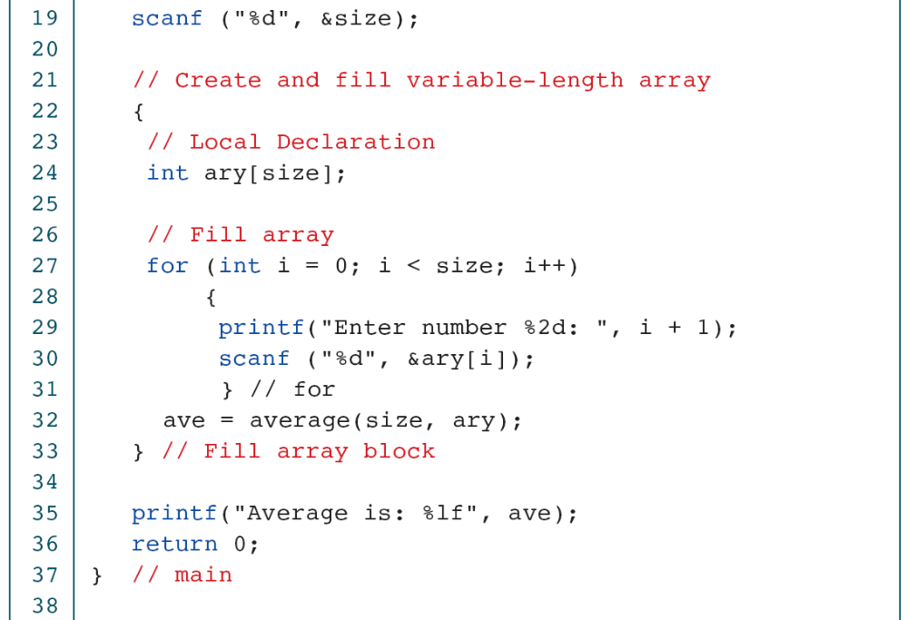
PROGRAM 8-5
Average Elements in Variable-length Array
Computer Science: A Structured Programming Approach Using C

Slide 19
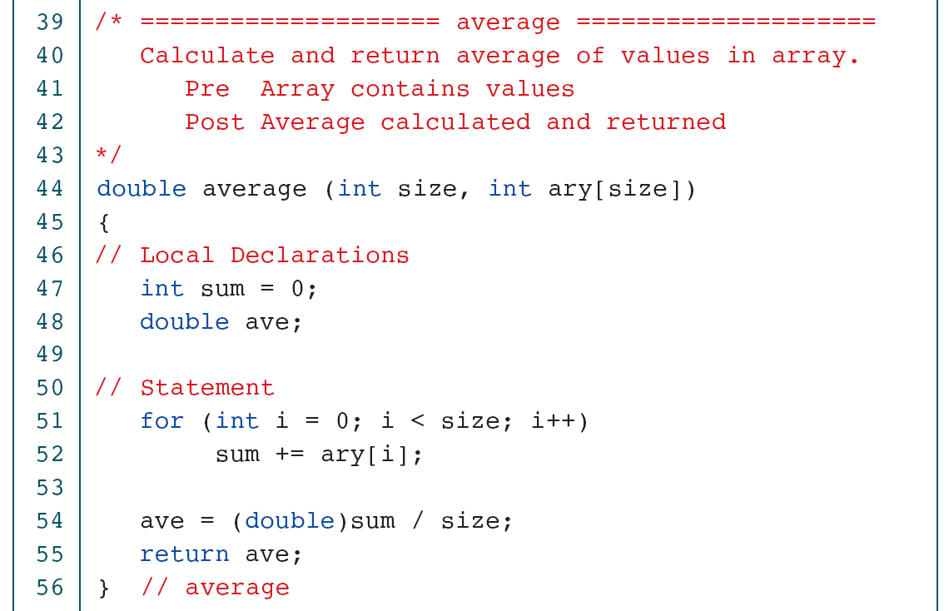
PROGRAM 8-5
Average Elements in Variable-length Array
Computer Science: A Structured Programming Approach Using C
Notes:
Don’t’ need size in parameter

Slide 20
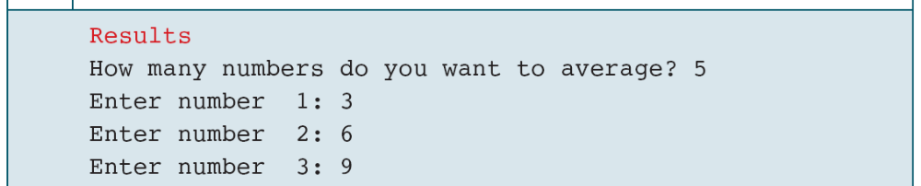
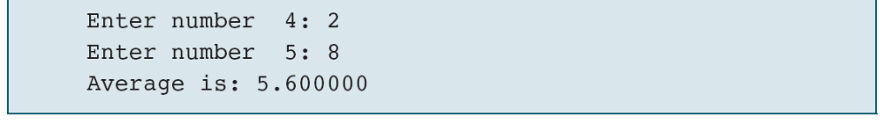
PROGRAM 8-5
Average Elements in Variable-length Array
Computer Science: A Structured Programming Approach Using C

Slide 21
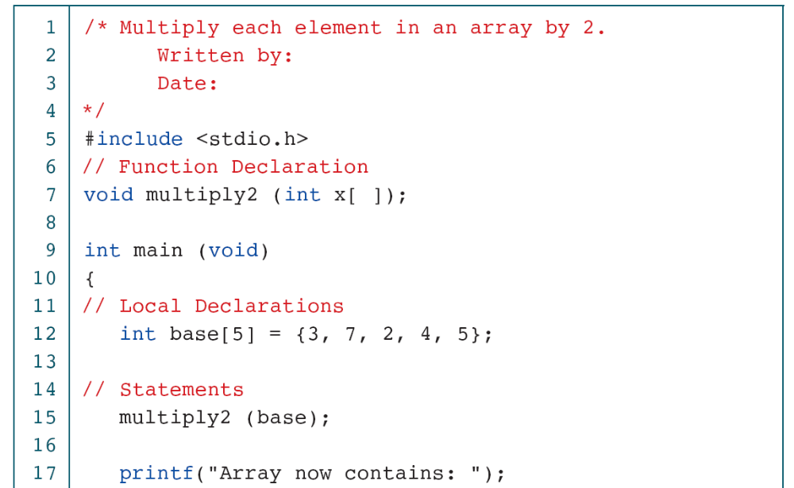
PROGRAM 8-6
Change Values in an Array
Computer Science: A Structured Programming Approach Using C

Slide 22
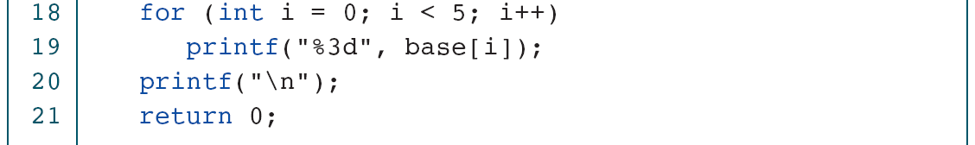
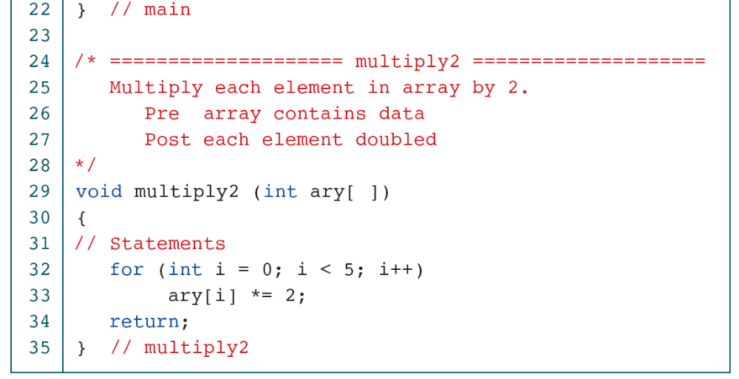
PROGRAM 8-6
Change Values in an Array
Computer Science: A Structured Programming Approach Using C

