Slide 1
11-2 C Strings
A C string is a variable-length array of characters that is delimited by the null character.
Topics discussed in this section:
Storing Strings
The String Delimiter
String Literals
Strings and Characters
Declaring Strings
Initializing Strings
Strings and the Assignment Operator
Reading and Writing Strings
Computer Science: A Structured Programming Approach Using C

Slide 2
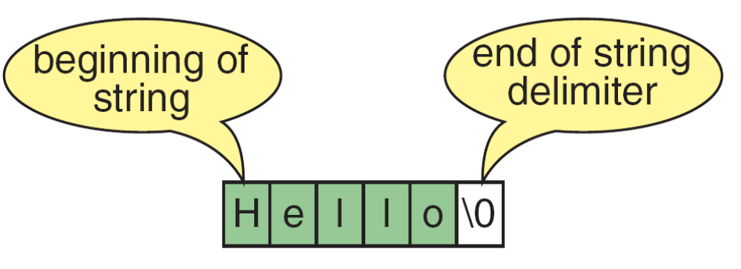
FIGURE 11-3 Storing Strings
Computer Science: A Structured Programming Approach Using C

Slide 3
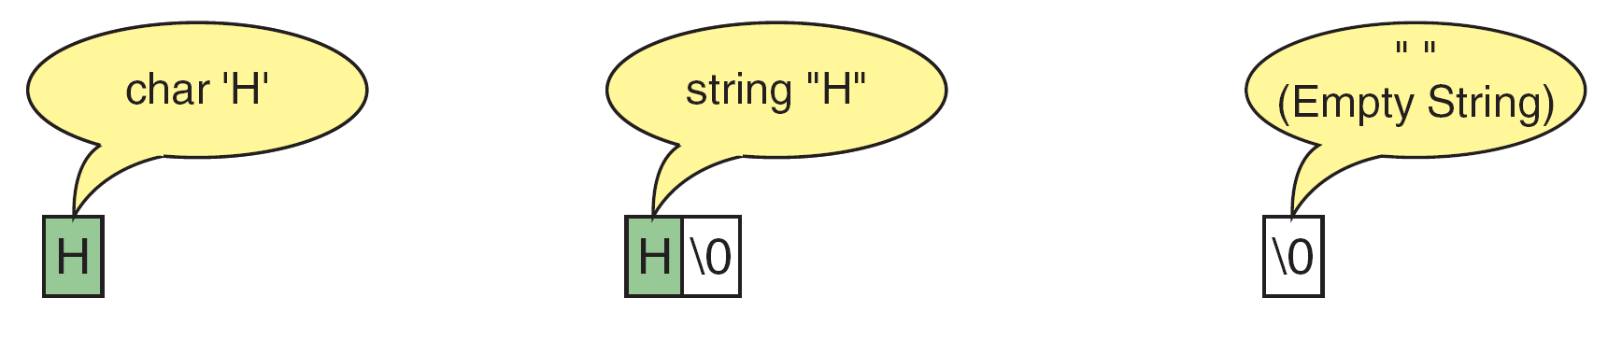
FIGURE 11-4 Storing Strings and Characters
Computer Science: A Structured Programming Approach Using C

Slide 4
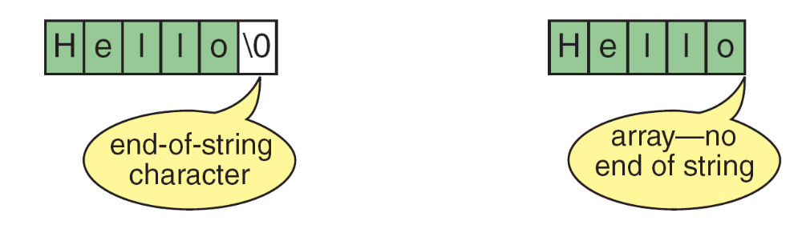
FIGURE 11-5 Differences Between Strings and Character Arrays
Computer Science: A Structured Programming Approach Using C

Slide 5
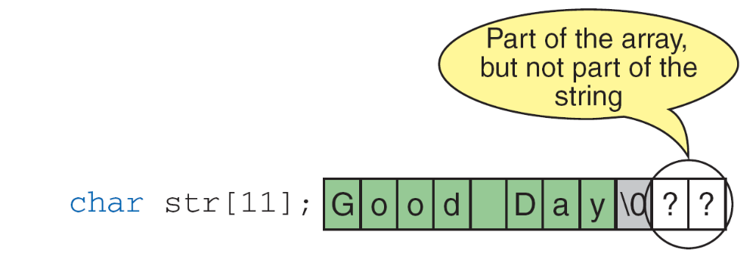
FIGURE 11-6 Strings in Arrays
Computer Science: A Structured Programming Approach Using C

Slide 6
Note
A string literal is enclosed in double quotes.
Computer Science: A Structured Programming Approach Using C

Slide 7
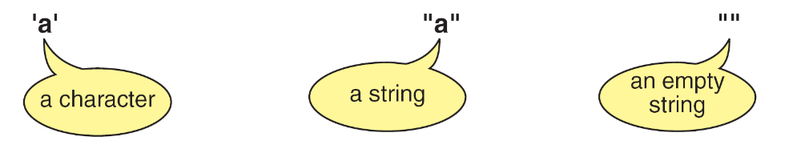
FIGURE 11-7 Character Literals and String Literals
Computer Science: A Structured Programming Approach Using C

Slide 8
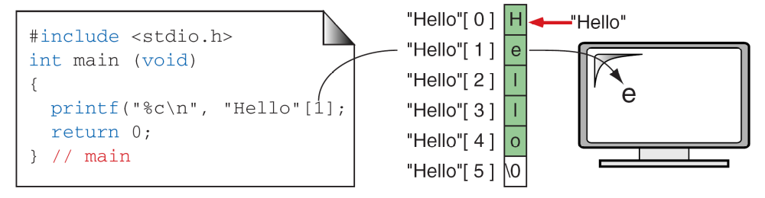
FIGURE 11-8 String Literal References
Computer Science: A Structured Programming Approach Using C

Slide 9
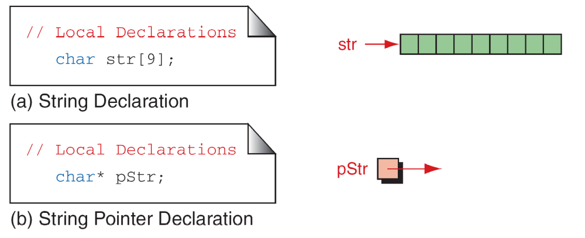
FIGURE 11-9 Defining Strings
Computer Science: A Structured Programming Approach Using C

Slide 10
Note
Memory for strings must be allocated before the
string can be used.
Computer Science: A Structured Programming Approach Using C

Slide 11
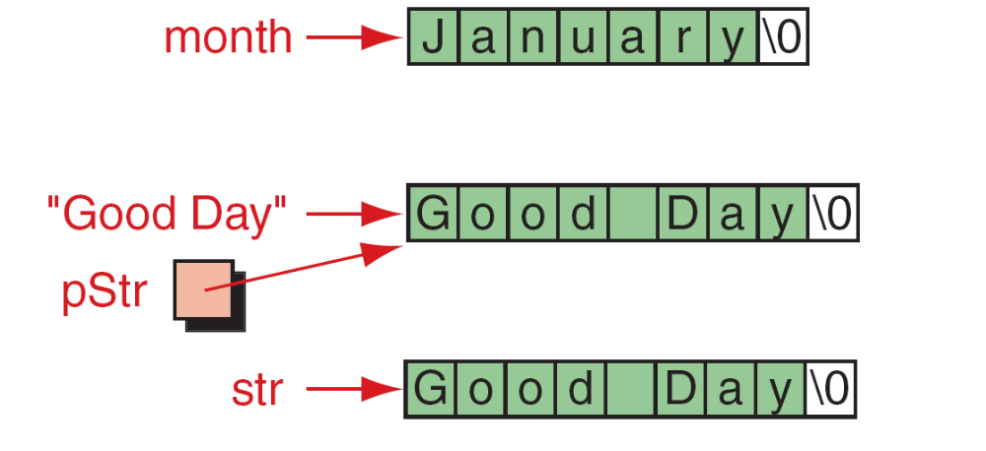
FIGURE 11-10 Initializing Strings
Computer Science: A Structured Programming Approach Using C

Slide 12
11-3 String Input/Output Functions
C provides two basic ways to read and write strings. First, we can read and write strings with the formatted input/output functions, scanf/fscanf and printf/fprintf. Second, we can use a special set of string-only functions, get string (gets/fgets) and put string ( puts/fputs ).
Topics discussed in this section:
Formatted String Input/Output
String Input/Output
Computer Science: A Structured Programming Approach Using C

Slide 13
Note
The string conversion code(s) skips whitespace.
Computer Science: A Structured Programming Approach Using C

Slide 14
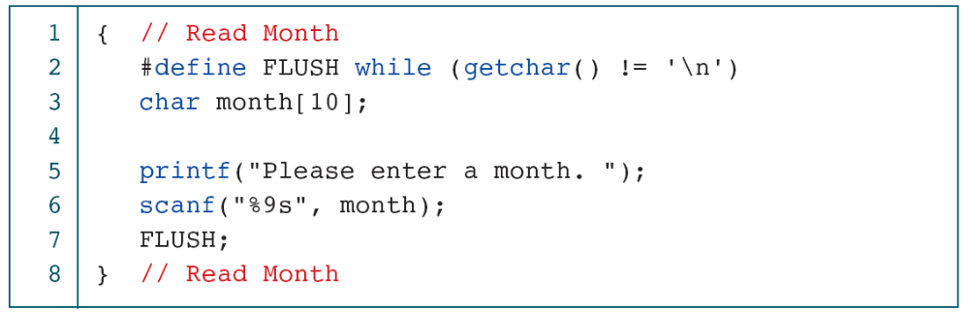
PROGRAM 11-1
Reading Strings
Computer Science: A Structured Programming Approach Using C

Slide 15
Note
Always use a width in the field specification
when reading strings.
Computer Science: A Structured Programming Approach Using C

Slide 16
Note
The maximum number of characters to be printed
is specified by the precision in the format
string of the field specification.
Computer Science: A Structured Programming Approach Using C

Slide 17
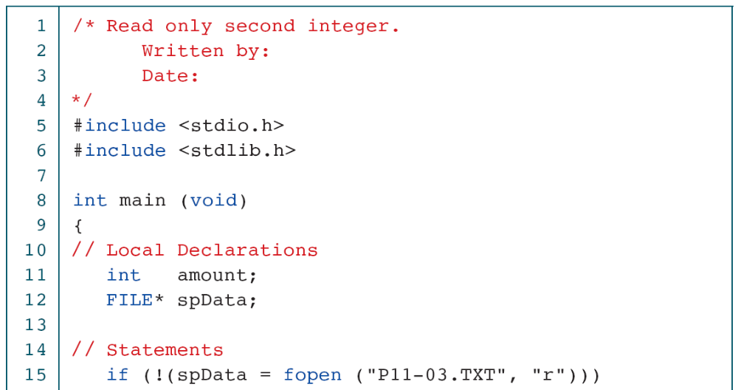
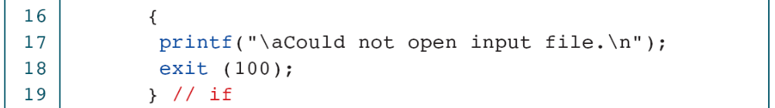
PROGRAM 11-2
Demonstrate String Scan Set
Computer Science: A Structured Programming Approach Using C

Slide 18
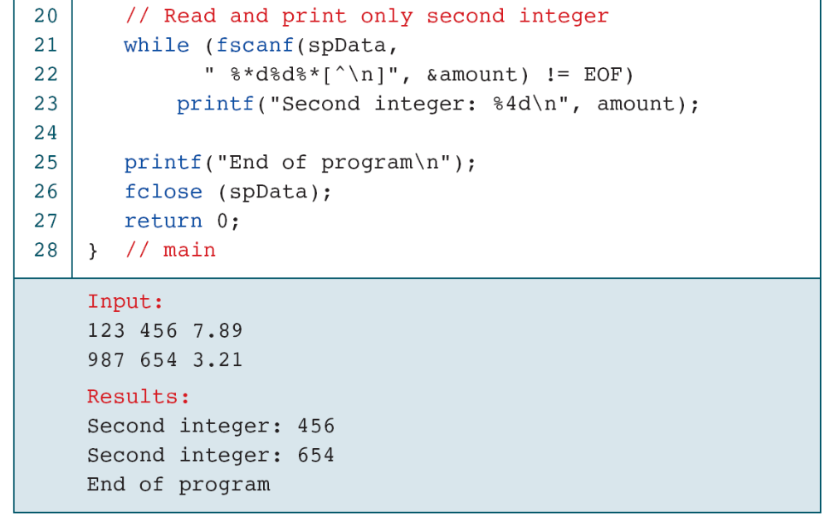
PROGRAM 11-2
Demonstrate String Scan Set
Computer Science: A Structured Programming Approach Using C

Slide 19
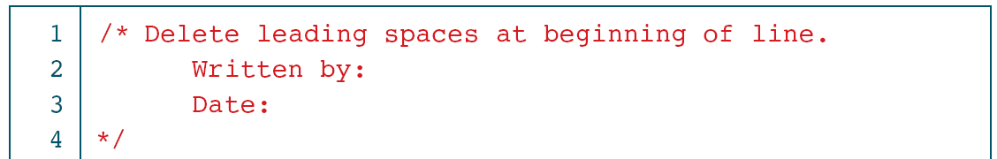
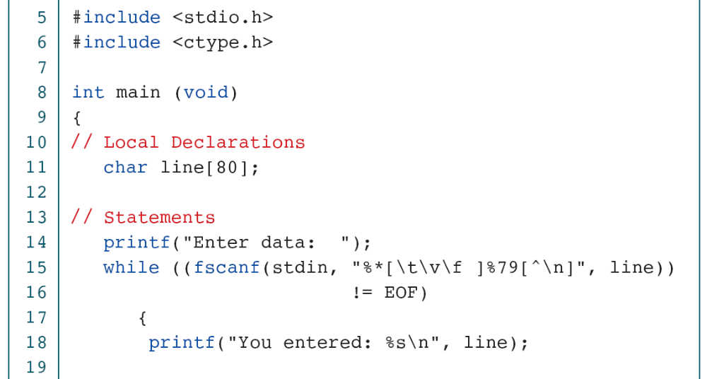
PROGRAM 11-3
Delete Leading Whitespace
Computer Science: A Structured Programming Approach Using C

Slide 20
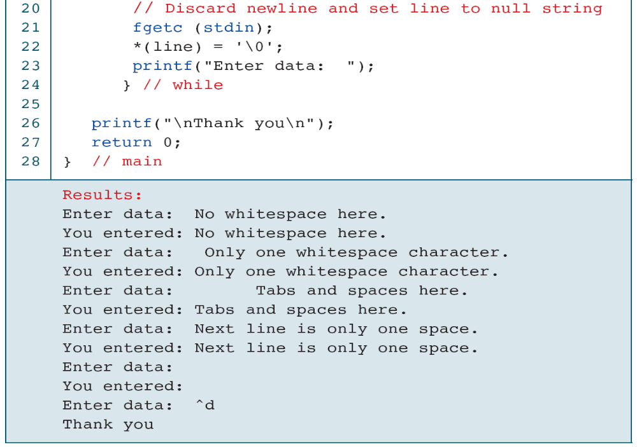
PROGRAM 11-3
Delete Leading Whitespace
Computer Science: A Structured Programming Approach Using C

Slide 21
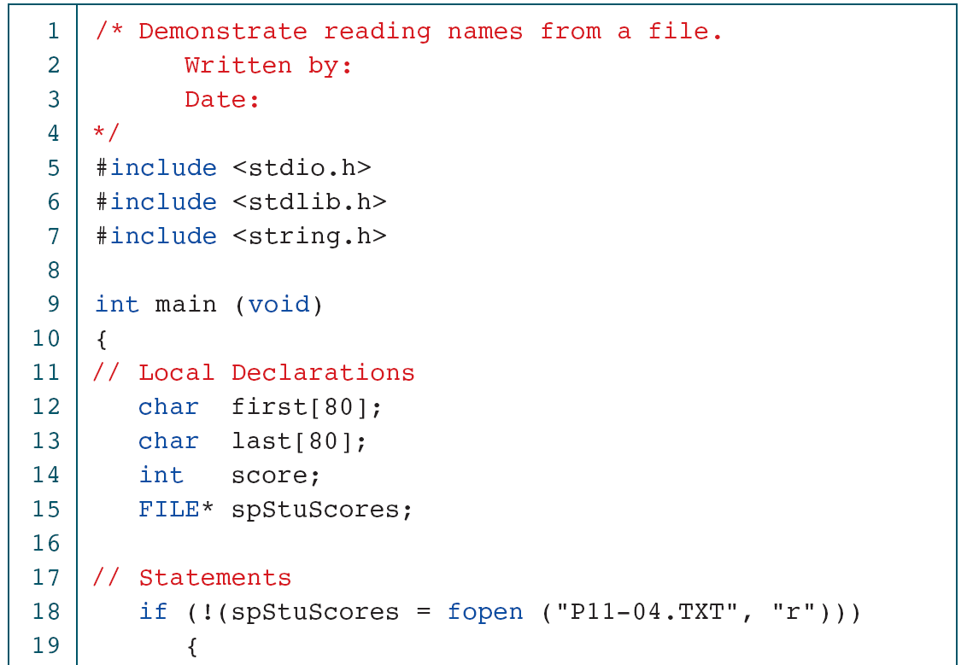
PROGRAM 11-4
Read Student Names and Scores
Computer Science: A Structured Programming Approach Using C

Slide 22
PROGRAM 11-4
Read Student Names and Scores
Computer Science: A Structured Programming Approach Using C

Slide 23
FIGURE 11-11 gets and fgets Functions
Computer Science: A Structured Programming Approach Using C

Slide 24
PROGRAM 11-5
Demonstrate fgets Operation
Computer Science: A Structured Programming Approach Using C

Slide 25
PROGRAM 11-5
Demonstrate fgets Operation
Computer Science: A Structured Programming Approach Using C

Slide 26
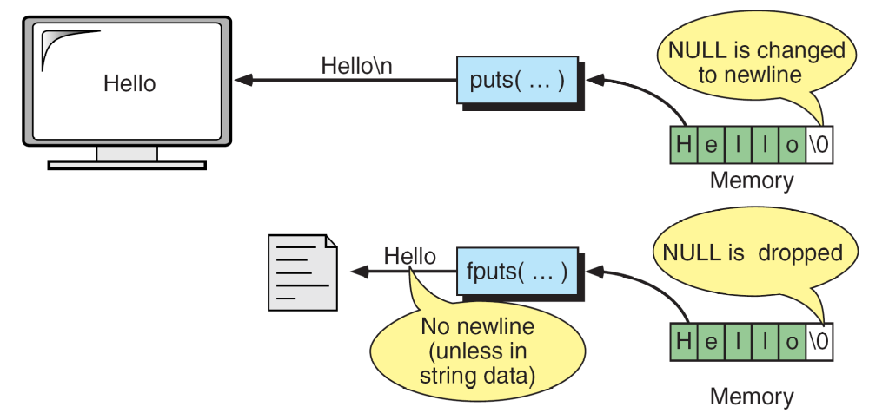
FIGURE 11-12 puts and fputs Operations
Computer Science: A Structured Programming Approach Using C

Slide 27
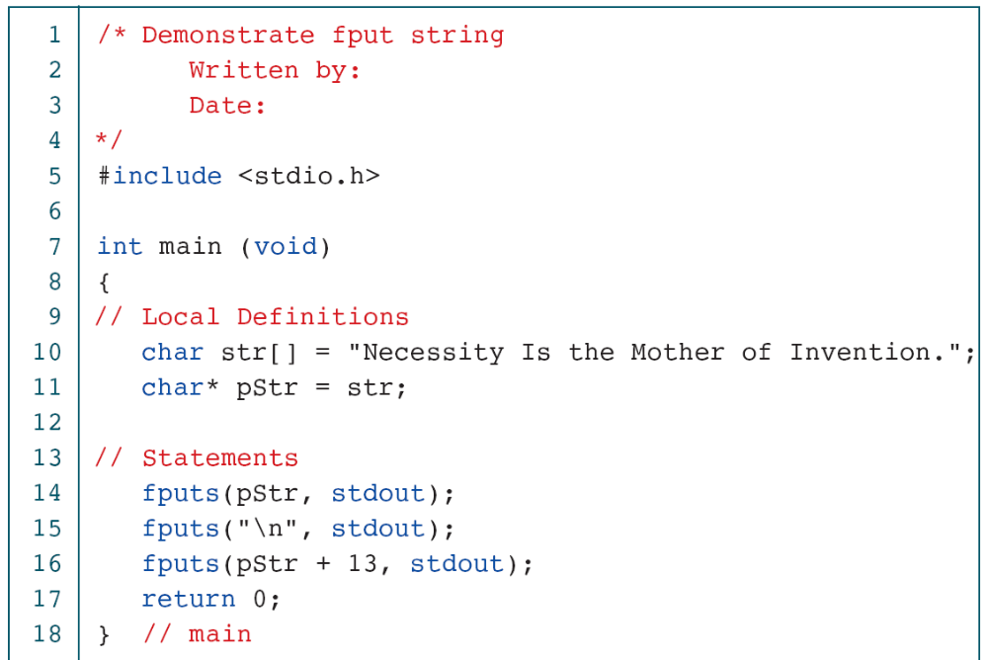
PROGRAM 11-6
Demonstration of Put String
Computer Science: A Structured Programming Approach Using C

Slide 28
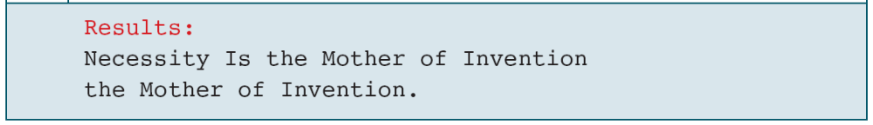
PROGRAM 11-6
Demonstration of Put String
Computer Science: A Structured Programming Approach Using C

Slide 29
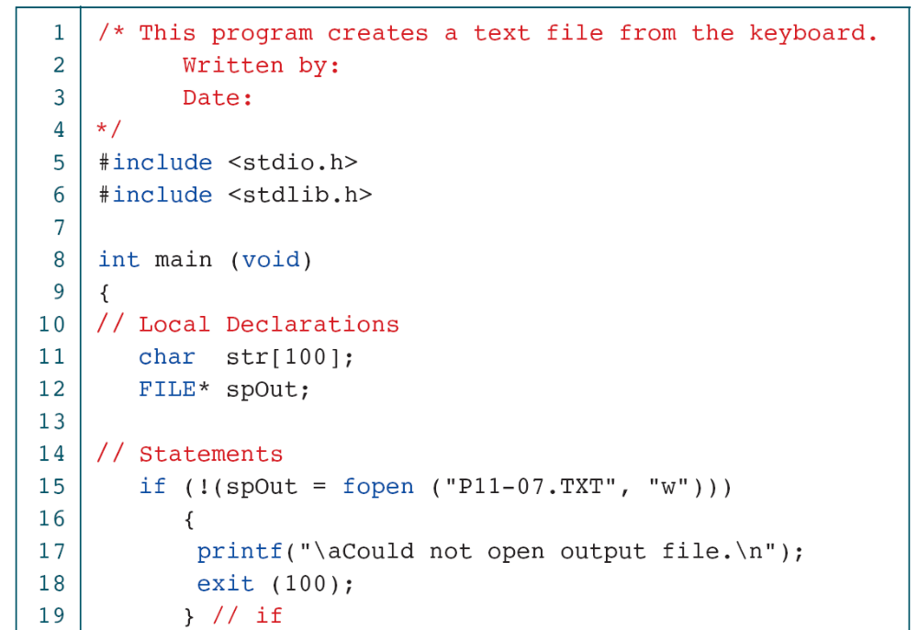
PROGRAM 11-7
Typewriter Program
Computer Science: A Structured Programming Approach Using C

Slide 30
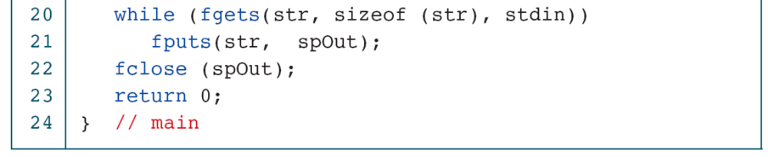
PROGRAM 11-7
Typewriter Program
Computer Science: A Structured Programming Approach Using C

Slide 31
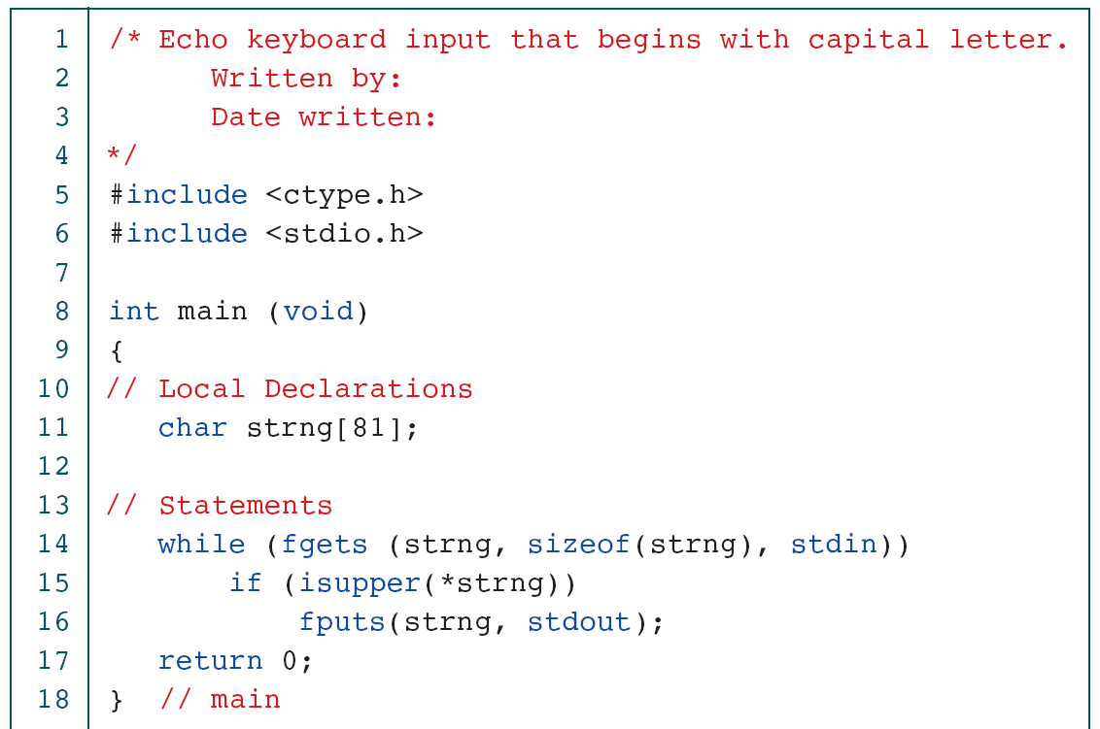
PROGRAM 11-8
Print Selected Sentences
Computer Science: A Structured Programming Approach Using C

Slide 32
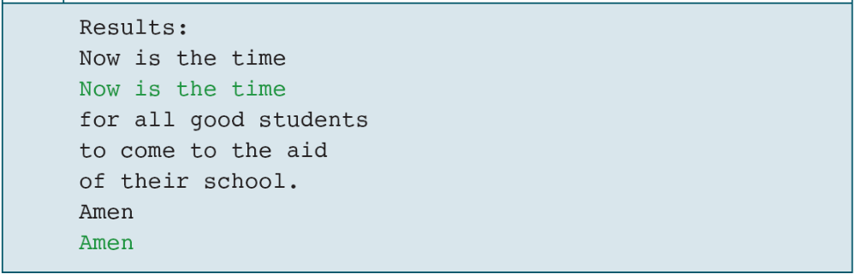
PROGRAM 11-8
Print Selected Sentences
Computer Science: A Structured Programming Approach Using C

Slide 33
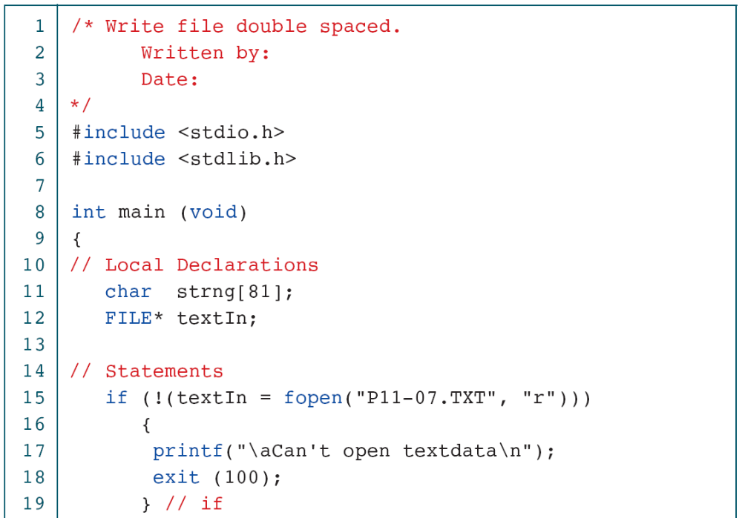
PROGRAM 11-9
Print File Double spaced
Computer Science: A Structured Programming Approach Using C

Slide 34
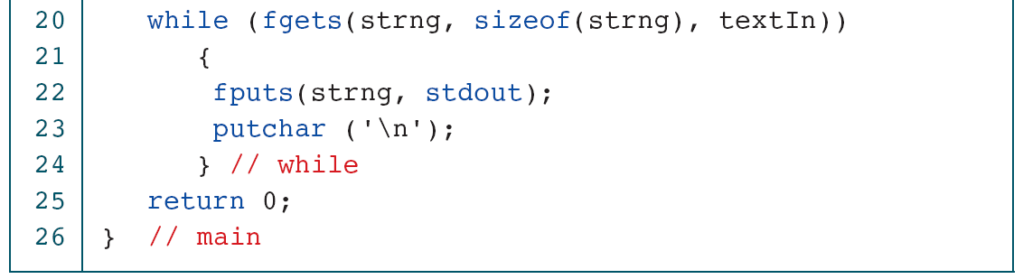
PROGRAM 11-9
Print File Double spaced
Computer Science: A Structured Programming Approach Using C

Slide 35
11-4 Arrays of Strings
When we discussed arrays of pointers in Chapter 10, we introduced the concept of a ragged array. Ragged arrays are very common with strings. Consider, for example, the need to store the days of the week in their textual format. We could create a two-dimensional array of seven days by ten characters, but this wastes space.
Computer Science: A Structured Programming Approach Using C

Slide 36
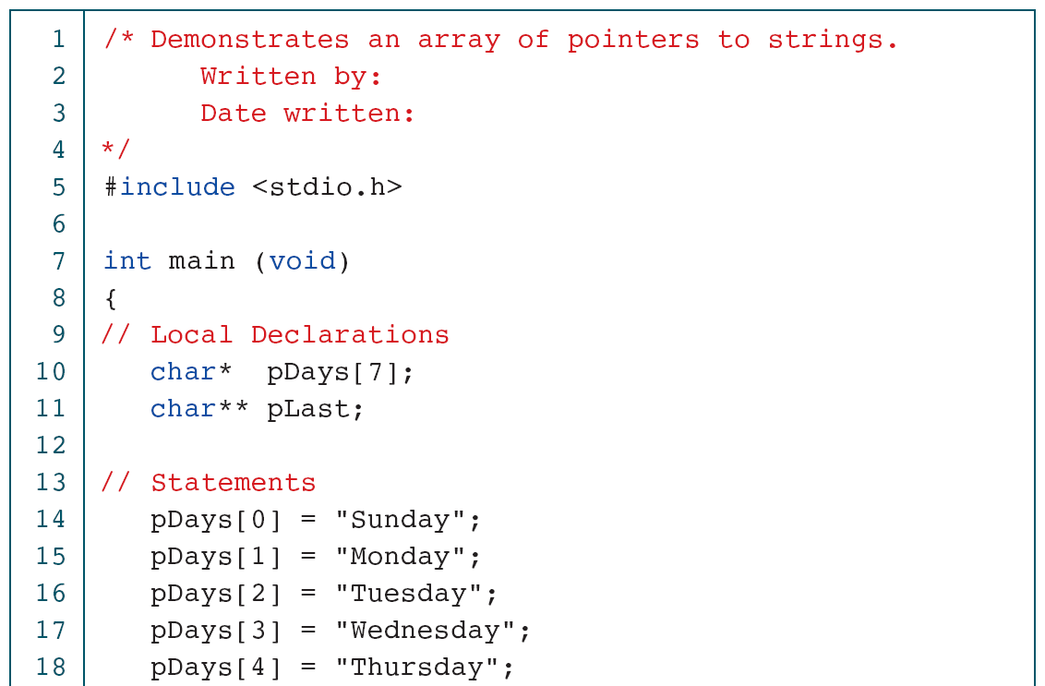
PROGRAM 11-10
Print Days of the Week
Computer Science: A Structured Programming Approach Using C

Slide 37
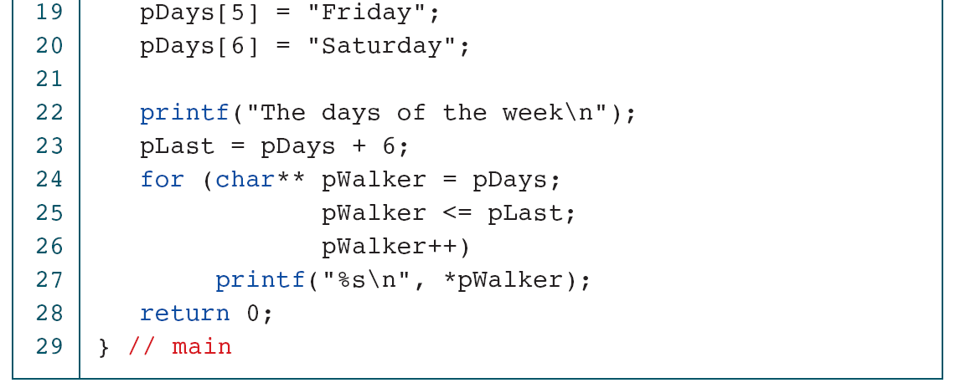
PROGRAM 11-10
Print Days of the Week
Computer Science: A Structured Programming Approach Using C

Slide 38
FIGURE 11-13 Pointers to Strings
Computer Science: A Structured Programming Approach Using C

