Slide 1
NOMA S-16 Presentation
Vidit Vaywala (AU1841128)
Varshil Shah (AU1841095)
Hemil Shah (AU1841135)
Kahaan Patel (AU1841110)

Slide 2
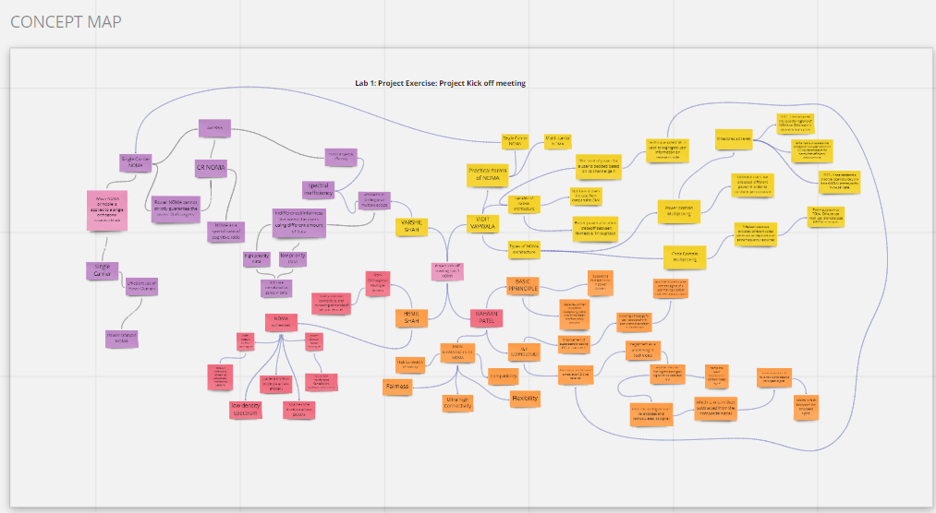

Slide 3
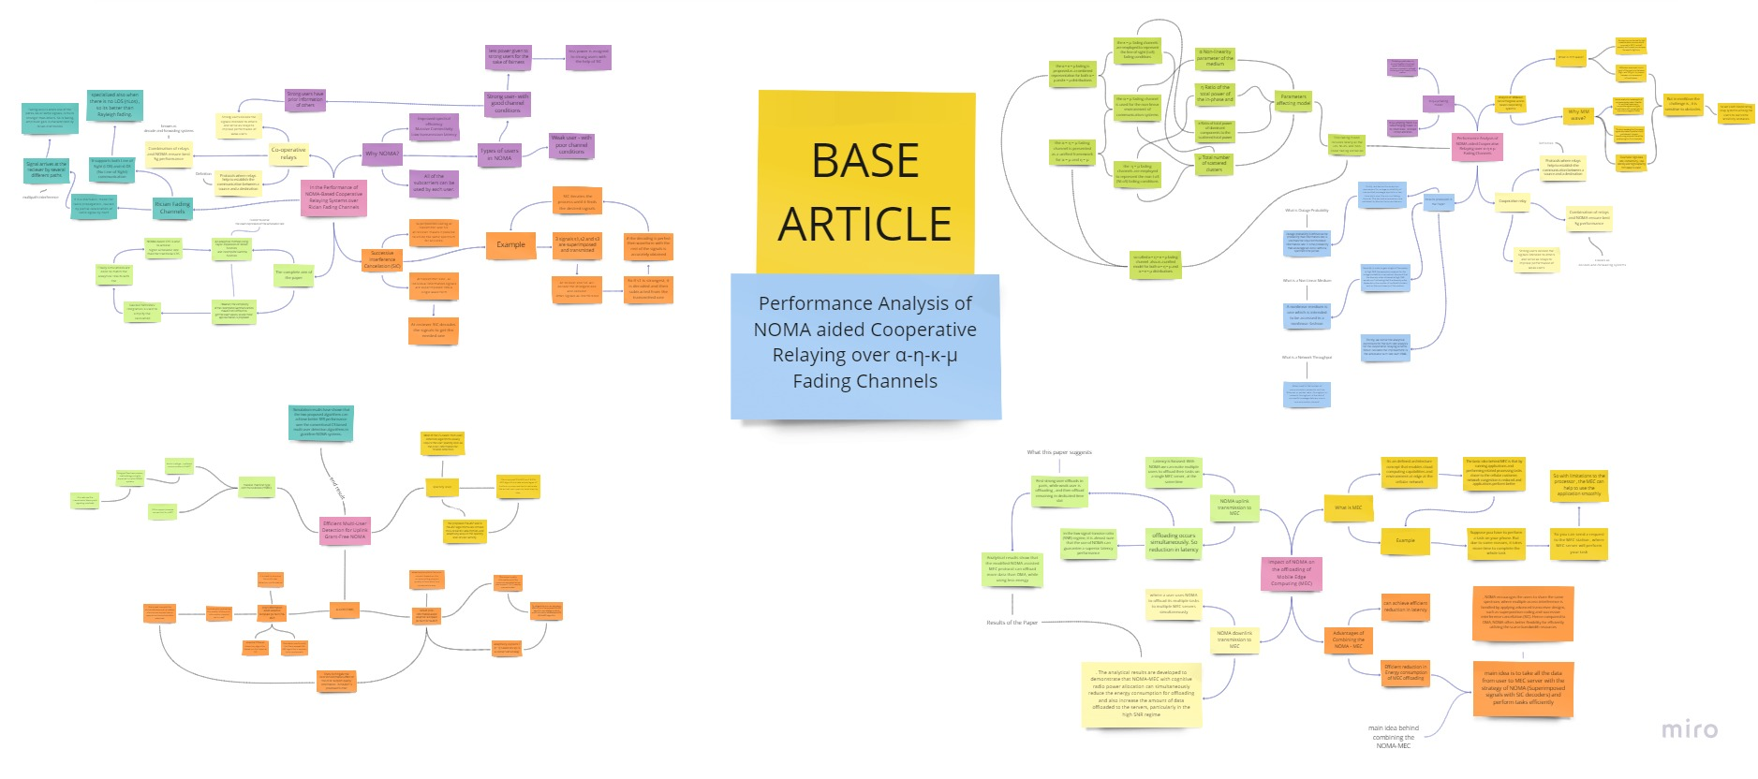

Slide 4
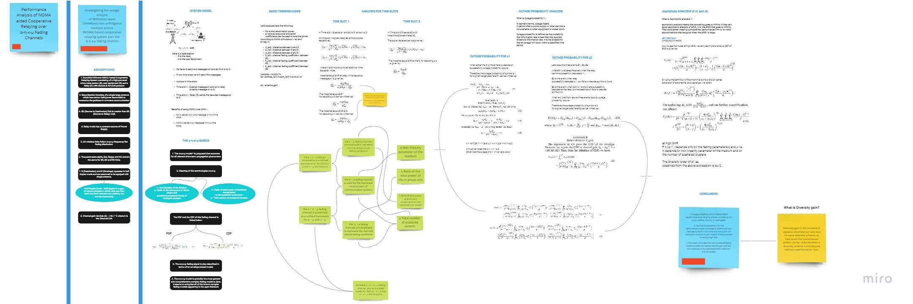

Slide 5
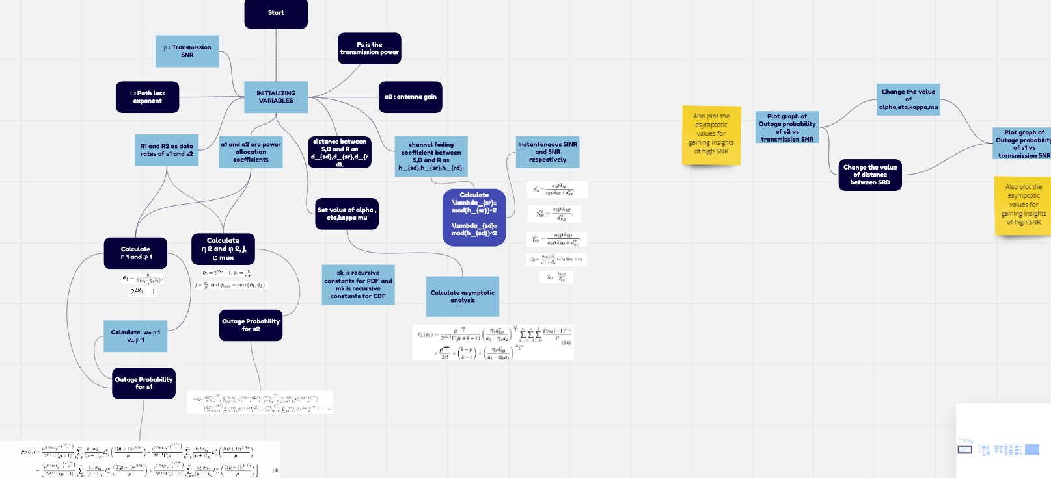

Slide 6
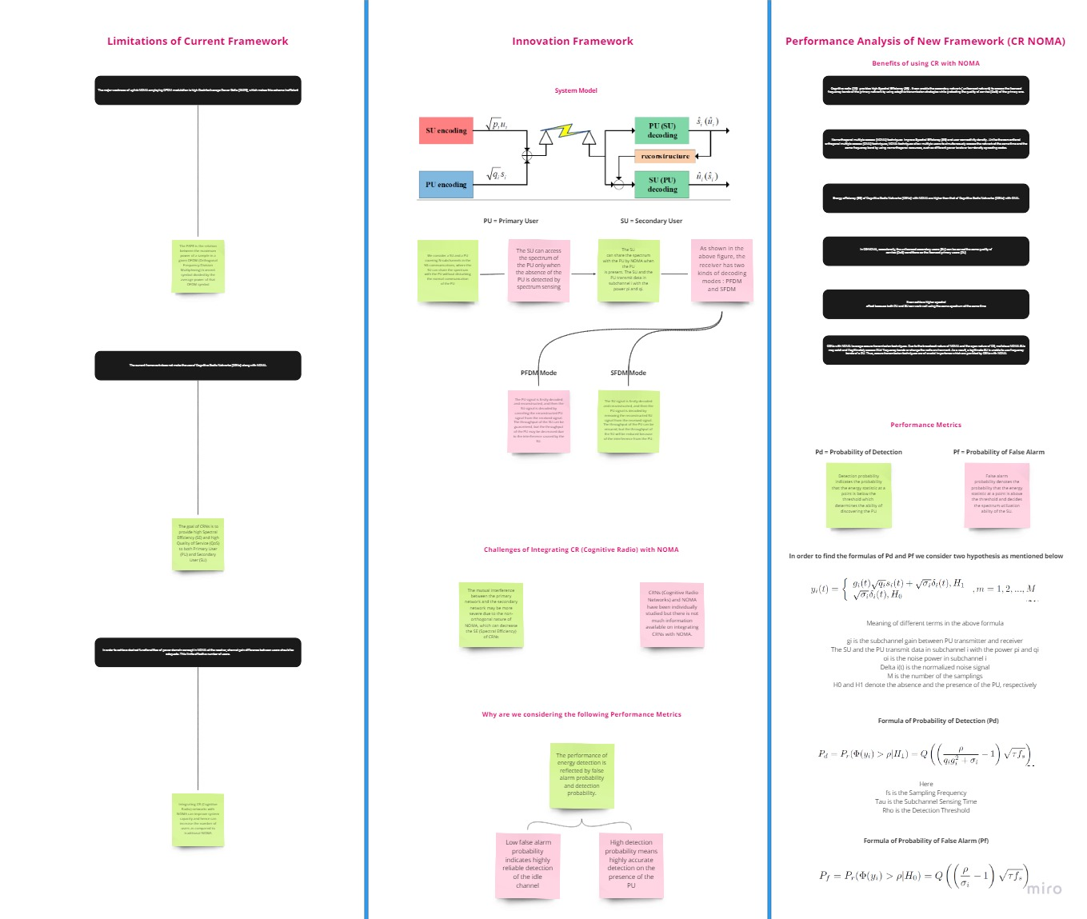

Slide 7
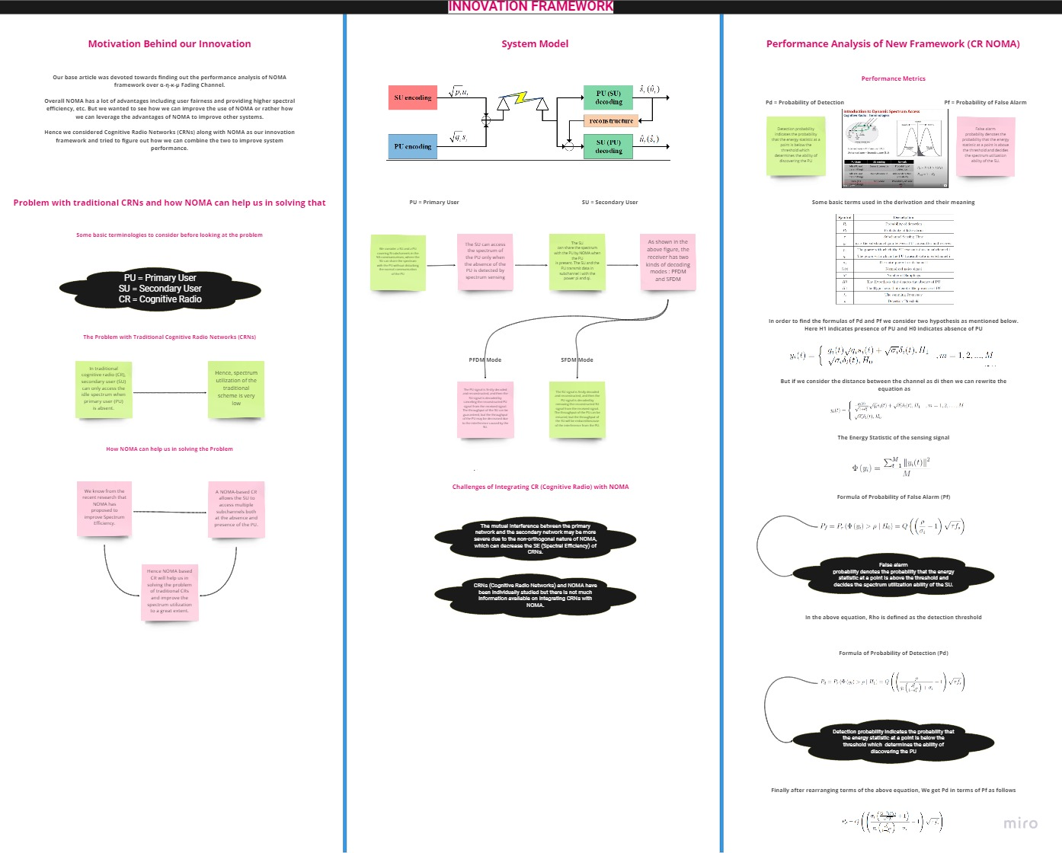
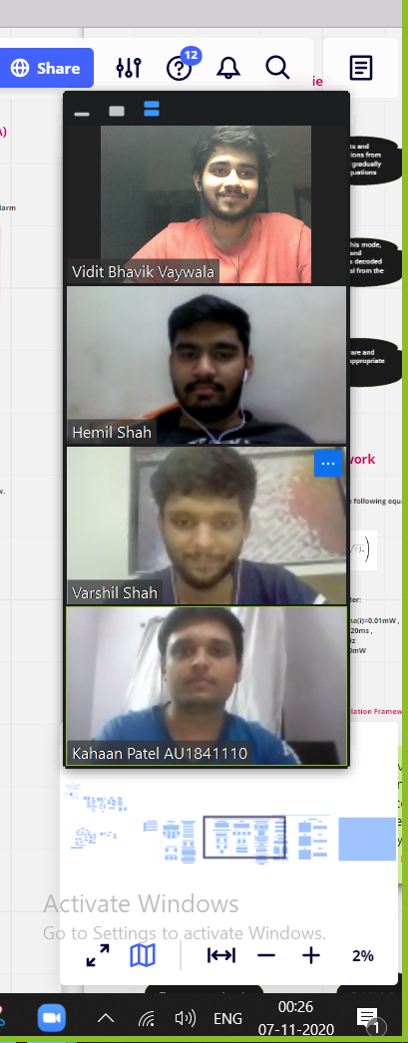

Slide 8
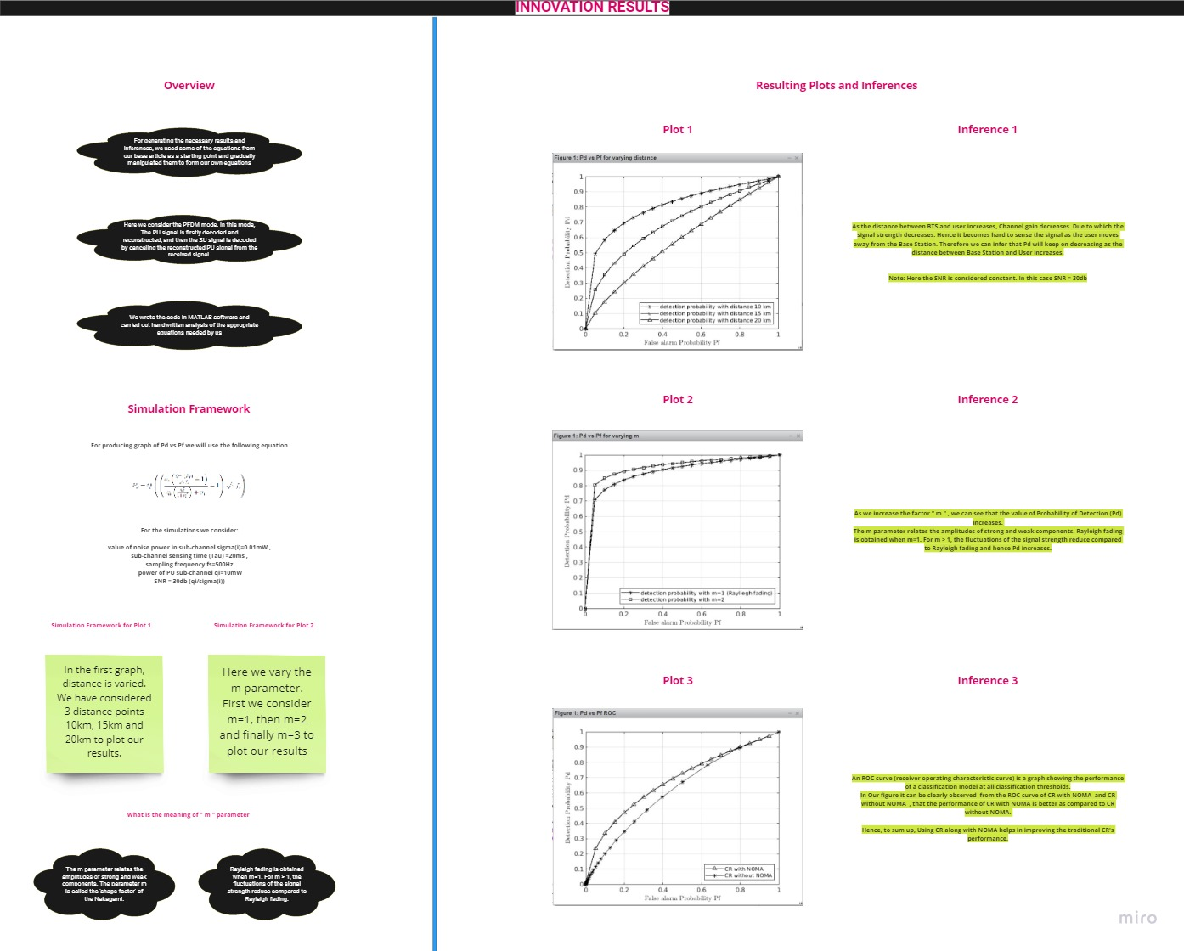

Slide 9


