Slide 2


Slide 3
High level

Slide 4
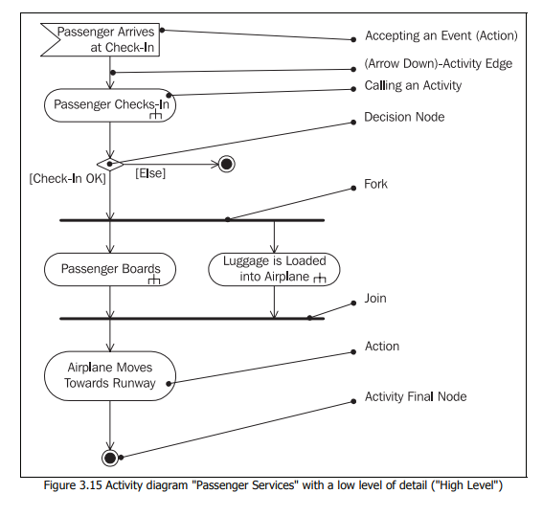

Slide 5
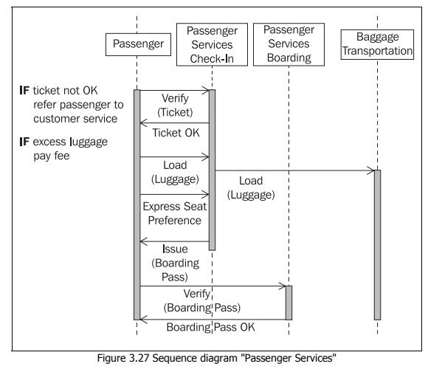

Slide 6
Detailed

Slide 7
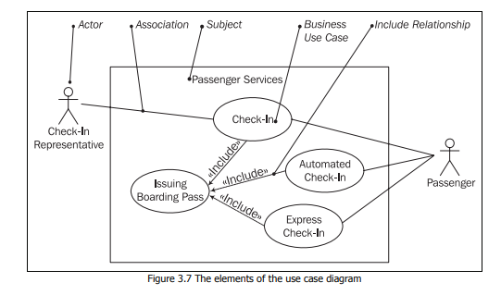

Slide 8
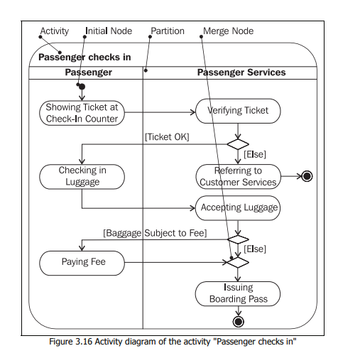

Slide 9
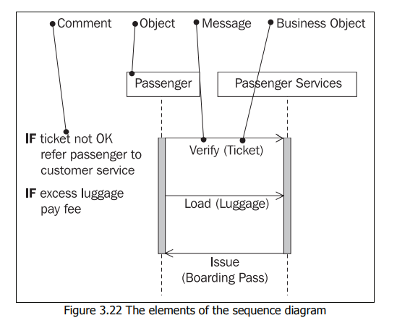

Slide 10
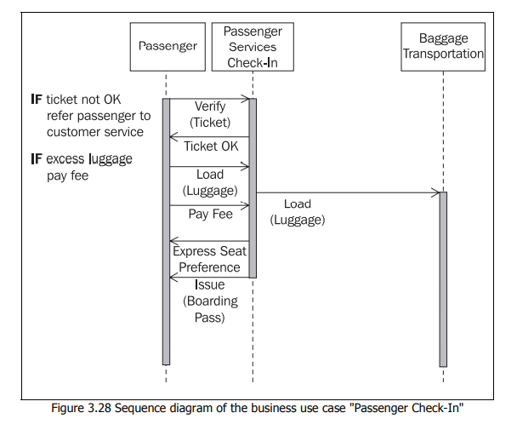

Slide 11
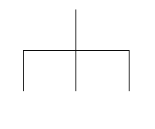
IF
Repeat

Slide 12
MSG(OBJECT)
WHILE
SYSYEM
REPEAT

Slide 13
MSG(OBJECT)
BUSINESS SYSTEM
USER
SYSTEM
IT SYSTEM

Slide 14





