Slide 1
What I will be explaining:
Project structure, agents, and behaviours Used
Detailed explanation of implemented requirements

Slide 2
Behaviours
Simple Behavior
OneShot Behavior
Cyclic Behavior
Ticker Behavior

Slide 3
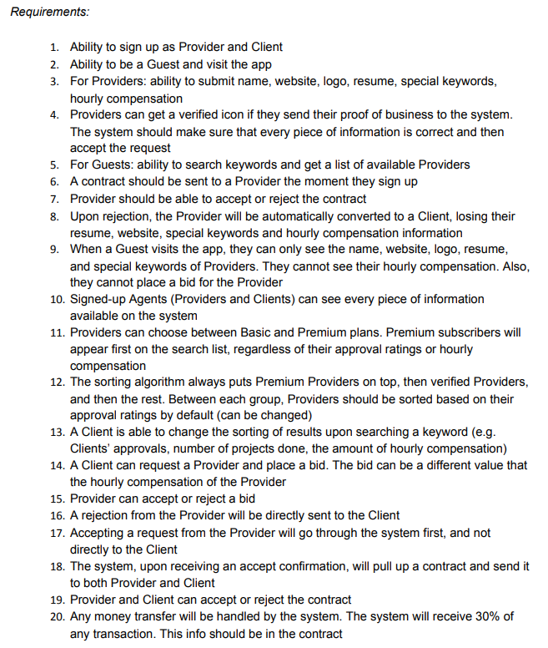
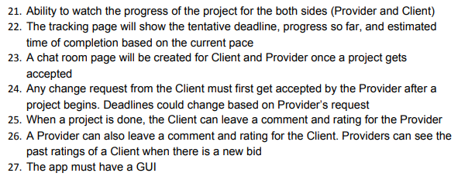

Slide 4

Sign Up
Enters Info
User Model
User
UI Agent
Profile Agent
User ID

Slide 5


Slide 7
Thank You For Watching

