Slide 1
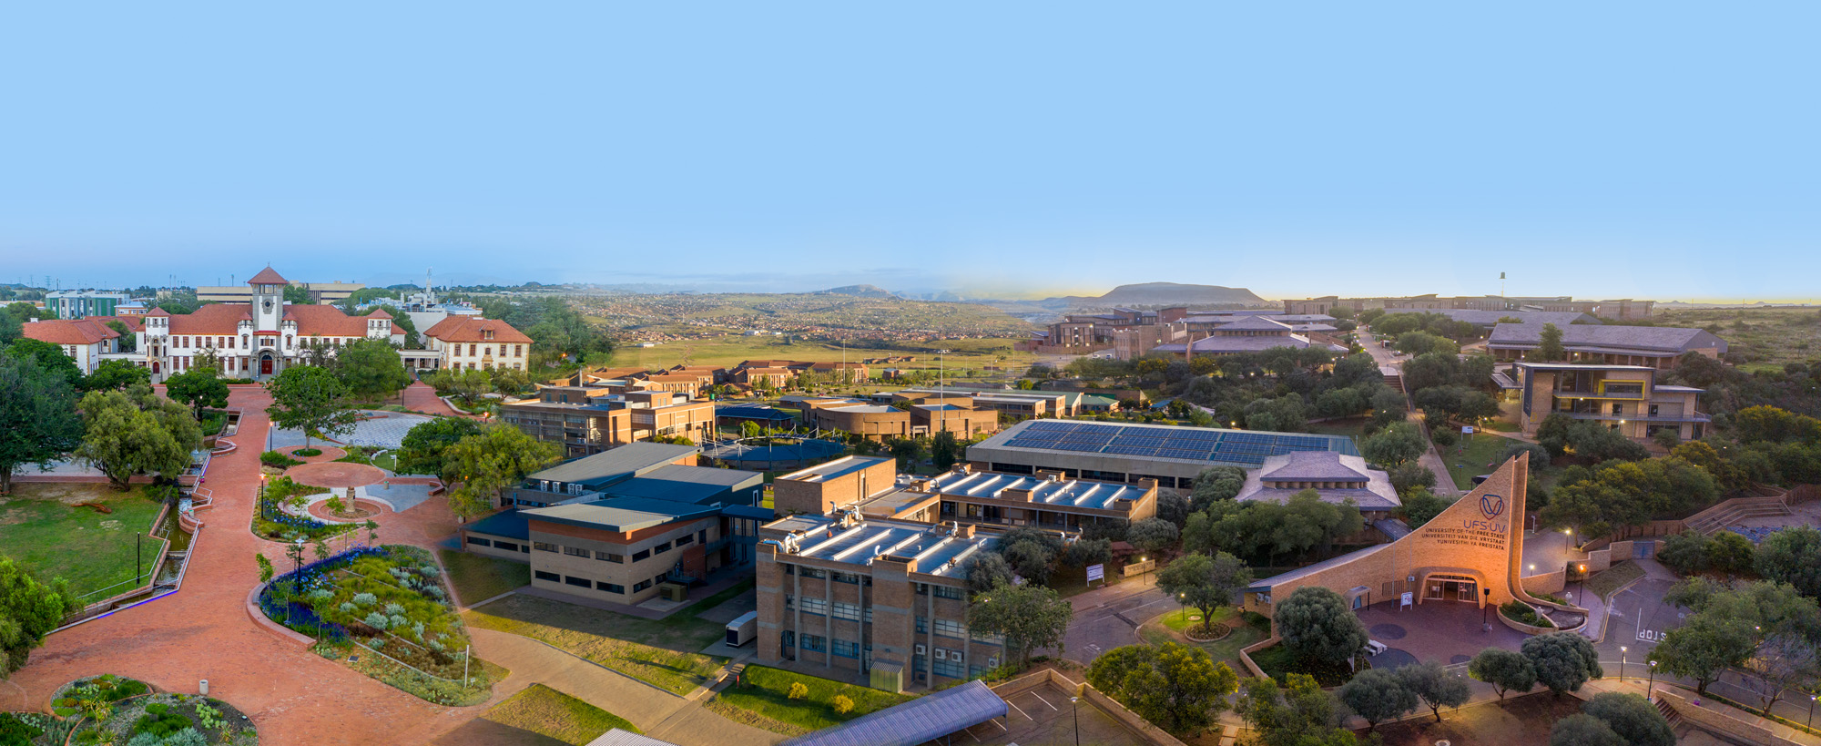



Click here to edit title
www.ufs.ac.za

Slide 2

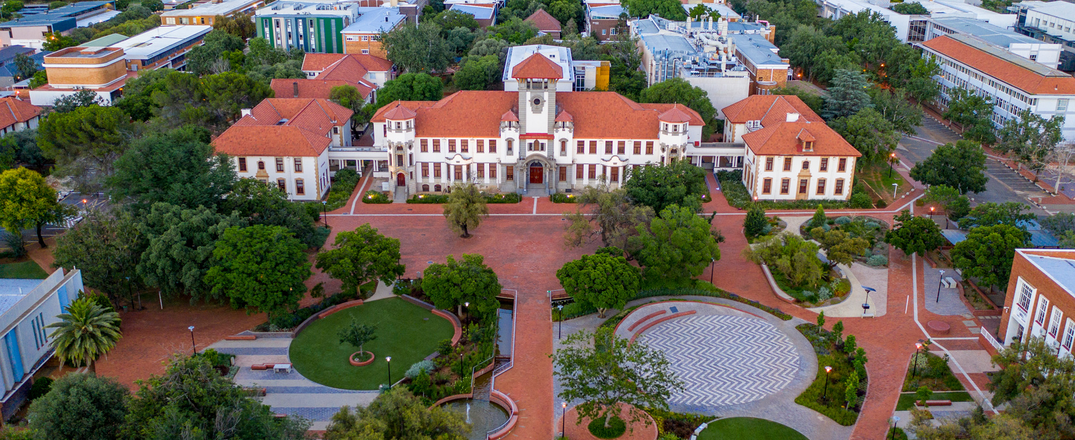
Click here to edit title
www.ufs.ac.za

Slide 3
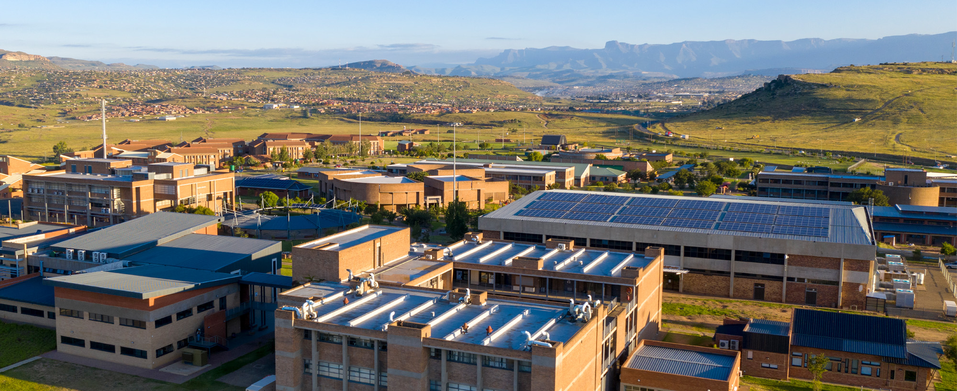
Click here to edit title
www.ufs.ac.za

Slide 4
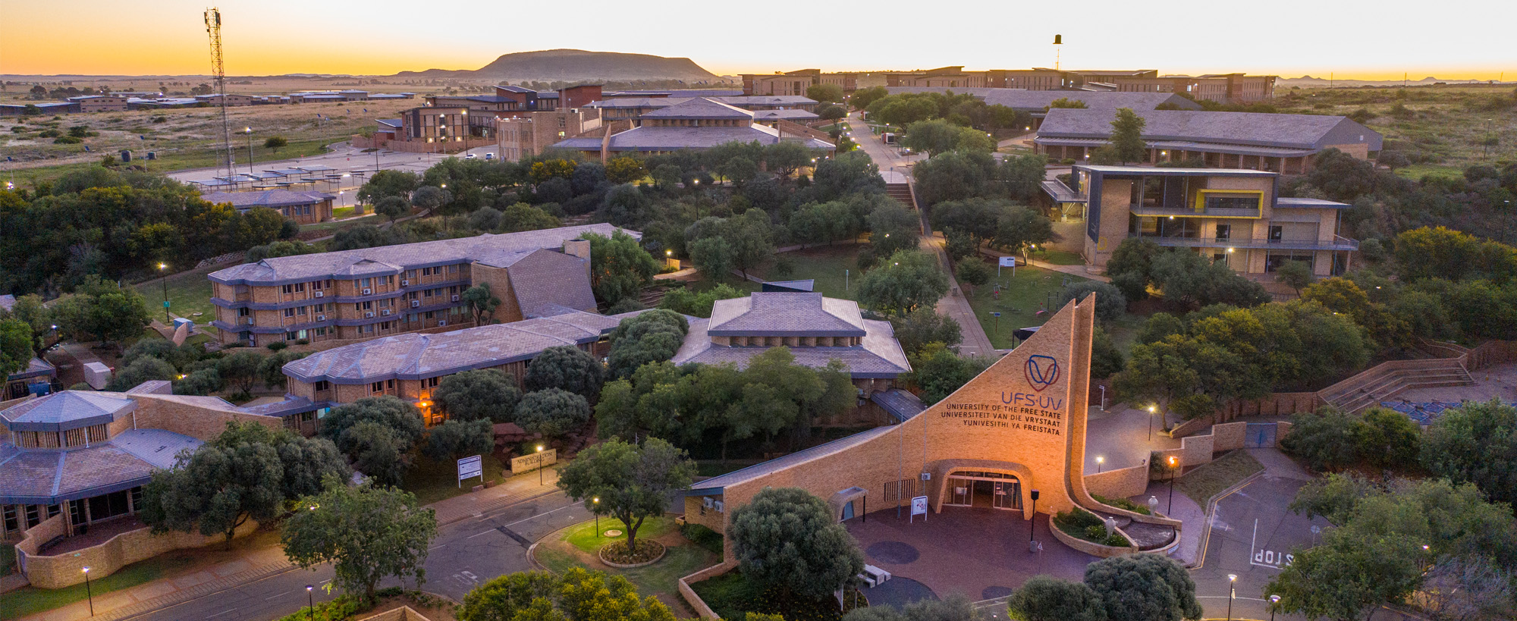
Click here to edit title
www.ufs.ac.za

