Slide 1

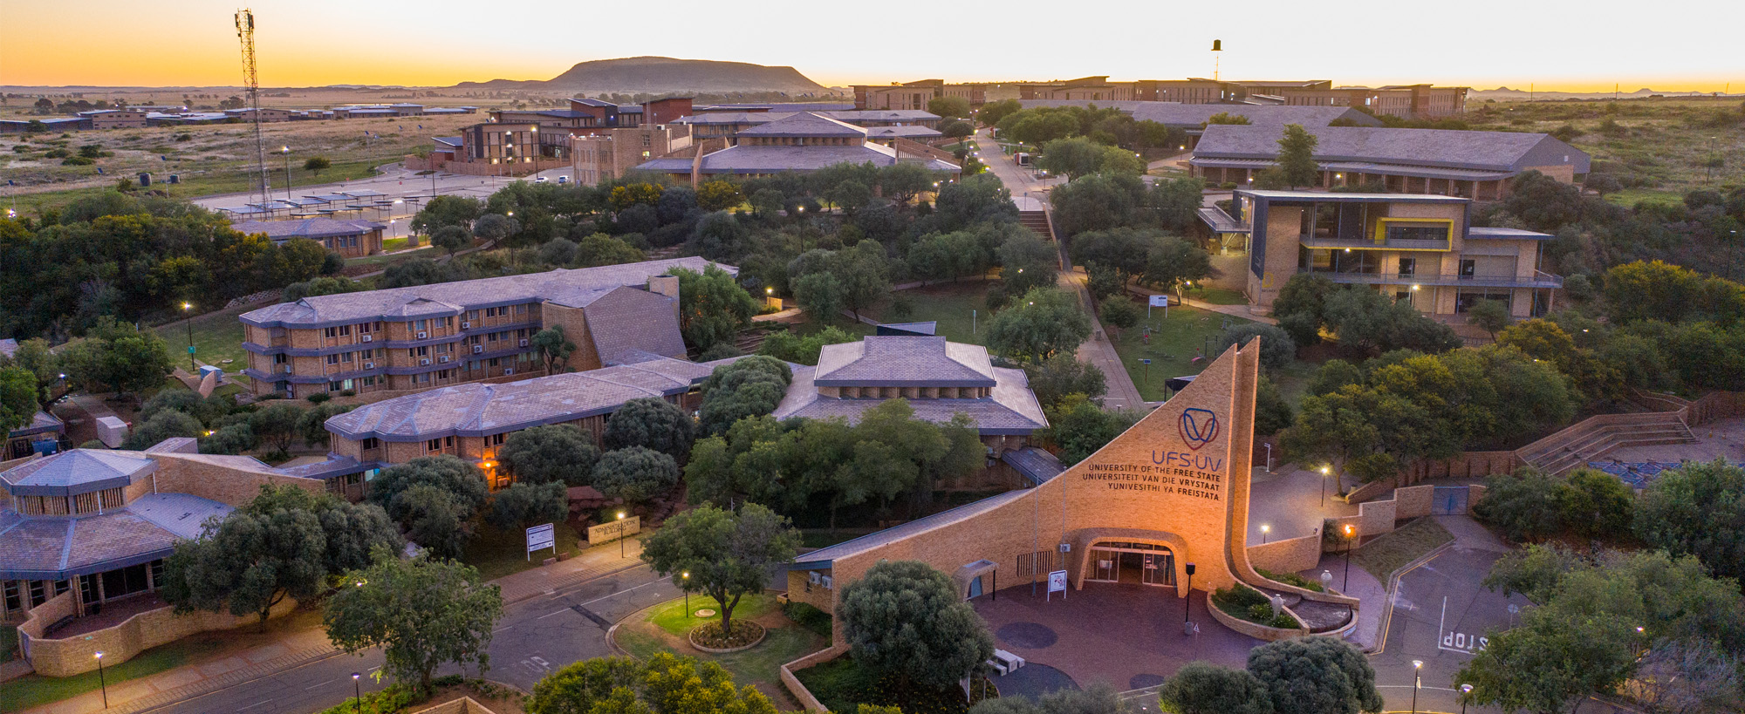


From Crisis to Capability: Building AI That Works Where It Matters Most for Learning
Moeketsi Mosia
A/Prof and ETDP-SETA Research Chair in Mathematics Education,
Vice-Dean: T&L
www.ufs.ac.za

Slide 2
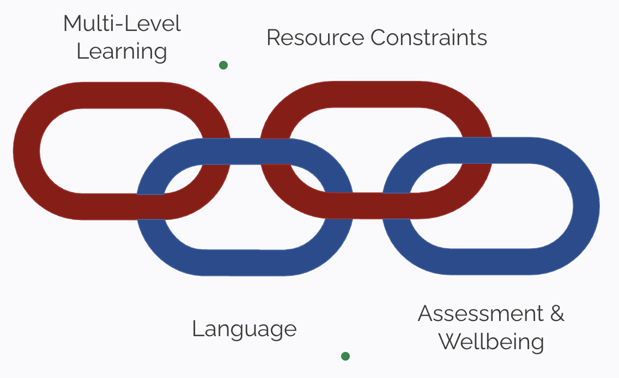
Key Challenges in South African Mathematics Education

Slide 3
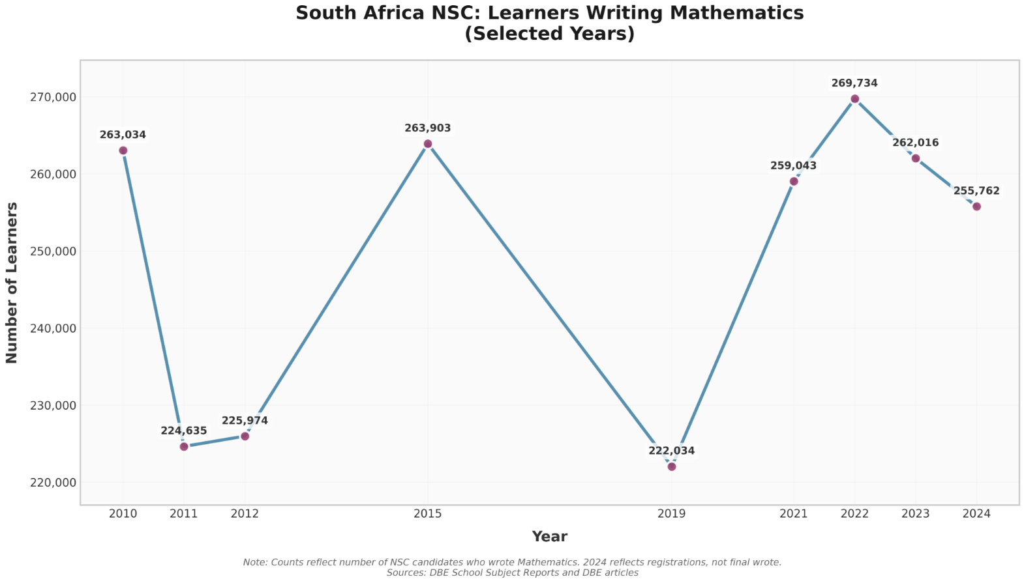
Effects on Enrollment

Slide 4
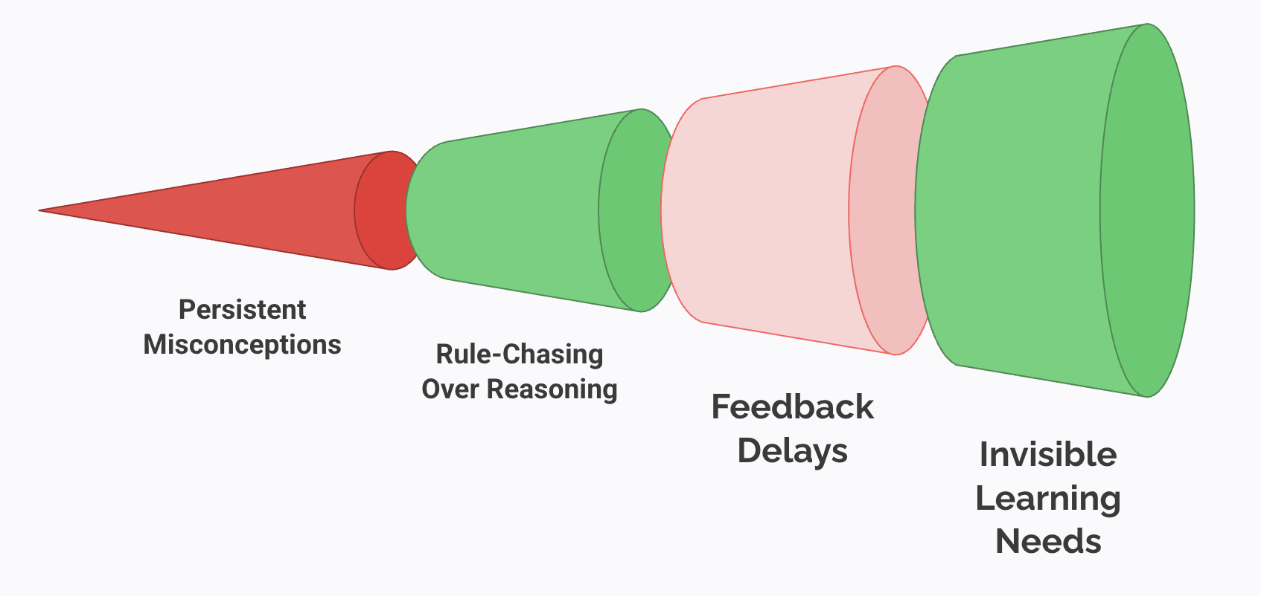
Classroom Pain Points We Can Fix

Slide 5
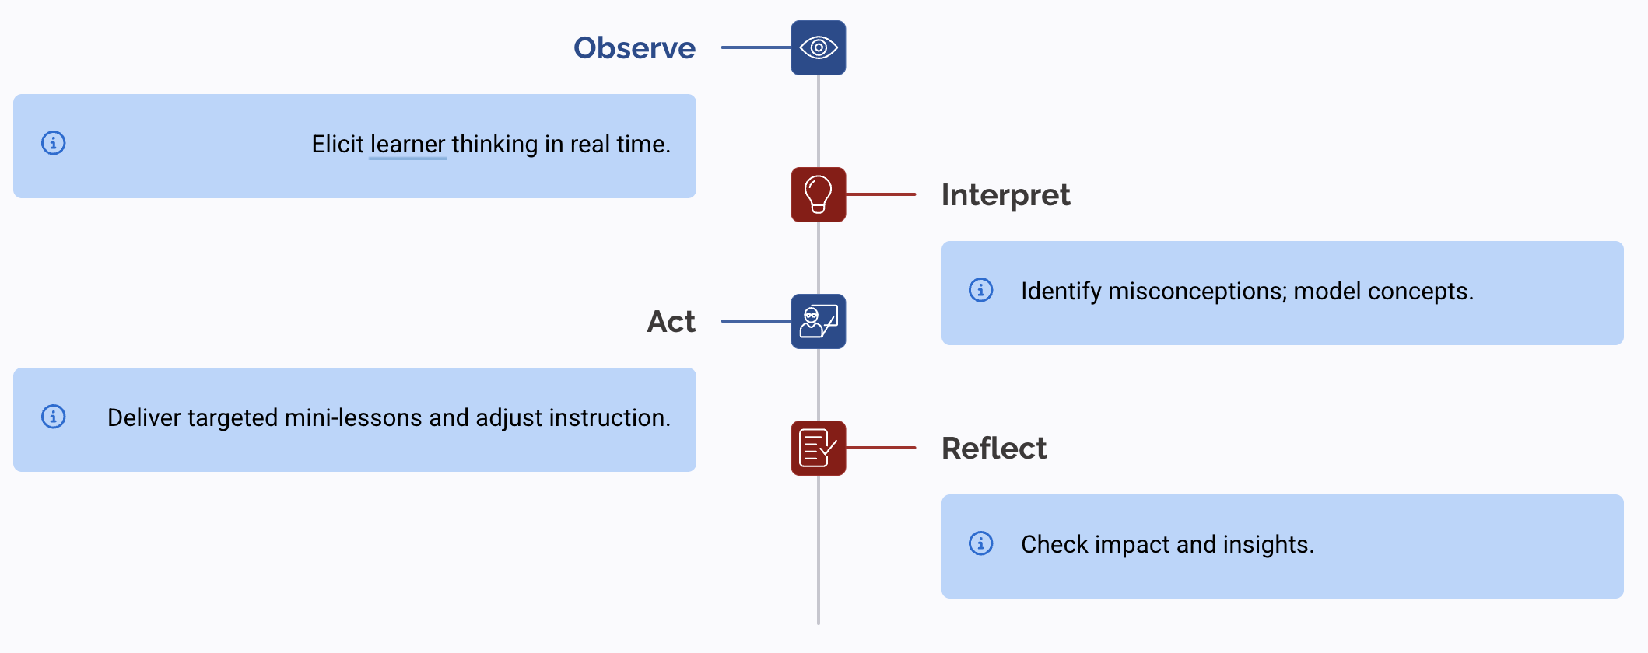
What Is a Good Teacher? The Core Loop

