Slide 1
Investment Portfolio: ETL Pipeline Strategy Returns

Slide 2
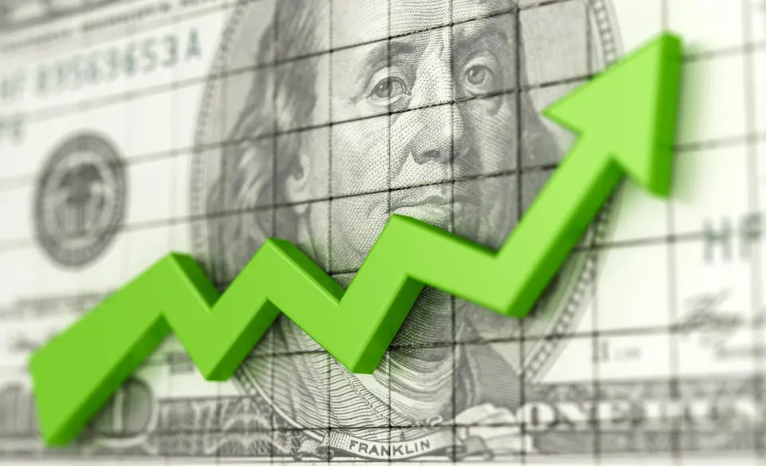
Investment Strategy:
Spread the capital across different sectors:
STOCKS:
Index ETFs:
Tech: QQQ
SP 500: SPY
Gold: AGI
ENERGY: MARA
PHARMA/Bio-Tech: REGN
Forex:
USD/AUD
Crypto:
DogeCoin
Profit:
Set 2 take profits:
Cut 20% of our position if we are 30% up.
Cut 30% of our original position if we are 70% up.

Slide 3
ETL Pipeline:
Collect data from 2 different sources.
Clean the data.
Apply Transformations (Date, Decimal points, Sorting, Aggregations…)
Apply summary Statistics.
Validation: Compare both data sets.
More Cleaning?
Load

Slide 4
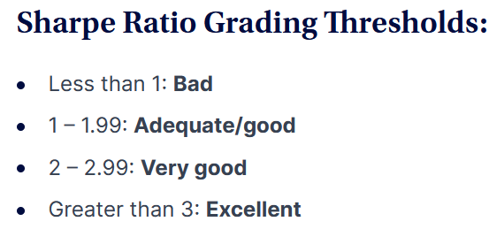
Stocks
Betas larger than 1.0 indicate greater volatility

Slide 5
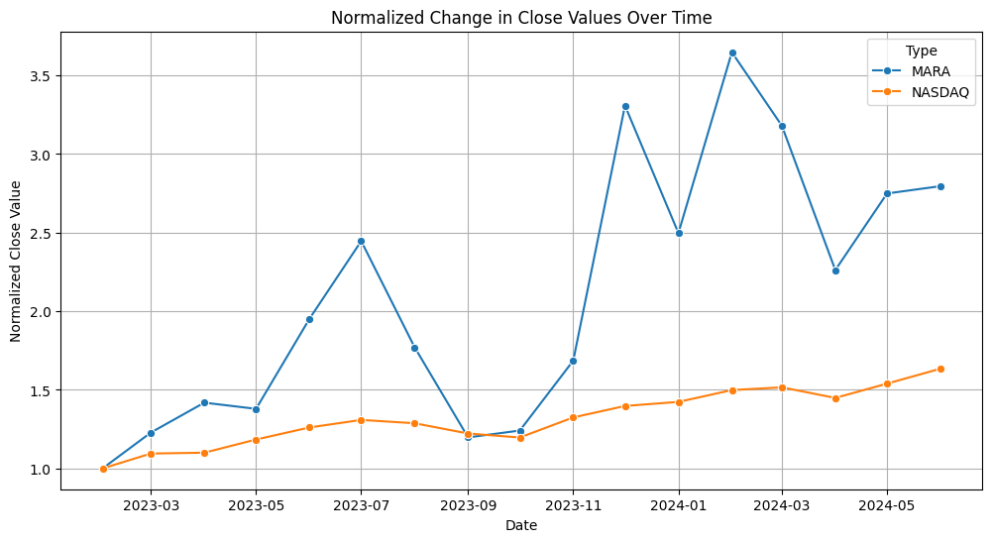
MARA
Shares bought: 4191
# Shares Sold: 2095
Average Cost: 3.58
Average Sell price: 5.37
Current Price: 19.85
Realized Profit: $3,750.05
Unrealized Profit: $41,605.60
Total Return: $45,355.65
Cumulative return: $60,359.43
Sharpe Ratio: 90.54
Beta: -0.0041
Volatility: 21.09

Slide 6
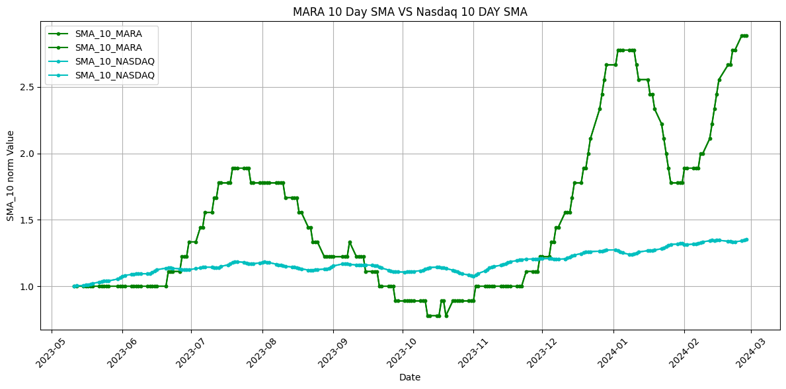
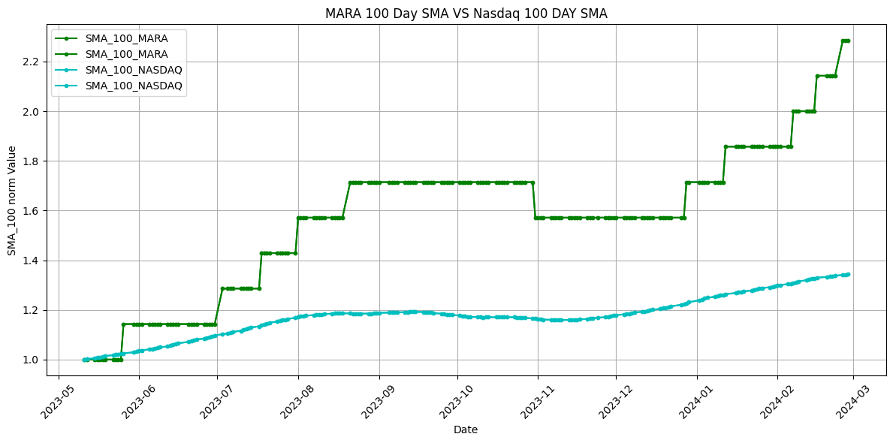
10 Day & 100 DAY SMA (Simple Moving Average) VS NASDAQ:

Slide 7
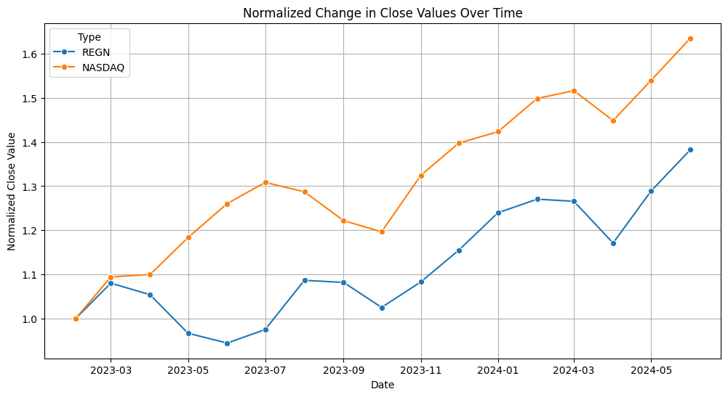
REGN
Shares bought: 20
# Shares Sold: 4
Average Cost: $721.86
Average Sell price:$ 938.42
Current Price: $1051.03
Realized Profit: $866.24
Unrealized Profit: $16,816.48
Total Return: $17,682.72
Cumulative return: $32,119.92
Sharpe Ratio: 0.82
Beta: -0.0339
Volatility: 213.52

Slide 8
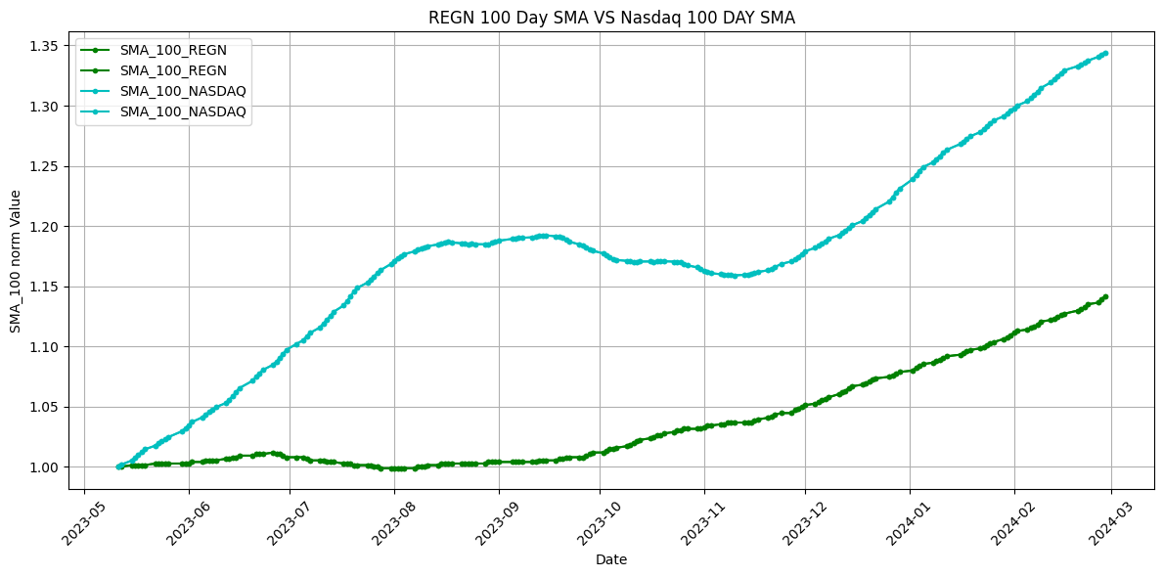
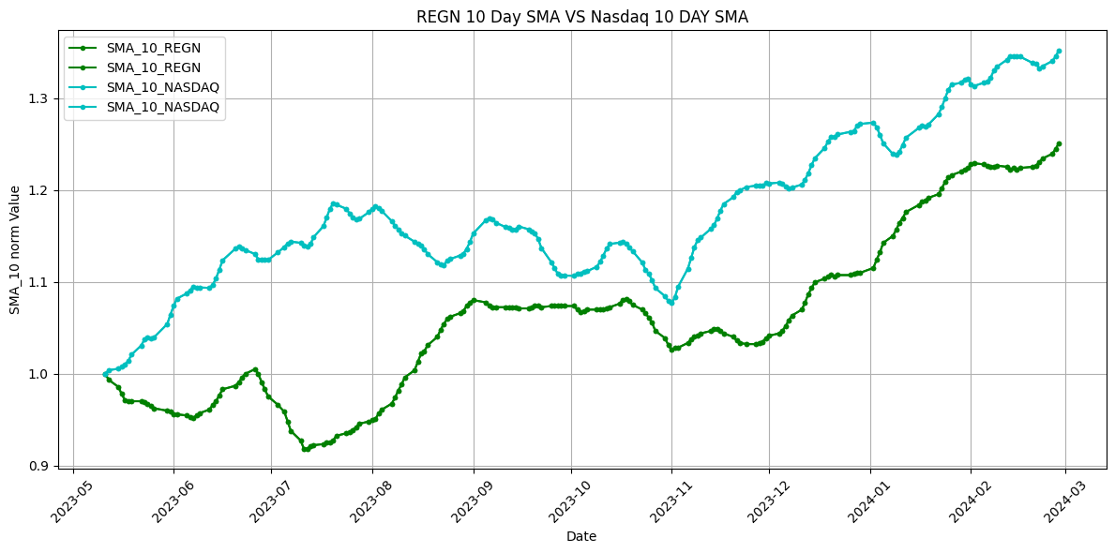
10 Day & 100 DAY SMA (Simple Moving Average) VS NASDAQ:

Slide 9
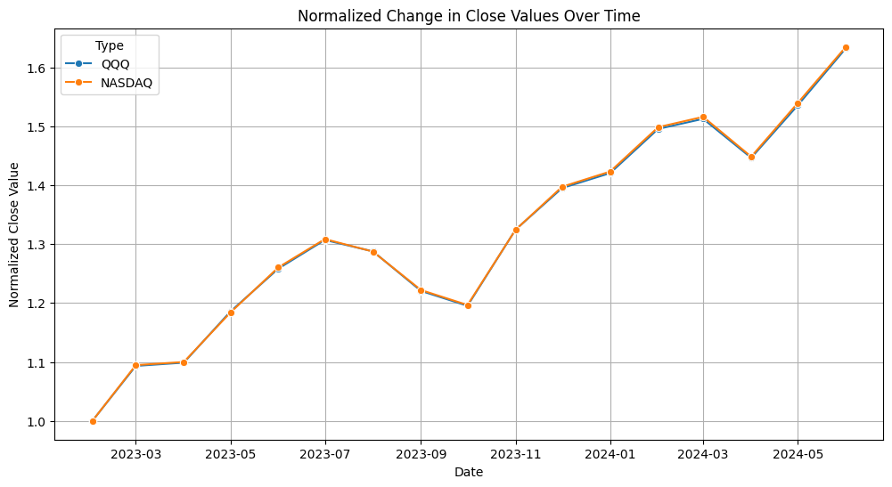
QQQ
Shares bought: 55
Shares Sold: 27
Average Cost: $268.65
Average Sell price: $402.95
Current Price: $479.11
Realized Profit: $3,626,77
Unrealized Profit: $13,415.08
Total Return: $17041.86
Cumulative return: $31,817.61
Sharpe Ratio: 4.28
Beta: -0.024
Volatility: 73.36

Slide 10
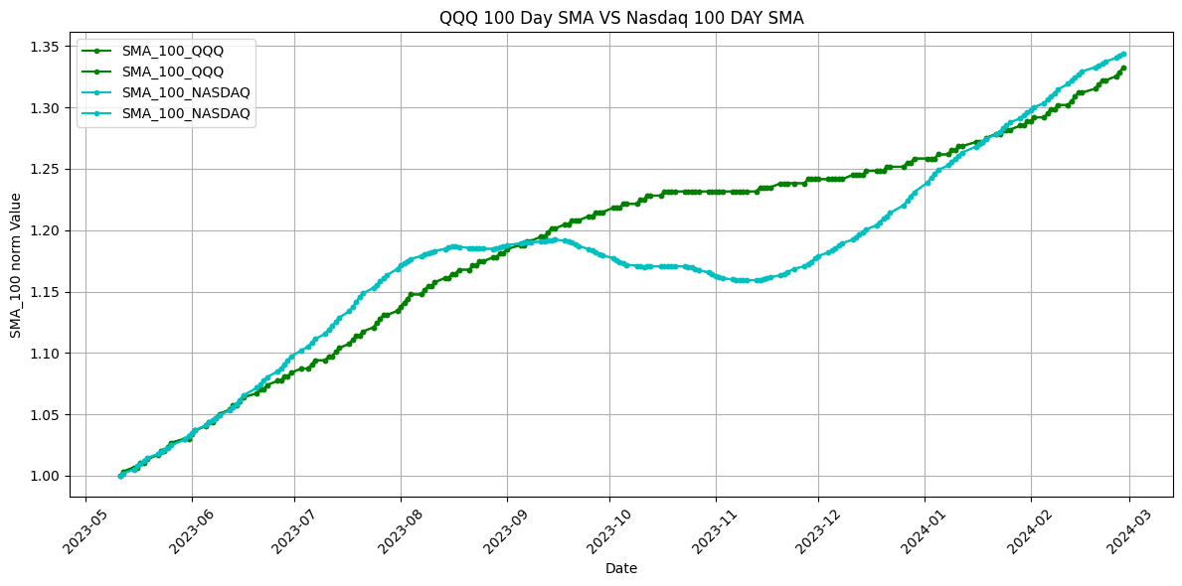
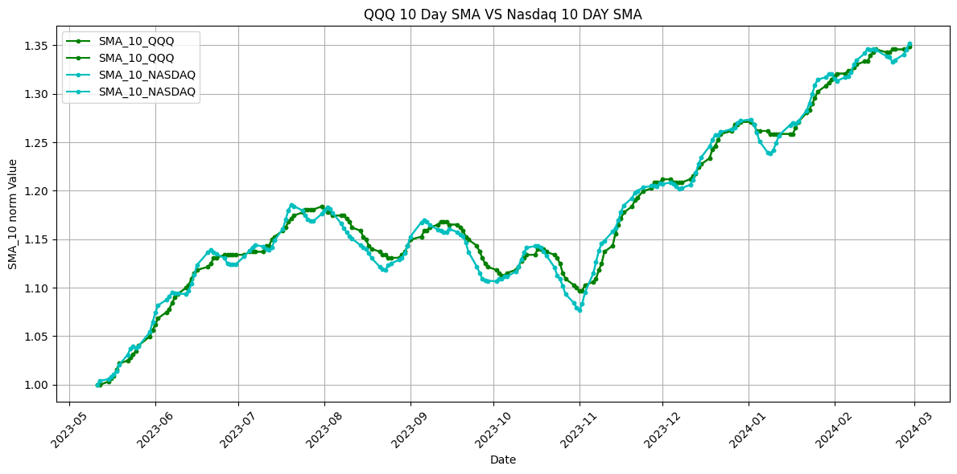
10 Day & 100 DAY SMA (Simple Moving Average) VS NASDAQ:

Slide 11
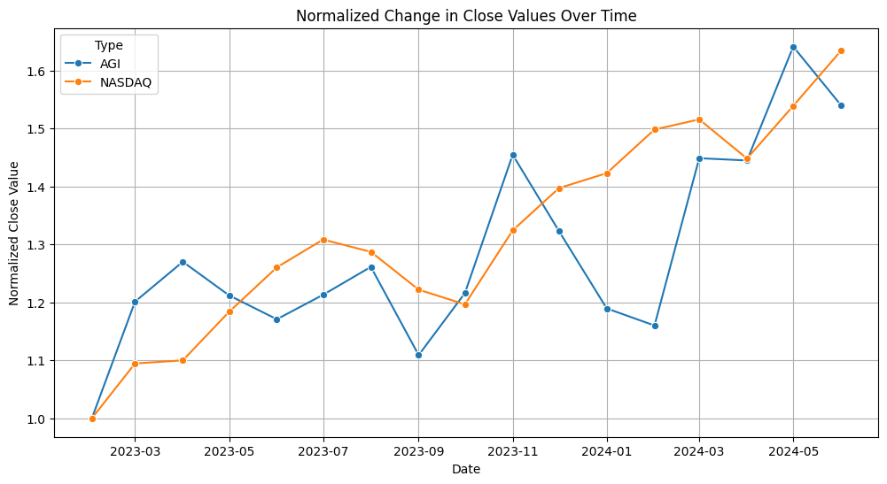
AGI
Shares bought: 1542
Shares Sold: 308
Average Cost: $10.24
Average Sell price: $13.31
Current Price: $15.68
Realized Profit: $945.56
Unrealized Profit: $19,349.12
Total Return: $20,294.68
Cumulative return: $36,084.76
Sharpe Ratio: 35.55
Beta: -0.00045
Volatility: 5.82

Slide 12
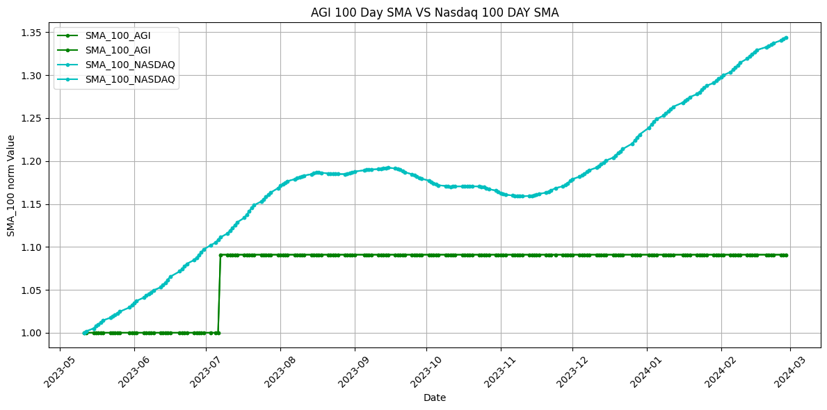
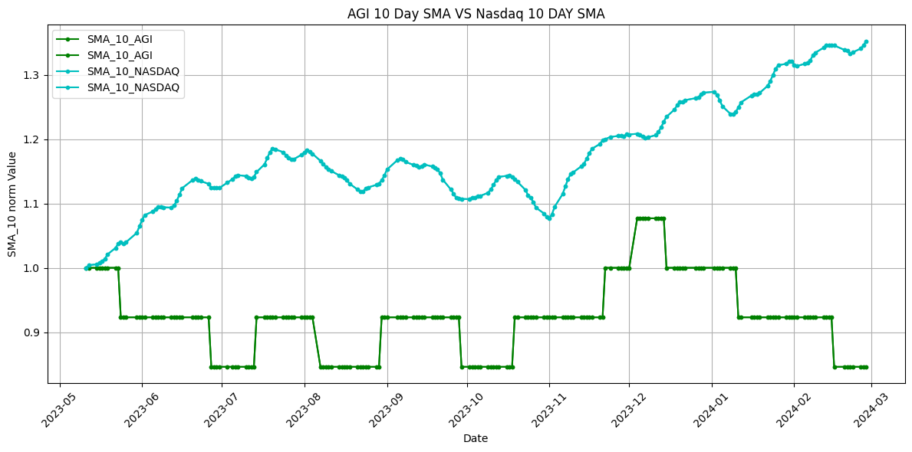
10 Day & 100 DAY SMA (Simple Moving Average) VS NASDAQ:

Slide 13
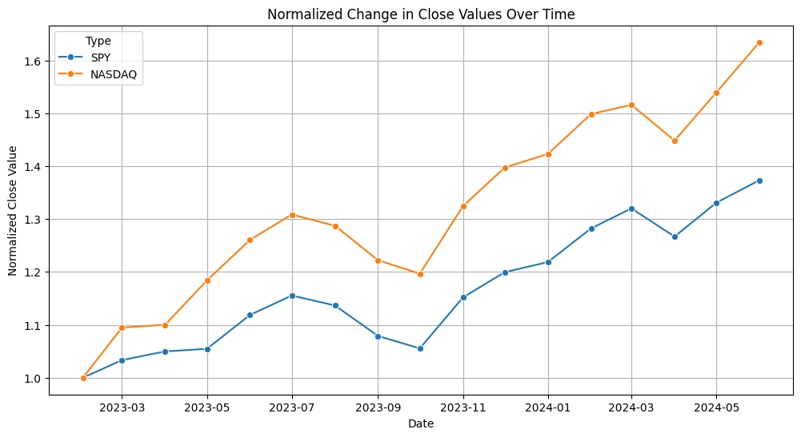
SPY
Shares bought: 39
Shares Sold: 7
Average Cost: $384.37
Average Sell price: $499.68
Current Price: $544.22
Realized Profit: $807.17
Unrealized Profit: $17,415.04
Total Return: $18,222.21
Cumulative return: $33,212.64
Sharpe Ratio: 2.17
Beta: -0.022
Volatility: 72.87

Slide 14
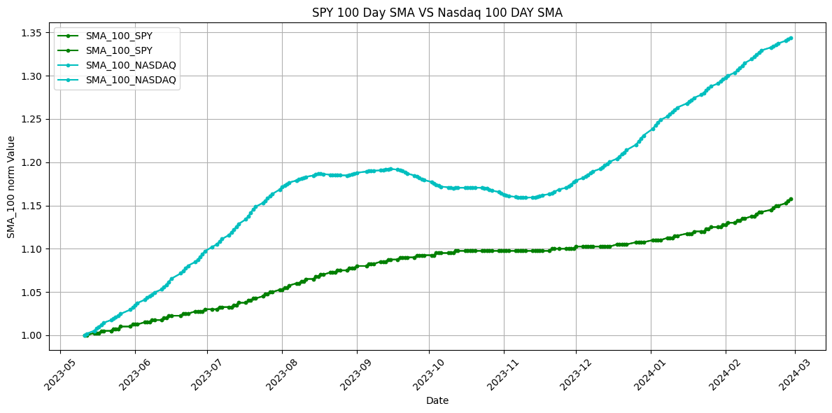
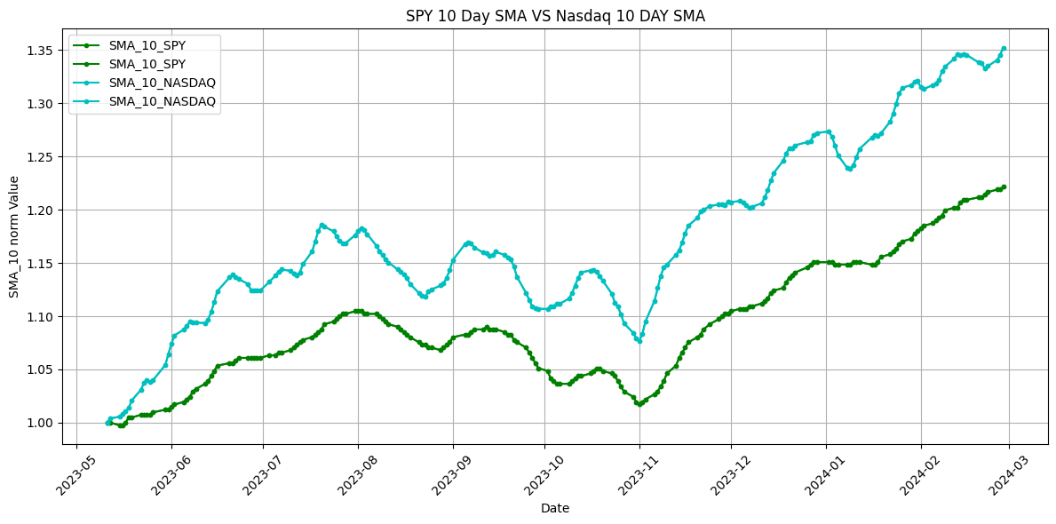
10 Day & 100 DAY SMA (Simple Moving Average) VS NASDAQ:

Slide 15
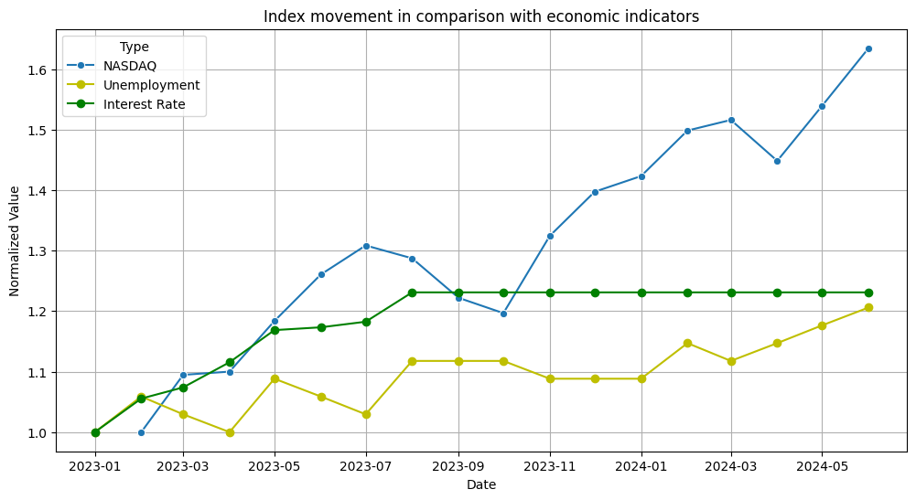
NASDAQ VS Economic indicators
Volatility: 2946.61

Slide 16
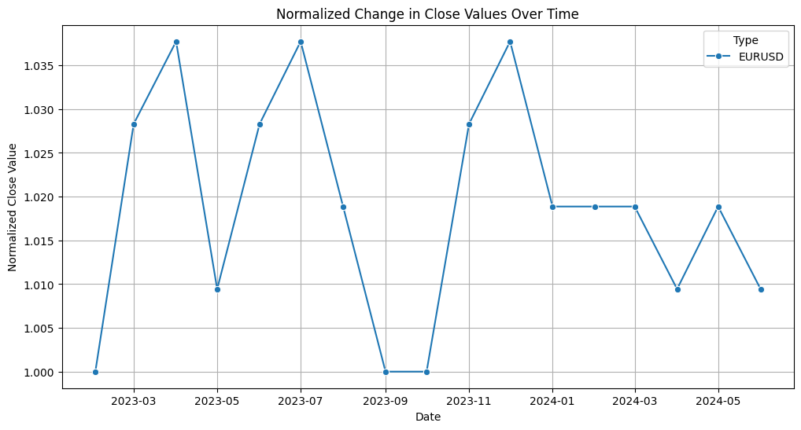
FOREX: USDEUR
Total Return: 0
Cumulative Return: 15000
Percentage: 0%

Slide 17
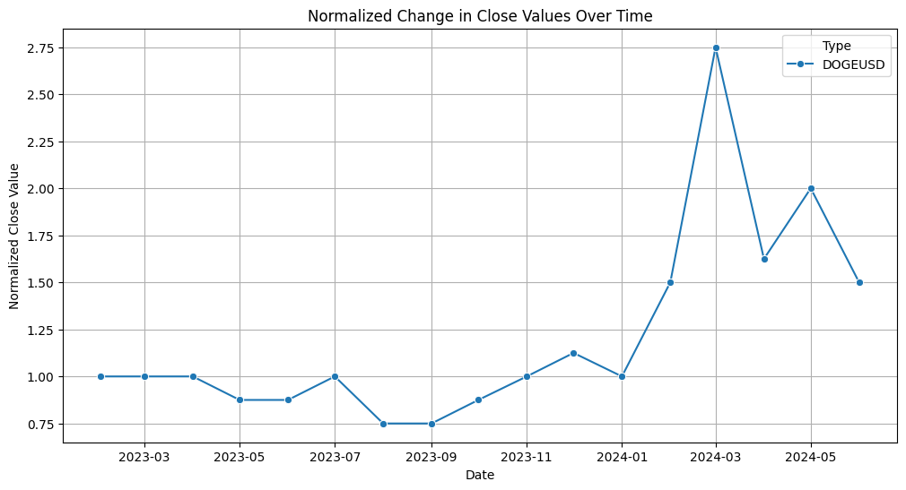
CRYPTO: DOGE COIN
Total Return: 10,714.25
Cumulative Return: 25,714.2
Percentage: 71.43%

Slide 18
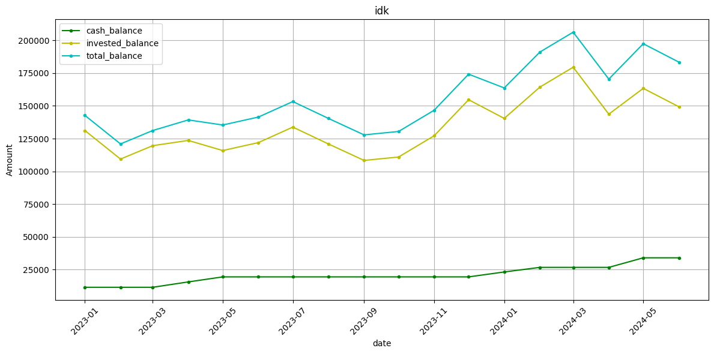
Total Portfolio
Total Return: $83,366.48
Cumulative Return: $183,366.48
Annualized Return: $55,577.33
Sharpe Ratio: 0.0039
Volatility: 85628.08

