Slide 1
DrunkoHopter
By. Mohammad El-khatib and Satyajit Simhadri

Slide 2
Objective of Game
Fly through the game and avoid the bombs
Gains 5 points after passing bomb
Collect gas tanks
Gains 50 points
To make harder as time goes on:
Bomb size increase
Speed increase
Level of ground changes

Slide 3

LibGDX
Where project was setup

Slide 4
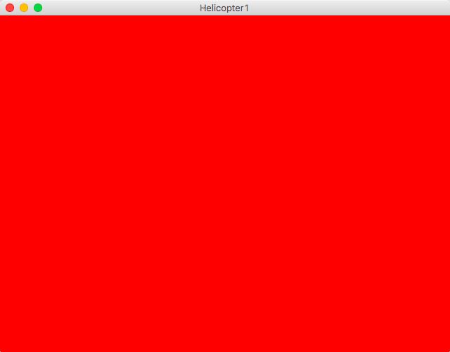
What Start off With

Slide 5
Game > Helicopter
Extends ApplicationAdapter
Includes
SpriteBatch
GameStateManager
Texture

Slide 6
GameStateManager
Includes Stack off all the states
Adds state onto the screen
Manages the scree

Slide 7
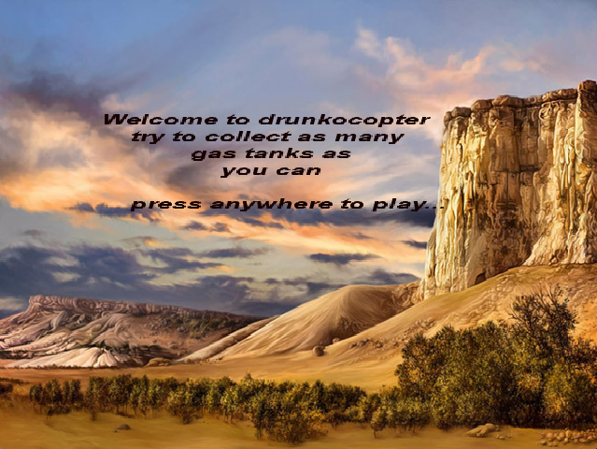
State -> MenuState
What MenuState looks like

Slide 8
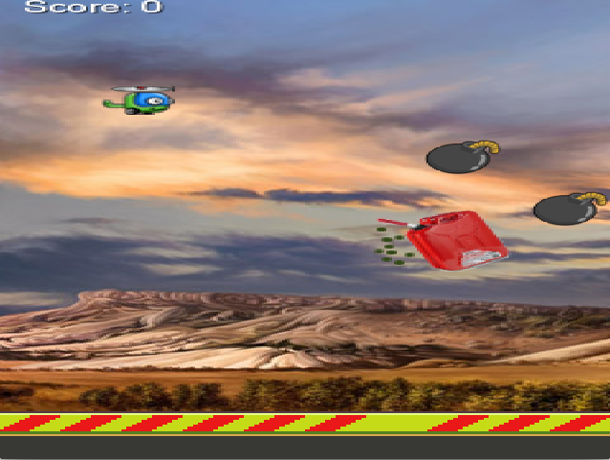
State -> PlayState
What PlayState looks like

Slide 9
State
PlayState
MenuState
State
(Current State)
GameOverState
GameStateManager

Slide 10
Objects in PlayState * edit this slide
private Array<Tube> tubes; // CHANGE TO BOMBS
private Bird bird; // CHANGE TO HELICOPTER

Slide 11
Sprites
Animation
Helicopter
Coins
Bombs

Slide 12
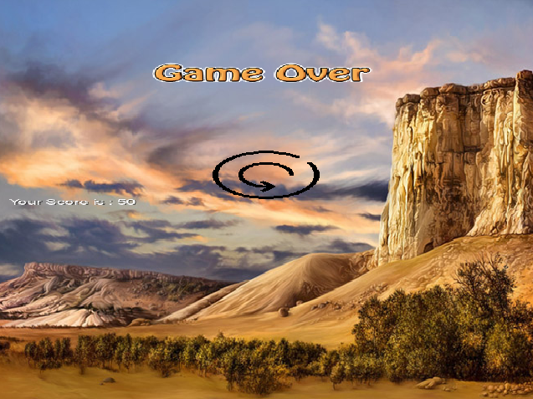
GameOverState
What GameOverState looks like

Slide 13

Bomb class -> android.assets
Bomb gets the image from the asset folder

Slide 14

Coin class -> android.assets
Coin class gets the Gas Tank image

Slide 15
Helicopter class -> android.assets
Helicopter Class uploads the helicopter animation

Slide 16
Spites -> Animation
public class Animation {
private Array<TextureRegion> frames = new Array();
private float maxFrameTime;
private float currentFrameTime;
private int frameCount;
private int frame;
public Animation(TextureRegion region, int frameCount, float cycleTime) {
int frameWidth = region.getRegionWidth() / frameCount;
for(int i = 0; i < frameCount; ++i) {
this.frames.add(new TextureRegion(region, i * frameWidth, 0, frameWidth, region.getRegionHeight()));
}
this.frameCount = frameCount;
this.maxFrameTime = cycleTime / (float)frameCount;
this.frame = 0;
}

Slide 17
Explanation
We create an Array of frames
Method to check difference in time between update functions
Recalls correct frame and set the helicopter to that frame

Slide 18
Collisions
public boolean collides(Rectangle player) {
return player.overlaps(this.boundCoin);
}
public boolean collides(Rectangle player) {
return player.overlaps(this.boundsTop) || player.overlaps(this.boundsBot);
}
Boolean collide functions when bounds overlap

Slide 19
Randomly set the bombs on the screen
if(this.cam.position.x - this.cam.viewportWidth / 2.0F > coin.getPosTopTube().x + (float)coin.getTopTube().getWidth()) {
coin.reposition1(coin.getPosTopTube().x + (float)((52 + 125) * 4));
score += 5;
}
if(this.cam.position.x - this.cam.viewportWidth / 2.0F > coin.getPosBotTube().x + (float)coin.getBottomTube().getWidth()) {
coin.reposition2(coin.getPosBotTube().x + (float)((52 + 125) * 4));
score += 5;
}
Algorithm to position bombs on the screen
Adds 5 to score when helicopter passes bomb

Slide 20
Helicopter
android
core
desktop
java
com

