Slide 1
COMP 225-hybrid: Software Engineering Methodologies Software Requirements Specification (SRS)
Name of project: Intelligent Freight Logistics Dispatch System (IFLDS)
Presented by:
Name Student #
Moesha Aurelle Emaleu Deutou 301444365 Date: August 11^{th,} 2025
Section #: 005
Semester: Summer 2025
Notes:
Instructions:
Customize the black text. Be sure to include the names of all team members.

Slide 2
Introduction
Purpose
The Intelligent Freight Logistics Dispatch System (IFLDS) revolutionizes freight logistics through AI-driven automation, matching shipments to drivers in under 2 seconds by analyzing proximity, capacity, and compliance data, far surpassing the industry's 5-minute standard. Its dynamic route optimization reduces fuel costs by 15-20% by accounting for real-time traffic and weather conditions, while integrated GPS tracking provides exceptional 5-minute ETA accuracy and automated delivery notifications. The system ensures compliance through blockchain-secured proof of delivery and automated Hours of Service monitoring, minimizing regulatory risks. Scalable for fleets of up to 500 vehicles and designed for global expansion, IFLDS delivers 15% annual cost reductions while maintaining 95% on-time delivery rates, setting a new benchmark for operational efficiency, transparency, and reliability in logistics management.
Project scope
The Intelligent Freight Logistics Dispatch System (IFLDS) is an AI-powered platform that transforms freight operations through three core components: (1) a dispatcher dashboard with AI-driven cargo-driver matching, (2) a driver mobile app with real-time navigation and digital proof-of-delivery, and (3) a customer portal for live tracking. It delivers 15-20% cost savings through dynamic route optimization, reduces manual workloads by 70%, and achieves 95% automation accuracy. Supporting 500+ concurrent users with <300ms response times, IFLDS integrates with Google Maps, Twilio, and payment processors while complying with FMCSA/GDPR. Designed for mid-sized fleets (100+ vehicles), it offers an 18-month payback period and 220% 5-year ROI, improving on-time deliveries by 20% with 90% driver adoption targets. The initial release does not include predictive maintenance, ERP integrations, or multilingual support.
View the full interactive System diagram here.
Notes:
Instructions:
Keep it direct to the point, take onboard any feedback you got from Part A

Slide 3
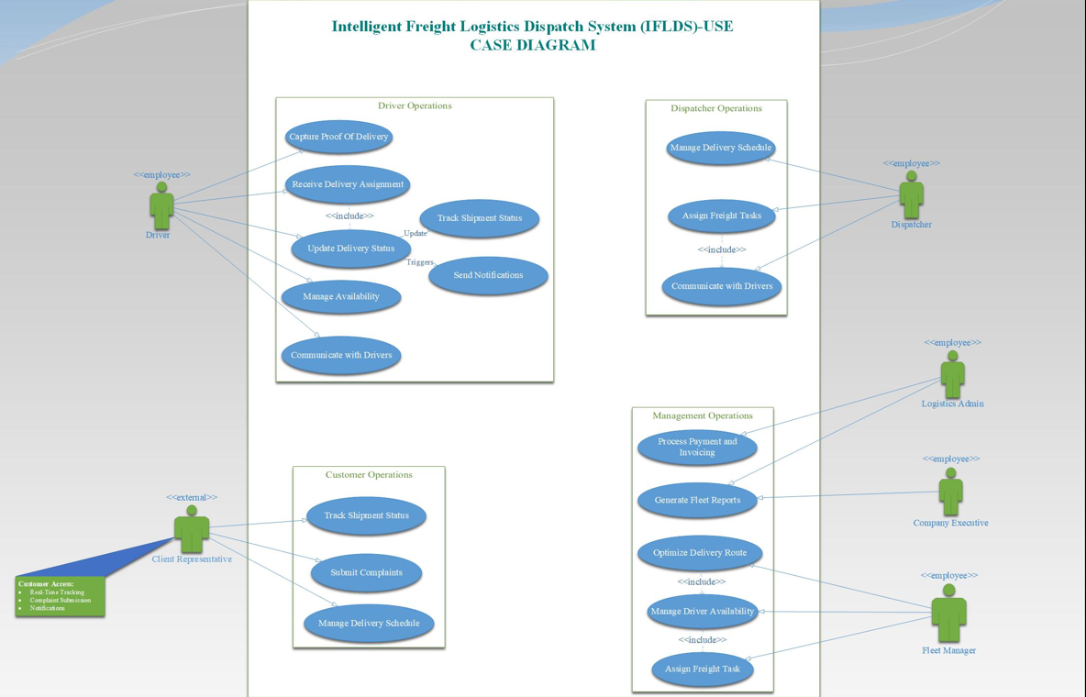
Packaged Use Case Diagram
Notes:
Instructions:
The use case diagram should show all the actors and the sub-systems

Slide 4
Use Cases Brief Descriptions only 6
Goal Use Case name | Actors | Use Case Brief Description
Assign Freight Task | Dispatcher, Driver | System matches shipments with optimal drivers (50-mile radius, 20% buffer) and notifies both parties
Optimize Delivery Route | Fleet Manager | Generates 3 AI-powered routes considering traffic/weather, then updates driver GPS in real-time
Capture Proof of Delivery | Driver | Validates and stores digital proof (photo/signature) with blockchain timestamping
Track Shipment Status | Customer, Dispatcher | Provides real-time GPS tracking with automated delay alerts (>15 mins threshold)
Manage Driver Availability | Driver | Adjusts fleet capacity metrics when drivers report status changes (On Duty/Break)
Generate Performance Reports | Logistics Admin | Compiles KPIs (delivery times, fuel usage) into visualized PDF/Excel reports
Notes:
Instructions:
List the top six use cases. In your brief description focus on what system response is to user actions

Slide 5
Use Cases Brief Description
Goal Use Cases | Use Case Brief Description
Assign Freight Task | The system automatically selects the optimal driver within a 50-mile radius and 20% capacity buffer, sends an encrypted assignment to the driver’s mobile app, and updates the customer portal with the revised ETA.
Optimize Delivery Route | The system analyzes real-time traffic and weather data to generate three route options balancing fuel efficiency and delivery time, then pushes the optimal route directly to the driver’s GPS navigation system.
Capture Proof of Delivery | Upon receiving a photo or signature, the system validates its metadata (location/timestamp), stores it in an immutable blockchain record, and triggers an automated notification to the customer confirming delivery completion.
Track Shipment Status | The system aggregates live GPS and vehicle telemetry data to calculate a dynamic ETA with ±5-minute accuracy, proactively alerting customers via SMS/email if delays exceed 15 minutes.
Manage Driver Availability | When drivers update their status, the system adjusts real-time fleet capacity metrics, triggers rebalancing alerts if coverage drops below thresholds, and logs break times for regulatory compliance.
Generate Fleet Reports | The system compiles key performance indicators (on-time rates, fuel consumption) into formatted PDF/Excel reports, automatically flagging statistical outliers like chronic delays for managerial review.
Notes:
Instructions
In your description focus on what system response is to user actions

Slide 6
Use Case Full Description (present one)
Use Case: Assign Freight Delivery Task –Optimize Driver Assignment (AFD-OA) Iteration: 1, last modification: June 30, 2025 Primary Actor: Logistics Dispatcher (Sarah Lim)
Triggering Event
New delivery request enters the dispatch queue
Scenario:
The dispatcher selects the delivery request from the dashboard.
The system evaluates:
Driver proximity (within a 50-mile radius)
Available drive hours (minimum 2 hours remaining)
Vehicle capacity (with a 20% buffer)
This system displays the top 3 driver matches with estimated ETAs.
The dispatcher confirms the assignment or manually overrides the system's suggestion.
The system then:
Logs the assignment in the audit trail for future reference (FR08)
Sends an encrypted push notification to the selected driver (FR06)
Updates the customer portal with the new estimated time of arrival (FR04)
Preconditions
Dispatcher is authenticated (FR09)
At least one pending delivery exists
Driver GPS and hours-of-service (HOS) data are current
Exceptions:
No available drivers meet the criteria:
System alerts dispatcher to expand the search radius or delay the assignment
Driver rejects the assignment:
System notifies dispatcher and suggests the next-best alternative driver
Notes:
Instructions:
Present one formal use case description, Clarify how scenario and triggering event applies to your case in addition to system flow with the user.

Slide 7
Use Case Full Description (Continued)
The GPS signal is lost:
System uses the last known location and prompts the dispatcher to input a ZIP code as a fallback
Priority: High (Core functionality for first release) Frequency of Use: 50–100 times daily during peak hours Channel to Primary Actor: Web-based dispatch dashboard
Secondary Actors:
Fleet Manager (Daniel Chou) - manages exception scenarios
Notification Service (e.g., Twilio API) - handles delivery of push alerts
Open Issues:
Optimal refresh rate for driver location updates (currently set at 15 seconds)
Handling assignment logic when more than 80% of drivers are already at capacity
Verification and audit trail policy for manual dispatcher overrides
View the full interactive SwimLane activity diagram here.
Notes:
Instructions:
Discuss pre-conditions and post conditions of system.

Slide 8
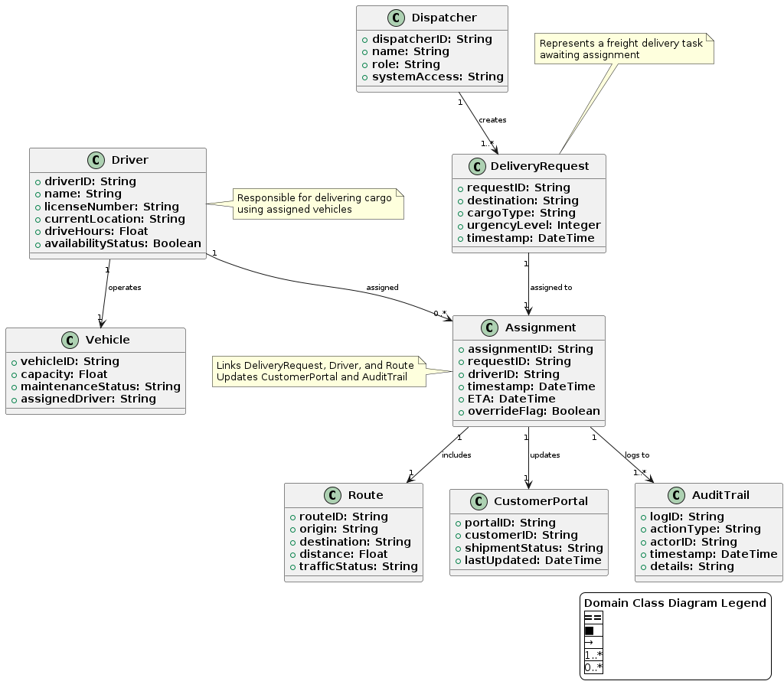
Domain Class Diagram first cut
Figure 1: First Cut Domain Class Diagram (Noun Technique)
Discussion on Class Relevance, Attributes, and Associations
The Intelligent Freight Logistics Dispatch System (IFLDS) is a comprehensive solution that automates and optimizes freight logistics operations. At its core, the system features a Dispatcher who creates and manages assignments, Drivers who execute deliveries using Vehicles (tracking capacity and maintenance), and DeliveryRequests that specify cargo details and priorities. The system intelligently generates Assignments by matching requests with optimal Routes (considering traffic and distance) while calculating accurate ETAs. Customers gain real-time visibility through the CustomerPortal, while all actions are logged in the AuditTrail for compliance. Key capabilities include dynamic dispatching (FR01), AI-powered route optimization (FR02), live shipment tracking (FR04), and robust security (NFR02). Built as a scalable cloud platform, IFLDS enhances operational efficiency by reducing delays and fuel costs while ensuring full transparency and regulatory compliance across the logistics workflow.
Notes:
Instructions:
Only classes with attributes and relationships (no methods)
Discuss why you think these classes are relevant and the attributes you chose per class, also why you chose these types of associations

Slide 9
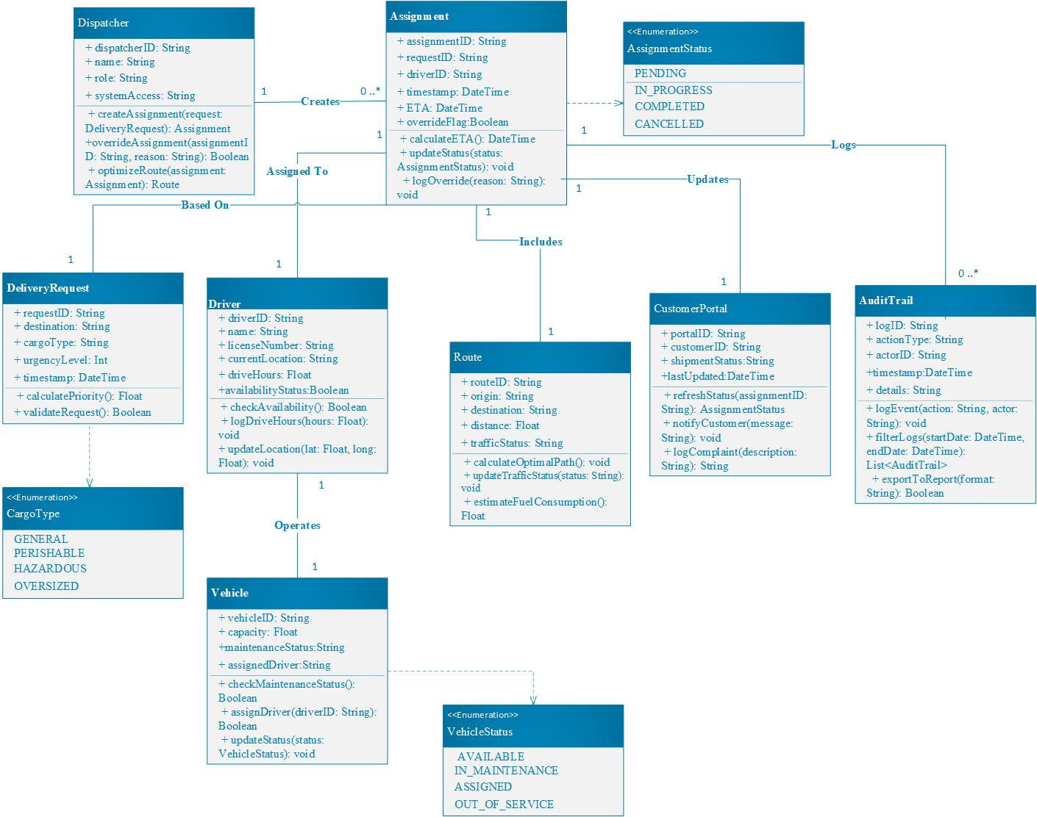
Domain Class Diagram with methods
Figure 2: CLASS DIAGRAMS
Notes:
Instructions:
Discuss why you think these classes are relevant and the methods you chose per class, also why you chose these types of associations

Slide 10
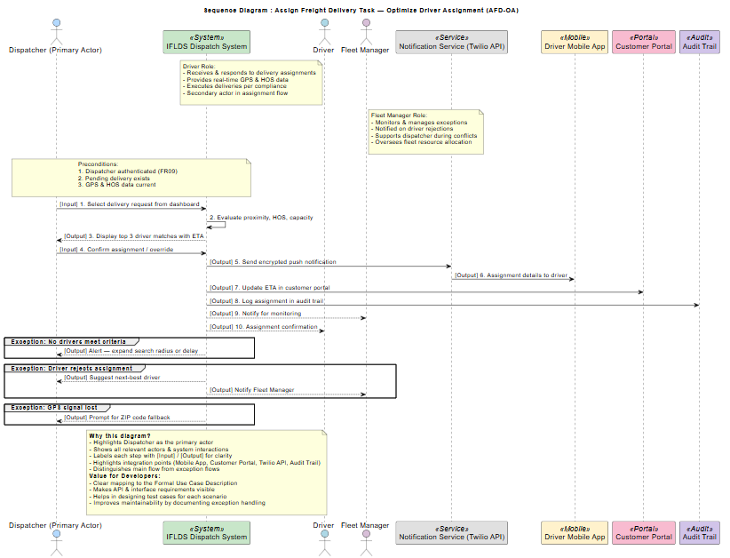
Sequence diagram (present one)
Figure 3: View the full interactive sequence diagram here.
Notes:
Instructions: Mention the use case name
Set a Hyper link to launch your SD if two large
Show Input / Output messages to and from the system
Discuss why you chose it and what value does it add to the project when developers read it

Slide 11
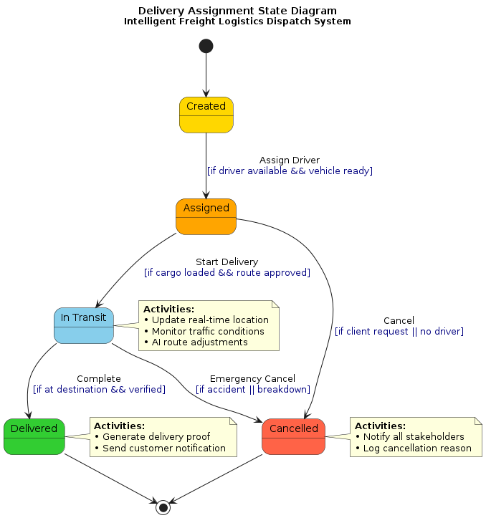
State machine diagram (present one)
Figure 4: Delivery assignment State Diagram
Notes:
Instructions:
Mention which object you chose.
Discuss why you chose this object and what value does the state machine diagram bring

