Slide 1
“Crazy”
Women from Different Classes
-- in the movie “Parasite”
Junfeng Zhao
Topic: Class and Gender
JMS215
Professor: Thiam Huat Kam
Date: July 3 2020

Slide 2


The goal of the media
what does the media represent?
MORAL?
LAW?
POOR?
THE WEAK?
picture comes from https://www.nbcnews.com/better/lifestyle/are-you-swiping-away-money-these-simple-tips-can-help-ncna1064331
picture comes from https://www.vox.com/policy-and-politics/2016/11/22/13641654/paul-ryan-trump-poverty-safety-net
PROFITS
Sellnow(2010) explained that “producers of entertainment media may operate by ethical standards that differ from yours or mine and, moreover, they might at times compromise ethical standards in the quest for higher profits”(p. 2).

Slide 3
Problem？
“media's ingrained preference for covering events rather than explaining underlying causes or processes”(Douglas,
2007, p. 242).
“Ideological work is winning and securing of hegemony over time”(Lull, 2003, p. 65).
NO
CHOICE
NO
UNDERSTANDING
Oppression
Race: “But whiteness itself is either politically oppressive or culturally empty”(Jensen, 2011, p. 27).
Sexuality: “Lesbian communities can be just as oppressive as straight communities when it comes to style”(Ciasullo, 2011, p. 336).

Slide 4
OPPRESSION : The Strong VS The Weak
R:4
White VS Black
C:3
Rich VS Poor
RACE
CLASS
G:2
Man VS Women
GENDER
S:1
Heterosexual VS Homosexual
Ciasullo(2011) said that “representation promises visibility, but visibility means not only that one is present but that one is being watched. It also means that certain images get singled out as watchable”(p. 332).
SEXUALITY

Slide 5
Parasite story
Work for
later
Work for first
Kim family
Park family
Gook family
Middle-class → Poor
Middle-class → Rich
Middle-class → Poor
Father: Park's dirver
Mother: Housekeeper
Son: Park's daughter's tutor
Daughter: Park's son's tutor
Husband: Boss of a big Tech company
Wife: Stay at home
Husband: Stay at the basement of Park's house
Wife: (Previous)Housekeeper

Slide 6
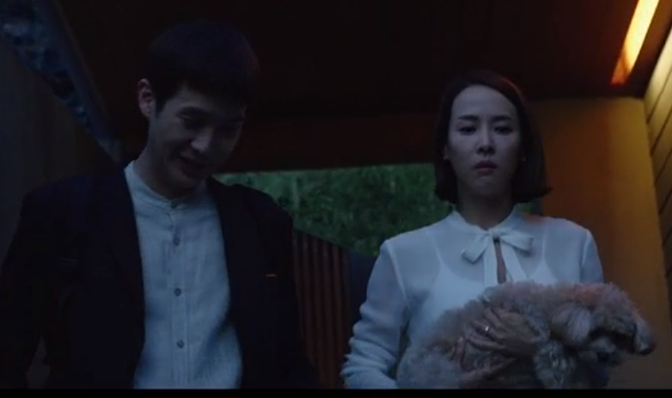
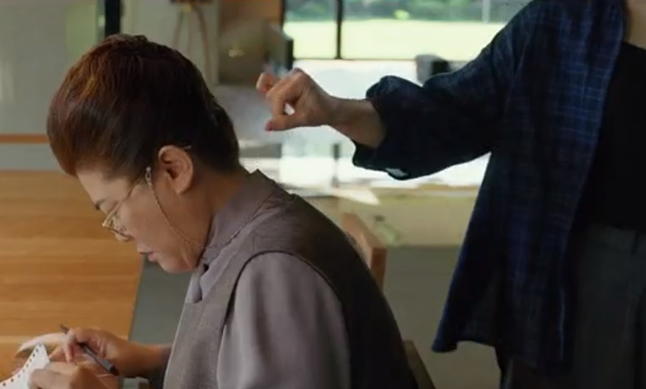
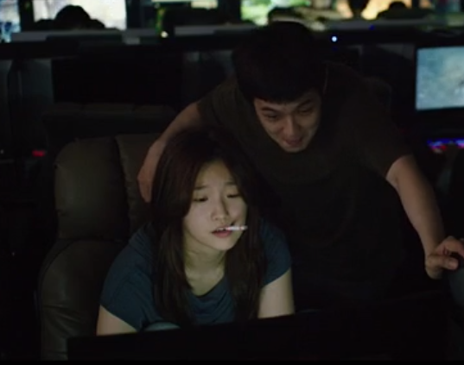
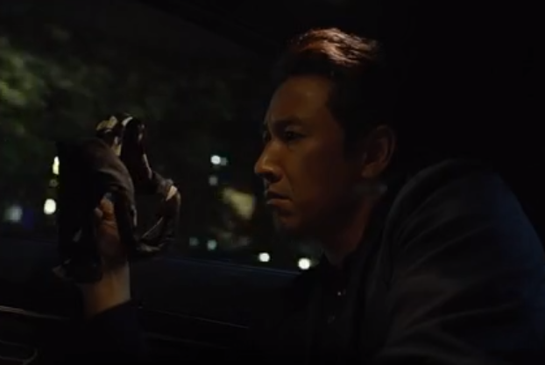
Trap and Plan
Kim family plans to make Park fire the original workers and let their family get jobs.
2
4
3
1
Son lies to Park that “he know someone(his sister) who are good at art”.
(0:20:27)
The daughter knows that Gook is allergic to peaches then uses peaches to make Gook be fired.
（0:43:19）
Daughter make a fake diploma for her brother
（ 0:11:17）
The daughter dropped her underwear in Park's car for framing the driver, and let him lose his job.(0:32:12)

Slide 7
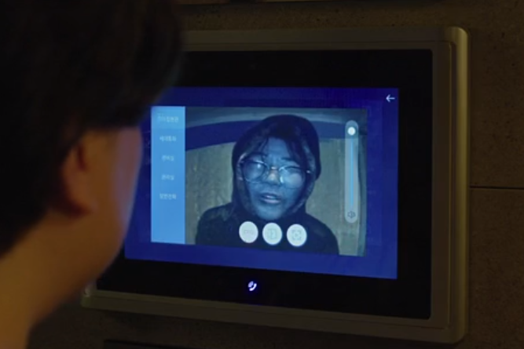
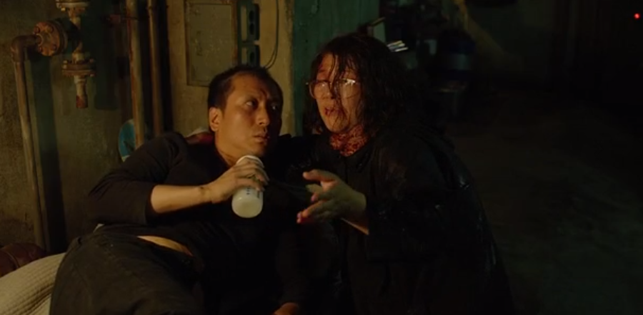
Negative Women Image in each Family
(Gook wife, 01:03:24)
(Gook wife, 01:07:17)
“Crazy”women under Patriarchy
In Gook family, all income comes from the wife. Thus the wife should be a more rational and calm role than the husband. However, here, we find that his wife's performances are almost crazy in most cases.
Butsch(2010) explained that “the few working-class men were portrayed as buffoons. They were dumb, immature, irresponsible, and lacking in common sense”(p. 101).

Slide 8
Conflicts then Death
within Class
Weapon?
When they discovered that another family had secrets, they all hoped to please the upper class by oppressing another family.
When competing for power, women have become the only weapon for family, while men are kings waiting for victory.
The women's stereotype just "feeds a poisonous trend in women's and girls' perceptions of their bodies" and is more likely to build a "self-objectification-viewing" for women(Heldman, 2008, p. 52).

Slide 9
Oppression and Maintain one group
Why black women didn't help white women for women right?
Hooks mentioned that “I was excited by the idea of talking with so many young black women but surprised when these women suggested that sexism was not a political issue of concern to black women, that the serious issue was racism”(p. 35).
Hooks explained that “Until black people redefine in a nonsexist revolutionary way the terms of our liberation, black women and men will always be confronted with the issue of whether supporting feminist efforts to end sexism is inimical to our interests as a people”(p. 36).

Slide 10
References
Butsch, R. (2010). Ralph, Fred, Archie and Homer and the King of Queens: Why television keeps recreating the white male working-class buffoon. In G. Dines and J.M Humez [Eds.] Gender, Race, and Class in the Media (3rd Ed, pp. 101-107). Thousand Oaks, CA: Sage Publications.
Ciasullo, A. (2011). Making her (in)visible: Cultural representations of lesbianism and the lesbian body in the 1990s.” In M.C. Kearney [Ed.] The Gender and Media Reader (pp. 329-341). London: Routledge.
Douglas, S. (2007). Where the girls are: Growing up female in the mass media. . In B. Arrighi [Ed.] Understanding Inequality: the Intersection of Race/Ethnicity, Class, and Gender ( 2nd Ed. pp. 241-249). Lanham, MD: Rowman & Littlefield.
Heldman, C. (2008). Out-of-body image. Ms., 51-55.
Hooks, B. (2009). Ain’t I a Woman: Black Women and Feminism. Boston: South End Press.
Jensen, R. (2011). Whiteness. . In S. Caliendo and C. McIlwain [Eds.] The Routledge Companion to Race and Ethnicity (pp. 21-28). London: Routledge.
Lull, J. (2003). Hegemony. In G. Dines and J.M. Humez [Eds.] Gender, Race, Class and the Media (pp. 61-65). Thousand Oaks, CA: Sage Publications.
Sellnow, D. (2010). The Rhetorical Power of Popular Culture. Thousand Oaks, CA: Sage Publications.

Slide 11
THANKS

