Slide 1

LabVIEW
Brandon Moe
JumpStart 2020

Slide 2
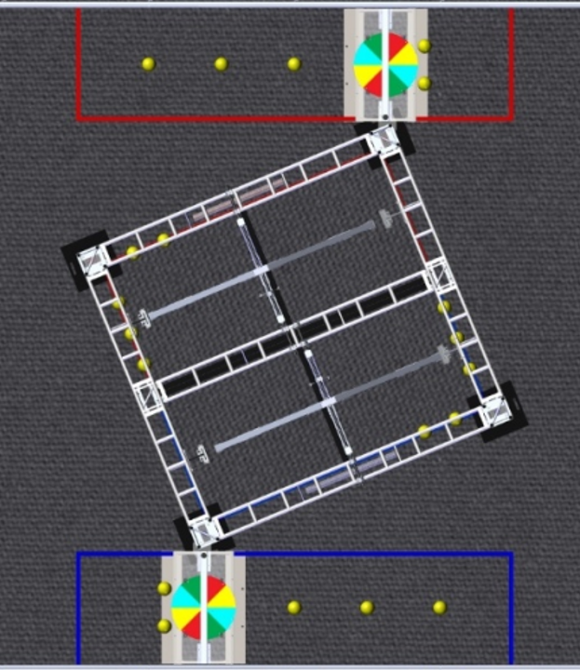
Who am I
Brandon Moe
Minnesota CSA
FRC Alumni
5 Years FRC Mentor
LabVIEW Beta Tester 4 years

Slide 3
What is LabVIEW?

Slide 4
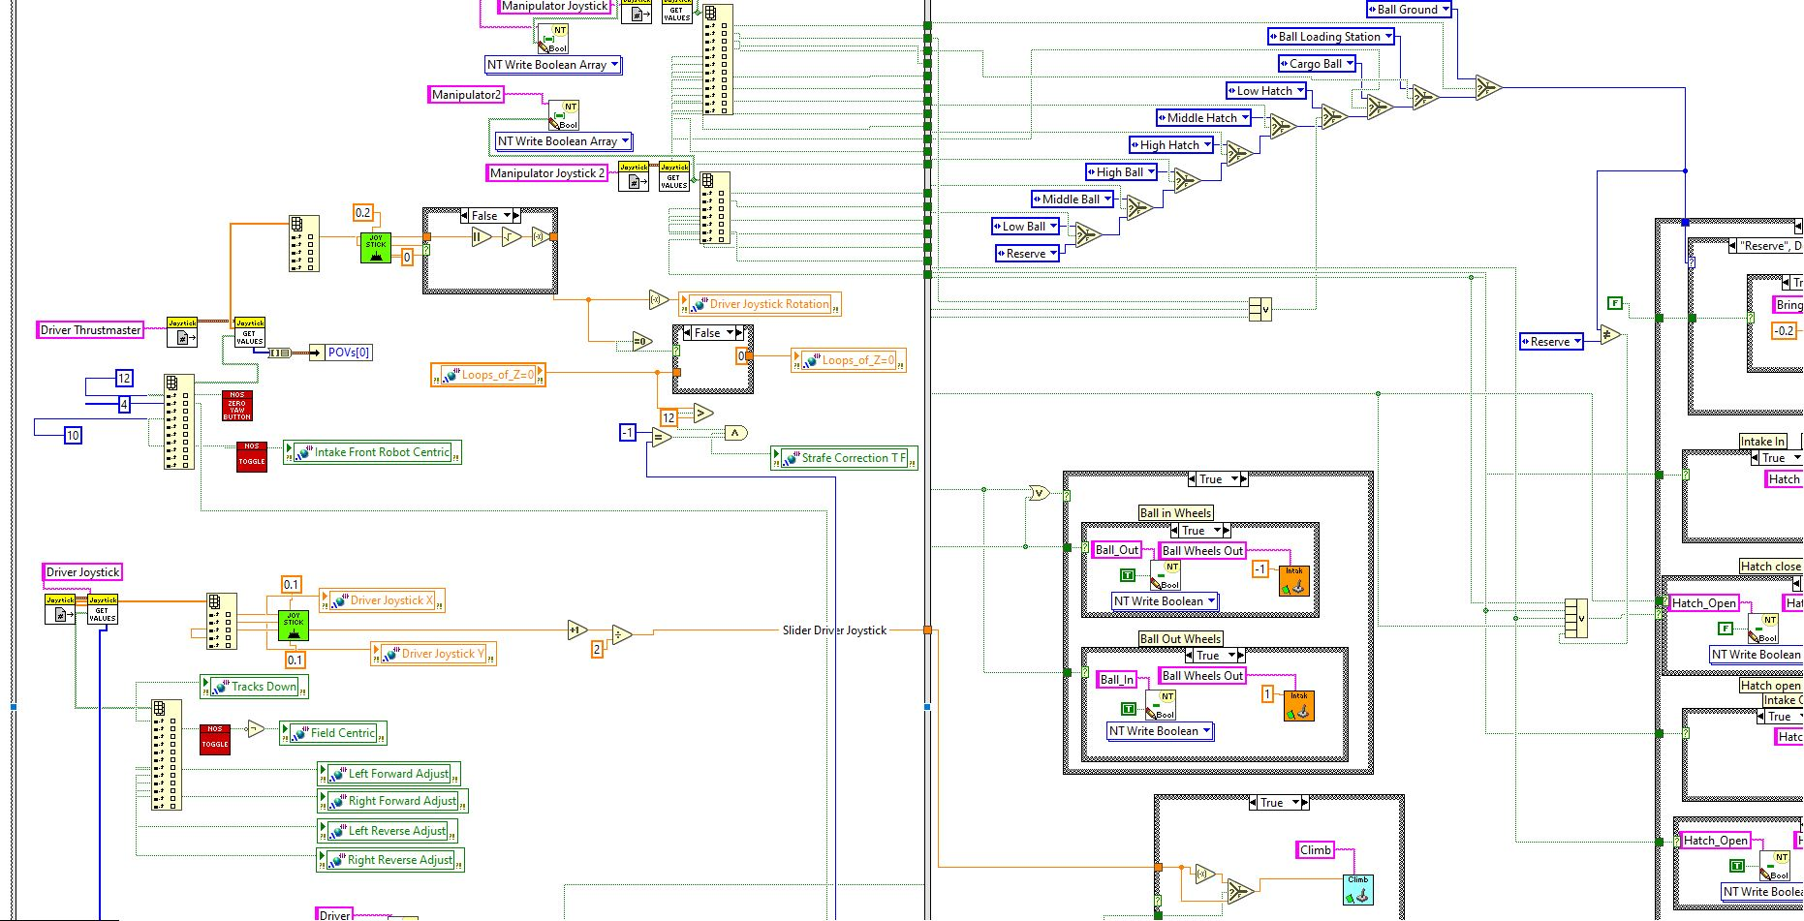
LabVIEW Code Example

Slide 5
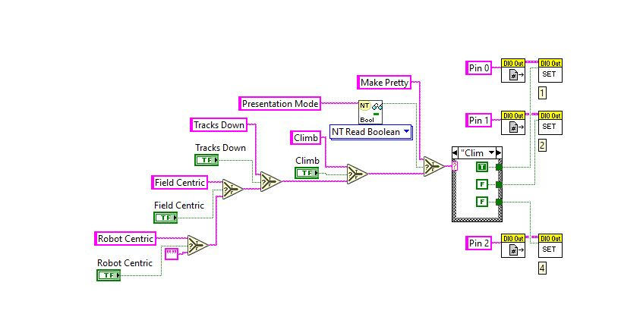
Visual Programming Language
Anything you want to do in LabVIEW has a picture associated with it. (VI’s)
Easy to follow. Even the hardware mentor can follow along.
Reads left to right. Follow the lines to follow the program.
Color coded by default.
Green = Boolean
Pink = String
Orange = Double
Blue = Int

Slide 6
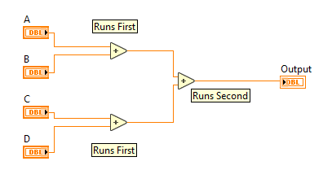
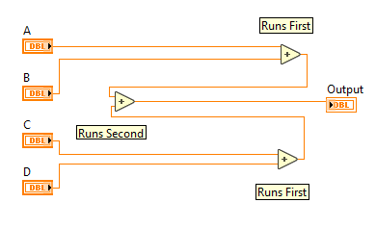
Data Flow Programming
A function will run when it has enough data to run.
It will not wait for something else in the code to finish if it has enough data to run.
In contrast, it will always wait until it has enough data.

Slide 7
LabVIEW Terminology

Slide 8
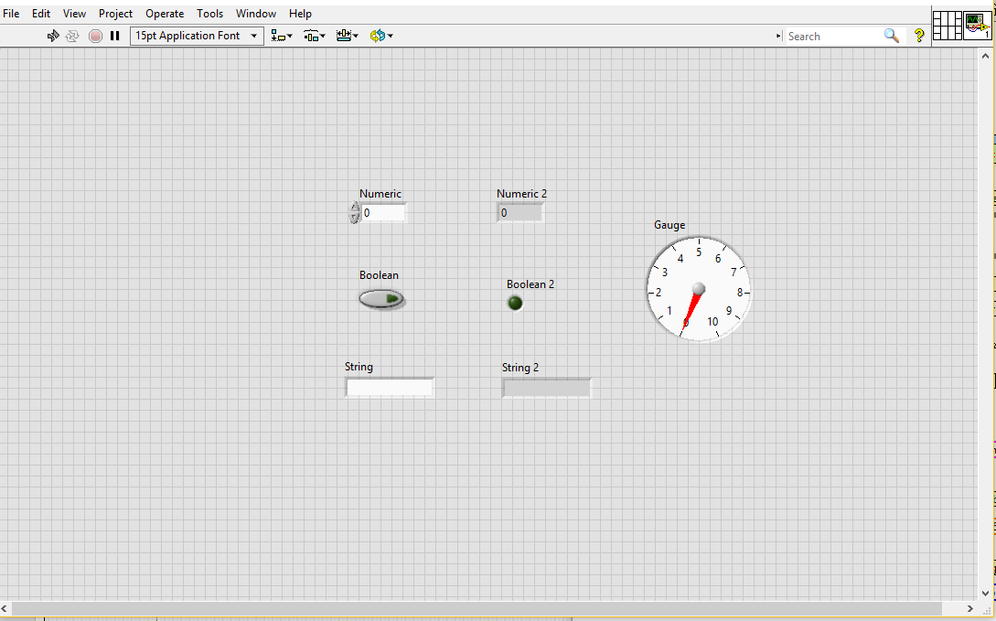
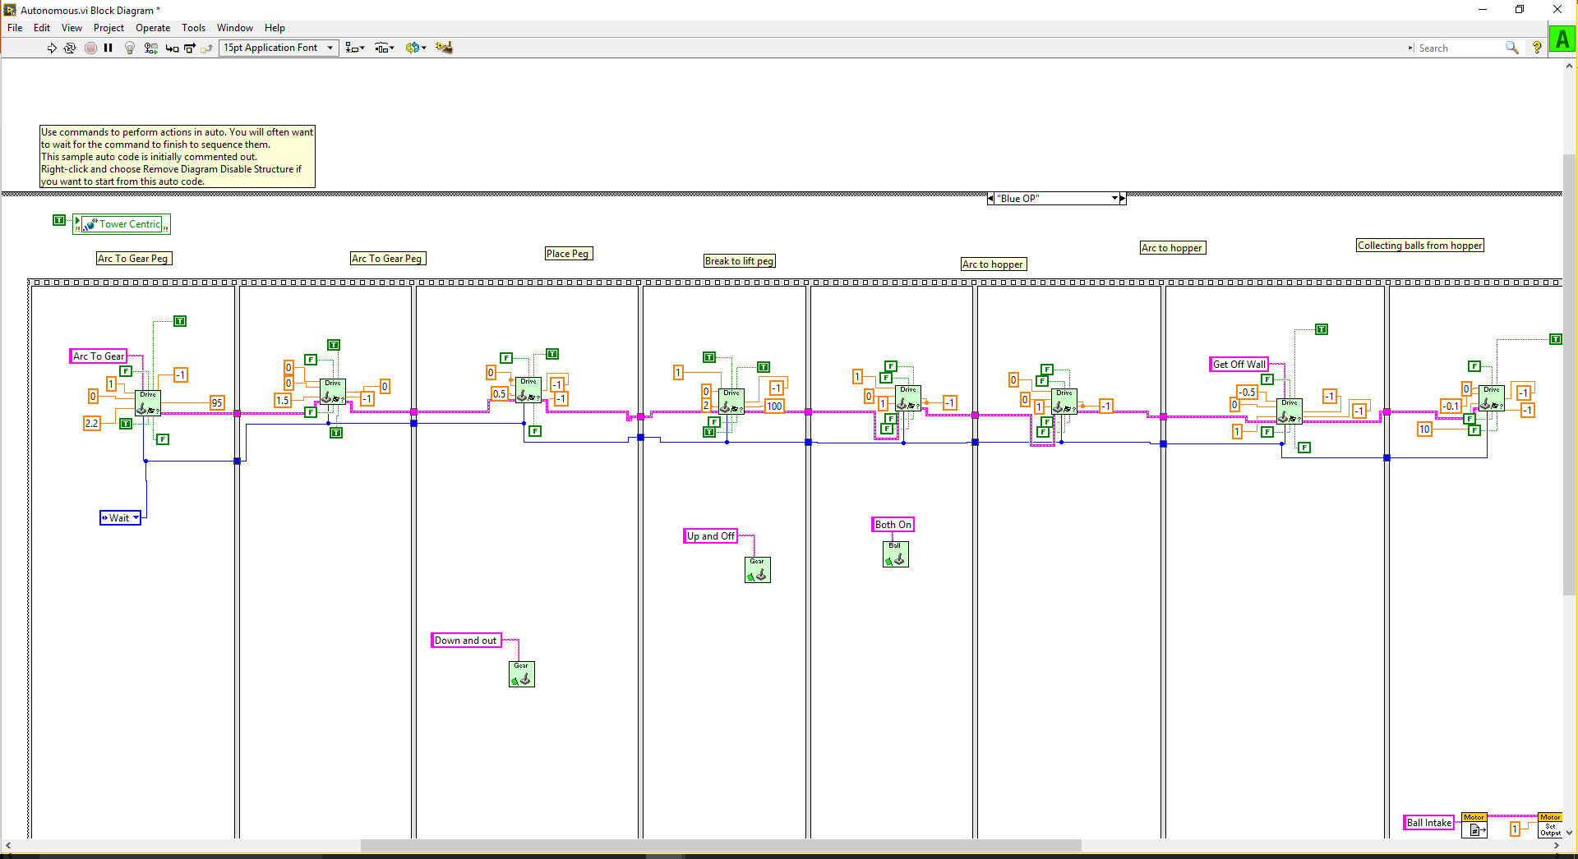
Views
Front Panel
Block Diagram

Slide 9
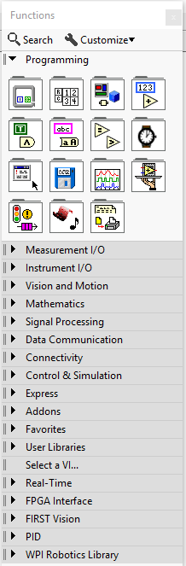
LabVIEW Pallet
All functions are found here
Used to write code
Right Click to pull up pallet

Slide 10
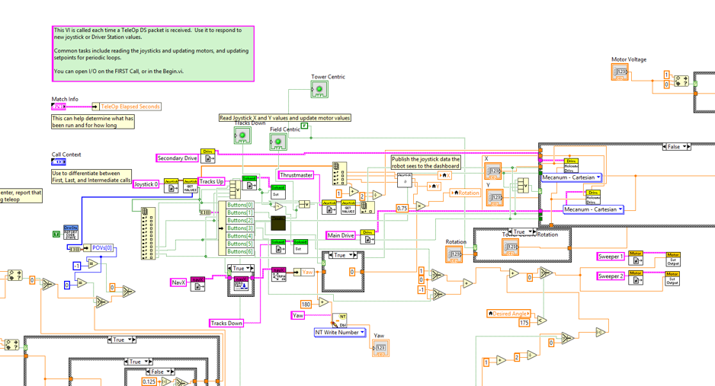
Spaghetti Code

Slide 11
LabVIEW Keystrokes to know
Ctrl-e: goes between front panel and block diagram
Ctrl-b: cleans up any broken wires
Ctrl-u: cleans up the highlighted code
Be carful with this one
Ctrl-Shift-n: pulls up the navigation window
Very helpful in big code
Ctrl-l: error list
Ctrl-z: undo
Ctrl-mouse: moves whole program

Slide 12
Parts of a Program

Slide 13
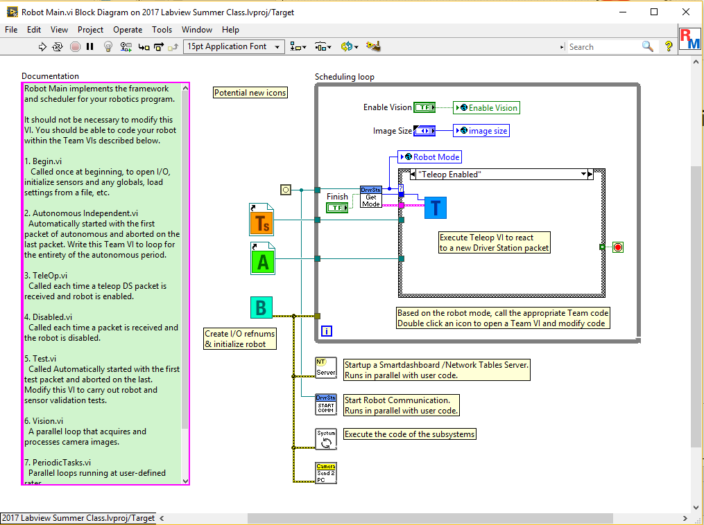
Robot Main
This is how your robot determines what to run.
Given information by the FMS or the Driver Station.
Do Not Modify This!! (unless you know what you are doing)

Slide 14
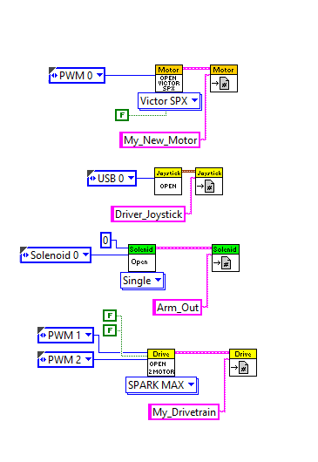
Begin
This is where you will initialize everything in your program.
Everything needs to be opened and given a reference name.
Give it a meaningful name
MyMotor
Left_Shooter_Motor

Slide 15
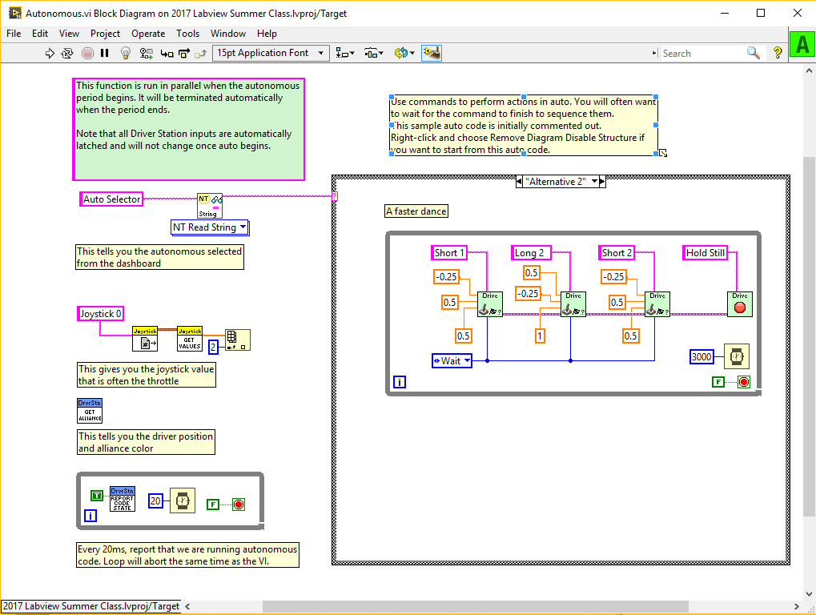
Autonomous
This is where the autonomous section of your code is.
Autonomous is the first 15 seconds of the match.

Slide 16
Teleop
The bulk of a match (2:15)
This is where the drivers control the robot.
Joysticks get processed here to make your robot function.

Slide 17
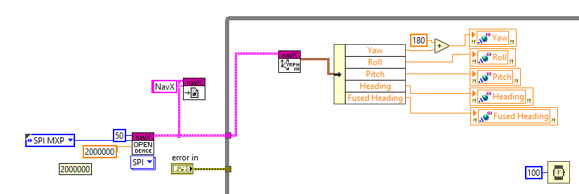
Periodic Tasks / Timed Tasks
Portion of the code you want to run all of the time.
Gyros
Vision Tracking
LED Lights

Slide 18
Let’s Code a Robot!
This is how easy and quick LabVIEW can be!

Slide 19
Requirements
4 Motor Drive Train (Kit Bot with Victor SPX)
PWM 0-3
1 Motor (Victor SPX)
PWM 4
Up and down on a 2 buttons
2 Solenoids
PCM 0-1
Out and In on 2 buttons
10 Minute Time Limit!!!!

Slide 20
What would you like to see coded in LabVIEW?

Slide 21
Options
Beginner
Intermediate
Advance
Toggle*
Gyro
Encoder
Pneumatics
Limit Switches
Robot Safety Features*
Coding Best Practices
Shifting Gear Box
Turn To Angle
LED Lights
Custom Driver Station*
LabVIEW Classes and Functions (Java Style)
Using Sensors to automate code*
Motion Profiling Vision Tracking
Eagle Eye
Motion Magic
Machine Learning (Logistical Regression)
* = recommended

Slide 22

Thank You!
Brandon Moe
612-991-2076
moexx399@d.umn.edu
https://github.com/moexx399

