Slide 1
Welcome to LabVIEW 2017
Brandon Moe

Slide 2
Syllabus Day!!

Slide 3
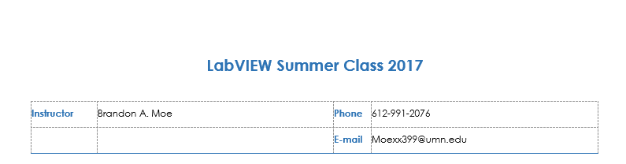
Introduction

Slide 4
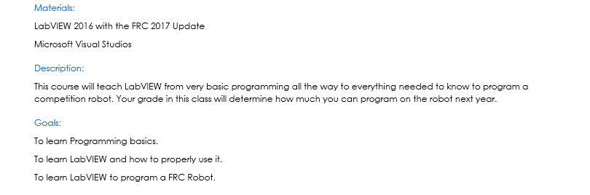
Overview

Slide 5
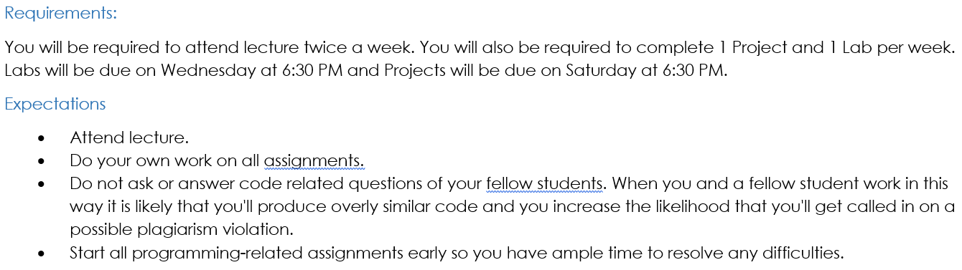
Requirements and Expectations

Slide 6
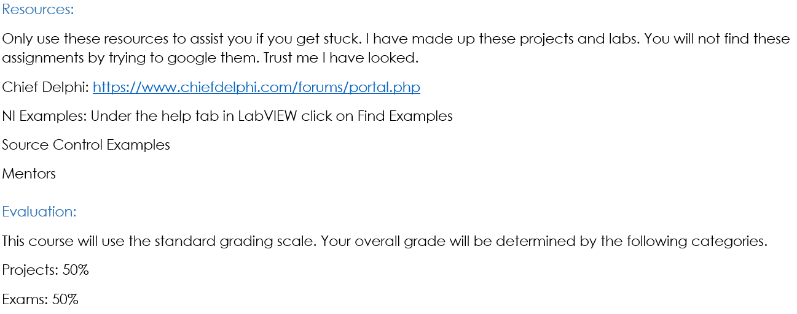
Resources and Evaluation

Slide 7
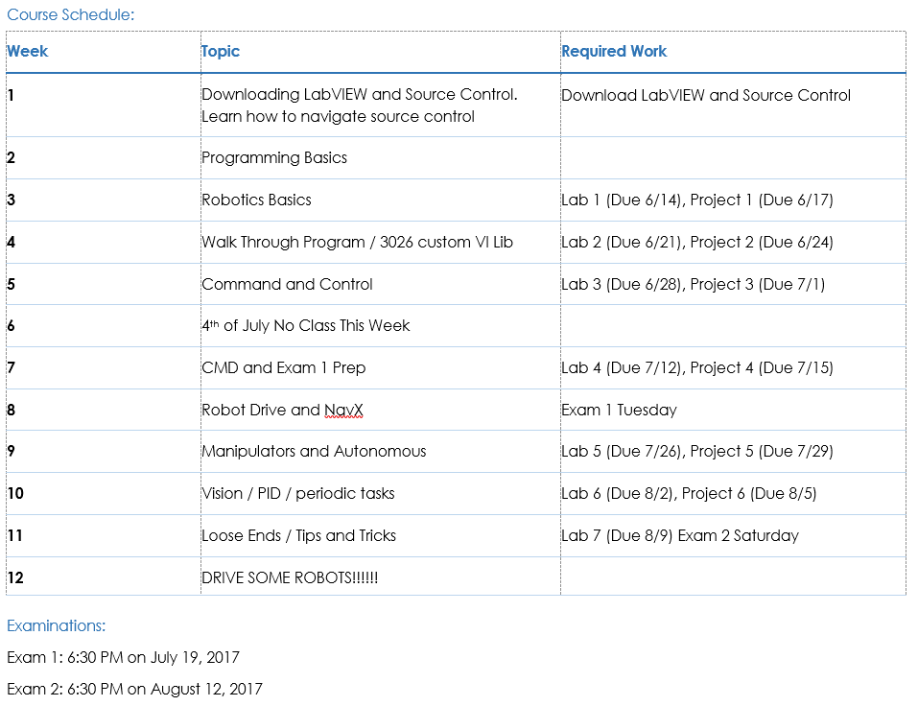
Class Schedule

Slide 8
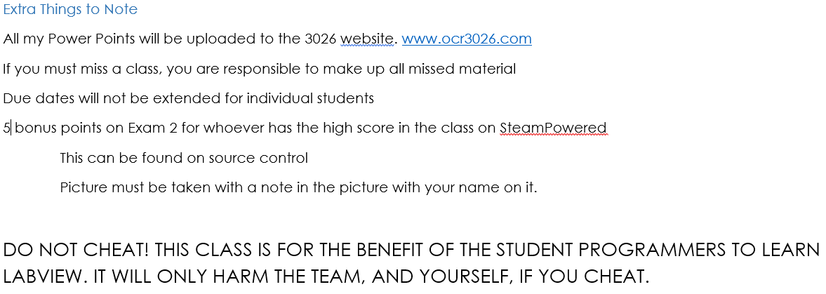
Loose Ends

Slide 9
Time Commitment
If you desire to be one of the lead programmer please know the following
It is a very big time commitment
Programming the robot usually happens later at night
Weekends during the build season are mandatory

Slide 10
Installing LabVIEW

Slide 11
Install LabVIEW 2016
LabVIEW Instructions
http://wpilib.screenstepslive.com/s/4485/m/13811/l/145005-installing-labview-for-frc-2017-labview-only
CTRE Download
Can be found in source control
NavX Download
http://www.pdocs.kauailabs.com/navx-mxp/software/roborio-libraries/labview/

Slide 12
Installing Source Control

