Slide 1

Moving Object Pipeline System (MOPS)
LDM-156
Mario Juric, Lynne Jones
Joachim Moeyens
University of Washington – Seattle – January 4, 2016

Slide 2
Basics
Installs on Linux and Mac OSX
On github (lsst/mops_daymops)
Requires gsl, eigen, boost
Currently uses SLALIB
Experimental branch uses PAL instead
Latest updates and commits:
neosim (scripts/experimentation)
fork (updates/fixes)
University of Washington – Seattle – January 4, 2016

Slide 3
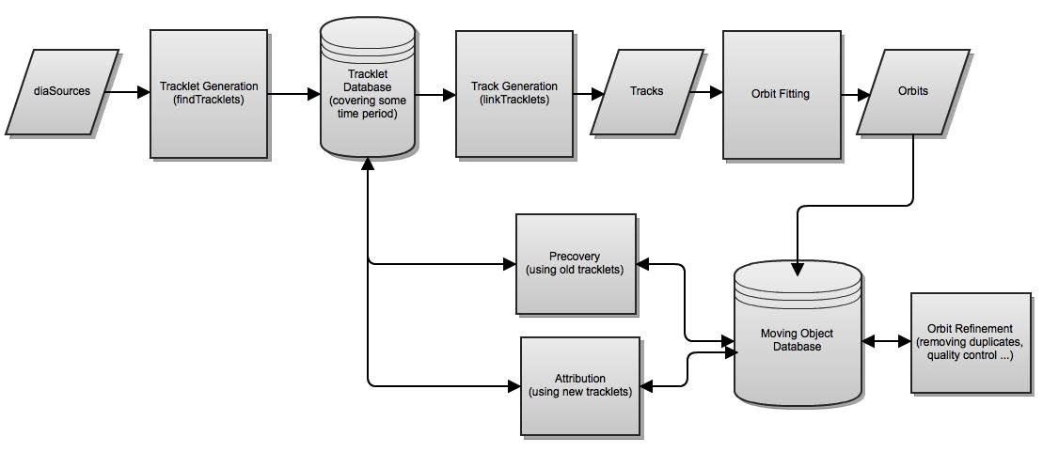
In Context
future
current
University of Washington – Seattle – January 4, 2016

Slide 4
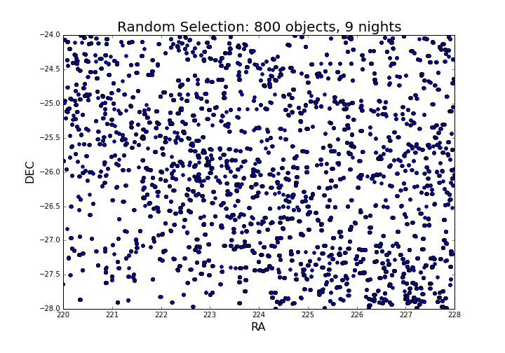
findTracklets
Links two DiaSource detections occurring within one night into a tracklet, assumes linear motion
findTracklets – collapseTracklets – purifyTracklets – removeSubsets – linkTracklets
University of Washington – Seattle – January 4, 2016

Slide 5
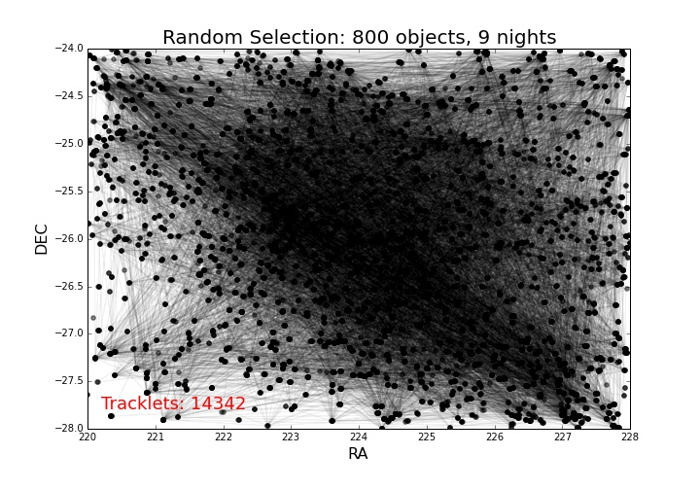
findTracklets
Links two DiaSource detections occurring within one night into a tracklet, assumes linear motion
findTracklets – collapseTracklets – purifyTracklets – removeSubsets – linkTracklets
University of Washington – Seattle – January 4, 2016

Slide 6
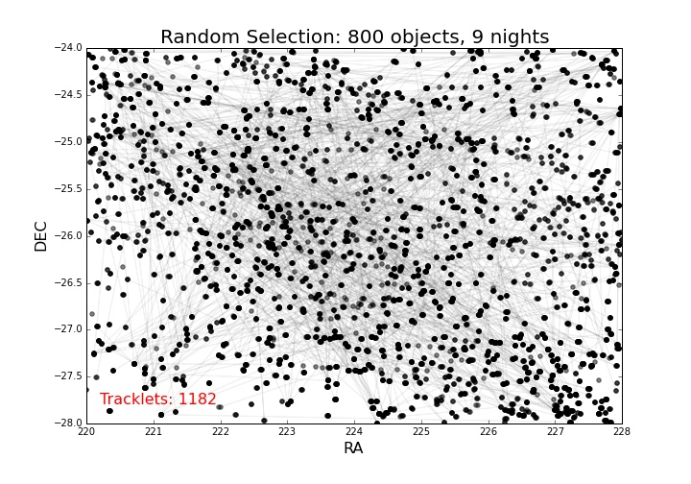
collapseTracklets
Merges collinear tracklets
findTracklets – collapseTracklets – purifyTracklets – removeSubsets – linkTracklets
University of Washington – Seattle – January 4, 2016

Slide 7

purifyTracklets
Removes detections from merged tracklets if they are sufficiently far away from the best-fit line
findTracklets – collapseTracklets – purifyTracklets – removeSubsets – linkTracklets
University of Washington – Seattle – January 4, 2016

Slide 8

removeSubsets
Removes tracklets that are subsets of longer tracklets
findTracklets – collapseTracklets – purifyTracklets – removeSubsets – linkTracklets
University of Washington – Seattle – January 4, 2016

Slide 9
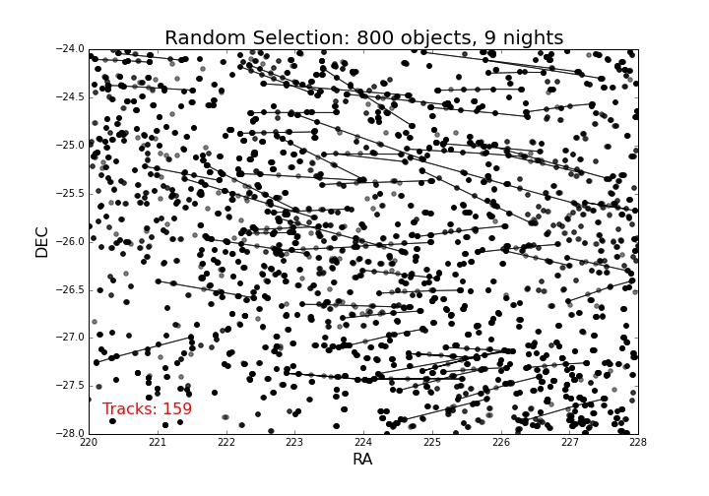
linkTracklets
Links tracklets into tracks, assumes quadratic fit
findTracklets – collapseTracklets – purifyTracklets – removeSubsets – linkTracklets
University of Washington – Seattle – January 4, 2016

Slide 10
Status
Run script
Accepts config file
Command line parameter specification with accepted defaults
Uses tracker and parameter object
Unittest
Experimental PAL branch
Compiles on Linux and Mac
Error: fails unittest
Tested up to linkTracklets
Error: has trouble moving data in 180 degree range despite no complaints from collapse, purifyTracklets
University of Washington – Seattle – January 4, 2016

Slide 11
Future
Fix errors/bugs
Make function inputs consistent
Run failure tests
Run efficiency tests
Understand scaling with larger datasets
Add orbit determination
Plotting and visualization tools
Analysis tools
University of Washington – Seattle – January 4, 2016

