Slide 1
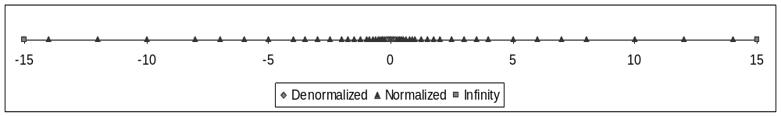
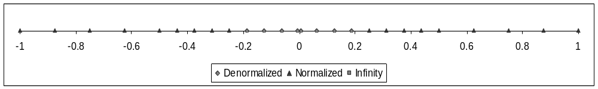

Slide 2
–∞
–10
–5
0
+5
+10
+∞
Denormalized
Normalized
Infinity
–0
+0
–1
–0.8
–0.6
–0.4
–0.2
0
+0.2
+0.4
+0.6
+0.8
+1
Denormalized
Normalized
Infinity

