Slide 1
CS:APP Chapter 4
Computer Architecture
Instruction Set
Architecture
Randal E. Bryant
Carnegie Mellon University
http://csapp.cs.cmu.edu
CS:APP

Slide 2
Instruction Set Architecture
Assembly Language View
  Processor state
    Registers, memory, …
  Instructions
    addl, movl, leal, …
    How instructions are encoded as bytes
Layer of Abstraction
  Above: how to program machine
    Processor executes instructions in a sequence
  Below: what needs to be built
    Use variety of tricks to make it run fast
    E.g., execute multiple instructions simultaneously
Application
Program
Compiler
OS
ISA
CPU
Design
Circuit
Design
Chip
Layout

Slide 3
Y86 Processor State
Program registers
Condition codes
Memory
%eax
%esi
%ecx
%edi
OF
ZF
SF
%edx
%esp
PC
%ebx
%ebp
  Program Registers
    Same 8 as with IA32. Each 32 bits
  Condition Codes
    Single-bit flags set by arithmetic or logical instructions
      OF: Overflow ZF: Zero SF:Negative
  Program Counter
    Indicates address of instruction
  Memory
    Byte-addressable storage array
    Words stored in little-endian byte order

Slide 4
Y86 Instructions
Format
  1--6 bytes of information read from memory
    Can determine instruction length from first byte
    Not as many instruction types, and simpler encoding than with IA32
  Each accesses and modifies some part(s) of the program state

Slide 5
Encoding Registers
Each register has 4-bit ID
  Same encoding as in IA32
Register ID 8 indicates “no register”
  Will use this in our hardware design in multiple places
%eax
0
%esi
6
%ecx
1
%edi
7
%edx
2
%esp
4
%ebx
3
%ebp
5

Slide 6
Instruction Example
Addition Instruction
  Add value in register rA to that in register rB
    Store result in register rB
    Note that Y86 only allows addition to be applied to register data
  Set condition codes based on result
  e.g., addl %eax,%esi Encoding: 60 06
  Two-byte encoding
    First indicates instruction type
    Second gives source and destination registers
Generic Form
Encoded Representation
addl rA, rB
6
0
rA
rB

Slide 7
Arithmetic and Logical Operations
Instruction Code
Function Code
Add
  Refer to generically as “OPl”
  Encodings differ only by “function code”
    Low-order 4 bytes in first instruction word
  Set condition codes as side effect
addl rA, rB
6
0
rA
rB
Subtract (rA from rB)
subl rA, rB
6
1
rA
rB
And
andl rA, rB
6
2
rA
rB
Exclusive-Or
xorl rA, rB
6
3
rA
rB

Slide 8
Move Operations
rrmovl rA, rB
2
0
rA
rB
Register --> Register
Immediate --> Register
irmovl V, rB
3
0
8
rB
V
Register --> Memory
rmmovl rA, D(rB)
4
0
rA
rB
D
Memory --> Register
mrmovl D(rB), rA
5
0
rA
rB
D
  Like the IA32 movl instruction
  Simpler format for memory addresses
  Give different names to keep them distinct

Slide 9
Move Instruction Examples
IA32
Y86
Encoding
movl $0xabcd, %edx
irmovl $0xabcd, %edx
30 82 cd ab 00 00
movl %esp, %ebx
rrmovl %esp, %ebx
20 43
movl -12(%ebp),%ecx
mrmovl -12(%ebp),%ecx
50 15 f4 ff ff ff
movl %esi,0x41c(%esp)
rmmovl %esi,0x41c(%esp)
40 64 1c 04 00 00
movl $0xabcd, (%eax)
—
movl %eax, 12(%eax,%edx)
—
movl (%ebp,%eax,4),%ecx
—

Slide 10
Jump Instructions
Jump Unconditionally
jmp Dest
7
0
Dest
  Refer to generically as “jXX”
  Encodings differ only by “function code”
  Based on values of condition codes
  Same as IA32 counterparts
  Encode full destination address
    Unlike PC-relative addressing seen in IA32
Jump When Less or Equal
jle Dest
7
1
Dest
Jump When Less
jl Dest
7
2
Dest
Jump When Equal
je Dest
7
3
Dest
Jump When Not Equal
jne Dest
7
4
Dest
Jump When Greater or Equal
jge Dest
7
5
Dest
Jump When Greater
jg Dest
7
6
Dest

Slide 11
Y86 Program Stack
Stack “Bottom”
  Region of memory holding program data
  Used in Y86 (and IA32) for supporting procedure calls
  Stack top indicated by %esp
    Address of top stack element
  Stack grows toward lower addresses
    Top element is at highest address in the stack
    When pushing, must first decrement stack pointer
    When popping, increment stack pointer
•
•
•
Increasing
Addresses
%esp
Stack “Top”

Slide 12
Stack Operations
pushl rA
a
0
rA
8
  Decrement %esp by 4
  Store word from rA to memory at %esp
  Like IA32
  Read word from memory at %esp
  Save in rA
  Increment %esp by 4
  Like IA32
popl rA
b
0
rA
8

Slide 13
Subroutine Call and Return
call Dest
8
0
Dest
  Push address of next instruction onto stack
  Start executing instructions at Dest
  Like IA32
  Pop value from stack
  Use as address for next instruction
  Like IA32
ret
9
0

Slide 14
Miscellaneous Instructions
nop
0
0
  Don’t do anything
  Stop executing instructions
  IA32 has comparable instruction, but can’t execute it in user mode
  We will use it to stop the simulator
halt
1
0

Slide 15
Writing Y86 Code
Try to Use C Compiler as Much as Possible
  Write code in C
  Compile for IA32 with gcc -S
  Transliterate into Y86
Coding Example
  Find number of elements in null-terminated list
    int len1(int a[]);
a
5043
6125
⇒ 3
7395
0

Slide 16
Y86 Code Generation Example
First Try
  Write typical array code
  Compile with gcc -O2 -S
Problem
  Hard to do array indexing on Y86
    Since don’t have scaled addressing modes
/* Find number of elements in
null-terminated list */
int len1(int a[])
{
int len;
for (len = 0; a[len]; len++)
;
return len;
}
L18:
incl %eax
cmpl $0,(%edx,%eax,4)
jne L18

Slide 17
Y86 Code Generation Example #2
Second Try
  Write with pointer code
  Compile with gcc -O2 -S
Result
  Don’t need to do indexed addressing
/* Find number of elements in
null-terminated list */
int len2(int a[])
{
int len = 0;
while (*a++)
len++;
return len;
}
L24:
movl (%edx),%eax
incl %ecx
L26:
addl $4,%edx
testl %eax,%eax
jne L24

Slide 18
Y86 Code Generation Example #3
IA32 Code
  Setup
Y86 Code
  Setup
len2:
pushl %ebp
xorl %ecx,%ecx
movl %esp,%ebp
movl 8(%ebp),%edx
movl (%edx),%eax
jmp L26
len2:
pushl %ebp # Save %ebp
xorl %ecx,%ecx # len = 0
rrmovl %esp,%ebp # Set frame
mrmovl 8(%ebp),%edx # Get a
mrmovl (%edx),%eax # Get *a
jmp L26 # Goto entry

Slide 19
Y86 Code Generation Example #4
IA32 Code
  Loop + Finish
Y86 Code
  Loop + Finish
L24:
movl (%edx),%eax
incl %ecx
L26:
addl $4,%edx
testl %eax,%eax
jne L24
movl %ebp,%esp
movl %ecx,%eax
popl %ebp
ret
L24:
mrmovl (%edx),%eax # Get *a
irmovl $1,%esi
addl %esi,%ecx # len++
L26: # Entry:
irmovl $4,%esi
addl %esi,%edx # a++
andl %eax,%eax # *a == 0?
jne L24 # No--Loop
rrmovl %ebp,%esp # Pop
rrmovl %ecx,%eax # Rtn len
popl %ebp
ret

Slide 20
Y86 Program Structure
irmovl Stack,%esp # Set up stack
rrmovl %esp,%ebp # Set up frame
irmovl List,%edx
pushl %edx # Push argument
call len2 # Call Function
halt # Halt
.align 4
List: # List of elements
.long 5043
.long 6125
.long 7395
.long 0
# Function
len2:
. . .
# Allocate space for stack
.pos 0x100
Stack:
  Program starts at address 0
  Must set up stack
    Make sure don’t overwrite code!
  Must initialize data
  Can use symbolic names

Slide 21
Assembling Y86 Program
  unix> yas eg.ys
  Generates “object code” file eg.yo
    Actually looks like disassembler output
  0x000: 308400010000 | irmovl Stack,%esp # Set up stack
  0x006: 2045 | rrmovl %esp,%ebp # Set up frame
  0x008: 308218000000 | irmovl List,%edx
  0x00e: a028 | pushl %edx # Push argument
  0x010: 8028000000 | call len2 # Call Function
  0x015: 10 | halt # Halt
  0x018: | .align 4
  0x018: | List: # List of elements
  0x018: b3130000 | .long 5043
  0x01c: ed170000 | .long 6125
  0x020: e31c0000 | .long 7395
  0x024: 00000000 | .long 0

Slide 22
Simulating Y86 Program
  unix> yis eg.yo
  Instruction set simulator
    Computes effect of each instruction on processor state
    Prints changes in state from original
  Stopped in 41 steps at PC = 0x16. Exception 'HLT', CC Z=1 S=0 O=0
  Changes to registers:
  %eax: 0x00000000 0x00000003
  %ecx: 0x00000000 0x00000003
  %edx: 0x00000000 0x00000028
  %esp: 0x00000000 0x000000fc
  %ebp: 0x00000000 0x00000100
  %esi: 0x00000000 0x00000004
  Changes to memory:
  0x00f4: 0x00000000 0x00000100
  0x00f8: 0x00000000 0x00000015
  0x00fc: 0x00000000 0x00000018

Slide 23
CISC Instruction Sets
  Complex Instruction Set Computer
  Dominant style through mid-80’s
Stack-oriented instruction set
  Use stack to pass arguments, save program counter
  Explicit push and pop instructions
Arithmetic instructions can access memory
  addl %eax, 12(%ebx,%ecx,4)
    requires memory read and write
    Complex address calculation
Condition codes
  Set as side effect of arithmetic and logical instructions
Philosophy
  Add instructions to perform “typical” programming tasks

Slide 24
RISC Instruction Sets
  Reduced Instruction Set Computer
  Internal project at IBM, later popularized by Hennessy (Stanford) and Patterson (Berkeley)
Fewer, simpler instructions
  Might take more to get given task done
  Can execute them with small and fast hardware
Register-oriented instruction set
  Many more (typically 32) registers
  Use for arguments, return pointer, temporaries
Only load and store instructions can access memory
  Similar to Y86 mrmovl and rmmovl
No Condition codes
  Test instructions return 0/1 in register

Slide 25
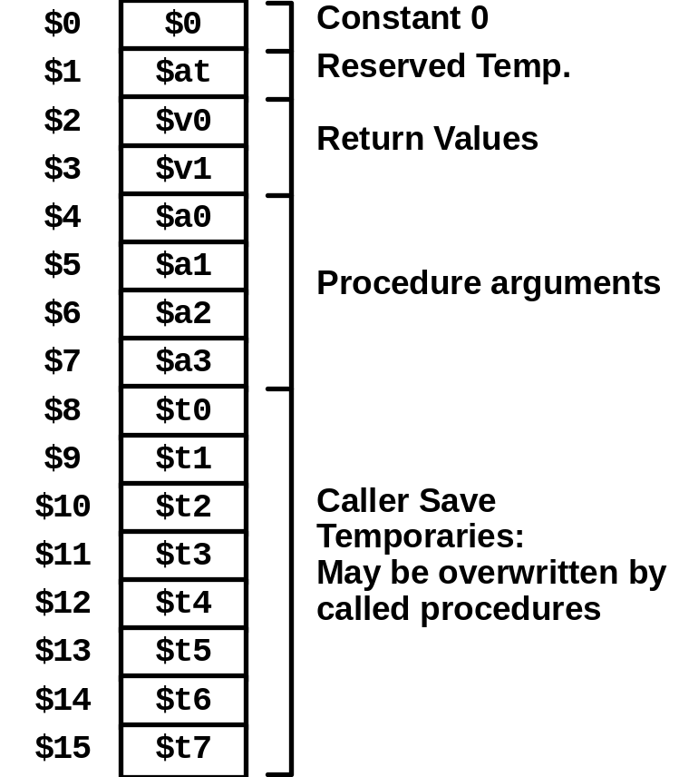
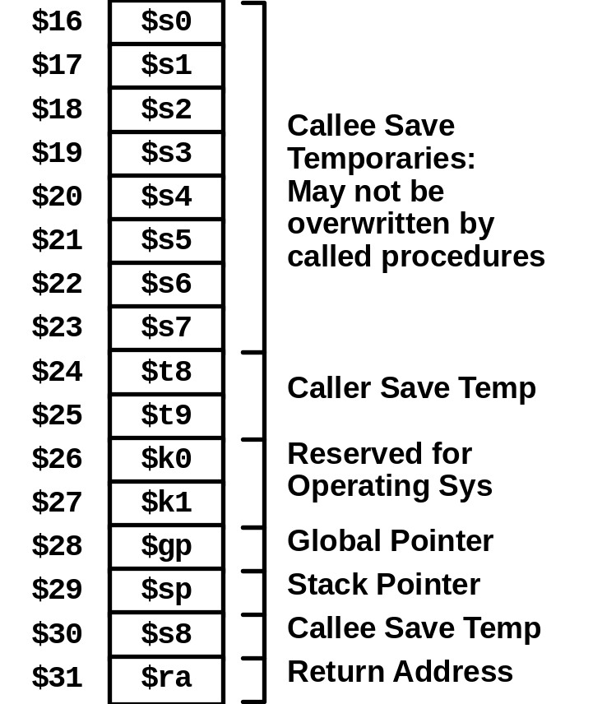
MIPS Registers

Slide 26
MIPS Instruction Examples
R-R
Op
Ra
Rb
Rd
00000
Fn
addu $3,$2,$1 # Register add: $3 = $2+$1
R-I
Op
Ra
Rb
Immediate
addu $3,$2, 3145 # Immediate add: $3 = $2+3145
sll $3,$2,2 # Shift left: $3 = $2 << 2
Branch
Op
Ra
Rb
Offset
beq $3,$2,dest # Branch when $3 = $2
Load/Store
Op
Ra
Rb
Offset
lw $3,16($2) # Load Word: $3 = M[$2+16]
sw $3,16($2) # Store Word: M[$2+16] = $3

Slide 27
CISC vs. RISC
Original Debate
  Strong opinions!
  CISC proponents---easy for compiler, fewer code bytes
  RISC proponents---better for optimizing compilers, can make run fast with simple chip design
Current Status
  For desktop processors, choice of ISA not a technical issue
    With enough hardware, can make anything run fast
    Code compatibility more important
  For embedded processors, RISC makes sense
    Smaller, cheaper, less power

Slide 28
Summary
Y86 Instruction Set Architecture
  Similar state and instructions as IA32
  Simpler encodings
  Somewhere between CISC and RISC
How Important is ISA Design?
  Less now than before
    With enough hardware, can make almost anything go fast
  Intel is moving away from IA32
    Does not allow enough parallel execution
    Introduced IA64
      64-bit word sizes (overcome address space limitations)
      Radically different style of instruction set with explicit parallelism
      Requires sophisticated compilers

