Slide 1
CS:APP Chapter 4
Computer Architecture
Logic Design
Randal E. Bryant
Carnegie Mellon University
http://csapp.cs.cmu.edu
CS:APP

Slide 2
Overview of Logic Design
Fundamental Hardware Requirements
  Communication
    How to get values from one place to another
  Computation
  Storage
Bits are Our Friends
  Everything expressed in terms of values 0 and 1
  Communication
    Low or high voltage on wire
  Computation
    Compute Boolean functions
  Storage
    Store bits of information

Slide 3
Digital Signals
0
1
0
Voltage
Time
  Use voltage thresholds to extract discrete values from continuous signal
  Simplest version: 1-bit signal
    Either high range (1) or low range (0)
    With guard range between them
  Not strongly affected by noise or low quality circuit elements
    Can make circuits simple, small, and fast

Slide 4
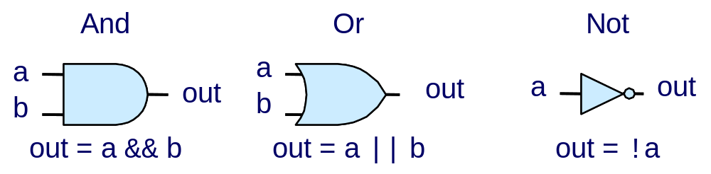
Computing with Logic Gates
  Outputs are Boolean functions of inputs
  Respond continuously to changes in inputs
    With some, small delay
Rising Delay
Falling Delay
a && b
b
Voltage
a
Time

Slide 5



Combinational Circuits
Acyclic Network
Primary
Inputs
Primary
Outputs
Acyclic Network of Logic Gates
  Continously responds to changes on primary inputs
  Primary outputs become (after some delay) Boolean functions of primary inputs

Slide 6
Bit Equality
Bit equal
a
HCL Expression
eq
bool eq = (a&&b)||(!a&&!b)
b
  Generate 1 if a and b are equal
Hardware Control Language (HCL)
  Very simple hardware description language
    Boolean operations have syntax similar to C logical operations
  We’ll use it to describe control logic for processors

Slide 7
Word Equality
Word-Level Representation
b₃₁
Bit equal
eq₃₁
B
=
Eq
a₃₁
b₃₀
Bit equal
eq₃₀
A
a₃₀
HCL Representation
Eq
bool Eq = (A == B)
b₁
Bit equal
eq₁
a₁
  32-bit word size
  HCL representation
    Equality operation
    Generates Boolean value
b₀
Bit equal
eq₀
a₀

Slide 8
Bit-Level Multiplexor
s
Bit MUX
HCL Expression
bool out = (s&&a)||(!s&&b)
b
out
a
  Control signal s
  Data signals a and b
  Output a when s=1, b when s=0

Slide 9
Word Multiplexor
s
Word-Level Representation
s
B
MUX
b₃₁
Out
out₃₁
A
a₃₁
HCL Representation
b₃₀
int Out = [
s : A;
1 : B;
];
out₃₀
a₃₀
  Select input word A or B depending on control signal s
  HCL representation
    Case expression
    Series of test : value pairs
    Output value for first successful test
b₀
out₀
a₀

Slide 10
HCL Word-Level Examples
Minimum of 3 Words
  Find minimum of three input words
  HCL case expression
  Final case guarantees match
int Min3 = [
A < B && A < C : A;
B < A && B < C : B;
1 : C;
];
C
MIN3
B
Min3
A
4-Way Multiplexor
s1
s0
  Select one of 4 inputs based on two control bits
  HCL case expression
  Simplify tests by assuming sequential matching
MUX4
int Out4 = [
!s1&&!s0: D0;
!s1 : D1;
!s0 : D2;
1 : D3;
];
D0
D1
Out4
D2
D3

Slide 11
Arithmetic Logic Unit
0
1
2
3
Y
A
Y
A
Y
A
Y
A
A
L
U
A
L
U
A
L
U
A
L
U
X + Y
X - Y
X & Y
X ^ Y
X
B
OF
X
B
OF
X
B
OF
X
B
OF
ZF
ZF
ZF
ZF
CF
CF
CF
CF
  Combinational logic
    Continuously responding to inputs
  Control signal selects function computed
    Corresponding to 4 arithmetic/logical operations in Y86
  Also computes values for condition codes

Slide 12
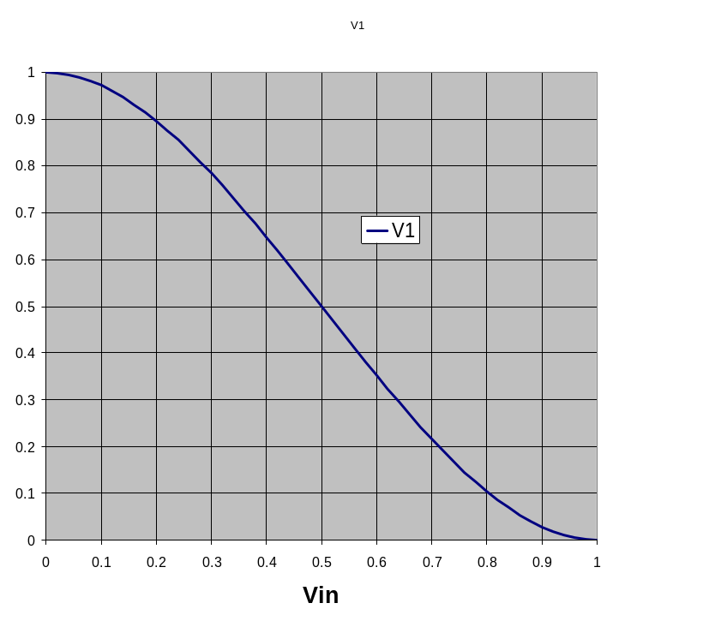
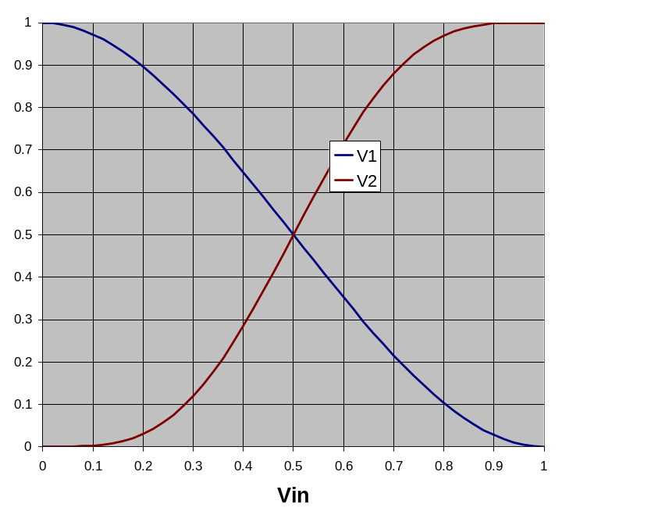
Storing 1 Bit
Bistable Element
q
Q+
!q
Q–
q = 0 or 1
V₂
V_{in}
V₁

Slide 13
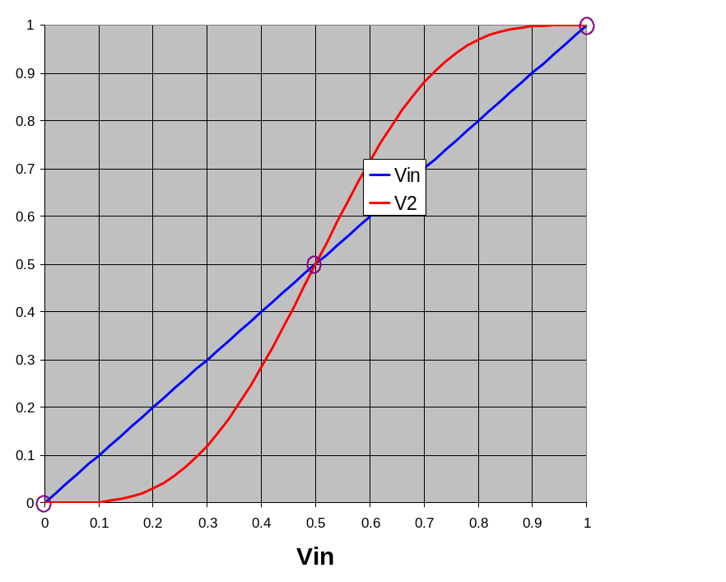
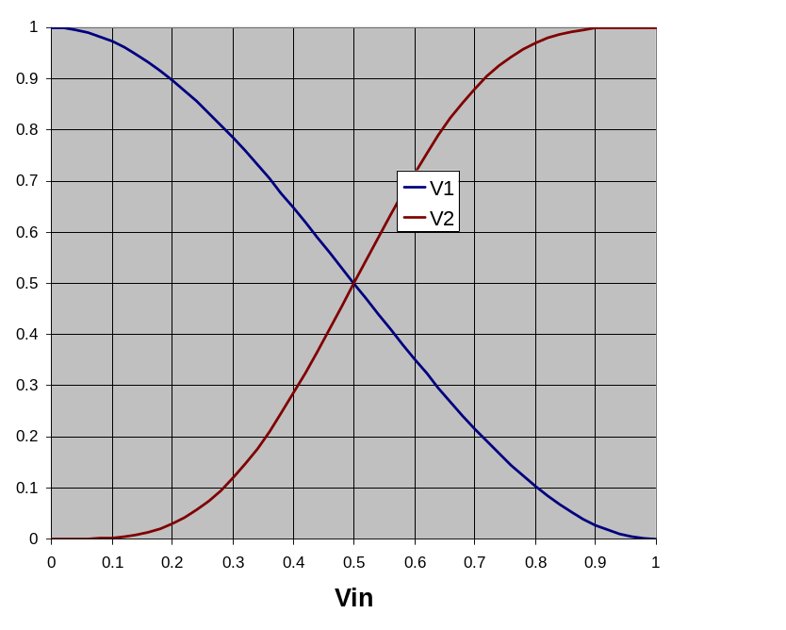
Storing 1 Bit (cont.)
Bistable Element
q
Q+
!q
Q–
q = 0 or 1
Stable 1
V_{in} = V₂
V₂
V₂
Metastable
V_{in}
V_{in}
V₁
V₁
Stable 0

Slide 14
Physical Analogy
Stable 1
Metastable
Stable 0
Metastable
Stable left
.
.
Stable right
.

Slide 15
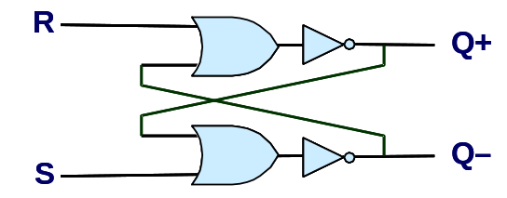
Storing and Accessing 1 Bit
Bistable Element
R-S Latch
q
R
Q+
Q+
!q
Q–
Q–
S
q = 0 or 1
Resetting
Setting
Storing
1
1
0
0
0
1
0
!q
q
0
0
1
1
1
0
0
q
!q

Slide 16
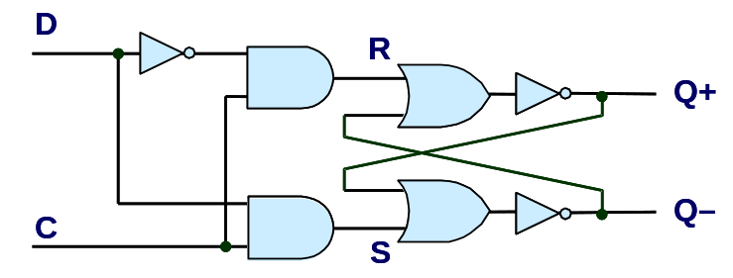
1-Bit Latch
D Latch
D
R
Data
Q+
C
Q–
Clock
S
Latching
Storing
d
!d
!d
!d
d
d
!d
0
!q
q
1
0
!q
d
d
!d
0
q

Slide 17
Transparent 1-Bit Latch
Latching
Changing D
d
!d
!d
!d
d
C
D
1
Q+
d
d
!d
Time
  When in latching mode, combinational propogation from D to Q+ and Q–
  Value latched depends on value of D as C falls

Slide 18
Edge-Triggered Latch
D
R
Data
Q+
Q–
C
S
T
Clock
Trigger
  Only in latching mode for brief period
    Rising clock edge
  Value latched depends on data as clock rises
  Output remains stable at all other times
C
T
D
Q+
Time

Slide 19
Registers
Structure
i₇
D
o₇
C
Q+
i₆
D
o₆
C
Q+
i₅
D
o₅
C
Q+
i₄
D
o₄
C
Q+
I
O
i₃
D
o₃
C
Q+
i₂
D
o₂
C
Q+
i₁
D
o₁
Clock
C
Q+
i₀
D
o₀
C
Q+
Clock
  Stores word of data
    Different from program registers seen in assembly code
  Collection of edge-triggered latches
  Loads input on rising edge of clock

Slide 20
Register Operation
State = x
State = y
x
Rising
clock
y
Input = y
Output = x


Output = y
  Stores data bits
  For most of time acts as barrier between input and output
  As clock rises, loads input

Slide 21
State Machine Example
Comb. Logic
0
  Accumulator circuit
  Load or accumulate on each cycle
A
L
U
MUX
0
Out
In
1
Load
Clock
Clock
Load
In
x₀
x₁
x₂
x₃
x₄
x₅
Out
x₀
x₀+x₁
x₀+x₁+x₂
x₃
x₃+x₄
x₃+x₄+x₅

Slide 22
Random-Access Memory
valA
Register
file
srcA
A
valW
Read ports
W
dstW
Write port
valB
srcB
B
Clock
  Stores multiple words of memory
    Address input specifies which word to read or write
  Register file
    Holds values of program registers
    %eax, %esp, etc.
    Register identifier serves as address
      ID 8 implies no read or write performed
  Multiple Ports
    Can read and/or write multiple words in one cycle
      Each has separate address and data input/output

Slide 23
Register File Timing
Reading
  Like combinational logic
  Output data generated based on input address
    After some delay
Writing
  Like register
  Update only as clock rises
valA
Register
file
2
x
srcA
A
x
valB
srcB
B
2
Register
file
2
x
Register
file
valW
2
y
y
Rising
clock
valW
W
dstW


2
W
dstW
Clock
Clock

Slide 24
Hardware Control Language
  Very simple hardware description language
  Can only express limited aspects of hardware operation
    Parts we want to explore and modify
Data Types
  bool: Boolean
    a, b, c, …
  int: words
    A, B, C, …
    Does not specify word size---bytes, 32-bit words, …
Statements
  bool a = bool-expr ;
  int A = int-expr ;

Slide 25
HCL Operations
  Classify by type of value returned
Boolean Expressions
  Logic Operations
    a && b, a || b, !a
  Word Comparisons
    A == B, A != B, A < B, A <= B, A >= B, A > B
  Set Membership
    A in { B, C, D }
      Same as A == B || A == C || A == D
Word Expressions
  Case expressions
    [ a : A; b : B; c : C ]
    Evaluate test expressions a, b, c, … in sequence
    Return word expression A, B, C, … for first successful test

Slide 26
Summary
Computation
  Performed by combinational logic
  Computes Boolean functions
  Continuously reacts to input changes
Storage
  Registers
    Hold single words
    Loaded as clock rises
  Random-access memories
    Hold multiple words
    Possible multiple read or write ports
    Read word when address input changes
    Write word as clock rises

