Slide 1
CS:APP Chapter 4
Computer Architecture
Sequential
Implementation
Randal E. Bryant
Carnegie Mellon University
http://csapp.cs.cmu.edu
CS:APP

Slide 2
Y86 Instruction Set
Byte
0
1
2
3
4
5
nop
0
0
addl
6
0
halt
1
0
subl
6
1
rrmovl rA, rB
2
0
rA
rB
andl
6
2
irmovl V, rB
3
0
8
rB
V
xorl
6
3
rmmovl rA, D(rB)
4
0
rA
rB
D
jmp
7
0
mrmovl D(rB), rA
5
0
rA
rB
D
jle
7
1
OPl rA, rB
6
fn
rA
rB
jl
7
2
jXX Dest
7
fn
Dest
je
7
3
call Dest
8
0
Dest
jne
7
4
ret
9
0
jge
7
5
pushl rA
A
0
rA
8
jg
7
6
popl rA
B
0
rA
8

Slide 3
Building Blocks
fun
=
Combinational Logic
  Compute Boolean functions of inputs
  Continuously respond to input changes
  Operate on data and implement control
Storage Elements
  Store bits
  Addressable memories
  Non-addressable registers
  Loaded only as clock rises
A
A
L
U
B
MUX
0
1
valA
Register
file
srcA
A
valW
W
dstW
valB
srcB
B
Clock
Clock

Slide 4
Hardware Control Language
  Very simple hardware description language
  Can only express limited aspects of hardware operation
    Parts we want to explore and modify
Data Types
  bool: Boolean
    a, b, c, …
  int: words
    A, B, C, …
    Does not specify word size---bytes, 32-bit words, …
Statements
  bool a = bool-expr ;
  int A = int-expr ;

Slide 5
HCL Operations
  Classify by type of value returned
Boolean Expressions
  Logic Operations
    a && b, a || b, !a
  Word Comparisons
    A == B, A != B, A < B, A <= B, A >= B, A > B
  Set Membership
    A in { B, C, D }
      Same as A == B || A == C || A == D
Word Expressions
  Case expressions
    [ a : A; b : B; c : C ]
    Evaluate test expressions a, b, c, … in sequence
    Return word expression A, B, C, … for first successful test

Slide 6
SEQ Hardware Structure
newPC
PC
valE
,
valM
Write back
valM
State
  Program counter register (PC)
  Condition code register (CC)
  Register File
  Memories
    Access same memory space
    Data: for reading/writing program data
    Instruction: for reading instructions
Instruction Flow
  Read instruction at address specified by PC
  Process through stages
  Update program counter
Data
Memory
Data
memory
memory
Addr
, Data
valE
CC
CC
ALU
Execute
Bch
ALU
aluA
,
aluB
valA
,
valB
Decode
srcA
,
srcB
A
A
B
dstA
,
dstB
B
M
Register
M
Register
Register
Register
file
file
file
file
E
E
icode
,
ifun
valP
rA
,
rB
valC
Instruction
PC
Instruction
PC
Fetch
memory
increment
memory
increment
PC

Slide 7
SEQ Stages
newPC
PC
valE
,
valM
Write back
valM
Fetch
  Read instruction from instruction memory
Decode
  Read program registers
Execute
  Compute value or address
Memory
  Read or write data
Write Back
  Write program registers
PC
  Update program counter
Data
Memory
Data
memory
memory
Addr
, Data
valE
CC
CC
ALU
Execute
Bch
ALU
aluA
,
aluB
valA
,
valB
Decode
srcA
,
srcB
A
A
B
dstA
,
dstB
B
M
Register
M
Register
Register
Register
file
file
file
file
E
E
icode
rA
,
ifun
valP
,
rB
valC
Instruction
PC
Instruction
PC
Fetch
memory
increment
memory
increment
PC

Slide 8
Instruction Decoding
Optional
Optional
5
0
rA
rB
D
icode
ifun
rA
rB
valC
Instruction Format
  Instruction byte icode:ifun
  Optional register byte rA:rB
  Optional constant word valC

Slide 9
Executing Arith./Logical Operation
OPl rA, rB
6
fn
rA
rB
Fetch
  Read 2 bytes
Decode
  Read operand registers
Execute
  Perform operation
  Set condition codes
Memory
  Do nothing
Write back
  Update register
PC Update
  Increment PC by 2

Slide 10
Stage Computation: Arith/Log. Ops
OPl rA, rB
Fetch
icode:ifun ← M₁[PC]
Read instruction byte
rA:rB ← M₁[PC+1]
Read register byte
valP ← PC+2
Compute next PC
Decode
valA ← R[rA]
Read operand A
valB ← R[rB]
Read operand B
Execute
valE ← valB OP valA
Perform ALU operation
Set CC
Set condition code register
Memory
Write
back
R[rB] ← valE
Write back result
PC update
PC ← valP
Update PC
  Formulate instruction execution as sequence of simple steps
  Use same general form for all instructions

Slide 11
Executing rmmovl
rmmovl rA, D(rB)
4
0
rA
rB
D
Fetch
  Read 6 bytes
Decode
  Read operand registers
Execute
  Compute effective address
Memory
  Write to memory
Write back
  Do nothing
PC Update
  Increment PC by 6

Slide 12
Stage Computation: rmmovl
rmmovl rA, D(rB)
Fetch
icode:ifun ← M₁[PC]
Read instruction byte
rA:rB ← M₁[PC+1]
Read register byte
valC ← M₄[PC+2]
Read displacement D
valP ← PC+6
Compute next PC
Decode
valA ← R[rA]
Read operand A
valB ← R[rB]
Read operand B
Execute
valE ← valB + valC
Compute effective address
Memory
M₄[valE] ← valA
Write value to memory
Write
back
PC update
PC ← valP
Update PC
  Use ALU for address computation

Slide 13
Executing popl
popl rA
b
0
rA
8
Fetch
  Read 2 bytes
Decode
  Read stack pointer
Execute
  Increment stack pointer by 4
Memory
  Read from old stack pointer
Write back
  Update stack pointer
  Write result to register
PC Update
  Increment PC by 2

Slide 14
Stage Computation: popl
popl rA
Fetch
icode:ifun ← M₁[PC]
Read instruction byte
rA:rB ← M₁[PC+1]
Read register byte
valP ← PC+2
Compute next PC
Decode
valA ← R[%esp]
Read stack pointer
valB ← R [%esp]
Read stack pointer
Execute
valE ← valB + 4
Increment stack pointer
Memory
valM ← M₄[valA]
Read from stack
Write
back
R[%esp] ← valE
Update stack pointer
R[rA] ← valM
Write back result
PC update
PC ← valP
Update PC
  Use ALU to increment stack pointer
  Must update two registers
    Popped value
    New stack pointer

Slide 15
Executing Jumps
jXX Dest
7
fn
Dest
fall thru:
XX
XX
Not taken
target:
XX
XX
Taken
Fetch
  Read 5 bytes
  Increment PC by 5
Decode
  Do nothing
Execute
  Determine whether to take branch based on jump condition and condition codes
Memory
  Do nothing
Write back
  Do nothing
PC Update
  Set PC to Dest if branch taken or to incremented PC if not branch

Slide 16
Stage Computation: Jumps
jXX Dest
Fetch
icode:ifun ← M₁[PC]
Read instruction byte
valC ← M₄[PC+1]
Read destination address
valP ← PC+5
Fall through address
Decode
Execute
Bch ← Cond(CC,ifun)
Take branch?
Memory
Write
back
PC update
PC ← Bch ? valC : valP
Update PC
  Compute both addresses
  Choose based on setting of condition codes and branch condition

Slide 17
Executing call
call Dest
8
0
Dest
return:
XX
XX
target:
XX
XX
Fetch
  Read 5 bytes
  Increment PC by 5
Decode
  Read stack pointer
Execute
  Decrement stack pointer by 4
Memory
  Write incremented PC to new value of stack pointer
Write back
  Update stack pointer
PC Update
  Set PC to Dest

Slide 18
Stage Computation: call
call Dest
Fetch
icode:ifun ← M₁[PC]
Read instruction byte
valC ← M₄[PC+1]
Read destination address
valP ← PC+5
Compute return point
Decode
valB ← R[%esp]
Read stack pointer
Execute
valE ← valB + –4
Decrement stack pointer
Memory
M₄[valE] ← valP
Write return value on stack
Write
back
R[%esp] ← valE
Update stack pointer
PC update
PC ← valC
Set PC to destination
  Use ALU to decrement stack pointer
  Store incremented PC

Slide 19
Executing ret
ret
9
0
return:
XX
XX
Fetch
  Read 1 byte
Decode
  Read stack pointer
Execute
  Increment stack pointer by 4
Memory
  Read return address from old stack pointer
Write back
  Update stack pointer
PC Update
  Set PC to return address

Slide 20
Stage Computation: ret
ret
Fetch
icode:ifun ← M₁[PC]
Read instruction byte
Decode
valA ← R[%esp]
Read operand stack pointer
valB ← R[%esp]
Read operand stack pointer
Execute
valE ← valB + 4
Increment stack pointer
Memory
valM ← M₄[valA]
Read return address
Write
back
R[%esp] ← valE
Update stack pointer
PC update
PC ← valM
Set PC to return address
  Use ALU to increment stack pointer
  Read return address from memory

Slide 21
Computation Steps
OPl rA, rB
Fetch
icode,ifun
icode:ifun ← M₁[PC]
Read instruction byte
rA,rB
rA:rB ← M₁[PC+1]
Read register byte
valC
[Read constant word]
valP
valP ← PC+2
Compute next PC
Decode
valA, srcA
valA ← R[rA]
Read operand A
valB, srcB
valB ← R[rB]
Read operand B
Execute
valE
valE ← valB OP valA
Perform ALU operation
Cond code
Set CC
Set condition code register
Memory
valM
[Memory read/write]
Write
back
dstE
R[rB] ← valE
Write back ALU result
dstM
[Write back memory result]
PC update
PC
PC ← valP
Update PC
  All instructions follow same general pattern
  Differ in what gets computed on each step

Slide 22
Computation Steps
call Dest
Fetch
icode,ifun
icode:ifun ← M₁[PC]
Read instruction byte
rA,rB
[Read register byte]
valC
valC ← M₄[PC+1]
Read constant word
valP
valP ← PC+5
Compute next PC
Decode
valA, srcA
[Read operand A]
valB, srcB
valB ← R[%esp]
Read operand B
Execute
valE
valE ← valB + –4
Perform ALU operation
Cond code
[Set condition code reg.]
Memory
valM
M₄[valE] ← valP
[Memory read/write]
Write
back
dstE
R[%esp] ← valE
[Write back ALU result]
dstM
Write back memory result
PC update
PC
PC ← valC
Update PC
  All instructions follow same general pattern
  Differ in what gets computed on each step

Slide 23
Computed Values
Fetch
  icode Instruction code
  ifun Instruction function
  rA Instr. Register A
  rB Instr. Register B
  valC Instruction constant
  valP Incremented PC
Decode
  srcA Register ID A
  srcB Register ID B
  dstE Destination Register E
  dstM Destination Register M
  valA Register value A
  valB Register value B
Execute
  valE ALU result
  Bch Branch flag
Memory
  valM Value from memory

Slide 24
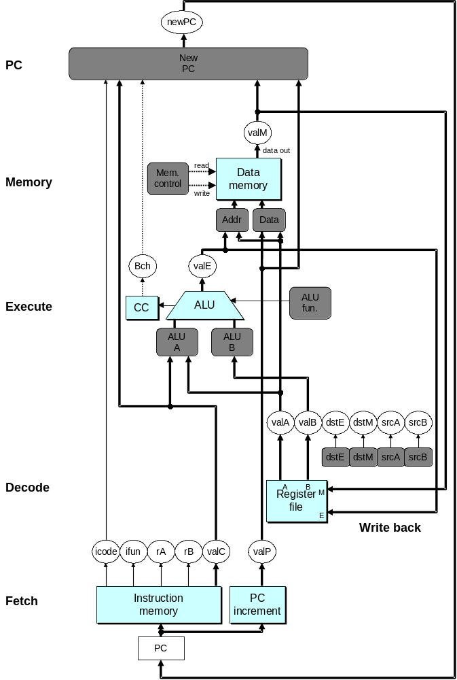
SEQ Hardware
Key
  Blue boxes: predesigned hardware blocks
    E.g., memories, ALU
  Gray boxes: control logic
    Describe in HCL
  White ovals: labels for signals
  Thick lines: 32-bit word values
  Thin lines: 4-8 bit values
  Dotted lines: 1-bit values

Slide 25
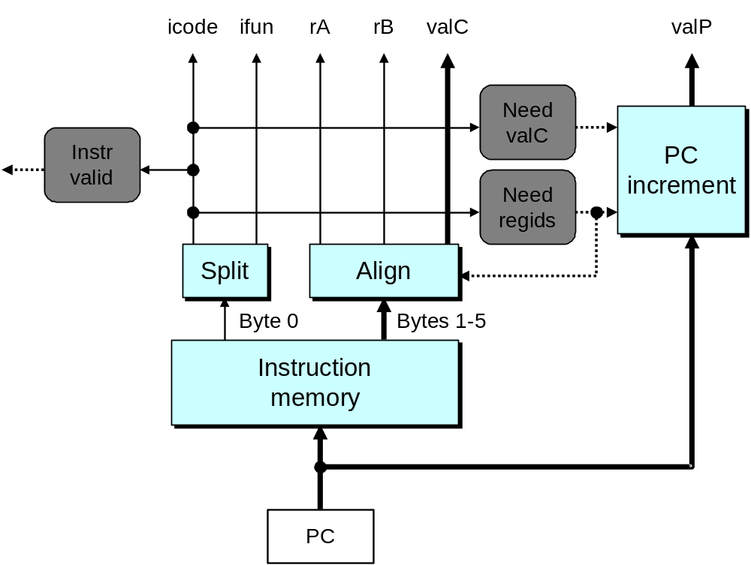
Fetch Logic
Predefined Blocks
  PC: Register containing PC
  Instruction memory: Read 6 bytes (PC to PC+5)
  Split: Divide instruction byte into icode and ifun
  Align: Get fields for rA, rB, and valC

Slide 26
Fetch Logic
Control Logic
  Instr. Valid: Is this instruction valid?
  Need regids: Does this instruction have a register bytes?
  Need valC: Does this instruction have a constant word?

Slide 27
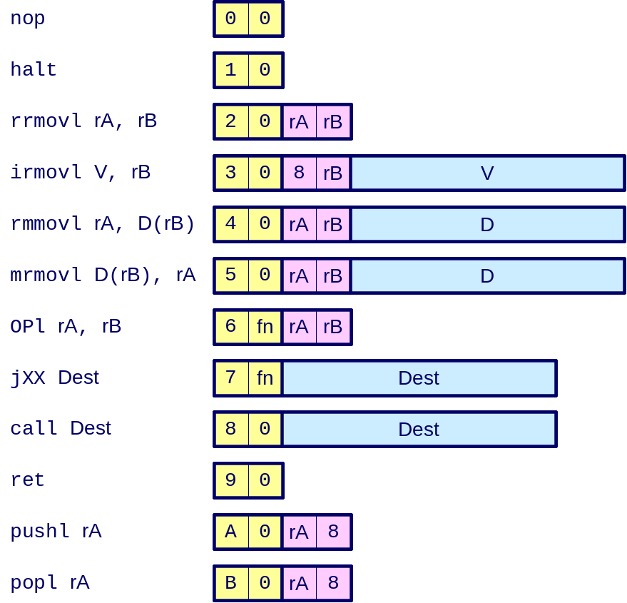
Fetch Control Logic
bool need_regids =
icode in { IRRMOVL, IOPL, IPUSHL, IPOPL,
IIRMOVL, IRMMOVL, IMRMOVL };
bool instr_valid = icode in
{ INOP, IHALT, IRRMOVL, IIRMOVL, IRMMOVL, IMRMOVL,
IOPL, IJXX, ICALL, IRET, IPUSHL, IPOPL };

Slide 28
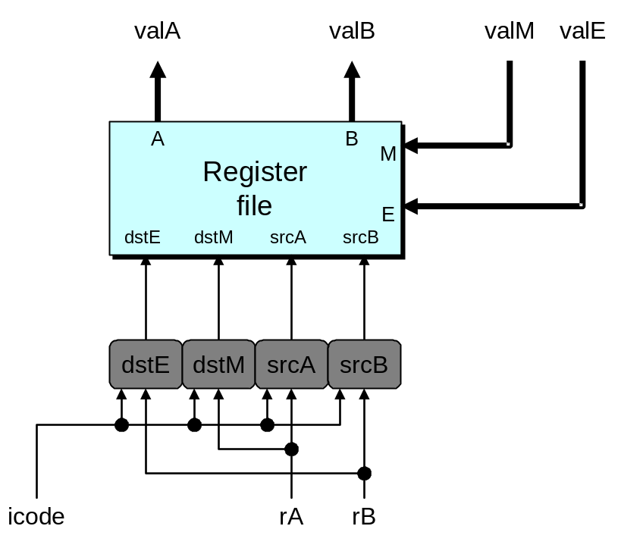
Decode Logic
Register File
  Read ports A, B
  Write ports E, M
  Addresses are register IDs or 8 (no access)
Control Logic
  srcA, srcB: read port addresses
  dstA, dstB: write port addresses

Slide 29
A Source
OPl rA, rB
Decode
valA ← R[rA]
Read operand A
rmmovl rA, D(rB)
Decode
valA ← R[rA]
Read operand A
popl rA
Decode
valA ← R[%esp]
Read stack pointer
jXX Dest
Decode
No operand
call Dest
Decode
No operand
ret
Decode
valA ← R[%esp]
Read stack pointer
int srcA = [
icode in { IRRMOVL, IRMMOVL, IOPL, IPUSHL } : rA;
icode in { IPOPL, IRET } : RESP;
1 : RNONE; # Don't need register
];

Slide 30
E Destination
OPl rA, rB
Write-back
R[rB] ← valE
Write back result
rmmovl rA, D(rB)
Write-back
None
popl rA
Write-back
R[%esp] ← valE
Update stack pointer
jXX Dest
Write-back
None
call Dest
Write-back
R[%esp] ← valE
Update stack pointer
ret
Write-back
R[%esp] ← valE
Update stack pointer
int dstE = [
icode in { IRRMOVL, IIRMOVL, IOPL} : rB;
icode in { IPUSHL, IPOPL, ICALL, IRET } : RESP;
1 : RNONE; # Don't need register
];

Slide 31
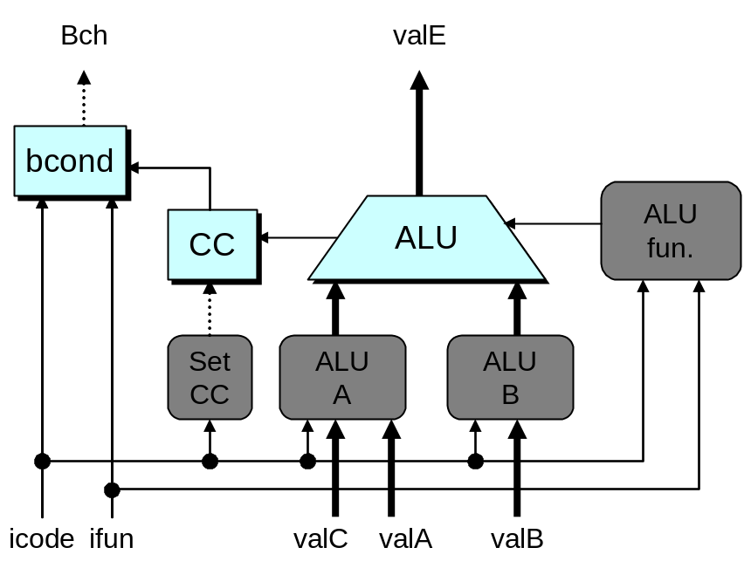
Execute Logic
Units
  ALU
    Implements 4 required functions
    Generates condition code values
  CC
    Register with 3 condition code bits
  bcond
    Computes branch flag
Control Logic
  Set CC: Should condition code register be loaded?
  ALU A: Input A to ALU
  ALU B: Input B to ALU
  ALU fun: What function should ALU compute?

Slide 32
ALU A Input
OPl rA, rB
Execute
valE ← valB OP valA
Perform ALU operation
rmmovl rA, D(rB)
Execute
valE ← valB + valC
Compute effective address
popl rA
Execute
valE ← valB + 4
Increment stack pointer
jXX Dest
Execute
No operation
call Dest
Execute
valE ← valB + –4
Decrement stack pointer
ret
Execute
valE ← valB + 4
Increment stack pointer
int aluA = [
icode in { IRRMOVL, IOPL } : valA;
icode in { IIRMOVL, IRMMOVL, IMRMOVL } : valC;
icode in { ICALL, IPUSHL } : -4;
icode in { IRET, IPOPL } : 4;
# Other instructions don't need ALU
];

Slide 33
ALU Operation
OPl rA, rB
Execute
valE ← valB OP valA
Perform ALU operation
rmmovl rA, D(rB)
Execute
valE ← valB + valC
Compute effective address
popl rA
Execute
valE ← valB + 4
Increment stack pointer
jXX Dest
Execute
No operation
call Dest
Execute
valE ← valB + –4
Decrement stack pointer
ret
Execute
valE ← valB + 4
Increment stack pointer
int alufun = [
icode == IOPL : ifun;
1 : ALUADD;
];

Slide 34
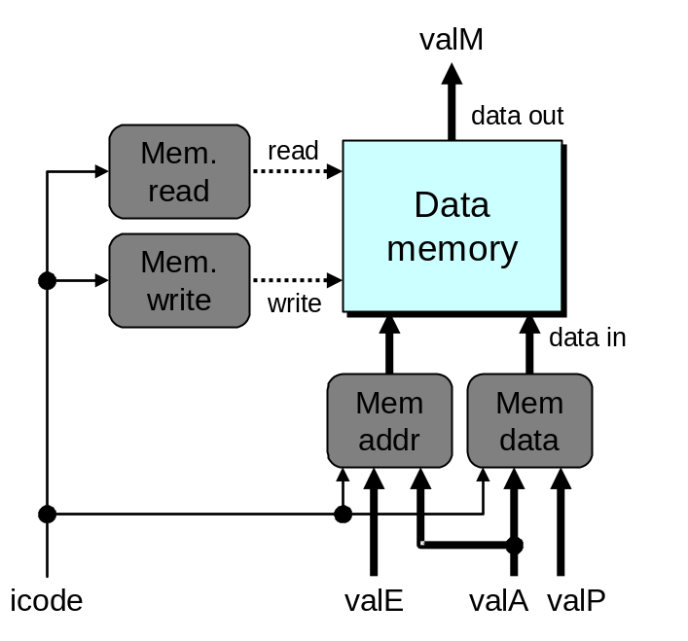
Memory Logic
Memory
  Reads or writes memory word
Control Logic
  Mem. read: should word be read?
  Mem. write: should word be written?
  Mem. addr.: Select address
  Mem. data.: Select data

Slide 35
Memory Address
OPl rA, rB
Memory
No operation
rmmovl rA, D(rB)
Memory
M₄[valE] ← valA
Write value to memory
popl rA
Memory
valM ← M₄[valA]
Read from stack
jXX Dest
Memory
No operation
call Dest
Memory
M₄[valE] ← valP
Write return value on stack
ret
Memory
valM ← M₄[valA]
Read return address
int mem_addr = [
icode in { IRMMOVL, IPUSHL, ICALL, IMRMOVL } : valE;
icode in { IPOPL, IRET } : valA;
# Other instructions don't need address
];

Slide 36
Memory Read
OPl rA, rB
Memory
No operation
rmmovl rA, D(rB)
Memory
M₄[valE] ← valA
Write value to memory
popl rA
Memory
valM ← M₄[valA]
Read from stack
jXX Dest
Memory
No operation
call Dest
Memory
M₄[valE] ← valP
Write return value on stack
ret
Memory
valM ← M₄[valA]
Read return address
bool mem_read = icode in { IMRMOVL, IPOPL, IRET };

Slide 37
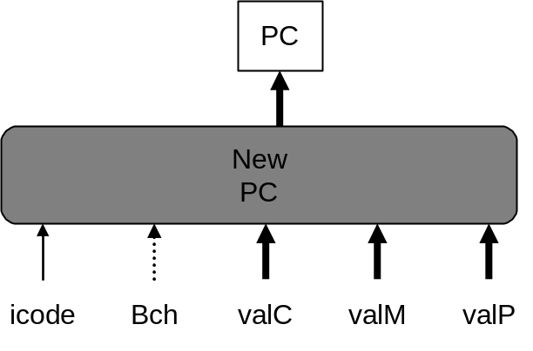
PC Update Logic
New PC
  Select next value of PC

Slide 38
PC
Update
OPl rA, rB
PC update
PC ← valP
Update PC
rmmovl rA, D(rB)
PC update
PC ← valP
Update PC
popl rA
PC update
PC ← valP
Update PC
jXX Dest
PC update
PC ← Bch ? valC : valP
Update PC
call Dest
PC update
PC ← valC
Set PC to destination
ret
PC update
PC ← valM
Set PC to return address
int new_pc = [
icode == ICALL : valC;
icode == IJXX && Bch : valC;
icode == IRET : valM;
1 : valP;
];

Slide 39
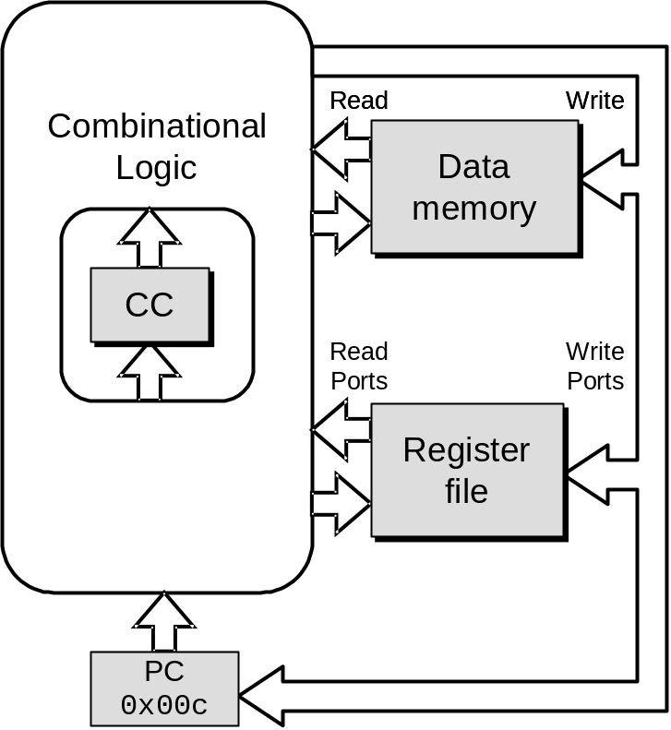
SEQ Operation
State
  PC register
  Cond. Code register
  Data memory
  Register file
  All updated as clock rises
Combinational Logic
  ALU
  Control logic
  Memory reads
    Instruction memory
    Register file
    Data memory

Slide 40
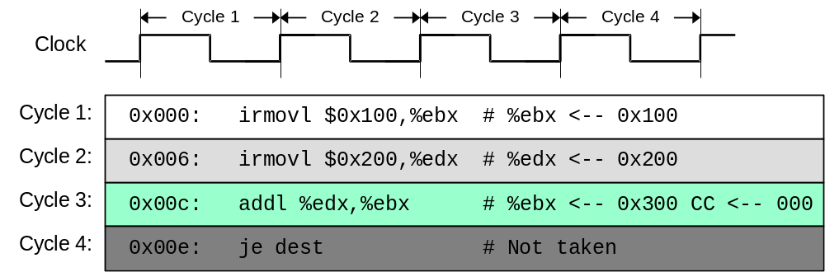
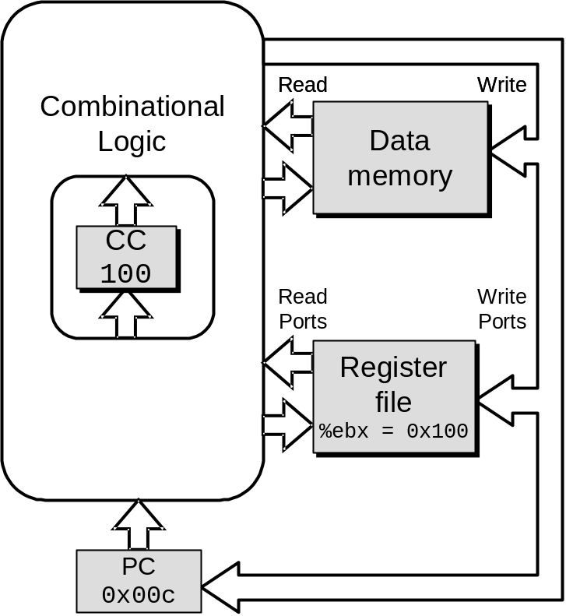
SEQ Operation #2
  state set according to second irmovl instruction
  combinational logic starting to react to state changes

Slide 41
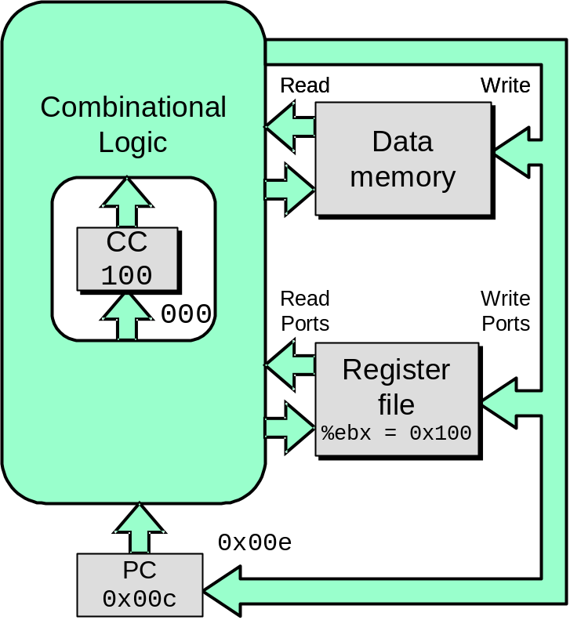
SEQ Operation #3
  state set according to second irmovl instruction
  combinational logic generates results for addl instruction

Slide 42
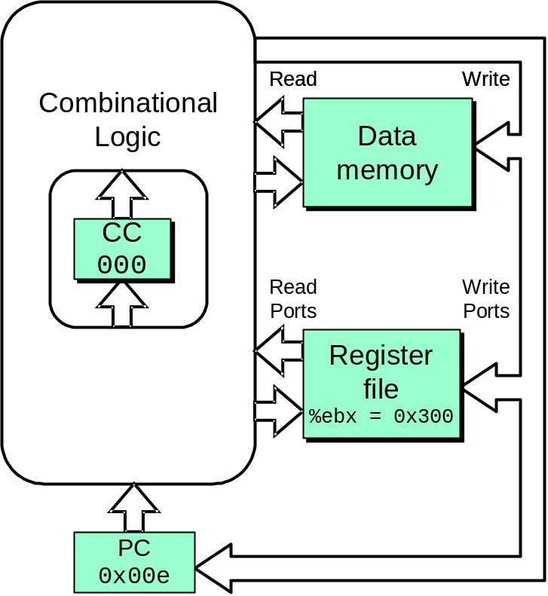
SEQ Operation #4
  state set according to addl instruction
  combinational logic starting to react to state changes

Slide 43
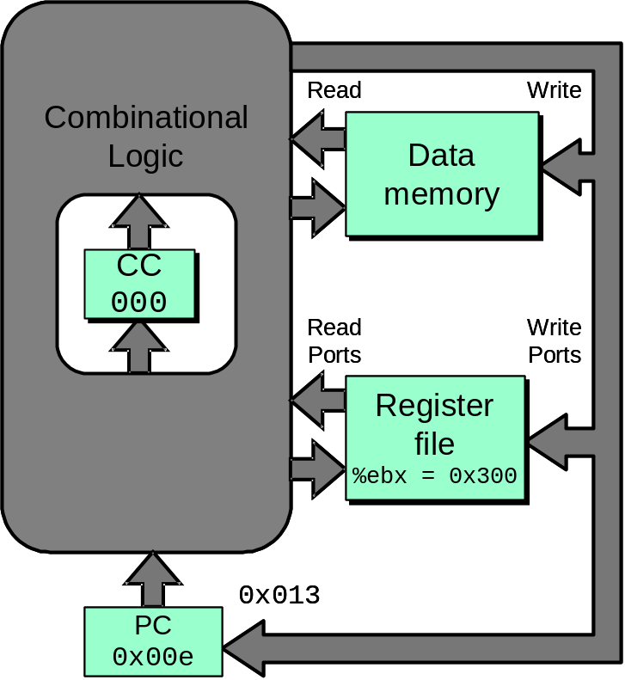
SEQ Operation #5
  state set according to addl instruction
  combinational logic generates results for je instruction

Slide 44
SEQ Summary
Implementation
  Express every instruction as series of simple steps
  Follow same general flow for each instruction type
  Assemble registers, memories, predesigned combinational blocks
  Connect with control logic
Limitations
  Too slow to be practical
  In one cycle, must propagate through instruction memory, register file, ALU, and data memory
  Would need to run clock very slowly
  Hardware units only active for fraction of clock cycle

