Slide 1
CS:APP Chapter 4
Computer Architecture
Pipelined
Implementation
Part I
Randal E. Bryant
Carnegie Mellon University
http://csapp.cs.cmu.edu
CS:APP

Slide 2
Overview
General Principles of Pipelining
  Goal
  Difficulties
Creating a Pipelined Y86 Processor
  Rearranging SEQ
  Inserting pipeline registers
  Problems with data and control hazards

Slide 3


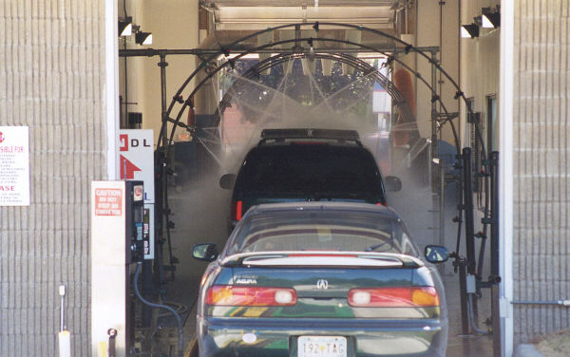
Real-World Pipelines: Car Washes
Sequential
Parallel
Pipelined
Idea
  Divide process into independent stages
  Move objects through stages in sequence
  At any given times, multiple objects being processed

Slide 4
Computational Example
300 ps
20 ps
Combinational
logic
R
e
g
Delay = 320 ps
Throughput = 3.12 GOPS
Clock
System
  Computation requires total of 300 picoseconds
  Additional 20 picoseconds to save result in register
  Can must have clock cycle of at least 320 ps

Slide 5
3-Way Pipelined Version
100 ps
20 ps
100 ps
20 ps
100 ps
20 ps
Comb.
logic
A
R
e
g
Comb.
logic
B
R
e
g
Comb.
logic
C
R
e
g
Delay = 360 ps
Throughput = 8.33 GOPS
Clock
System
  Divide combinational logic into 3 blocks of 100 ps each
  Can begin new operation as soon as previous one passes through stage A.
    Begin new operation every 120 ps
  Overall latency increases
    360 ps from start to finish

Slide 6
Pipeline Diagrams
Unpipelined
  Cannot start new operation until previous one completes
3-Way Pipelined
  Up to 3 operations in process simultaneously
OP1
OP2
OP3
Time
OP1
A
B
C
OP2
A
B
C
OP3
A
B
C
Time

Slide 7
Operating a Pipeline
239
241
300
359
Clock
OP1
A
B
C
OP2
A
B
C
OP3
A
B
C
0
120
240
360
480
640
Time
100 ps
20 ps
100 ps
20 ps
100 ps
20 ps
100 ps
100 ps
100 ps
20 ps
20 ps
20 ps
100 ps
100 ps
100 ps
20 ps
20 ps
20 ps
100 ps
100 ps
100 ps
20 ps
20 ps
20 ps
Comb.
logic
A
R
e
g
Comb.
logic
B
R
e
g
Comb.
logic
C
Comb.
logic
A
R
e
g
Comb.
logic
B
R
e
g
Comb.
logic
C
R
e
g
Comb.
logic
A
Comb.
logic
A
R
e
g
R
e
g
Comb.
logic
B
Comb.
logic
B
R
e
g
R
e
g
Comb.
logic
C
Comb.
logic
C
R
e
g
R
e
g
R
e
g
Clock
Clock
Clock
Clock

Slide 8
Limitations: Nonuniform Delays
50 ps
20 ps
150 ps
20 ps
100 ps
20 ps
Comb.
logic
A
R
e
g
Comb.
logic
B
R
e
g
Comb.
logic
C
R
e
g
Delay = 510 ps
Throughput = 5.88 GOPS
Clock
OP1
A
B
C
OP2
A
B
C
OP3
A
B
C
Time
  Throughput limited by slowest stage
  Other stages sit idle for much of the time
  Challenging to partition system into balanced stages

Slide 9
Limitations: Register Overhead
50 ps
20 ps
50 ps
20 ps
50 ps
20 ps
50 ps
20 ps
50 ps
20 ps
50 ps
20 ps
Comb.
logic
R
e
g
Comb.
logic
R
e
g
Comb.
logic
R
e
g
Comb.
logic
R
e
g
Comb.
logic
R
e
g
Comb.
logic
R
e
g
Clock
Delay = 420 ps, Throughput = 14.29 GOPS
  As try to deepen pipeline, overhead of loading registers becomes more significant
  Percentage of clock cycle spent loading register:
    1-stage pipeline: 6.25%
    3-stage pipeline: 16.67%
    6-stage pipeline: 28.57%
  High speeds of modern processor designs obtained through very deep pipelining

Slide 10
Data Dependencies
Combinational
logic
R
e
g
Clock
OP1
OP2
OP3
Time
System
  Each operation depends on result from preceding one

Slide 11
Data Hazards
Comb.
logic
A
R
e
g
Comb.
logic
B
R
e
g
Comb.
logic
C
R
e
g
Clock
OP1
A
B
C
OP2
A
B
C
OP3
A
B
C
OP4
A
B
C
Time
  Result does not feed back around in time for next operation
  Pipelining has changed behavior of system

Slide 12
Data Dependencies in Processors
1 irmovl $50, %eax
2 addl %eax , %ebx
3 mrmovl 100( %ebx ), %edx
  Result from one instruction used as operand for another
    Read-after-write (RAW) dependency
  Very common in actual programs
  Must make sure our pipeline handles these properly
    Get correct results
    Minimize performance impact

Slide 13
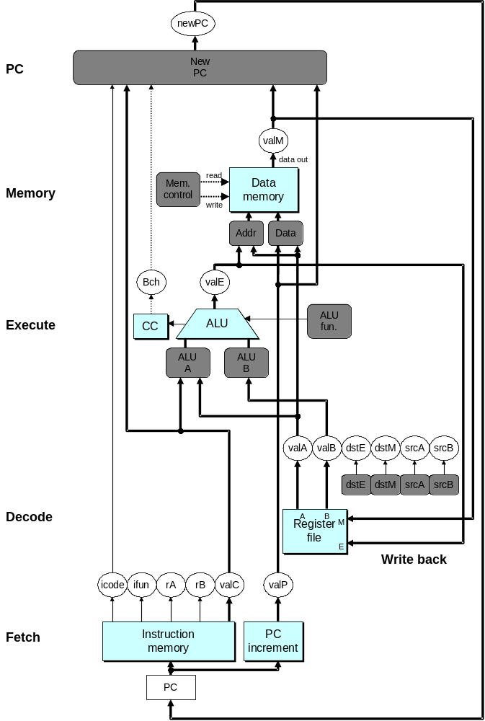
SEQ Hardware
  Stages occur in sequence
  One operation in process at a time

Slide 14
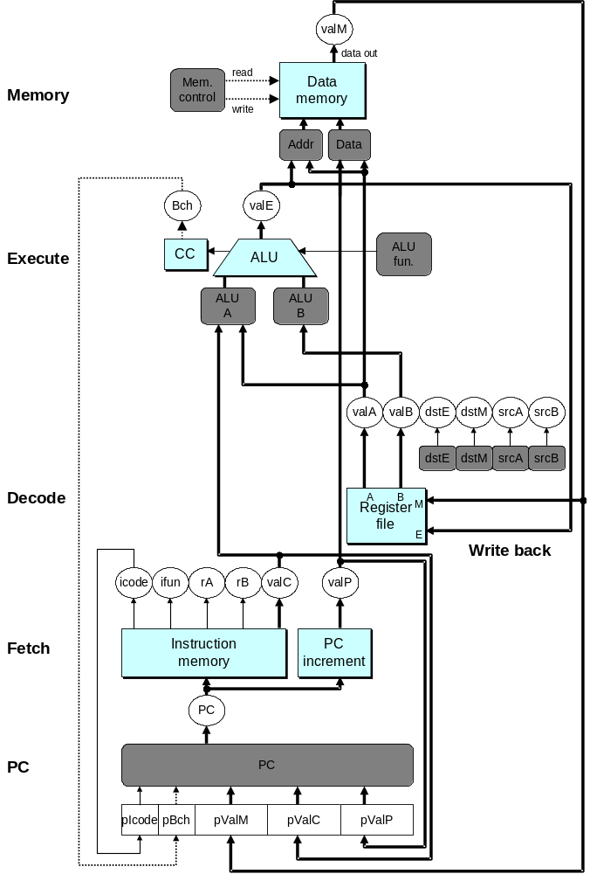
SEQ+ Hardware
  Still sequential implementation
  Reorder PC stage to put at beginning
PC Stage
  Task is to select PC for current instruction
  Based on results computed by previous instruction
Processor State
  PC is no longer stored in register
  But, can determine PC based on other stored information

Slide 15
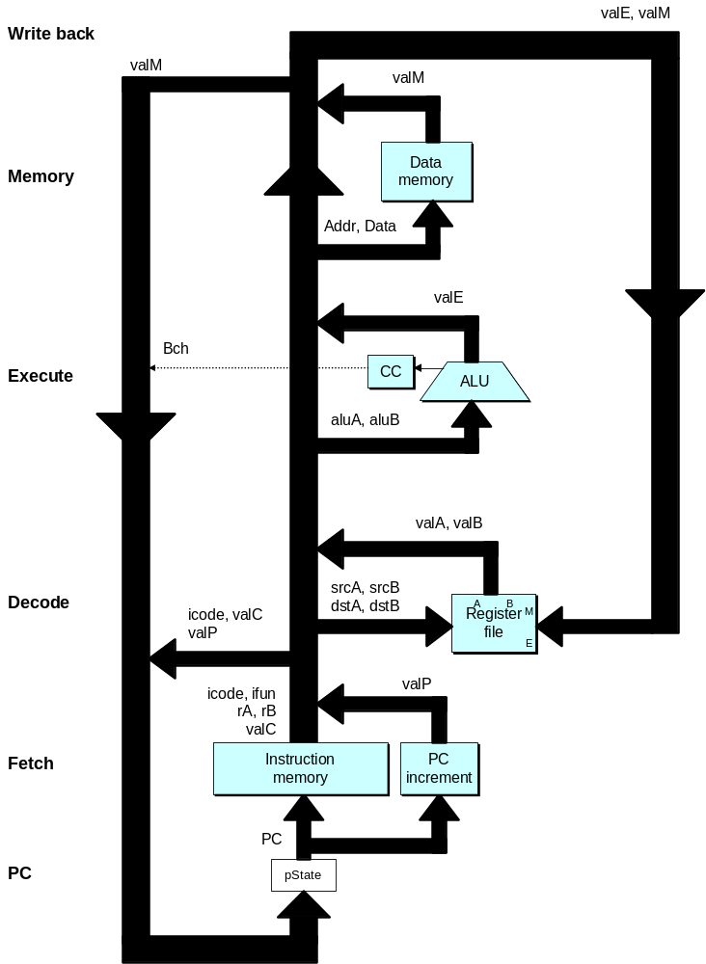
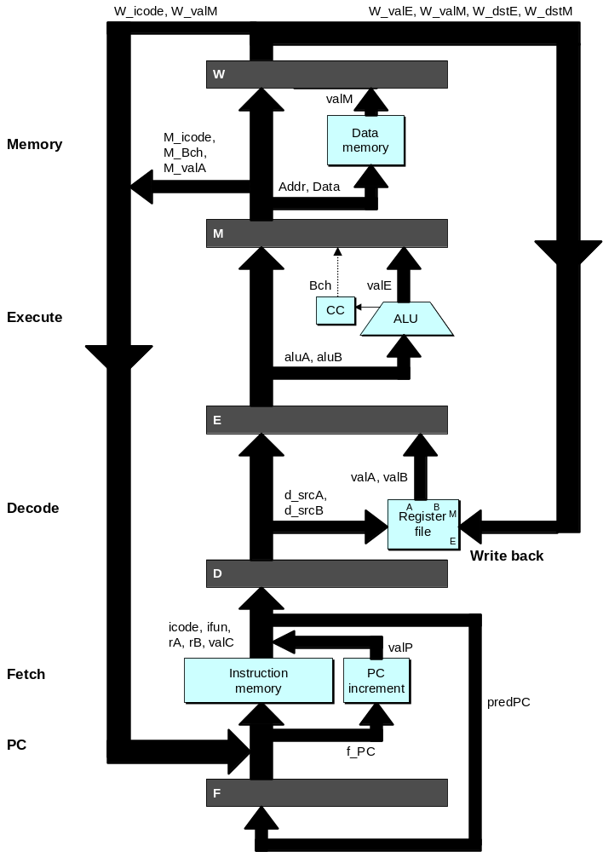
Adding Pipeline Registers

Slide 16
Pipeline Stages
Fetch
  Select current PC
  Read instruction
  Compute incremented PC
Decode
  Read program registers
Execute
  Operate ALU
Memory
  Read or write data memory
Write Back
  Update register file

Slide 17
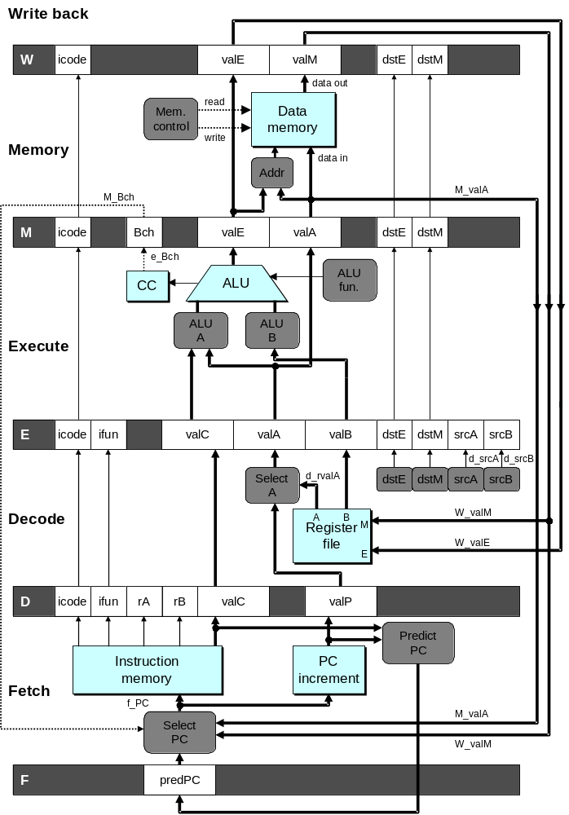
PIPE- Hardware
  Pipeline registers hold intermediate values from instruction execution
Forward (Upward) Paths
  Values passed from one stage to next
  Cannot jump past stages
    e.g., valC passes through decode

Slide 18
Feedback Paths
Predicted PC
  Guess value of next PC
Branch information
  Jump taken/not-taken
  Fall-through or target address
Return point
  Read from memory
Register updates
  To register file write ports

Slide 19
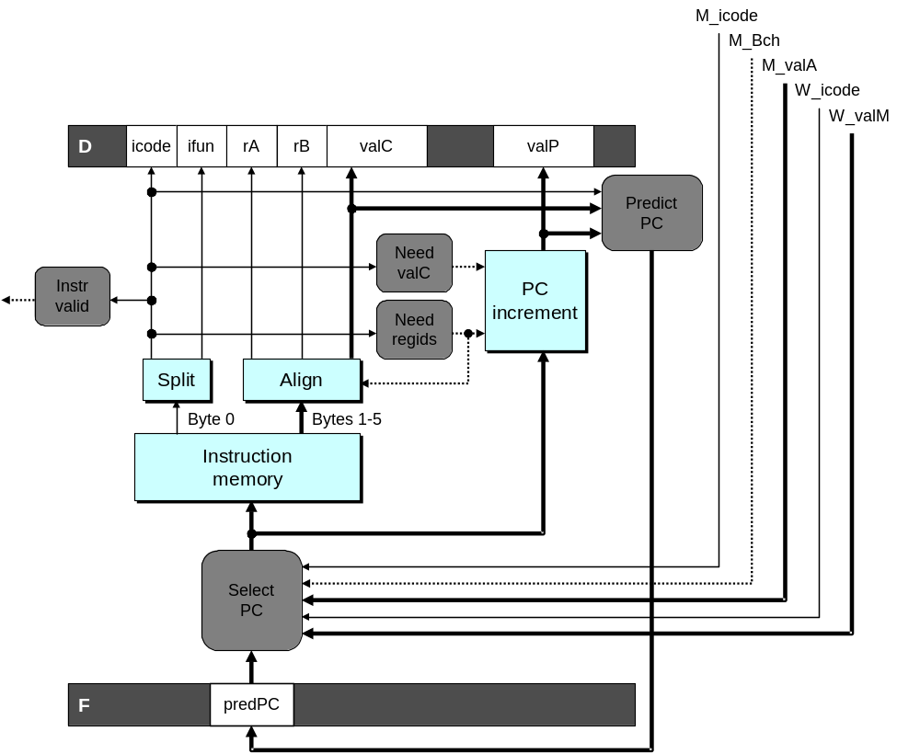
Predicting the PC
  Start fetch of new instruction after current one has completed fetch stage
    Not enough time to reliably determine next instruction
  Guess which instruction will follow
    Recover if prediction was incorrect

Slide 20
Our Prediction Strategy
Instructions that Don’t Transfer Control
  Predict next PC to be valP
  Always reliable
Call and Unconditional Jumps
  Predict next PC to be valC (destination)
  Always reliable
Conditional Jumps
  Predict next PC to be valC (destination)
  Only correct if branch is taken
    Typically right 60% of time
Return Instruction
  Don’t try to predict

Slide 21
Recovering from PC Misprediction
  Mispredicted Jump
    Will see branch flag once instruction reaches memory stage
    Can get fall-through PC from valA
  Return Instruction
    Will get return PC when ret reaches write-back stage

Slide 22
Pipeline Demonstration
1
2
3
4
5
6
7
8
9
irmovl $1,%eax #I1
F
D
E
M
W
irmovl $2,%ecx #I2
F
D
E
M
W
irmovl $3,%edx #I3
F
D
E
M
W
irmovl $4,%ebx #I4
F
D
E
M
W
halt #I5
F
D
E
M
W
Cycle 5
File: demo-basic.ys
W
I1
M
I2
E
I3
D
I4
F
I5

Slide 23
Data Dependencies: 3 Nop’s
# demo-h3.ys
1
2
3
4
5
6
7
8
9
10
11
F
F
D
D
E
E
M
M
W
0x000:
irmovl
$10,%
edx
W
F
F
D
D
E
E
M
M
W
0x006:
irmovl
$3,%
eax
W
F
F
D
D
E
E
M
M
W
0x00c:
nop
W
F
F
D
D
E
E
M
M
W
0x00d:
nop
W
F
F
D
D
E
E
M
M
W
0x00e:
nop
W
F
F
D
D
E
E
M
M
W
0x00f:
addl
%
edx
,%
eax
W
F
F
D
D
E
E
M
M
W
0x011: halt
W
Cycle 6
W
W

R[

R[
]
]
3
%
3
%
eax
eax
Cycle 7
D
D

valA

valA
R[
R[
]
]
=
=
10
%
10
%
edx
edx

valB

valB
R[
R[
]
]
=
=
3
%
3
%
eax
eax

Slide 24
Data Dependencies: 2 Nop’s
# demo-h2.ys
1
2
3
4
5
6
7
8
9
10
F
F
D
D
E
E
M
M
W
0x000:
irmovl
$10,%
edx
W
F
F
D
D
E
E
M
M
W
0x006:
irmovl
$3,%
eax
W
F
F
D
D
E
E
M
M
W
0x00c:
nop
W
F
F
D
D
E
E
M
M
W
0x00d:
nop
W
F
F
D
D
E
E
M
M
W
0x00e:
addl
%
edx
,%
eax
W
F
F
D
D
E
E
M
M
W
0x010: halt
W
Cycle 6
W
W
W


R[
]

3
R[
R[
]
]
3
%
eax
3
%
%
eax
eax
•
•
•
•
•
•
D
D
D


valA

valA
valA
R[
R[
R[
]
]
]
=
=
=
10
10
%
10
Error
%
%
edx
edx
edx


valB

valB
valB
R[
R[
R[
]
]
]
=
=
=
0
0
%
0
%
%
eax
eax
eax

Slide 25
Data Dependencies: 1 Nop
# demo-h1.ys
1
2
3
4
5
6
7
8
9
0x000:
irmovl
$10,%
edx
F
D
E
M
W
0x006:
irmovl
$3,%
eax
F
D
E
M
W
F
F
D
D
E
E
M
M
W
0x00c:
nop
W
F
F
D
D
E
E
M
M
W
0x00d:
addl
%
edx
,%
eax
W
F
F
D
D
E
E
M
M
W
0x00f: halt
W
Cycle 5
W
W

R[

R[
]
]
10
%
10
%
edx
edx
M
M_
valE
= 3
M_
dstE
=
%
eax
•
•
•
D
D
Error

valA

valA
R[
R[
]
]
=
=
0
%
0
%
edx
edx

valB

valB
R[
R[
]
]
=
=
0
%
0
%
eax
eax

Slide 26
Data Dependencies: No Nop
# demo-h0.ys
1
2
3
4
5
6
7
8
0x000:
irmovl
$10,%
edx
F
D
E
M
W
0x006:
irmovl
$3,%
eax
F
D
E
M
W
0x00c:
addl
%
edx
,%
eax
F
D
E
M
W
0x00e: halt
F
D
E
M
W
Cycle 4
M
M_
valE
= 10
M_
dstE
=
%
edx
E
e_
valE

0 + 3 = 3
E_
dstE
=
%
eax
D
D
Error

valA

valA
R[
R[
]
]
=
=
0
%
0
%
edx
edx

valB

valB
R[
R[
]
]
=
=
0
%
0
%
eax
eax

Slide 27
Branch Misprediction Example
demo-j.ys
0x000: xorl %eax,%eax
0x002: jne t # Not taken
0x007: irmovl $1, %eax # Fall through
0x00d: nop
0x00e: nop
0x00f: nop
0x010: halt
0x011: t: irmovl $3, %edx # Target (Should not execute)
0x017: irmovl $4, %ecx # Should not execute
0x01d: irmovl $5, %edx # Should not execute
  Should only execute first 8 instructions

Slide 28
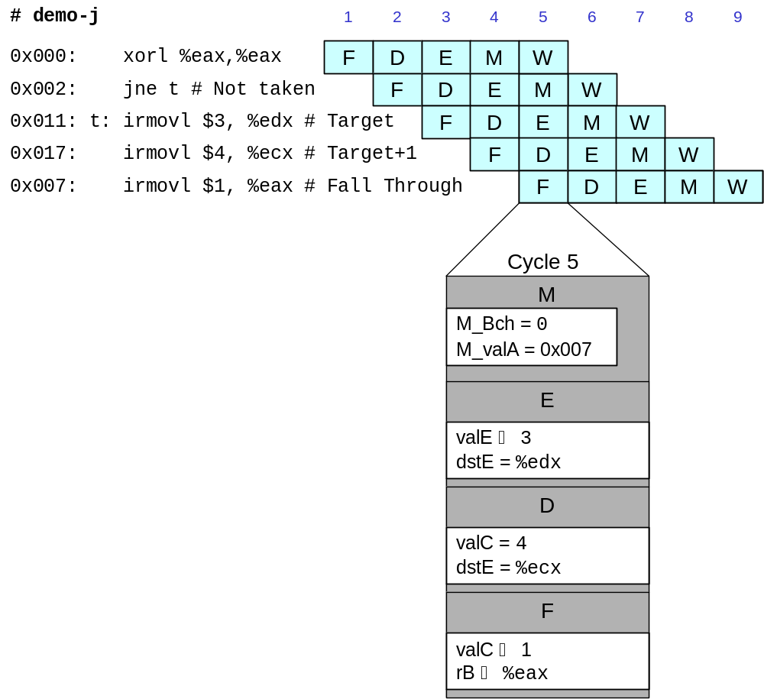
Branch Misprediction Trace
  Incorrectly execute two instructions at branch target

Slide 29
Return Example
demo-ret.ys
0x000: irmovl Stack,%esp # Intialize stack pointer
0x006: nop # Avoid hazard on %esp
0x007: nop
0x008: nop
0x009: call p # Procedure call
0x00e: irmovl $5,%esi # Return point
0x014: halt
0x020: .pos 0x20
0x020: p: nop # procedure
0x021: nop
0x022: nop
0x023: ret
0x024: irmovl $1,%eax # Should not be executed
0x02a: irmovl $2,%ecx # Should not be executed
0x030: irmovl $3,%edx # Should not be executed
0x036: irmovl $4,%ebx # Should not be executed
0x100: .pos 0x100
0x100: Stack: # Stack: Stack pointer
  Require lots of nops to avoid data hazards

Slide 30
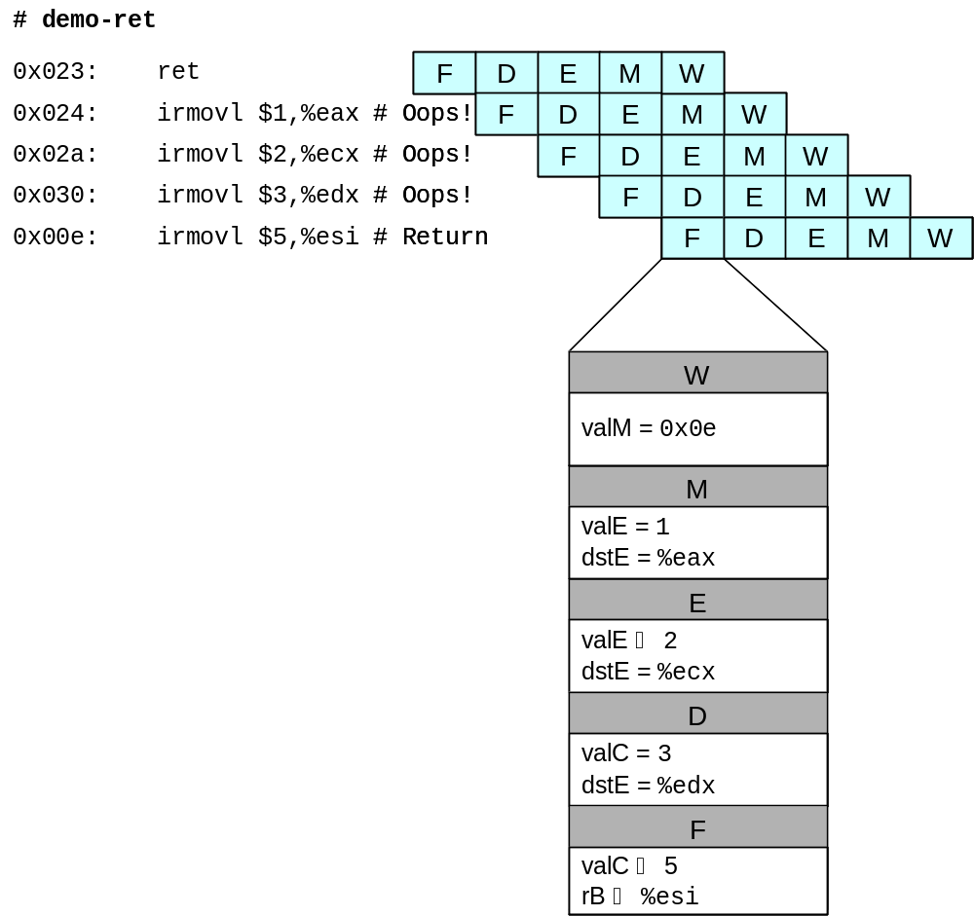
Incorrect Return Example
  Incorrectly execute 3 instructions following ret

Slide 31
Pipeline Summary
Concept
  Break instruction execution into 5 stages
  Run instructions through in pipelined mode
Limitations
  Can’t handle dependencies between instructions when instructions follow too closely
  Data dependencies
    One instruction writes register, later one reads it
  Control dependency
    Instruction sets PC in way that pipeline did not predict correctly
    Mispredicted branch and return
Fixing the Pipeline
  We’ll do that next time

