Slide 1
CS:APP Chapter 4
Computer Architecture
Pipelined
Implementation
Part II
Randal E. Bryant
Carnegie Mellon University
http://csapp.cs.cmu.edu
CS:APP

Slide 2
Overview
  Make the pipelined processor work!
Data Hazards
  Instruction having register R as source follows shortly after instruction having register R as destination
  Common condition, don’t want to slow down pipeline
Control Hazards
  Mispredict conditional branch
    Our design predicts all branches as being taken
    Naïve pipeline executes two extra instructions
  Getting return address for ret instruction
    Naïve pipeline executes three extra instructions
Making Sure It Really Works
  What if multiple special cases happen simultaneously?

Slide 3
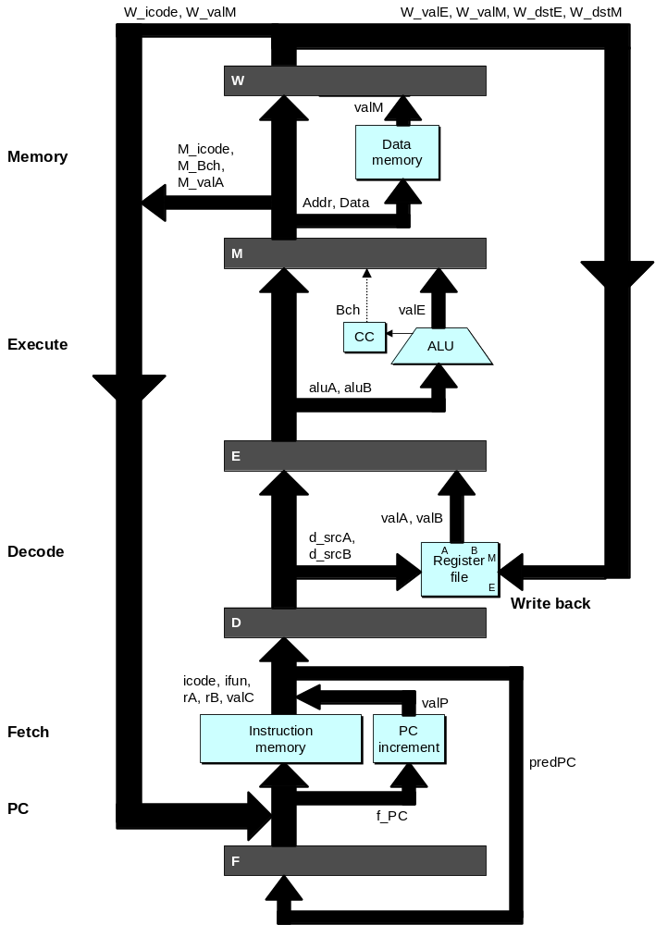
Pipeline Stages
Fetch
  Select current PC
  Read instruction
  Compute incremented PC
Decode
  Read program registers
Execute
  Operate ALU
Memory
  Read or write data memory
Write Back
  Update register file

Slide 4
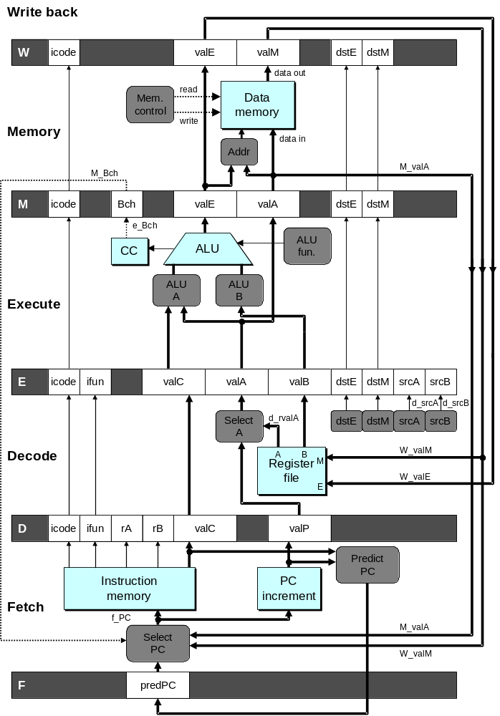
PIPE- Hardware
  Pipeline registers hold intermediate values from instruction execution
Forward (Upward) Paths
  Values passed from one stage to next
  Cannot jump past stages
    e.g., valC passes through decode

Slide 5
Data Dependencies: 2 Nop’s
# demo-h2.ys
1
2
3
4
5
6
7
8
9
10
F
F
D
D
E
E
M
M
W
0x000:
irmovl
$10,%
edx
W
F
F
D
D
E
E
M
M
W
0x006:
irmovl
$3,%
eax
W
F
F
D
D
E
E
M
M
W
0x00c:
nop
W
F
F
D
D
E
E
M
M
W
0x00d:
nop
W
F
F
D
D
E
E
M
M
W
0x00e:
addl
%
edx
,%
eax
W
F
F
D
D
E
E
M
M
W
0x010: halt
W
Cycle 6
W
W
W


R[
]
R[

R[
3
]
]
3
%
eax
%
3
%
eax
eax
•
•
•
•
•
•
D
D
D


valA

valA
valA
R[
R[
R[
]
]
]
=
=
=
10
10
%
10
Error
%
%
edx
edx
edx


valB

valB
valB
R[
R[
R[
]
]
]
=
=
=
0
0
%
0
%
%
eax
eax
eax

Slide 6
Data Dependencies: No Nop
# demo-h0.ys
1
2
3
4
5
6
7
8
0x000:
irmovl
$10,%
edx
F
D
E
M
W
0x006:
irmovl
$3,%
eax
F
D
E
M
W
0x00c:
addl
%
edx
,%
eax
F
D
E
M
W
0x00e: halt
F
D
E
M
W
Cycle 4
M
M_
valE
= 10
M_
dstE
=
%
edx
E
e_
valE

0 + 3 = 3
E_
dstE
=
%
eax
D
D
Error

valA

valA
R[
R[
]
]
=
=
0
%
0
%
edx
edx

valB

valB
R[
R[
]
]
=
=
0
%
0
%
eax
eax

Slide 7
Stalling for Data Dependencies
# demo-h2.ys
1
2
3
4
5
6
7
8
9
10
11
0x000: irmovl $10,%edx
F
D
E
M
W
0x006: irmovl $3,%eax
F
D
E
M
W
0x00c: nop
F
D
E
M
W
0x00d: nop
F
D
E
M
W
bubble
E
M
W
0x00e: addl %edx,%eax
F
D
D
E
M
W
0x010: halt
F
F
D
E
M
W
  If instruction follows too closely after one that writes register, slow it down
  Hold instruction in decode
  Dynamically inject nop into execute stage

Slide 8
Stall Condition
Write back
W
icode
valE
valM
dstE
dstM
data out
read
Data
Mem
.
Data
control
memory
Source Registers
  srcA and srcB of current instruction in decode stage
Destination Registers
  dstE and dstM fields
  Instructions in execute, memory, and write-back stages
Special Case
  Don’t stall for register ID 8
    Indicates absence of register operand
write
memory
Memory
data in
Addr
M_Bch
M_
valA
M
icode
Bch
valE
valA
dstE
dstM
e_Bch
ALU
ALU
CC
ALU
CC
fun.
ALU
ALU
Execute
A
B
E
icode
ifun
valC
valA
valB
dstE
dstM
srcA
srcB
Select
d_
rvalA
d_
srcA
d_
srcB
A
dstE
dstM
srcA
srcB
Decode
A
B
M
W_
valM
Register
Register
file
W_
valE
file
E
D
icode
ifun
rA
rB
valC
valP
Predict
Instruction
PC
PC
Instruction
PC
memory
increment
Fetch
memory
increment
f_PC
M_
valA
Select
PC
W_
valM
F
predPC

Slide 9
Detecting Stall Condition
# demo-h2.ys
1
2
3
4
5
6
7
8
9
10
11
0x000: irmovl $10,%edx
F
D
E
M
W
0x006: irmovl $3,%eax
F
D
E
M
W
0x00c: nop
F
D
E
M
W
0x00d: nop
F
D
E
M
W
bubble
E
M
W
0x00e: addl %edx,%eax
F
D
D
E
M
W
0x010: halt
F
F
D
E
M
W
Cycle 6
W
W_dstE = %eax
W_valE = 3
•
•
•
D
srcA = %edx
srcB = %eax

Slide 10
Stalling X3
# demo-h0.ys
1
2
3
4
5
6
7
8
9
10
11
0x000: irmovl $10,%edx
F
D
E
M
W
0x006: irmovl $3,%eax
F
D
E
M
W
bubble
E
M
W
bubble
E
M
W
bubble
E
M
W
0x00c: addl %edx,%eax
F
D
D
D
D
E
M
W
0x00e: halt
F
F
F
F
D
E
M
W
Cycle 6
W
Cycle 5
W_dstE = %eax
M
Cycle 4
M_dstE = %eax
•
•
•
E
•
•
•
E_dstE = %eax
D
D
D
srcA = %edx
srcB = %eax
srcA = %edx
srcB = %eax
srcA = %edx
srcB = %eax

Slide 11
What Happens When Stalling?
# demo-h0.ys
Cycle 4
Cycle 5
Cycle 6
Cycle 7
Cycle 8
0x000: irmovl $10,%edx
Write Back
0x000: irmovl $10,%edx
0x006: irmovl $3,%eax
bubble
bubble
0x006: irmovl $3,%eax
Memory
0x000: irmovl $10,%edx
0x006: irmovl $3,%eax
bubble
bubble
bubble
0x00c: addl %edx,%eax
Execute
0x006: irmovl $3,%eax
bubble
bubble
bubble
0x00c: addl %edx,%eax
0x00e: halt
Decode
0x00c: addl %edx,%eax
0x00c: addl %edx,%eax
0x00c: addl %edx,%eax
0x00c: addl %edx,%eax
0x00e: halt
Fetch
0x00e: halt
0x00e: halt
0x00e: halt
0x00e: halt
  Stalling instruction held back in decode stage
  Following instruction stays in fetch stage
  Bubbles injected into execute stage
    Like dynamically generated nop’s
    Move through later stages

Slide 12
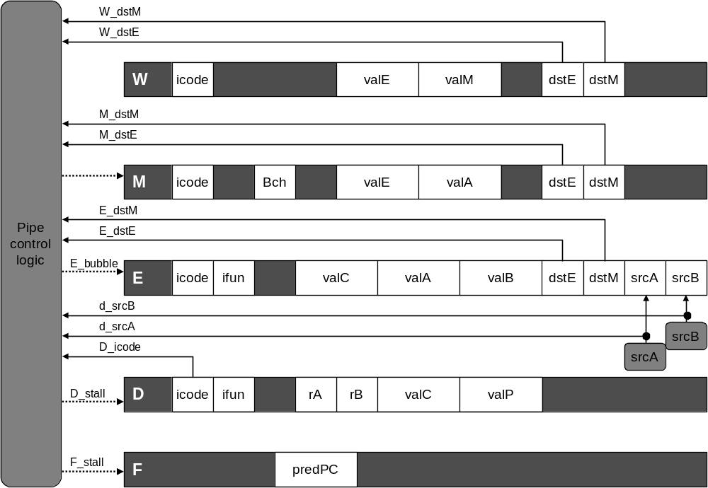
Implementing Stalling
Pipeline Control
  Combinational logic detects stall condition
  Sets mode signals for how pipeline registers should update

Slide 13
Pipeline Register Modes
Rising
Rising
Input = y
Output = x

clock

Output = y
clock
Normal
x
x
y
y
stall
bubble
= 0
= 0
Rising
Rising
Input = y
Output = x

clock

Output = x
clock
Stall
x
x
x
x
stall
bubble
= 1
= 0
Rising
Rising
Input = y
Output = x

clock

Output =
nop
clock
n
Bubble
x
x
o
p
stall
bubble
= 0
= 1

Slide 14
Data Forwarding
Naïve Pipeline
  Register isn’t written until completion of write-back stage
  Source operands read from register file in decode stage
    Needs to be in register file at start of stage
Observation
  Value generated in execute or memory stage
Trick
  Pass value directly from generating instruction to decode stage
  Needs to be available at end of decode stage

Slide 15
Data Forwarding Example
# demo-h2.ys
1
2
3
4
5
6
7
8
9
10
F
F
D
D
E
E
M
M
W
0x000:
irmovl
$10,%
edx
W
F
F
D
D
E
E
M
M
W
0x006:
irmovl
$3,%
eax
W
F
F
D
D
E
E
M
M
W
0x00c:
nop
W
F
F
D
D
E
E
M
M
W
0x00d:
nop
W
F
F
D
D
E
E
M
M
W
0x00e:
addl
%
edx
,%
eax
W
F
F
D
D
E
E
M
M
W
0x010: halt
W
  irmovl in write-back stage
  Destination value in W pipeline register
  Forward as valB for decode stage
Cycle 6
W
W_
dstE
=
%
eax
R[
%
eax
]

3
W_
valE
= 3
•
•
•
D
srcA
=
%
edx
valA

R[
%
edx
]
=
10
srcB
=
%
eax
valB

W_
valE
=
3

Slide 16
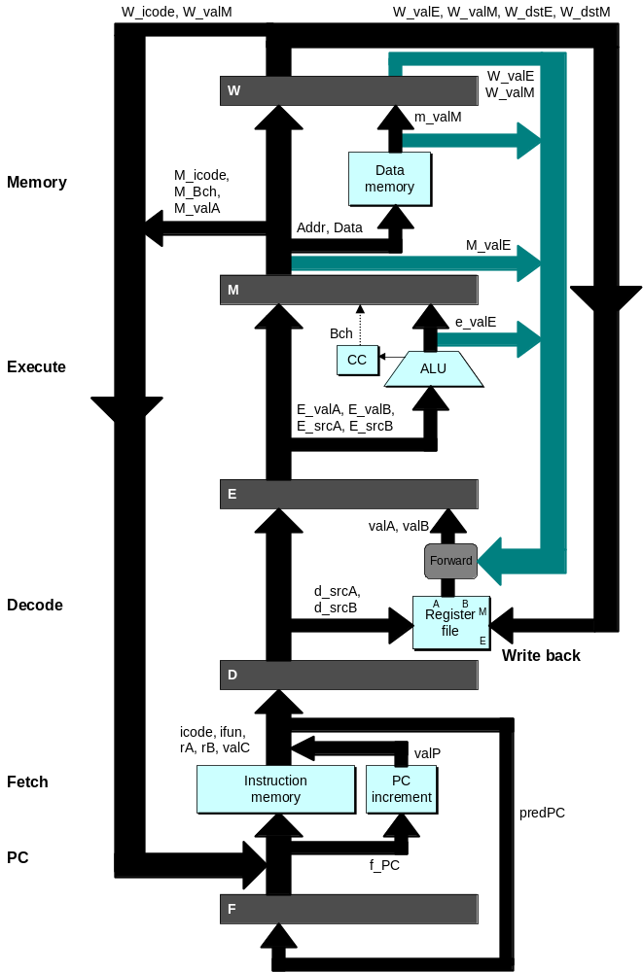
Bypass Paths
Decode Stage
  Forwarding logic selects valA and valB
  Normally from register file
  Forwarding: get valA or valB from later pipeline stage
Forwarding Sources
  Execute: valE
  Memory: valE, valM
  Write back: valE, valM

Slide 17
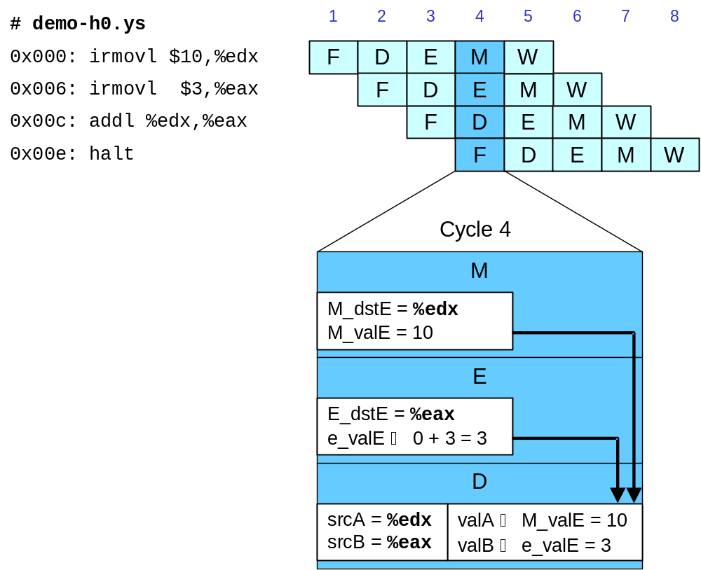
Data Forwarding Example #2
Register %edx
  Generated by ALU during previous cycle
  Forward from memory as valA
Register %eax
  Value just generated by ALU
  Forward from execute as valB

Slide 18
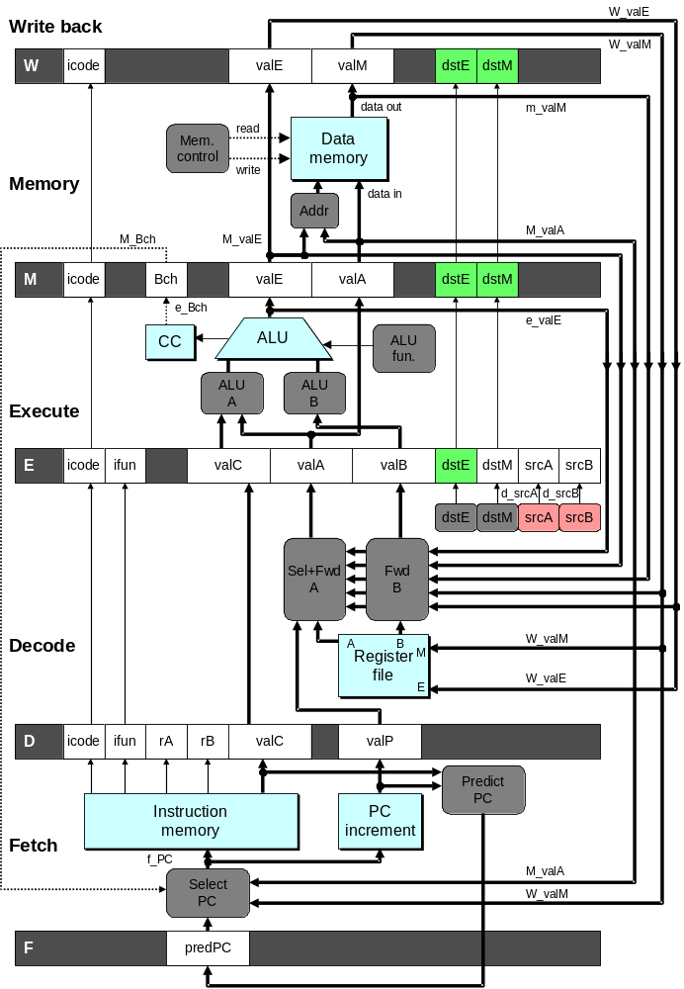
Implementing Forwarding
  Add additional feedback paths from E, M, and W pipeline registers into decode stage
  Create logic blocks to select from multiple sources for valA and valB in decode stage

Slide 19
Implementing Forwarding
## What should be the A value?
int new_E_valA = [
# Use incremented PC
D_icode in { ICALL, IJXX } : D_valP;
# Forward valE from execute
d_srcA == E_dstE : e_valE;
# Forward valM from memory
d_srcA == M_dstM : m_valM;
# Forward valE from memory
d_srcA == M_dstE : M_valE;
# Forward valM from write back d_srcA == W_dstM : W_valM;
# Forward valE from write back
d_srcA == W_dstE : W_valE;
# Use value read from register file
1 : d_rvalA;
];

Slide 20
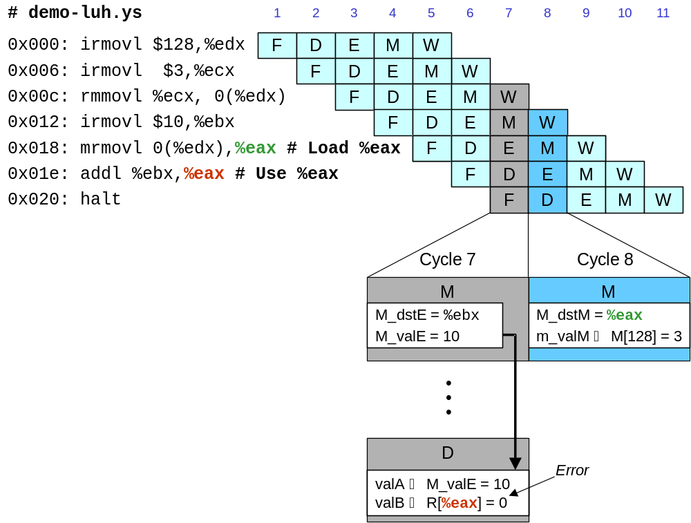
Limitation of Forwarding
Load-use dependency
  Value needed by end of decode stage in cycle 7
  Value read from memory in memory stage of cycle 8

Slide 21
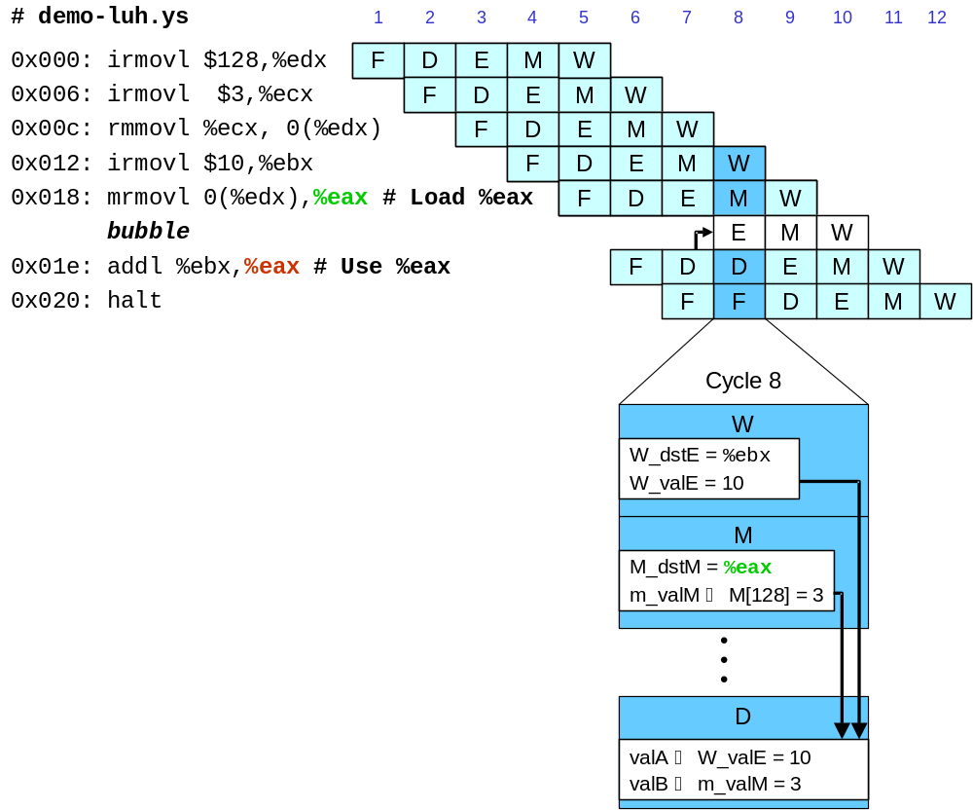
Avoiding Load/Use Hazard
  Stall using instruction for one cycle
  Can then pick up loaded value by forwarding from memory stage

Slide 22
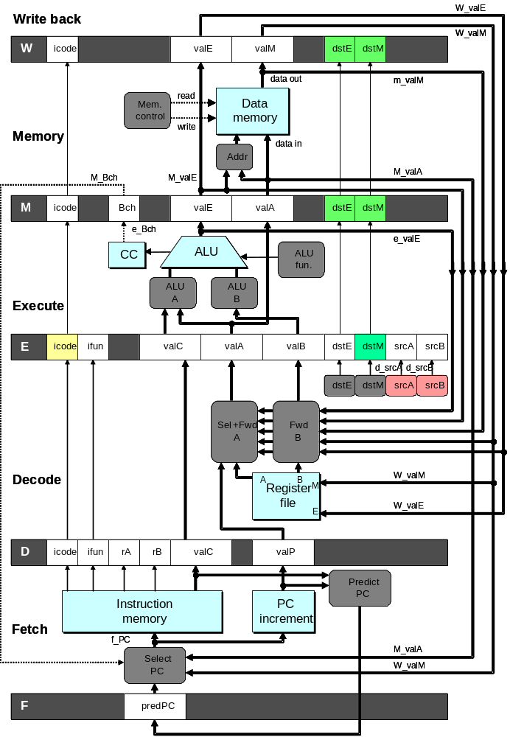
Detecting Load/Use Hazard
Condition | Trigger
Load/Use Hazard | E_icode in { IMRMOVL, IPOPL } && E_dstM in { d_srcA, d_srcB }

Slide 23
Control for Load/Use Hazard
# demo
-
luh
.
ys
1
2
3
4
5
6
7
8
9
10
11
12
F
F
D
D
E
E
M
M
W
0x000:
irmovl
$128,%
edx
W
F
F
D
D
E
E
M
M
W
0x006:
irmovl
$3,%
ecx
W
F
F
D
D
E
E
M
M
W
0x00c:
rmmovl
%
ecx
, 0(%
edx
)
W
F
F
D
D
E
E
M
M
W
0x012:
irmovl
$10,%
ebx
W
%
eax
# Load %
eax
F
F
F
D
D
D
E
E
E
M
M
M
W
W
0x018:
mrmovl
0(%
edx
),
W
bubble
E
M
W
0x01e:
addl
%
ebx
,
%
eax
# Use %
eax
F
D
D
E
M
W
0x020: halt
F
F
D
E
M
W
  Stall instructions in fetch and decode stages
  Inject bubble into execute stage
Condition | F | D | E | M | W
Load/Use Hazard | stall | stall | bubble | normal | normal

Slide 24
Branch Misprediction Example
demo-j.ys
0x000: xorl %eax,%eax
0x002: jne t # Not taken
0x007: irmovl $1, %eax # Fall through
0x00d: nop
0x00e: nop
0x00f: nop
0x010: halt
0x011: t: irmovl $3, %edx # Target (Should not execute)
0x017: irmovl $4, %ecx # Should not execute
0x01d: irmovl $5, %edx # Should not execute
  Should only execute first 8 instructions

Slide 25
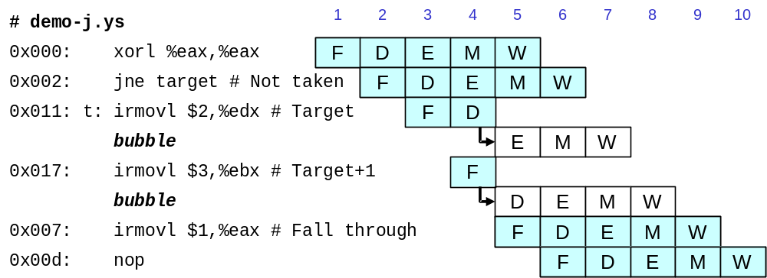
Handling Misprediction
Predict branch as taken
  Fetch 2 instructions at target
Cancel when mispredicted
  Detect branch not-taken in execute stage
  On following cycle, replace instructions in execute and decode by bubbles
  No side effects have occurred yet

Slide 26
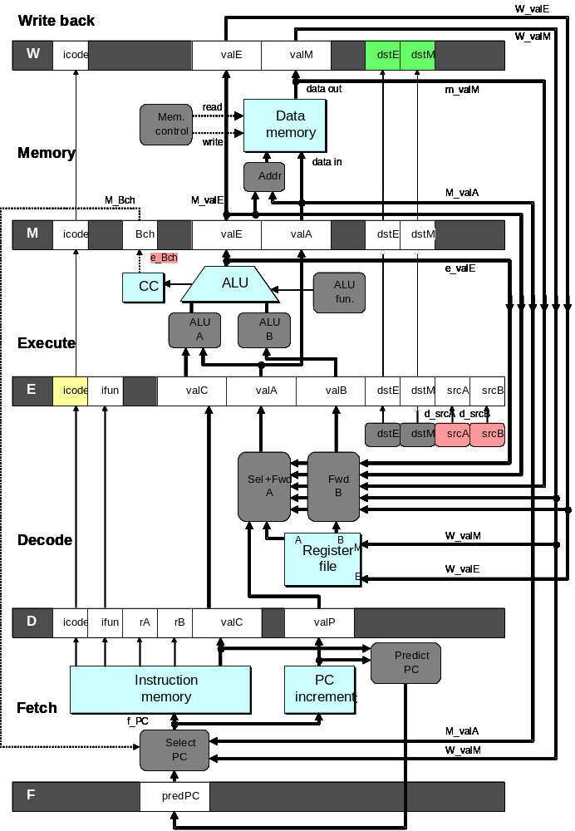
Detecting Mispredicted Branch
Condition | Trigger
Mispredicted Branch | E_icode = IJXX & !e_Bch

Slide 27
Control for Misprediction
Condition | F | D | E | M | W
Mispredicted Branch | normal | bubble | bubble | normal | normal

Slide 28
Return Example
demo-retb.ys
0x000: irmovl Stack,%esp # Initialize stack pointer
0x006: call p # Procedure call
0x00b: irmovl $5,%esi # Return point
0x011: halt
0x020: .pos 0x20
0x020: p: irmovl $-1,%edi # procedure
0x026: ret
0x027: irmovl $1,%eax # Should not be executed
0x02d: irmovl $2,%ecx # Should not be executed
0x033: irmovl $3,%edx # Should not be executed
0x039: irmovl $4,%ebx # Should not be executed
0x100: .pos 0x100
0x100: Stack: # Stack: Stack pointer
  Previously executed three additional instructions

Slide 29
Correct Return Example
# demo
-
retb
0x026: ret
F
D
E
M
W
bubble
F
D
E
M
W
bubble
F
D
E
M
W
bubble
F
D
E
M
W
F
F
D
D
E
E
M
M
W
0x00b:
irmovl
$5,%
esi
# Return
W
  As ret passes through pipeline, stall at fetch stage
    While in decode, execute, and memory stage
  Inject bubble into decode stage
  Release stall when reach write-back stage
W
W
valM
valM
=
=
0x0b
0x0b
•
•
•
F
F

valC

valC
5
5

rB

rB
%
%
esi
esi

Slide 30
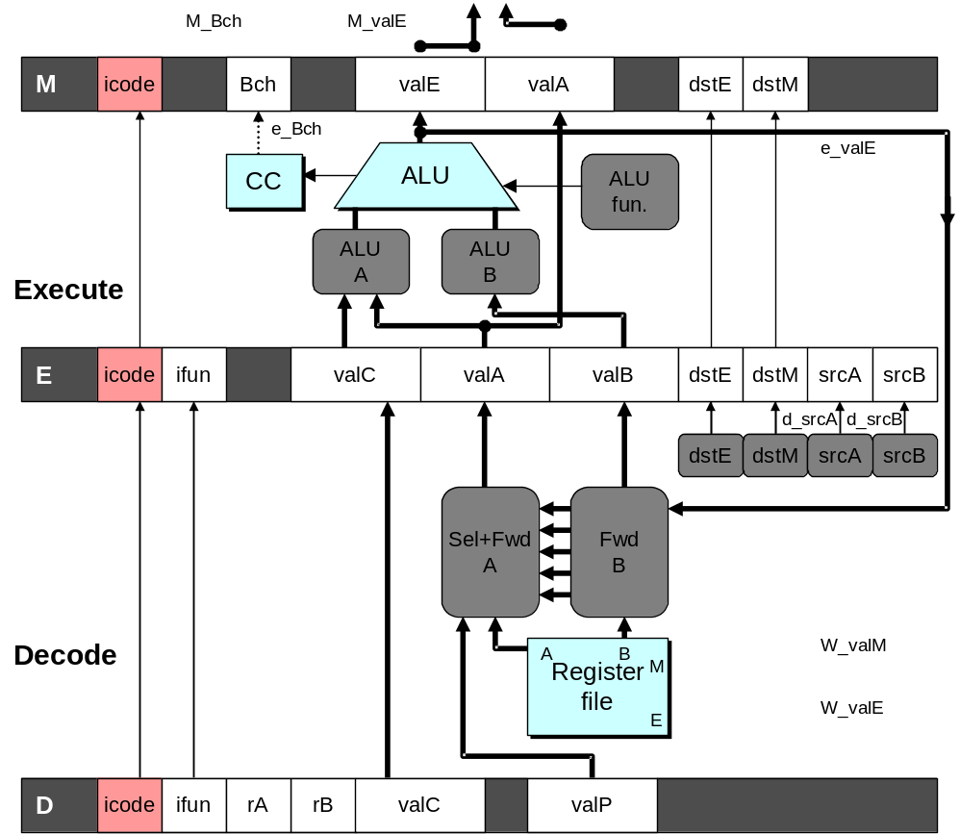
Detecting Return
Condition | Trigger
Processing ret | IRET in { D_icode, E_icode, M_icode }

Slide 31
Control for Return
# demo
-
retb
0x026: ret
F
D
E
M
W
bubble
F
D
E
M
W
bubble
F
D
E
M
W
bubble
F
D
E
M
W
F
F
D
D
E
E
M
M
W
0x00b:
irmovl
$5,%
esi
# Return
W
Condition | F | D | E | M | W
Processing ret | stall | bubble | normal | normal | normal

Slide 32
Special Control Cases
Detection
Action (on next cycle)
Condition | Trigger
Processing ret | IRET in { D_icode, E_icode, M_icode }
Load/Use Hazard | E_icode in { IMRMOVL, IPOPL } && E_dstM in { d_srcA, d_srcB }
Mispredicted Branch | E_icode = IJXX & !e_Bch
Condition | F | D | E | M | W
Processing ret | stall | bubble | normal | normal | normal
Load/Use Hazard | stall | stall | bubble | normal | normal
Mispredicted Branch | normal | bubble | bubble | normal | normal

Slide 33
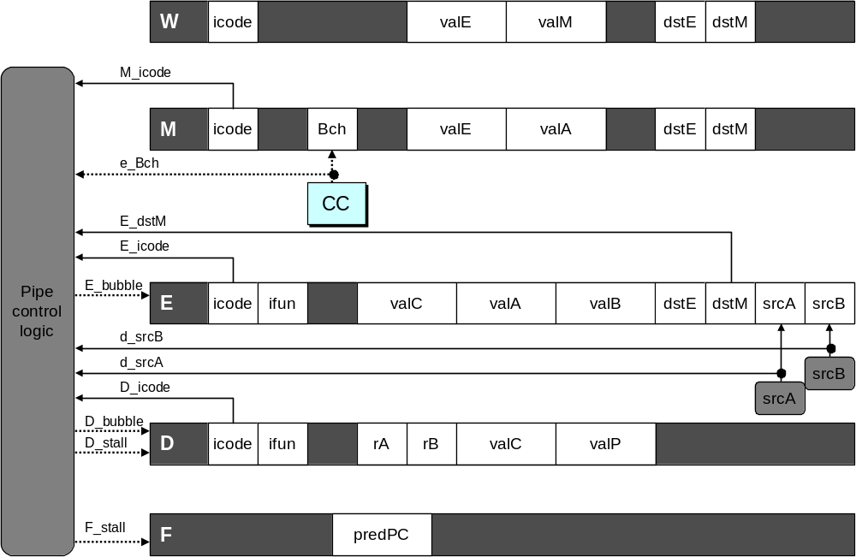
Implementing Pipeline Control
  Combinational logic generates pipeline control signals
  Action occurs at start of following cycle

Slide 34
Initial Version of Pipeline Control
bool F_stall =
# Conditions for a load/use hazard
E_icode in { IMRMOVL, IPOPL } && E_dstM in { d_srcA, d_srcB } ||
# Stalling at fetch while ret passes through pipeline
IRET in { D_icode, E_icode, M_icode };
bool D_stall =
# Conditions for a load/use hazard
E_icode in { IMRMOVL, IPOPL } && E_dstM in { d_srcA, d_srcB };
bool D_bubble =
# Mispredicted branch
(E_icode == IJXX && !e_Bch) ||
# Stalling at fetch while ret passes through pipeline
IRET in { D_icode, E_icode, M_icode };
bool E_bubble =
# Mispredicted branch
(E_icode == IJXX && !e_Bch) ||
# Load/use hazard
E_icode in { IMRMOVL, IPOPL } && E_dstM in { d_srcA, d_srcB};

Slide 35
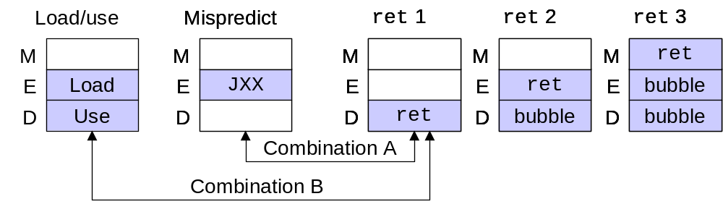
Control Combinations
  Special cases that can arise on same clock cycle
Combination A
  Not-taken branch
  ret instruction at branch target
Combination B
  Instruction that reads from memory to %esp
  Followed by ret instruction

Slide 36
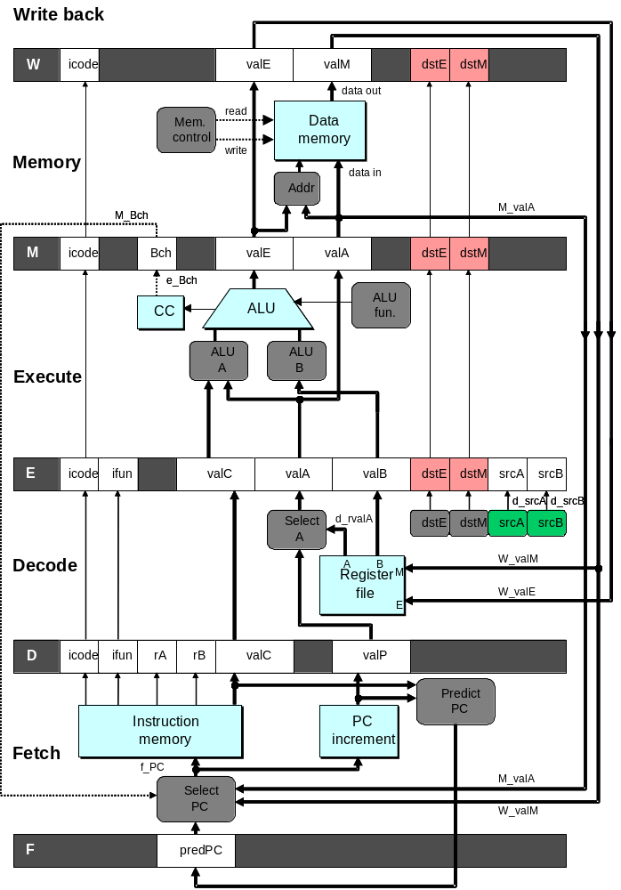
Control Combination A
1
1
Mispredict
1
Mispredict
ret
ret
ret
M
M
M
M
M
JXX
E
JXX
E
E
E
E
ret
ret
D
ret
D
D
D
D
Combination A
Condition | F | D | E | M | W
Processing ret | stall | bubble | normal | normal | normal
Mispredicted Branch | normal | bubble | bubble | normal | normal
Combination | stall | bubble | bubble | normal | normal
  Should handle as mispredicted branch
  Stalls F pipeline register
  But PC selection logic will be using M_valM anyhow

Slide 37
Control Combination B
1
1
Load/use
ret
1
ret
ret
M
M
M
M
E
Load
E
E
E
Use
ret
ret
D
D
ret
D
D
Combination B
Condition | F | D | E | M | W
Processing ret | stall | bubble | normal | normal | normal
Load/Use Hazard | stall | stall | bubble | normal | normal
Combination | stall | bubble + stall | bubble | normal | normal
  Would attempt to bubble and stall pipeline register D
  Signaled by processor as pipeline error

Slide 38
Handling Control Combination B
1
1
Load/use
ret
1
ret
ret
M
M
M
M
E
Load
E
E
E
Use
ret
ret
D
D
ret
D
D
Combination B
Condition | F | D | E | M | W
Processing ret | stall | bubble | normal | normal | normal
Load/Use Hazard | stall | stall | bubble | normal | normal
Combination | stall | stall | bubble | normal | normal
  Load/use hazard should get priority
  ret instruction should be held in decode stage for additional cycle

Slide 39
Corrected Pipeline Control Logic
bool D_bubble =
# Mispredicted branch
(E_icode == IJXX && !e_Bch) ||
# Stalling at fetch while ret passes through pipeline
IRET in { D_icode, E_icode, M_icode }
# but not condition for a load/use hazard
&& !(E_icode in { IMRMOVL, IPOPL }
&& E_dstM in { d_srcA, d_srcB });
Condition | F | D | E | M | W
Processing ret | stall | bubble | normal | normal | normal
Load/Use Hazard | stall | stall | bubble | normal | normal
Combination | stall | stall | bubble | normal | normal
  Load/use hazard should get priority
  ret instruction should be held in decode stage for additional cycle

Slide 40
Pipeline Summary
Data Hazards
  Most handled by forwarding
    No performance penalty
  Load/use hazard requires one cycle stall
Control Hazards
  Cancel instructions when detect mispredicted branch
    Two clock cycles wasted
  Stall fetch stage while ret passes through pipeline
    Three clock cycles wasted
Control Combinations
  Must analyze carefully
  First version had subtle bug
    Only arises with unusual instruction combination

