Slide 1
CS:APP Chapter 4
Computer Architecture
Wrap-Up
Randal E. Bryant
Carnegie Mellon University
http://csapp.cs.cmu.edu
CS:APP

Slide 2
Overview
Wrap-Up of PIPE Design
  Performance analysis
  Fetch stage design
  Exceptional conditions
Modern High-Performance Processors
  Out-of-order execution

Slide 3
Performance Metrics
Clock rate
  Measured in Megahertz or Gigahertz
  Function of stage partitioning and circuit design
    Keep amount of work per stage small
Rate at which instructions executed
  CPI: cycles per instruction
  On average, how many clock cycles does each instruction require?
  Function of pipeline design and benchmark programs
    E.g., how frequently are branches mispredicted?

Slide 4
CPI for PIPE
CPI ≈ 1.0
  Fetch instruction each clock cycle
  Effectively process new instruction almost every cycle
    Although each individual instruction has latency of 5 cycles
CPI > 1.0
  Sometimes must stall or cancel branches
Computing CPI
  C clock cycles
  I instructions executed to completion
  B bubbles injected (C = I + B)
  CPI = C/I = (I+B)/I = 1.0 + B/I
  Factor B/I represents average penalty due to bubbles

Slide 5
CPI for PIPE (Cont.)
  B/I = LP + MP + RP
  LP: Penalty due to load/use hazard stalling
    Fraction of instructions that are loads 0.25
    Fraction of load instructions requiring stall 0.20
    Number of bubbles injected each time 1
    ⇒ LP = 0.25 * 0.20 * 1 = 0.05
  MP: Penalty due to mispredicted branches
    Fraction of instructions that are cond. jumps 0.20
    Fraction of cond. jumps mispredicted 0.40
    Number of bubbles injected each time 2
    ⇒ MP = 0.20 * 0.40 * 2 = 0.16
  RP: Penalty due to ret instructions
    Fraction of instructions that are returns 0.02
    Number of bubbles injected each time 3
    ⇒ RP = 0.02 * 3 = 0.06
  Net effect of penalties 0.05 + 0.16 + 0.06 = 0.27
    ⇒ CPI = 1.27 (Not bad!)
Typical Values

Slide 6
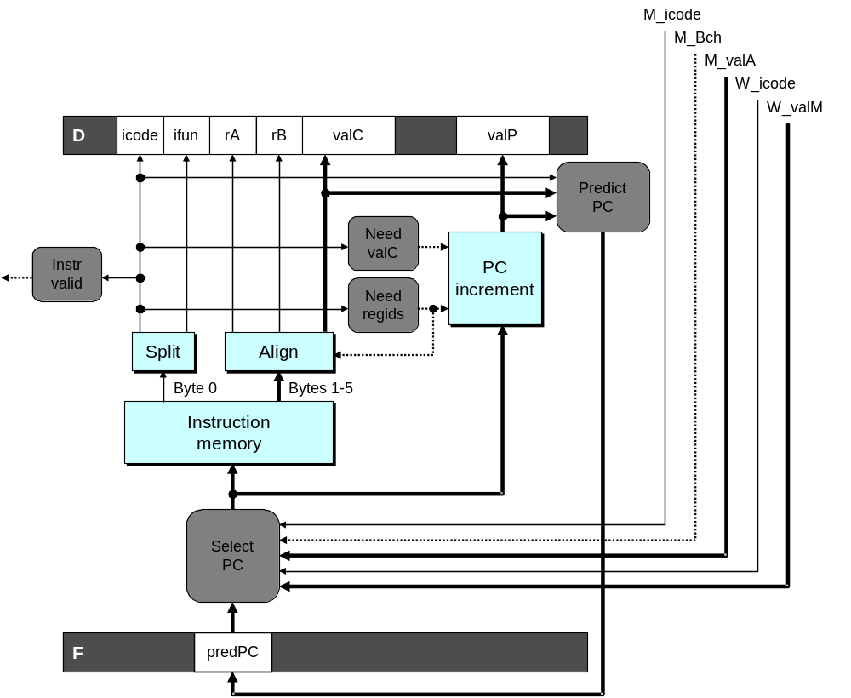
Fetch Logic Revisited
During Fetch Cycle
  Select PC
  Read bytes from instruction memory
  Examine icode to determine instruction length
  Increment PC
Timing
  Steps 2 & 4 require significant amount of time

Slide 7
Standard Fetch Timing
Select PC
need_regids, need_valC
Mem. Read
Increment
1 clock cycle
  Must Perform Everything in Sequence
  Can’t compute incremented PC until know how much to increment it by

Slide 8
A Fast PC Increment Circuit
incrPC
High-order 29 bits
Low-order 3 bits
MUX
carry
0
1
29-bit
incre-
menter
3-bit adder
Slow
Fast
need_regids
0
High-order 29 bits
need_ValC
Low-order 3 bits
PC

Slide 9
Modified Fetch Timing
need_regids, need_valC
Select PC
3-bit add
Mem. Read
MUX
Incrementer
Standard cycle
1 clock cycle
29-Bit Incrementer
  Acts as soon as PC selected
  Output not needed until final MUX
  Works in parallel with memory read

Slide 10
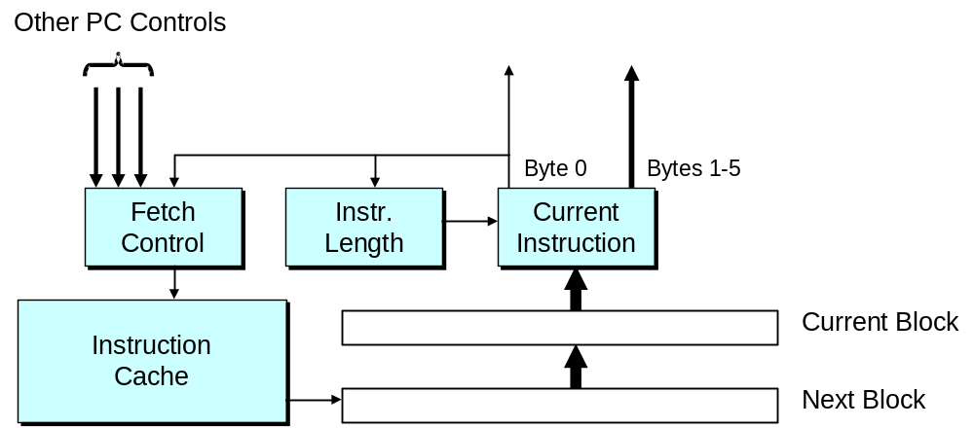
More Realistic Fetch Logic
Fetch Box
  Integrated into instruction cache
  Fetches entire cache block (16 or 32 bytes)
  Selects current instruction from current block
  Works ahead to fetch next block
    As reaches end of current block
    At branch target

Slide 11
Exceptions
  Conditions under which pipeline cannot continue normal operation
Causes
  Halt instruction (Current)
  Bad address for instruction or data (Previous)
  Invalid instruction (Previous)
  Pipeline control error (Previous)
Desired Action
  Complete some instructions
    Either current or previous (depends on exception type)
  Discard others
  Call exception handler
    Like an unexpected procedure call

Slide 12
Exception Examples
Detect in Fetch Stage
jmp $-1 # Invalid jump target
.byte 0xFF # Invalid instruction code
halt # Halt instruction
Detect in Memory Stage
irmovl $100,%eax
rmmovl %eax,0x10000(%eax) # invalid address

Slide 13
Exceptions in Pipeline Processor #1
# demo-exc1.ys
irmovl $100,%eax
rmmovl %eax,0x10000(%eax) # Invalid address
nop
.byte 0xFF # Invalid instruction code
1
2
3
4
5
0x000: irmovl $100,%eax
F
D
E
M
W
Exception detected
0x006: rmmovl %eax,0x1000(%eax)
F
D
E
M
0x00c: nop
F
D
E
0x00d: .byte 0xFF
F
D
Exception detected
Desired Behavior
  rmmovl should cause exception

Slide 14
Exceptions in Pipeline Processor #2
# demo-exc2.ys
0x000: xorl %eax,%eax # Set condition codes
0x002: jne t # Not taken
0x007: irmovl $1,%eax
0x00d: irmovl $2,%edx
0x013: halt
0x014: t: .byte 0xFF # Target
1
2
3
4
5
6
7
8
9
0x000: xorl %eax,%eax
F
D
E
M
W
0x002: jne t
F
D
E
M
0x014: t: .byte 0xFF
F
D
E
M
W
0x???: (I’m lost!)
F
D
E
M
W
0x007: irmovl $1,%eax
F
D
E
M
W
Exception detected
Desired Behavior
  No exception should occur

Slide 15
Maintaining Exception Ordering
W
exc
icode
valE
valM
dstE
dstM
M
exc
icode
Bch
valE
valA
dstE
dstM
E
exc
icode
ifun
valC
valA
valB
dstE
dstM
srcA
srcB
D
exc
icode
ifun
rA
rB
valC
valP
F
predPC
  Add exception status field to pipeline registers
  Fetch stage sets to either “AOK,” “ADR” (when bad fetch address), or “INS” (illegal instruction)
  Decode & execute pass values through
  Memory either passes through or sets to “ADR”
  Exception triggered only when instruction hits write back

Slide 16
Side Effects in Pipeline Processor
# demo-exc3.ys
irmovl $100,%eax
rmmovl %eax,0x10000(%eax) # invalid address
addl %eax,%eax # Sets condition codes
1
2
3
4
5
0x000: irmovl $100,%eax
F
D
E
M
W
Exception detected
0x006: rmmovl %eax,0x1000(%eax)
F
D
E
M
0x00c: addl %eax,%eax
F
D
E
Condition code set
Desired Behavior
  rmmovl should cause exception
  No following instruction should have any effect

Slide 17
Avoiding Side Effects
Presence of Exception Should Disable State Update
  When detect exception in memory stage
    Disable condition code setting in execute
    Must happen in same clock cycle
  When exception passes to write-back stage
    Disable memory write in memory stage
    Disable condition code setting in execute stage
Implementation
  Hardwired into the design of the PIPE simulator
  You have no control over this

Slide 18
Rest of Exception Handling
Calling Exception Handler
  Push PC onto stack
    Either PC of faulting instruction or of next instruction
    Usually pass through pipeline along with exception status
  Jump to handler address
    Usually fixed address
    Defined as part of ISA
Implementation
  Haven’t tried it yet!

Slide 19
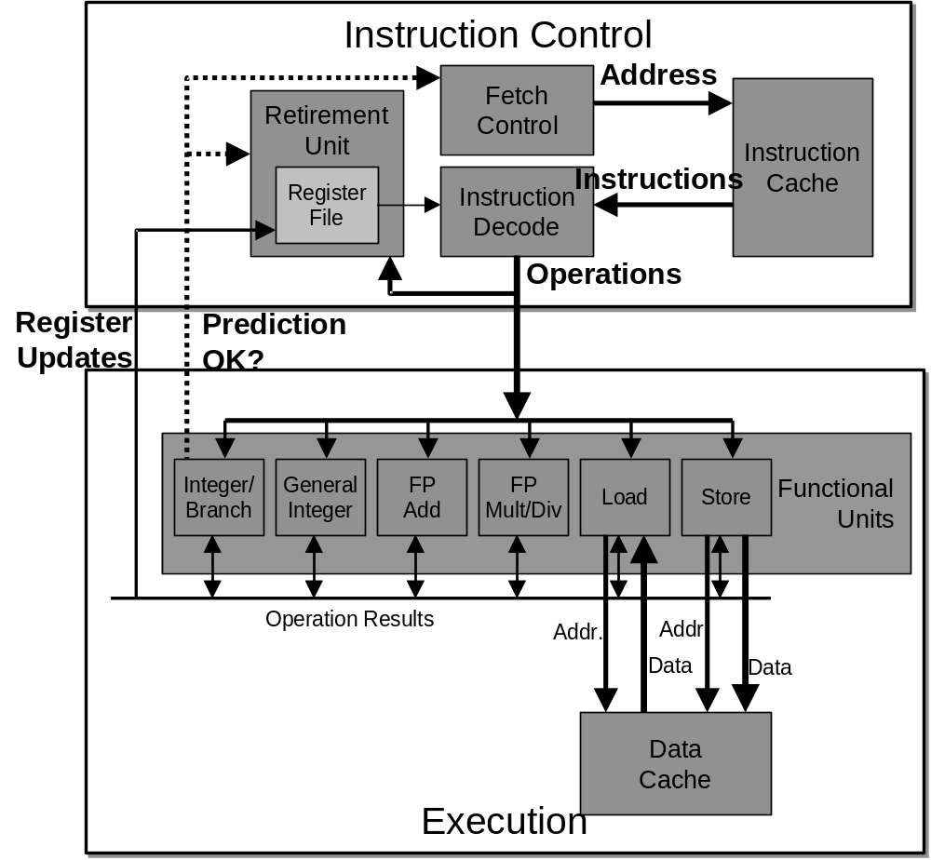
Modern CPU Design

Slide 20
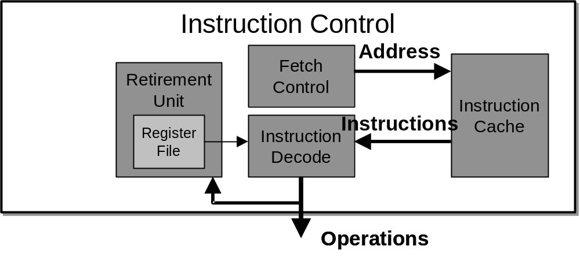
Instruction Control
Grabs Instruction Bytes From Memory
  Based on Current PC + Predicted Targets for Predicted Branches
  Hardware dynamically guesses whether branches taken/not taken and (possibly) branch target
Translates Instructions Into Operations
  Primitive steps required to perform instruction
  Typical instruction requires 1–3 operations
Converts Register References Into Tags
  Abstract identifier linking destination of one operation with sources of later operations

Slide 21
Execution
Unit
Register
Prediction
Operations
Updates
OK?
Integer/
General
FP
FP
Load
Store
Functional
Branch
Integer
Add
Mult
/Div
Units
Operation Results
Addr
.
Addr
.
Data
Data
Data
Cache
Execution
Execution
  Multiple functional units
    Each can operate in independently
  Operations performed as soon as operands available
    Not necessarily in program order
    Within limits of functional units
  Control logic
    Ensures behavior equivalent to sequential program execution

Slide 22
CPU Capabilities of Pentium III
Multiple Instructions Can Execute in Parallel
  1 load
  1 store
  2 integer (one may be branch)
  1 FP Addition
  1 FP Multiplication or Division
Some Instructions Take > 1 Cycle, but Can be Pipelined
  Instruction Latency Cycles/Issue
  Load / Store 3 1
  Integer Multiply 4 1
  Integer Divide 36 36
  Double/Single FP Multiply 5 2
  Double/Single FP Add 3 1
  Double/Single FP Divide 38 38

Slide 23
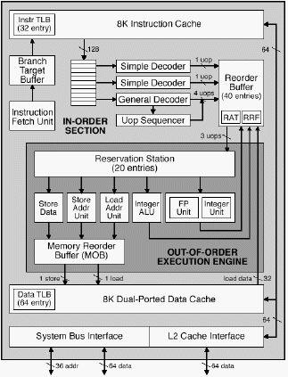
PentiumPro Block Diagram
P6 Microarchitecture
  PentiumPro
  Pentium II
  Pentium III
Microprocessor Report
2/16/95

Slide 24
PentiumPro Operation
Translates instructions dynamically into “Uops”
  118 bits wide
  Holds operation, two sources, and destination
Executes Uops with “Out of Order” engine
  Uop executed when
    Operands available
    Functional unit available
  Execution controlled by “Reservation Stations”
    Keeps track of data dependencies between uops
    Allocates resources

Slide 25
PentiumPro Branch Prediction
Critical to Performance
  11–15 cycle penalty for misprediction
Branch Target Buffer
  512 entries
  4 bits of history
  Adaptive algorithm
    Can recognize repeated patterns, e.g., alternating taken–not taken
Handling BTB misses
  Detect in cycle 6
  Predict taken for negative offset, not taken for positive
    Loops vs. conditionals

Slide 26
Example Branch Prediction
Branch History
  Encode information about prior history of branch instructions
  Predict whether or not branch will be taken
State Machine
  Each time branch taken, transition to right
  When not taken, transition to left
  Predict branch taken when in state Yes! or Yes?
NT
NT
NT
T
Yes!
Yes?
No?
No!
NT
T
T
T

Slide 27
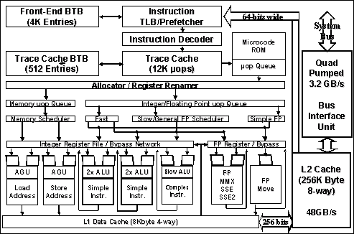
Pentium 4 Block Diagram
Intel Tech. Journal
Q1, 2001
  Next generation microarchitecture

Slide 28
Pentium 4 Features
L2 Cache
IA32
Instrs.
Instruct.
Decoder
Trace
Cache
Trace Cache
  Replaces traditional instruction cache
  Caches instructions in decoded form
  Reduces required rate for instruction decoder
Double-Pumped ALUs
  Simple instructions (add) run at 2X clock rate
Very Deep Pipeline
  20+ cycle branch penalty
  Enables very high clock rates
  Slower than Pentium III for a given clock rate
uops
Operations

Slide 29
Processor Summary
Design Technique
  Create uniform framework for all instructions
    Want to share hardware among instructions
  Connect standard logic blocks with bits of control logic
Operation
  State held in memories and clocked registers
  Computation done by combinational logic
  Clocking of registers/memories sufficient to control overall behavior
Enhancing Performance
  Pipelining increases throughput and improves resource utilization
  Must make sure maintains ISA behavior

