Slide 1
15-213
“The course that gives CMU its Zip!”
Integers
Sep 3, 2002
Topics
  Numeric Encodings
    Unsigned & Two’s complement
  Programming Implications
    C promotion rules
  Basic operations
    Addition, negation, multiplication
  Programming Implications
    Consequences of overflow
    Using shifts to perform power-of-2 multiply/divide
class03.ppt
15-213 F’02

Slide 2
C Puzzles
  Taken from old exams
  Assume machine with 32 bit word size, two’s complement integers
  For each of the following C expressions, either:
    Argue that is true for all argument values
    Give example where not true
x < 0 ⇒ ((x*2) < 0)
ux >= 0
x & 7 == 7 ⇒ (x<<30) < 0
ux > -1
x > y ⇒ -x < -y
x * x >= 0
x > 0 && y > 0 ⇒ x + y > 0
x >= 0 ⇒ -x <= 0
x <= 0 ⇒ -x >= 0
Initialization
int x = foo();
int y = bar();
unsigned ux = x;
unsigned uy = y;

Slide 3
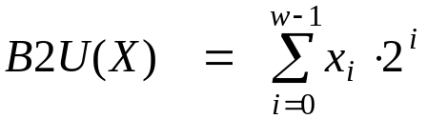
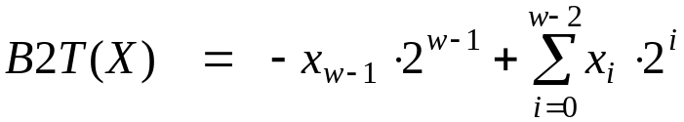
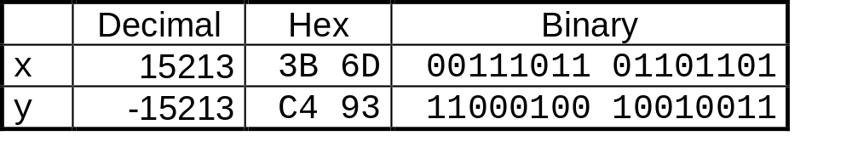
Encoding Integers
Unsigned
Two’s Complement
short int x = 15213;
short int y = -15213;
Sign
Bit
  C short 2 bytes long
Sign Bit
  For 2’s complement, most significant bit indicates sign
    0 for nonnegative
    1 for negative

Slide 4
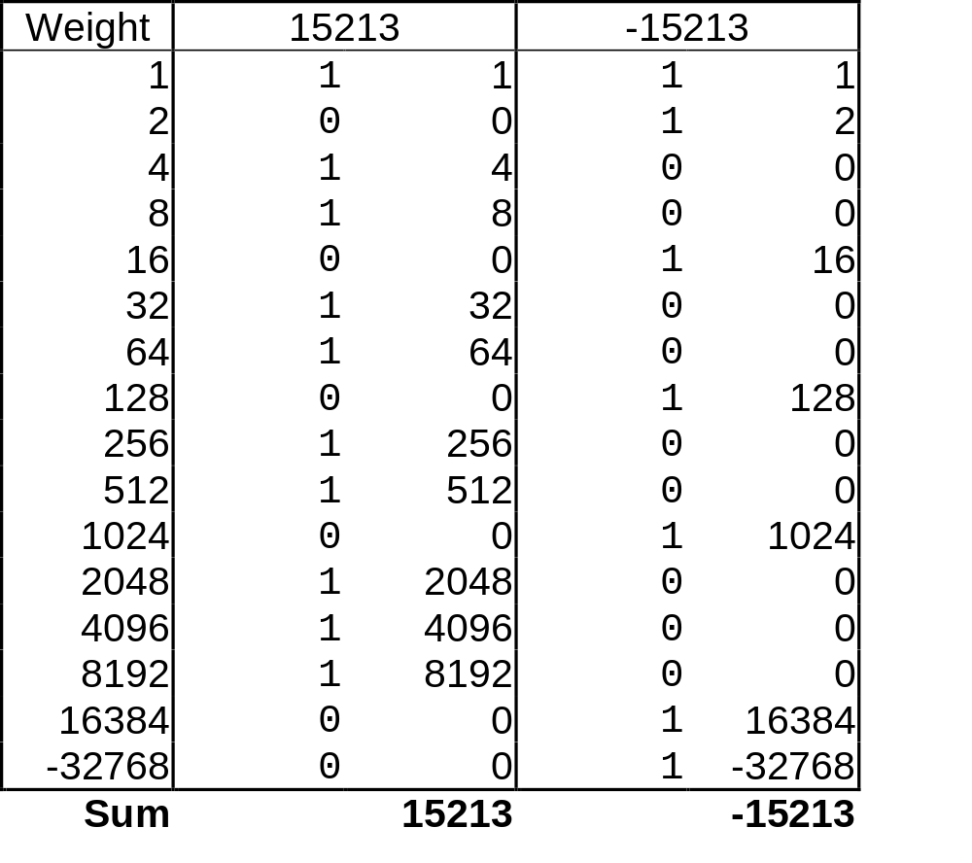
Encoding Example (Cont.)
x = 15213: 00111011 01101101
y = -15213: 11000100 10010011

Slide 5
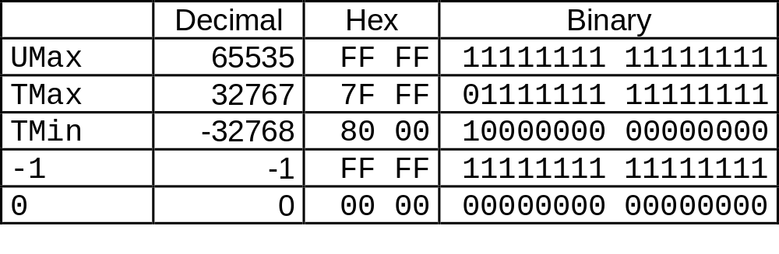
Numeric Ranges
Unsigned Values
  UMin = 0
    000…0
  UMax = 2^{w} – 1
    111…1
Two’s Complement Values
  TMin = –2^{w–1}
    100…0
  TMax = 2^{w–1} – 1
    011…1
Other Values
  Minus 1
    111…1
Values for W = 16

Slide 6
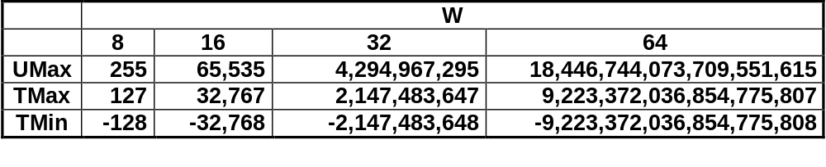
Values for Different Word Sizes
Observations
  |TMin | = TMax + 1
    Asymmetric range
  UMax = 2 * TMax + 1
C Programming
  #include <limits.h>
    K&R App. B11
  Declares constants, e.g.,
    ULONG_MAX
    LONG_MAX
    LONG_MIN
  Values platform-specific

Slide 7
Unsigned & Signed Numeric Values
X
B2U(X)
B2T(X)
Equivalence
  Same encodings for nonnegative values
Uniqueness
  Every bit pattern represents unique integer value
  Each representable integer has unique bit encoding
⇒ Can Invert Mappings
  U2B(x) = B2U⁻¹(x)
    Bit pattern for unsigned integer
  T2B(x) = B2T⁻¹(x)
    Bit pattern for two’s comp integer
0000
0
0
0001
1
1
0010
2
2
0011
3
3
0100
4
4
0101
5
5
0110
6
6
0111
7
7
1000
8
–8
1001
9
–7
1010
10
–6
1011
11
–5
1100
12
–4
1101
13
–3
1110
14
–2
1111
15
–1

Slide 8
Casting Signed to Unsigned
C Allows Conversions from Signed to Unsigned
Resulting Value
  No change in bit representation
  Nonnegative values unchanged
    ux = 15213
  Negative values change into (large) positive values
    uy = 50323
short int x = 15213;
unsigned short int ux = (unsigned short) x;
short int y = -15213;
unsigned short int uy = (unsigned short) y;

Slide 9
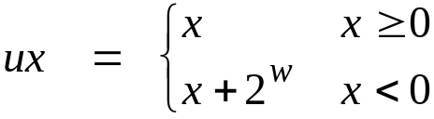
Relation between Signed & Unsigned
Two’s Complement
T2U
Unsigned
x
T2B
B2U
ux
X
Maintain Same Bit Pattern
w–1
0
ux
+
+
+
• • •
+
+
+
-
x
-
+
+
• • •
+
+
+
+2^{w–1} – –2^{w–1} = 2*2^{w–1} = 2^{w}

Slide 10
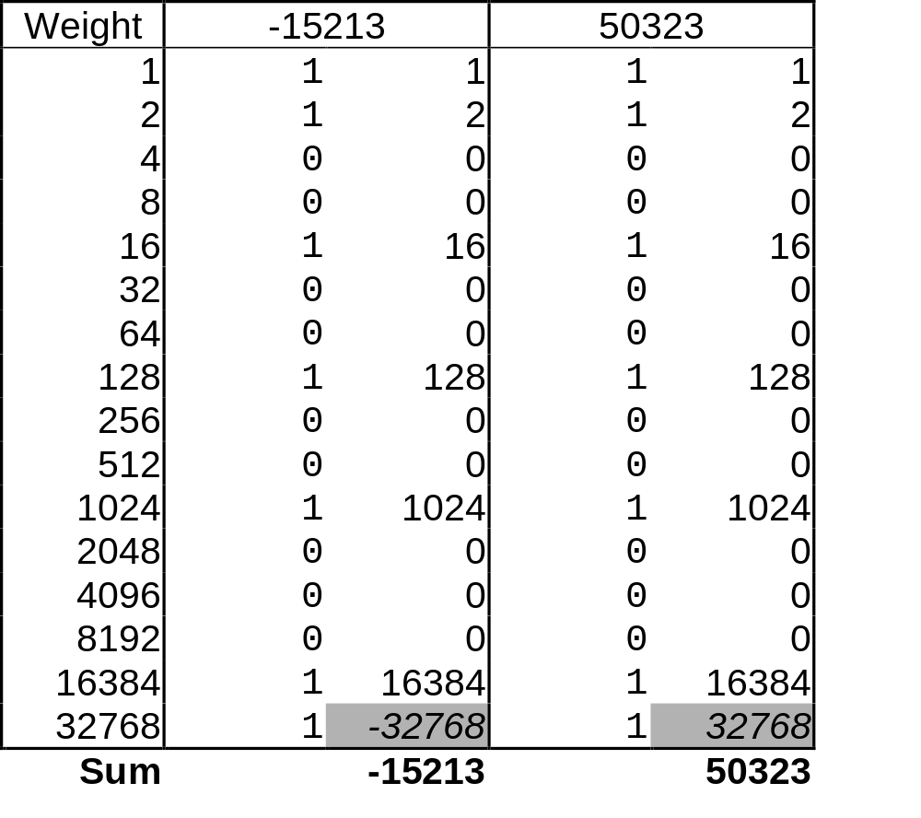
Relation Between Signed & Unsigned
  uy = y + 2 * 32768 = y + 65536

Slide 11
Signed vs. Unsigned in C
Constants
  By default are considered to be signed integers
  Unsigned if have “U” as suffix
    0U, 4294967259U
Casting
  Explicit casting between signed & unsigned same as U2T and T2U
    int tx, ty;
    unsigned ux, uy;
    tx = (int) ux;
    uy = (unsigned) ty;
  Implicit casting also occurs via assignments and procedure calls
    tx = ux;
    uy = ty;

Slide 12
Casting Surprises
Expression Evaluation
  If mix unsigned and signed in single expression, signed values implicitly cast to unsigned
  Including comparison operations <, >, ==, <=, >=
  Examples for W = 32
Constant₁ Constant₂ Relation Evaluation
  0 0U
  -1 0
  -1 0U
  2147483647 -2147483648
  2147483647U -2147483648
  -1 -2
  (unsigned) -1 -2
  2147483647 2147483648U
  2147483647 (int) 2147483648U
  0 0U == unsigned
  -1 0 < signed
  -1 0U > unsigned
  2147483647 -2147483648 > signed
  2147483647U -2147483648 < unsigned
  -1 -2 > signed
  (unsigned) -1 -2 > unsigned
  2147483647 2147483648U < unsigned
  2147483647 (int) 2147483648U > signed

Slide 13
Explanation of Casting Surprises
2’s Comp. → Unsigned
  Ordering Inversion
  Negative → Big Positive
UMax
UMax – 1
TMax + 1
Unsigned
Range
TMax
TMax
2’s Comp.
Range
0
0
–1
–2
TMin

Slide 14
Sign Extension
Task:
  Given w-bit signed integer x
  Convert it to w+k-bit integer with same value
Rule:
  Make k copies of sign bit:
  X ′ = x_{w–1} ,…, x_{w–1} , x_{w–1} , x_{w–2} ,…, x₀
k copies of MSB
w
X
• • •
• • •
X ′
• • •
• • •
k
w

Slide 15
Sign Extension Example
short int x = 15213;
int ix = (int) x;
short int y = -15213;
int iy = (int) y;
Decimal
Hex
Binary
x
15213
3B 6D
00111011 01101101
ix
15213
00 00 3B 6D
00000000 00000000 00111011 01101101
y
-15213
C4 93
11000100 10010011
iy
-15213
FF FF C4 93
11111111 11111111 11000100 10010011
  Converting from smaller to larger integer data type
  C automatically performs sign extension

Slide 16
Justification For Sign Extension
Prove Correctness by Induction on k
  Induction Step: extending by single bit maintains value
  Key observation: –2^{w–1} = –2^{w} +2^{w–1}
  Look at weight of upper bits:
    X –2^{w–1} x_{w–1}
    X ′ –2^{w} x_{w–1} + 2^{w–1} x_{w–1} = –2^{w–1} x_{w–1}
w
X
-
• • •
X ′
-
+
• • •
w+1

Slide 17
Why Should I Use Unsigned?
Don’t Use Just Because Number Nonzero
  C compilers on some machines generate less efficient code
    unsigned i;
    for (i = 1; i < cnt; i++)
    a[i] += a[i-1];
  Easy to make mistakes
    for (i = cnt-2; i >= 0; i--)
    a[i] += a[i+1];
Do Use When Performing Modular Arithmetic
  Multiprecision arithmetic
  Other esoteric stuff
Do Use When Need Extra Bit’s Worth of Range
  Working right up to limit of word size

Slide 18
Negating with Complement & Increment
Claim: Following Holds for 2’s Complement
  ~x + 1 == -x
Complement
  Observation: ~x + x == 1111…11₂ == -1
Increment
  ~x + x + (-x + 1) == -1 + (-x + 1)
  ~x + 1 == -x
Warning: Be cautious treating int’s as integers
  OK here
x
1
0
0
1
1
1
0
1
+
~x
0
1
1
0
0
0
1
0
-1
1
1
1
1
1
1
1
1

Slide 19
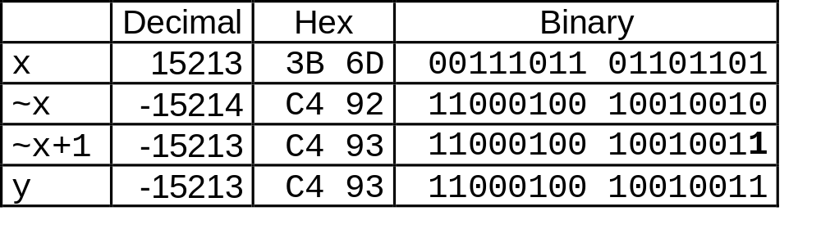
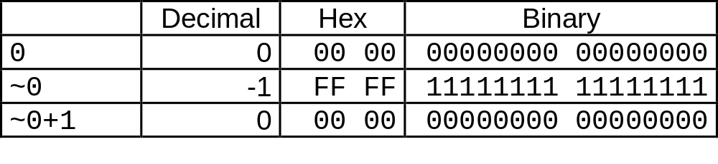
Comp. & Incr. Examples
x = 15213
0

Slide 20

Unsigned Addition
u
• • •
Operands: w bits
+
v
• • •
True Sum: w+1 bits
u + v
• • •
Discard Carry: w bits
UAdd_{w}(u , v)
• • •
Standard Addition Function
  Ignores carry output
Implements Modular Arithmetic
  s = UAdd_{w}(u , v) = u + v mod 2^{w}

Slide 21
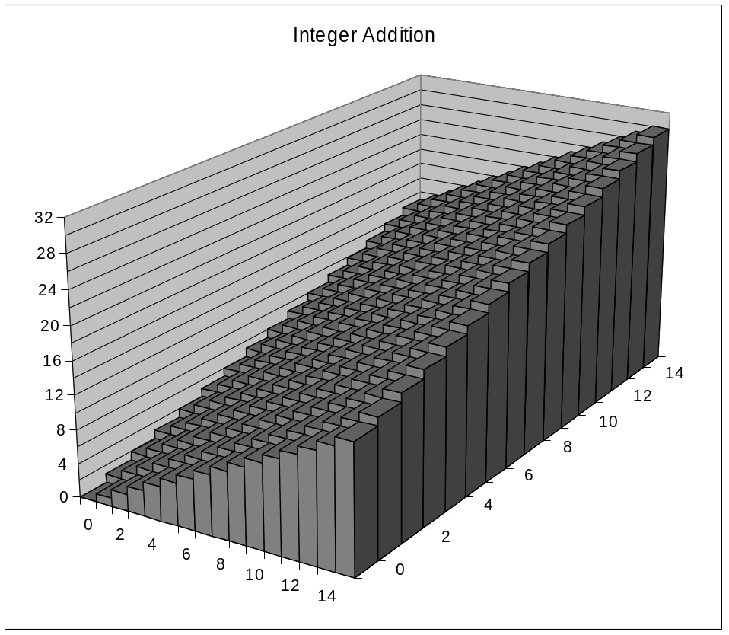
Visualizing Integer Addition
Integer Addition
  4-bit integers u, v
  Compute true sum Add₄(u , v)
  Values increase linearly with u and v
  Forms planar surface
Add₄(u , v)
v
u

Slide 22
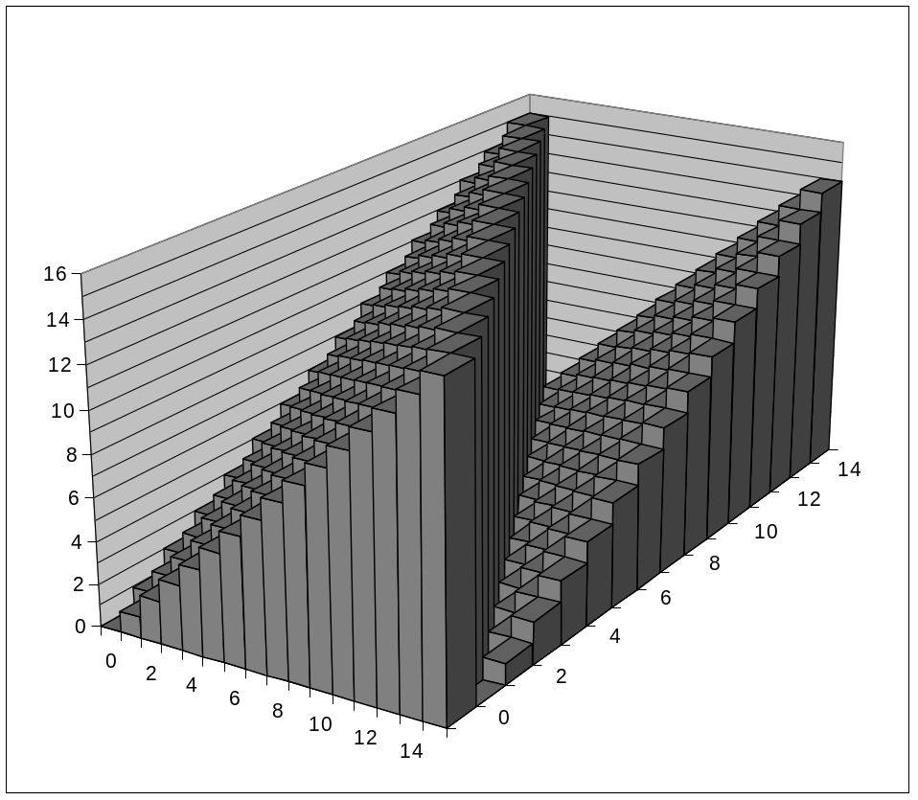
Visualizing Unsigned Addition
Wraps Around
  If true sum ≥ 2^{w}
  At most once
Overflow
UAdd₄(u , v)
True Sum
2^{w+1}
Overflow
2^{w}
v
0
Modular Sum
u

Slide 23
Mathematical Properties
Modular Addition Forms an Abelian Group
  Closed under addition
    0 ≤ UAdd_{w}(u , v) ≤ 2^{w} –1
  Commutative
    UAdd_{w}(u , v) = UAdd_{w}(v , u)
  Associative
    UAdd_{w}(t, UAdd_{w}(u , v)) = UAdd_{w}(UAdd_{w}(t, u ), v)
  0 is additive identity
    UAdd_{w}(u , 0) = u
  Every element has additive inverse
    Let UComp_{w} (u ) = 2^{w} – u
    UAdd_{w}(u , UComp_{w} (u )) = 0

Slide 24
Two’s Complement Addition
u
• • •
Operands: w bits
+
v
• • •
True Sum: w+1 bits
u + v
• • •
Discard Carry: w bits
TAdd_{w}(u , v)
• • •
TAdd and UAdd have Identical Bit-Level Behavior
  Signed vs. unsigned addition in C:
  int s, t, u, v;
  s = (int) ((unsigned) u + (unsigned) v);
  t = u + v
  Will give s == t

Slide 25

Characterizing TAdd
Functionality
  True sum requires w+1 bits
  Drop off MSB
  Treat remaining bits as 2’s comp. integer
True Sum
0 111…1
2^{w}–1
PosOver
TAdd Result
0 100…0
2^{w –1}
011…1
0 000…0
0
000…0
PosOver
1 100…0
–2^{w –1}
100…0
TAdd(u , v)
1 000…0
–2^{w}
NegOver
> 0
v
< 0
(NegOver)
< 0
> 0
u
(PosOver)
NegOver

Slide 26
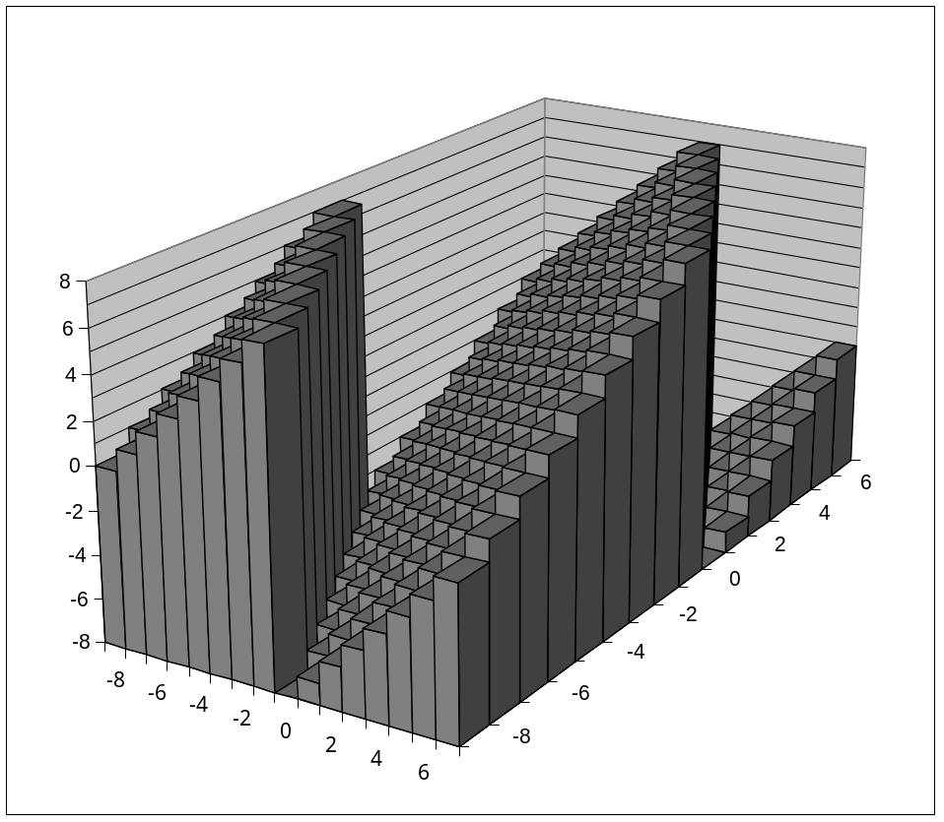
Visualizing 2’s Comp. Addition
NegOver
Values
  4-bit two’s comp.
  Range from -8 to +7
Wraps Around
  If sum ≥ 2^{w–1}
    Becomes negative
    At most once
  If sum < –2^{w–1}
    Becomes positive
    At most once
TAdd₄(u , v)
v
u
PosOver

Slide 27
Detecting 2’s Comp. Overflow
Task
  Given s = TAdd_{w}(u , v)
  Determine if s = Add_{w}(u , v)
  Example
  int s, u, v;
  s = u + v;
Claim
  Overflow iff either:
    u, v < 0, s ≥ 0 (NegOver)
    u, v ≥ 0, s < 0 (PosOver)
  ovf = (u<0 == v<0) && (u<0 != s<0);
2^{w}–1
PosOver
2^{w –1}
0
NegOver

Slide 28
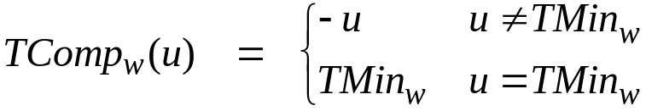
Mathematical Properties of TAdd
Isomorphic Algebra to UAdd
  TAdd_{w}(u , v) = U2T(UAdd_{w}(T2U(u ), T2U(v)))
    Since both have identical bit patterns
Two’s Complement Under TAdd Forms a Group
  Closed, Commutative, Associative, 0 is additive identity
  Every element has additive inverse
    Let TComp_{w} (u ) = U2T(UComp_{w}(T2U(u ))
    TAdd_{w}(u , TComp_{w} (u )) = 0

Slide 29
Multiplication
Computing Exact Product of w-bit numbers x, y
  Either signed or unsigned
Ranges
  Unsigned: 0 ≤ x * y ≤ (2^{w} – 1) ² = 2^{2w} – 2^{w+1} + 1
    Up to 2w bits
  Two’s complement min: x * y ≥ (–2^{w–1})*(2^{w–1}–1) = –2^{2w–2} + 2^{w–1}
    Up to 2w–1 bits
  Two’s complement max: x * y ≤ (–2^{w–1}) ² = 2^{2w–2}
    Up to 2w bits, but only for (TMin_{w})²
Maintaining Exact Results
  Would need to keep expanding word size with each product computed
  Done in software by “arbitrary precision” arithmetic packages

Slide 30
Unsigned Multiplication in C
u
• • •
Operands: w bits
*
v
• • •
True Product: 2*w bits
u · v
• • •
• • •
Discard w bits: w bits
UMult_{w}(u , v)
• • •
Standard Multiplication Function
  Ignores high order w bits
Implements Modular Arithmetic
  UMult_{w}(u , v) = u · v mod 2^{w}

Slide 31
Unsigned vs. Signed Multiplication
Unsigned Multiplication
  unsigned ux = (unsigned) x;
  unsigned uy = (unsigned) y;
  unsigned up = ux * uy
  Truncates product to w-bit number up = UMult_{w}(ux, uy)
  Modular arithmetic: up = ux ⋅ uy mod 2^{w}
Two’s Complement Multiplication
  int x, y;
  int p = x * y;
  Compute exact product of two w-bit numbers x, y
  Truncate result to w-bit number p = TMult_{w}(x, y)

Slide 32
Unsigned vs. Signed Multiplication
Unsigned Multiplication
  unsigned ux = (unsigned) x;
  unsigned uy = (unsigned) y;
  unsigned up = ux * uy
Two’s Complement Multiplication
  int x, y;
  int p = x * y;
Relation
  Signed multiplication gives same bit-level result as unsigned
  up == (unsigned) p

Slide 33
Power-of-2 Multiply with Shift
Operation
  u << k gives u * 2^{k}
  Both signed and unsigned
Examples
  u << 3 == u * 8
  u << 5 - u << 3 == u * 24
  Most machines shift and add much faster than multiply
    Compiler generates this code automatically
k
u
• • •
Operands: w bits
*
2^{k}
0
•••
0
1
0
•••
0
0
True Product: w+k bits
u · 2^{k}
• • •
0
•••
0
0
Discard k bits: w bits
UMult_{w}(u , 2^{k})
•••
0
•••
0
0
TMult_{w}(u , 2^{k})

Slide 34
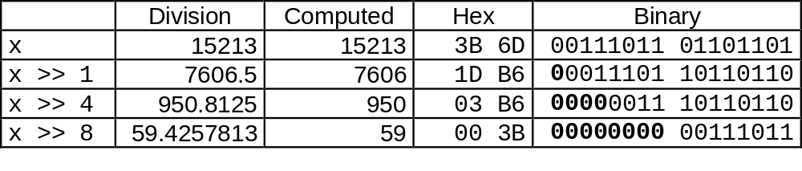
Unsigned Power-of-2 Divide with Shift
Quotient of Unsigned by Power of 2
  u >> k gives ⎣ u / 2^{k} ⎦
  Uses logical shift
k
u
•••
•••
Binary Point
Operands:
/
2^{k}
0
•••
0
1
0
•••
0
0
Division:
u / 2^{k}
0
•••
•••
.
•••
Result:
⎣ u / 2^{k} ⎦
0
•••
•••

Slide 35
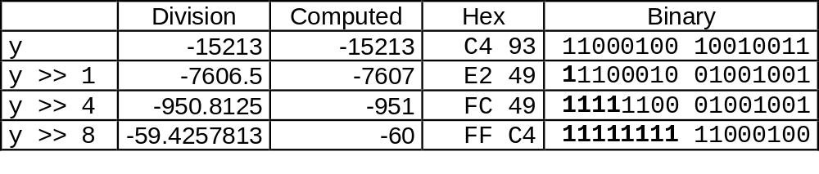
Signed Power-of-2 Divide with Shift
Quotient of Signed by Power of 2
  x >> k gives ⎣ x / 2^{k} ⎦
  Uses arithmetic shift
  Rounds wrong direction when u < 0
k
x
•••
•••
Binary Point
Operands:
/
2^{k}
0
•••
0
1
0
•••
0
0
Division:
x / 2^{k}
0
•••
•••
.
•••
Result:
RoundDown(x / 2^{k})
0
•••
•••

Slide 36
Correct Power-of-2 Divide
Quotient of Negative Number by Power of 2
  Want ⎡ x / 2^{k} ⎤ (Round Toward 0)
  Compute as ⎣ (x+2^{k}-1)/ 2^{k} ⎦
    In C: (x + (1<<k)-1) >> k
    Biases dividend toward 0
Case 1: No rounding
k
Dividend:
u
1
•••
0
•••
0
0
+2^{k} +–1
0
•••
0
0
1
•••
1
1
Binary Point
1
•••
1
•••
1
1
Divisor:
/
2^{k}
0
•••
0
1
0
•••
0
0
⎡ u / 2^{k} ⎤
.
0
1
•••
1
1
1
•••
1
•••
1
1
    Biasing has no effect

Slide 37
Correct Power-of-2 Divide (Cont.)
Case 2: Rounding
k
Dividend:
x
1
•••
•••
+2^{k} +–1
0
•••
0
0
1
•••
1
1
1
•••
•••
Incremented by 1
Binary Point
Divisor:
/
2^{k}
0
•••
0
1
0
•••
0
0
⎡ x / 2^{k} ⎤
.
0
1
•••
1
1
1
•••
•••
    Biasing adds 1 to final result
Incremented by 1

Slide 38
Properties of Unsigned Arithmetic
Unsigned Multiplication with Addition Forms Commutative Ring
  Addition is commutative group
  Closed under multiplication
    0 ≤ UMult_{w}(u , v) ≤ 2^{w} –1
  Multiplication Commutative
    UMult_{w}(u , v) = UMult_{w}(v , u)
  Multiplication is Associative
    UMult_{w}(t, UMult_{w}(u , v)) = UMult_{w}(UMult_{w}(t, u ), v)
  1 is multiplicative identity
    UMult_{w}(u , 1) = u
  Multiplication distributes over addtion
    UMult_{w}(t, UAdd_{w}(u , v)) = UAdd_{w}(UMult_{w}(t, u ), UMult_{w}(t, v))

Slide 39
Properties of Two’s Comp. Arithmetic
Isomorphic Algebras
  Unsigned multiplication and addition
    Truncating to w bits
  Two’s complement multiplication and addition
    Truncating to w bits
Both Form Rings
  Isomorphic to ring of integers mod 2^{w}
Comparison to Integer Arithmetic
  Both are rings
  Integers obey ordering properties, e.g.,
    u > 0 ⇒ u + v > v
    u > 0, v > 0 ⇒ u · v > 0
  These properties are not obeyed by two’s comp. arithmetic
    TMax + 1 == TMin
    15213 * 30426 == -10030 (16-bit words)

Slide 40
C Puzzle Answers
  Assume machine with 32 bit word size, two’s comp. integers
  TMin makes a good counterexample in many cases
x < 0 ⇒ ((x*2) < 0) False: TMin
ux >= 0 True: 0 = UMin
x & 7 == 7 ⇒ (x<<30) < 0 True: x₁ = 1
ux > -1 False: 0
x > y ⇒ -x < -y False: -1, TMin
x * x >= 0 False: 30426
x > 0 && y > 0 ⇒ x + y > 0 False: TMax, TMax
x >= 0 ⇒ -x <= 0 True: –TMax < 0
x <= 0 ⇒ -x >= 0 False: TMin
x < 0 ⇒ ((x*2) < 0)
ux >= 0
x & 7 == 7 ⇒ (x<<30) < 0
ux > -1
x > y ⇒ -x < -y
x * x >= 0
x > 0 && y > 0 ⇒ x + y > 0
x >= 0 ⇒ -x <= 0
x <= 0 ⇒ -x >= 0

