Slide 1
Machine-Level Programming II:
Control Flow
Sept. 12, 2002
15-213
“The course that gives CMU its Zip!”
Topics
  Condition Codes
    Setting
    Testing
  Control Flow
    If-then-else
    Varieties of Loops
    Switch Statements
class06.ppt

Slide 2
Condition Codes
Single Bit Registers
  CF Carry Flag SF Sign Flag
  ZF Zero Flag OF Overflow Flag
Implicitly Set By Arithmetic Operations
  addl Src,Dest
  C analog: t = a + b
  CF set if carry out from most significant bit
    Used to detect unsigned overflow
  ZF set if t == 0
  SF set if t < 0
  OF set if two’s complement overflow
    (a>0 && b>0 && t<0) || (a<0 && b<0 && t>=0)
Not Set by leal instruction

Slide 3
Setting Condition Codes (cont.)
Explicit Setting by Compare Instruction
  cmpl Src2,Src1
  cmpl b,a like computing a-b without setting destination
  CF set if carry out from most significant bit
    Used for unsigned comparisons
  ZF set if a == b
  SF set if (a-b) < 0
  OF set if two’s complement overflow
    (a>0 && b<0 && (a-b)<0) || (a<0 && b>0 && (a-b)>0)

Slide 4
Setting Condition Codes (cont.)
Explicit Setting by Test instruction
  testl Src2,Src1
  Sets condition codes based on value of Src1 & Src2
    Useful to have one of the operands be a mask
  testl b,a like computing a&b without setting destination
  ZF set when a&b == 0
  SF set when a&b < 0

Slide 5
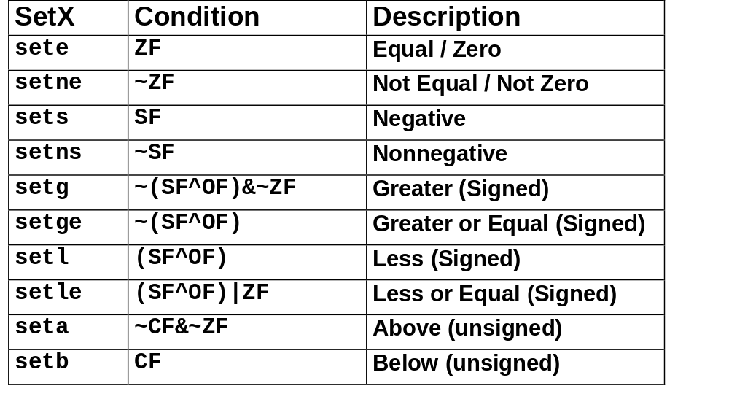
Reading Condition Codes
SetX Instructions
  Set single byte based on combinations of condition codes

Slide 6
Reading Condition Codes (Cont.)
SetX Instructions
  Set single byte based on combinations of condition codes
  One of 8 addressable byte registers
    Embedded within first 4 integer registers
    Does not alter remaining 3 bytes
    Typically use movzbl to finish job
%eax
%ah
%al
%edx
%dh
%dl
%ecx
%ch
%cl
%ebx
%bh
%bl
%esi
int gt (int x, int y)
{
return x > y;
}
%edi
%esp
Body
%ebp
movl 12(%ebp),%eax # eax = y
cmpl %eax,8(%ebp) # Compare x : y
setg %al # al = x > y
movzbl %al,%eax # Zero rest of %eax
Note inverted ordering!

Slide 7
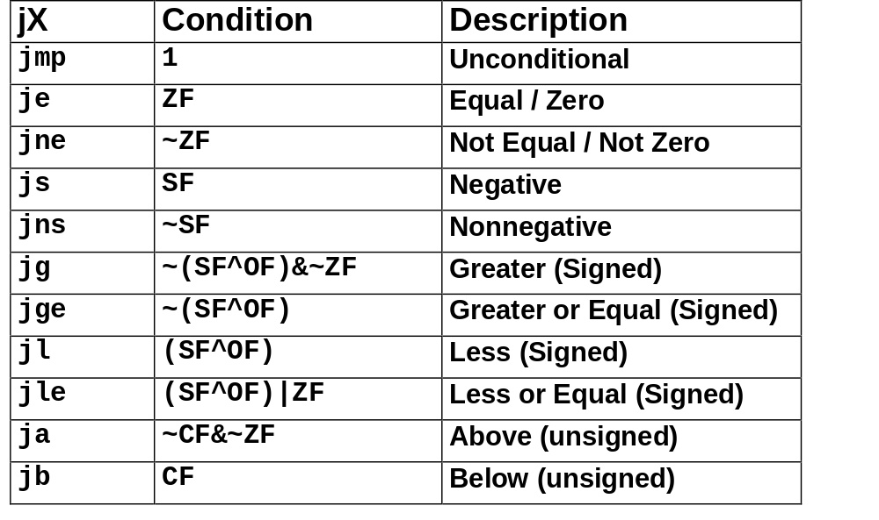
Jumping
jX Instructions
  Jump to different part of code depending on condition codes

Slide 8
Conditional Branch Example
_max:
pushl %ebp
movl %esp,%ebp
movl 8(%ebp),%edx
movl 12(%ebp),%eax
cmpl %eax,%edx
jle L9
movl %edx,%eax
L9:
movl %ebp,%esp
popl %ebp
ret
Set
Up
int max(int x, int y)
{
if (x > y)
return x;
else
return y;
}
Body
Finish

Slide 9
Conditional Branch Example (Cont.)
int goto_max(int x, int y)
{
int rval = y;
int ok = (x <= y);
if (ok)
goto done;
rval = x;
done:
return rval;
}
  C allows “goto” as means of transferring control
    Closer to machine-level programming style
  Generally considered bad coding style
movl 8(%ebp),%edx # edx = x
movl 12(%ebp),%eax # eax = y
cmpl %eax,%edx # x : y
jle L9 # if <= goto L9
movl %edx,%eax # eax = x
L9: # Done:
Skipped when x ≤ y

Slide 10
“Do-While” Loop Example
C Code
Goto Version
int fact_do
(int x)
{
int result = 1;
do {
result *= x;
x = x-1;
} while (x > 1);
return result;
}
int fact_goto(int x)
{
int result = 1;
loop:
result *= x;
x = x-1;
if (x > 1)
goto loop;
return result;
}
  Use backward branch to continue looping
  Only take branch when “while” condition holds

Slide 11
“Do-While” Loop Compilation
Goto Version
Assembly
int fact_goto
(int x)
{
int result = 1;
loop:
result *= x;
x = x-1;
if (x > 1)
goto loop;
return result;
}
_fact_goto:
pushl %ebp # Setup
movl %esp,%ebp # Setup
movl $1,%eax # eax = 1
movl 8(%ebp),%edx # edx = x
L11:
imull %edx,%eax # result *= x
decl %edx # x--
cmpl $1,%edx # Compare x : 1
jg L11 # if > goto loop
movl %ebp,%esp # Finish
popl %ebp # Finish
ret # Finish
Registers
  %edx x
  %eax result

Slide 12
General “Do-While” Translation
C Code
Goto Version
do
Body
while (Test);
loop:
Body
if (Test)
goto loop
  Body can be any C statement
    Typically compound statement:
  Test is expression returning integer
    = 0 interpreted as false ≠0 interpreted as true
{
Statement₁;
Statement₂;
…
Statement_{n};
}

Slide 13
“While” Loop Example #1
C Code
First Goto Version
int fact_while
(int x)
{
int result = 1;
while (x > 1) {
result *= x;
x = x-1;
};
return result;
}
int fact_while_goto
(int x)
{
int result = 1;
loop:
if (!(x > 1))
goto done;
result *= x;
x = x-1;
goto loop;
done:
return result;
}
  Is this code equivalent to the do-while version?
  Must jump out of loop if test fails

Slide 14
Actual “While” Loop Translation
C Code
Second Goto Version
int fact_while(int x)
{
int result = 1;
while (x > 1) {
result *= x;
x = x-1;
};
return result;
}
int fact_while_goto2
(int x)
{
int result = 1;
if (!(x > 1))
goto done;
loop:
result *= x;
x = x-1;
if (x > 1)
goto loop;
done:
return result;
}
  Uses same inner loop as do-while version
  Guards loop entry with extra test

Slide 15
General “While” Translation
C Code
while (Test)
Body
Do-While Version
Goto Version
if (!Test)
goto done;
loop:
Body
if (Test)
goto loop;
done:
if (!Test)
goto done;
do
Body
while(Test);
done:

Slide 16
“For” Loop Example
/* Compute x raised to nonnegative power p */
int ipwr_for(int x, unsigned p) {
int result;
for (result = 1; p != 0; p = p>>1) {
if (p & 0x1)
result *= x;
x = x*x;
}
return result;
}
Algorithm
  Exploit property that p = p₀ + 2p₁ + 4p₂ + … 2^{n–1}p_{n–1}
  Gives: x^{p} = z₀ · z₁ ² · (z₂ ²) ² · … · (…((z_{n –1}²) ² )…) ²
    z_{i} = 1 when p_{i} = 0
    z_{i} = x when p_{i} = 1
  Complexity O(log p)
Example
3¹⁰ = 3² * 3⁸
= 3² * ((3²) ²) ²
n–1 times

Slide 17
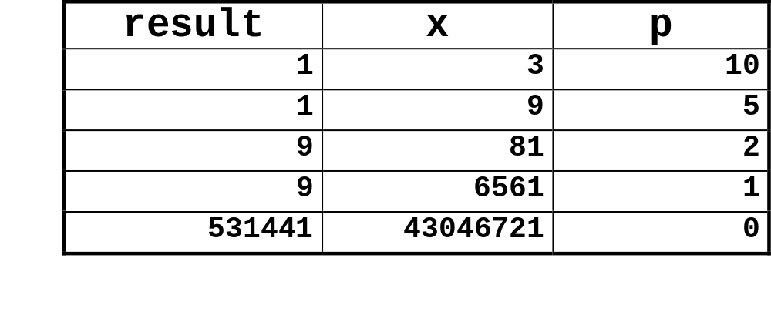
ipwr Computation
/* Compute x raised to nonnegative power p */
int ipwr_for(int x, unsigned p) {
int result;
for (result = 1; p != 0; p = p>>1) {
if (p & 0x1)
result *= x;
x = x*x;
}
return result;
}

Slide 18
“For” Loop Example
General Form
int result;
for (result = 1;
p != 0;
p = p>>1) {
if (p & 0x1)
result *= x;
x = x*x;
}
for (Init; Test; Update )
Body
Init
Test
Update
result = 1
p != 0
p = p >> 1
{
if (p & 0x1)
result *= x;
x = x*x;
}
Body

Slide 19
“For”→ “While”
For Version
While Version
for (Init; Test; Update )
Body
Init;
while (Test ) {
Body
Update ;
}
Do-While Version
Init;
if (!Test)
goto done;
do {
Body
Update ;
} while (Test)
done:
Goto Version
Init;
if (!Test)
goto done;
loop:
Body
Update ;
if (Test)
goto loop;
done:

Slide 20
“For” Loop Compilation
Goto Version
result = 1;
if (p == 0)
goto done;
loop:
if (p & 0x1)
result *= x;
x = x*x;
p = p >> 1;
if (p != 0)
goto loop;
done:
Init;
if (!Test)
goto done;
loop:
Body
Update ;
if (Test)
goto loop;
done:
Init
Test
Body
result = 1
p != 0
{
if (p & 0x1)
result *= x;
x = x*x;
}
Update
p = p >> 1

Slide 21
Switch Statements
typedef enum
{ADD, MULT, MINUS, DIV, MOD, BAD}
op_type;
char unparse_symbol(op_type op)
{
switch (op) {
case ADD :
return '+';
case MULT:
return '*';
case MINUS:
return '-';
case DIV:
return '/';
case MOD:
return '%';
case BAD:
return '?';
}
}
Implementation Options
  Series of conditionals
    Good if few cases
    Slow if many
  Jump Table
    Lookup branch target
    Avoids conditionals
    Possible when cases are small integer constants
  GCC
    Picks one based on case structure
  Bug in example code
    No default given

Slide 22
Jump Table Structure
Switch Form
Jump Table
Jump Targets
switch(op) {
case val_0:
Block 0
case val_1:
Block 1
• • •
case val_n-1:
Block n–1
}
jtab:
Targ0
Targ0:
Code Block
0
Targ1
Targ2
Targ1:
Code Block
1
•
•
•
Targ2:
Code Block
2
Targn-1
Approx. Translation
•
•
•
target = JTab[op];
goto *target;
Targn-1:
Code Block
n–1

Slide 23
Switch Statement Example
Branching Possibilities
Enumerated Values
  ADD 0
  MULT 1
  MINUS 2
  DIV 3
  MOD 4
  BAD 5
typedef enum
{ADD, MULT, MINUS, DIV, MOD, BAD}
op_type;
char unparse_symbol(op_type op)
{
switch (op) {
• • •
}
}
unparse_symbol:
pushl %ebp # Setup
movl %esp,%ebp # Setup
movl 8(%ebp),%eax # eax = op
cmpl $5,%eax # Compare op : 5
ja .L49 # If > goto done
jmp *.L57(,%eax,4) # goto Table[op]
Setup:

Slide 24
Assembly Setup Explanation
Symbolic Labels
  Labels of form .LXX translated into addresses by assembler
Table Structure
  Each target requires 4 bytes
  Base address at .L57
Jumping
  jmp .L49
  Jump target is denoted by label .L49
  jmp *.L57(,%eax,4)
  Start of jump table denoted by label .L57
  Register %eax holds op
  Must scale by factor of 4 to get offset into table
  Fetch target from effective Address .L57 + op*4

Slide 25
Jump Table
Table Contents
Targets & Completion
.section .rodata
.align 4
.L57:
.long .L51 #Op = 0
.long .L52 #Op = 1
.long .L53 #Op = 2
.long .L54 #Op = 3
.long .L55 #Op = 4
.long .L56 #Op = 5
.L51:
movl $43,%eax # ’+’
jmp .L49
.L52:
movl $42,%eax # ’*’
jmp .L49
.L53:
movl $45,%eax # ’-’
jmp .L49
.L54:
movl $47,%eax # ’/’
jmp .L49
.L55:
movl $37,%eax # ’%’
jmp .L49
.L56:
movl $63,%eax # ’?’
# Fall Through to .L49
Enumerated Values
  ADD 0
  MULT 1
  MINUS 2
  DIV 3
  MOD 4
  BAD 5

Slide 26
Switch Statement Completion
.L49: # Done:
movl %ebp,%esp # Finish
popl %ebp # Finish
ret # Finish
Puzzle
  What value returned when op is invalid?
Answer
  Register %eax set to op at beginning of procedure
  This becomes the returned value
Advantage of Jump Table
  Can do k-way branch in O(1) operations

Slide 27
Object Code
Setup
  Label .L49 becomes address 0x804875c
  Label .L57 becomes address 0x8048bc0
08048718 <unparse_symbol>:
8048718: 55 pushl %ebp
8048719: 89 e5 movl %esp,%ebp
804871b: 8b 45 08 movl 0x8(%ebp),%eax
804871e: 83 f8 05 cmpl $0x5,%eax
8048721: 77 39 ja 804875c <unparse_symbol+0x44>
8048723: ff 24 85 c0 8b jmp *0x8048bc0(,%eax,4)

Slide 28
Object Code (cont.)
Jump Table
  Doesn’t show up in disassembled code
  Can inspect using GDB
  gdb code-examples
  (gdb) x/6xw 0x8048bc0
    Examine 6 hexadecimal format “words” (4-bytes each)
    Use command “help x” to get format documentation
  0x8048bc0 <_fini+32>:
  0x08048730
  0x08048737
  0x08048740
  0x08048747
  0x08048750
  0x08048757

Slide 29
Extracting Jump Table from Binary
Jump Table Stored in Read Only Data Segment (.rodata)
  Various fixed values needed by your code
Can examine with objdump
  objdump code-examples –s –-section=.rodata
  Show everything in indicated segment.
Hard to read
  Jump table entries shown with reversed byte ordering
  E.g., 30870408 really means 0x08048730
Contents of section .rodata:
8048bc0 30870408 37870408 40870408 47870408 0...7...@...G...
8048bd0 50870408 57870408 46616374 28256429 P...W...Fact(%d)
8048be0 203d2025 6c640a00 43686172 203d2025 = %ld..Char = %
…

Slide 30
Disassembled Targets
8048730: b8 2b 00 00 00 movl $0x2b,%eax
8048735: eb 25 jmp 804875c <unparse_symbol+0x44>
8048737: b8 2a 00 00 00 movl $0x2a,%eax
804873c: eb 1e jmp 804875c <unparse_symbol+0x44>
804873e: 89 f6 movl %esi,%esi
8048740: b8 2d 00 00 00 movl $0x2d,%eax
8048745: eb 15 jmp 804875c <unparse_symbol+0x44>
8048747: b8 2f 00 00 00 movl $0x2f,%eax
804874c: eb 0e jmp 804875c <unparse_symbol+0x44>
804874e: 89 f6 movl %esi,%esi
8048750: b8 25 00 00 00 movl $0x25,%eax
8048755: eb 05 jmp 804875c <unparse_symbol+0x44>
8048757: b8 3f 00 00 00 movl $0x3f,%eax
  movl %esi,%esi does nothing
  Inserted to align instructions for better cache performance

Slide 31
Matching Disassembled Targets
8048730: b8 2b 00 00 00 movl
8048735: eb 25 jmp
8048737: b8 2a 00 00 00 movl
804873c: eb 1e jmp
804873e: 89 f6 movl
8048740: b8 2d 00 00 00 movl
8048745: eb 15 jmp
8048747: b8 2f 00 00 00 movl
804874c: eb 0e jmp
804874e: 89 f6 movl
8048750: b8 25 00 00 00 movl
8048755: eb 05 jmp
8048757: b8 3f 00 00 00 movl
Entry
0x08048730
0x08048737
0x08048740
0x08048747
0x08048750
0x08048757

Slide 32
Sparse Switch Example
/* Return x/111 if x is multiple
&& <= 999. -1 otherwise */
int div111(int x)
{
switch(x) {
case 0: return 0;
case 111: return 1;
case 222: return 2;
case 333: return 3;
case 444: return 4;
case 555: return 5;
case 666: return 6;
case 777: return 7;
case 888: return 8;
case 999: return 9;
default: return -1;
}
}
  Not practical to use jump table
    Would require 1000 entries
  Obvious translation into if-then-else would have max. of 9 tests

Slide 33
Sparse Switch Code
movl 8(%ebp),%eax # get x
cmpl $444,%eax # x:444
je L8
jg L16
cmpl $111,%eax # x:111
je L5
jg L17
testl %eax,%eax # x:0
je L4
jmp L14
. . .
  Compares x to possible case values
  Jumps different places depending on outcomes
. . .
L5:
movl $1,%eax
jmp L19
L6:
movl $2,%eax
jmp L19
L7:
movl $3,%eax
jmp L19
L8:
movl $4,%eax
jmp L19
. . .

Slide 34
Sparse Switch Code Structure
444
<
>
=
111
4
777
<
>
<
>
=
=
1
7
0
222
555
888
≠
=
≠
<
>
=
=
≠
=
-1
0
2
5
8
333
666
999
≠
=
≠
=
≠
=
-1
3
-1
6
-1
9
  Organizes cases as binary tree
  Logarithmic performance

Slide 35
Summarizing
C Control
  if-then-else
  do-while
  while
  switch
Assembler Control
  jump
  Conditional jump
Compiler
  Must generate assembly code to implement more complex control
Standard Techniques
  All loops converted to do-while form
  Large switch statements use jump tables
Conditions in CISC
  CISC machines generally have condition code registers
Conditions in RISC
  Use general registers to store condition information
  Special comparison instructions
  E.g., on Alpha:
  cmple $16,1,$1
    Sets register $1 to 1 when Register $16 <= 1

