Slide 1
Code Optimization I:
Machine Independent Optimizations
Sept. 26, 2002
15-213
“The course that gives CMU its Zip!”
Topics
  Machine-Independent Optimizations
    Code motion
    Reduction in strength
    Common subexpression sharing
  Tuning
    Identifying performance bottlenecks
class10.ppt

Slide 2
Great Reality #4
There’s more to performance than asymptotic complexity
Constant factors matter too!
  Easily see 10:1 performance range depending on how code is written
  Must optimize at multiple levels:
    algorithm, data representations, procedures, and loops
Must understand system to optimize performance
  How programs are compiled and executed
  How to measure program performance and identify bottlenecks
  How to improve performance without destroying code modularity and generality

Slide 3
Optimizing Compilers
Provide efficient mapping of program to machine
  register allocation
  code selection and ordering
  eliminating minor inefficiencies
Don’t (usually) improve asymptotic efficiency
  up to programmer to select best overall algorithm
  big-O savings are (often) more important than constant factors
    but constant factors also matter
Have difficulty overcoming “optimization blockers”
  potential memory aliasing
  potential procedure side-effects

Slide 4
Limitations of Optimizing Compilers
Operate Under Fundamental Constraint
  Must not cause any change in program behavior under any possible condition
  Often prevents it from making optimizations when would only affect behavior under pathological conditions.
Behavior that may be obvious to the programmer can be obfuscated by languages and coding styles
  e.g., data ranges may be more limited than variable types suggest
Most analysis is performed only within procedures
  whole-program analysis is too expensive in most cases
Most analysis is based only on static information
  compiler has difficulty anticipating run-time inputs
When in doubt, the compiler must be conservative

Slide 5
Machine-Independent Optimizations
  Optimizations you should do regardless of processor / compiler
Code Motion
  Reduce frequency with which computation performed
    If it will always produce same result
    Especially moving code out of loop
for (i = 0; i < n; i++) {
int ni = n*i;
for (j = 0; j < n; j++)
a[ni + j] = b[j];
}
for (i = 0; i < n; i++)
for (j = 0; j < n; j++)
a[n*i + j] = b[j];

Slide 6
Compiler-Generated Code Motion
  Most compilers do a good job with array code + simple loop structures
Code Generated by GCC
for (i = 0; i < n; i++) {
int ni = n*i;
int *p = a+ni;
for (j = 0; j < n; j++)
*p++ = b[j];
}
for (i = 0; i < n; i++)
for (j = 0; j < n; j++)
a[n*i + j] = b[j];
imull %ebx,%eax # i*n
movl 8(%ebp),%edi # a
leal (%edi,%eax,4),%edx # p = a+i*n (scaled by 4)
# Inner Loop
.L40:
movl 12(%ebp),%edi # b
movl (%edi,%ecx,4),%eax # b+j (scaled by 4)
movl %eax,(%edx) # *p = b[j]
addl $4,%edx # p++ (scaled by 4)
incl %ecx # j++
jl .L40 # loop if j<n

Slide 7
Reduction in Strength
  Replace costly operation with simpler one
  Shift, add instead of multiply or divide
    16*x --> x << 4
    Utility machine dependent
    Depends on cost of multiply or divide instruction
    On Pentium II or III, integer multiply only requires 4 CPU cycles
  Recognize sequence of products
int ni = 0;
for (i = 0; i < n; i++) {
for (j = 0; j < n; j++)
a[ni + j] = b[j];
ni += n;
}
for (i = 0; i < n; i++)
for (j = 0; j < n; j++)
a[n*i + j] = b[j];

Slide 8
Make Use of Registers
  Reading and writing registers much faster than reading/writing memory
Limitation
  Compiler not always able to determine whether variable can be held in register
  Possibility of Aliasing
  See example later

Slide 9
Machine-Independent Opts. (Cont.)
Share Common Subexpressions
  Reuse portions of expressions
  Compilers often not very sophisticated in exploiting arithmetic properties
/* Sum neighbors of i,j */
up = val[(i-1)*n + j];
down = val[(i+1)*n + j];
left = val[i*n + j-1];
right = val[i*n + j+1];
sum = up + down + left + right;
int inj = i*n + j;
up = val[inj - n];
down = val[inj + n];
left = val[inj - 1];
right = val[inj + 1];
sum = up + down + left + right;
3 multiplications: i*n, (i–1)*n, (i+1)*n
1 multiplication: i*n
leal -1(%edx),%ecx # i-1
imull %ebx,%ecx # (i-1)*n
leal 1(%edx),%eax # i+1
imull %ebx,%eax # (i+1)*n
imull %ebx,%edx # i*n

Slide 10
Vector ADT
length
0
1
2
length–1
data
• • •
Procedures
  vec_ptr new_vec(int len)
    Create vector of specified length
  int get_vec_element(vec_ptr v, int index, int *dest)
    Retrieve vector element, store at *dest
    Return 0 if out of bounds, 1 if successful
  int *get_vec_start(vec_ptr v)
    Return pointer to start of vector data
  Similar to array implementations in Pascal, ML, Java
    E.g., always do bounds checking

Slide 11
Optimization Example
void combine1(vec_ptr v, int *dest)
{
int i;
*dest = 0;
for (i = 0; i < vec_length(v); i++) {
int val;
get_vec_element(v, i, &val);
*dest += val;
}
}
Procedure
  Compute sum of all elements of vector
  Store result at destination location

Slide 12
Time Scales
Absolute Time
  Typically use nanoseconds
    10^{–9} seconds
  Time scale of computer instructions
Clock Cycles
  Most computers controlled by high frequency clock signal
  Typical Range
    100 MHz
      10⁸ cycles per second
      Clock period = 10ns
    2 GHz
      2 X 10⁹ cycles per second
      Clock period = 0.5ns
  Fish machines: 550 MHz (1.8 ns clock period)

Slide 13
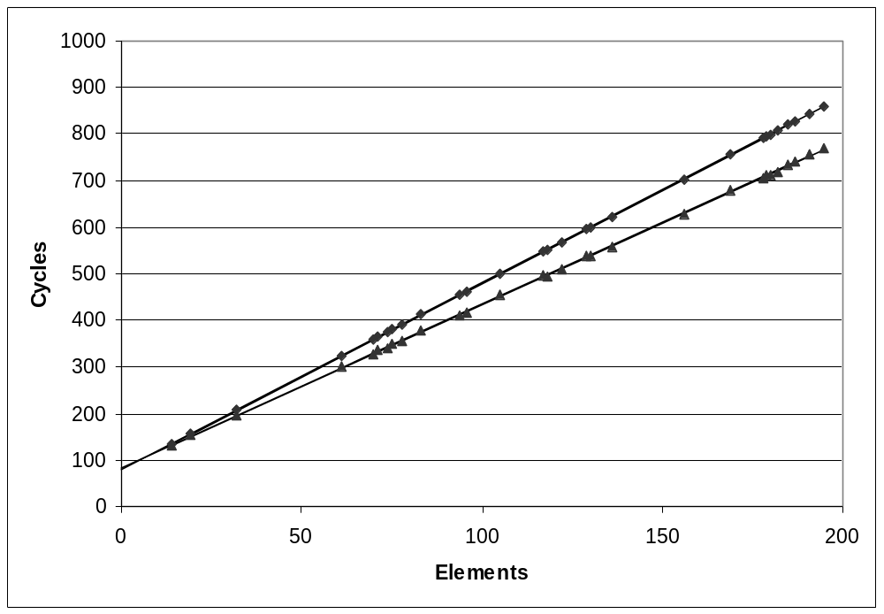
Cycles Per Element
  Convenient way to express performance of program that operators on vectors or lists
  Length = n
  T = CPE*n + Overhead
vsum1
Slope = 4.0
vsum2
Slope = 3.5

Slide 14
Optimization Example
void combine1(vec_ptr v, int *dest)
{
int i;
*dest = 0;
for (i = 0; i < vec_length(v); i++) {
int val;
get_vec_element(v, i, &val);
*dest += val;
}
}
Procedure
  Compute sum of all elements of integer vector
  Store result at destination location
  Vector data structure and operations defined via abstract data type
Pentium II/III Performance: Clock Cycles / Element
  42.06 (Compiled -g) 31.25 (Compiled -O2)

Slide 15
Understanding Loop
void combine1-goto(vec_ptr v, int *dest)
{
int i = 0;
int val;
*dest = 0;
if (i >= vec_length(v))
goto done;
loop:
get_vec_element(v, i, &val);
*dest += val;
i++;
if (i < vec_length(v))
goto loop
done:
}
1 iteration
Inefficiency
  Procedure vec_length called every iteration
  Even though result always the same

Slide 16
Move vec_length Call Out of Loop
void combine2(vec_ptr v, int *dest)
{
int i;
int length = vec_length(v);
*dest = 0;
for (i = 0; i < length; i++) {
int val;
get_vec_element(v, i, &val);
*dest += val;
}
}
Optimization
  Move call to vec_length out of inner loop
    Value does not change from one iteration to next
    Code motion
  CPE: 20.66 (Compiled -O2)
    vec_length requires only constant time, but significant overhead

Slide 17
Code Motion Example #2
Procedure to Convert String to Lower Case
  Extracted from 213 lab submissions, Fall, 1998
void lower(char *s)
{
int i;
for (i = 0; i < strlen(s); i++)
if (s[i] >= 'A' && s[i] <= 'Z')
s[i] -= ('A' - 'a');
}

Slide 18
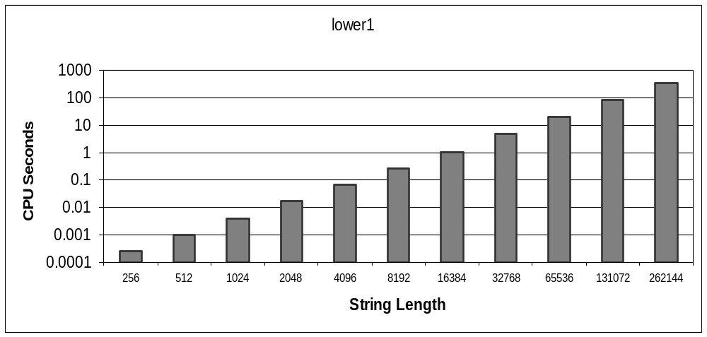
Lower Case Conversion Performance
  Time quadruples when double string length
  Quadratic performance

Slide 19
Convert Loop To Goto Form
void lower(char *s)
{
int i = 0;
if (i >= strlen(s))
goto done;
loop:
if (s[i] >= 'A' && s[i] <= 'Z')
s[i] -= ('A' - 'a');
i++;
if (i < strlen(s))
goto loop;
done:
}
  strlen executed every iteration
  strlen linear in length of string
    Must scan string until finds '\0'
  Overall performance is quadratic

Slide 20
Improving Performance
void lower(char *s)
{
int i;
int len = strlen(s);
for (i = 0; i < len; i++)
if (s[i] >= 'A' && s[i] <= 'Z')
s[i] -= ('A' - 'a');
}
  Move call to strlen outside of loop
  Since result does not change from one iteration to another
  Form of code motion

Slide 21
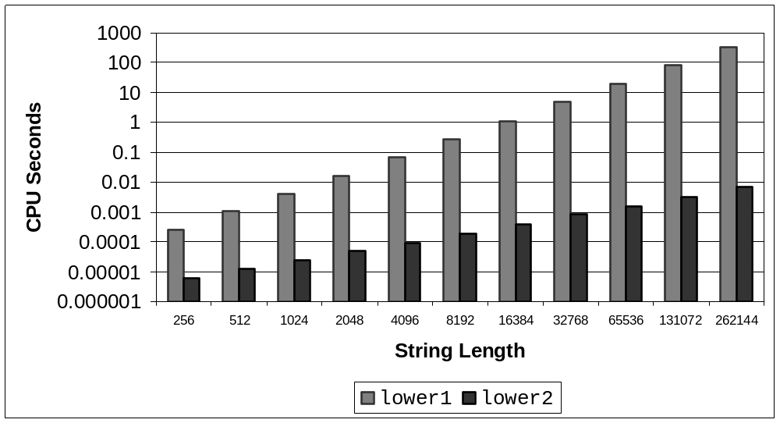
Lower Case Conversion Performance
  Time doubles when double string length
  Linear performance

Slide 22
Optimization Blocker: Procedure Calls
Why couldn’t the compiler move vec_len or strlen out of the inner loop?
  Procedure may have side effects
    Alters global state each time called
  Function may not return same value for given arguments
    Depends on other parts of global state
    Procedure lower could interact with strlen
Why doesn’t compiler look at code for vec_len or strlen?
  Linker may overload with different version
    Unless declared static
  Interprocedural optimization is not used extensively due to cost
Warning:
  Compiler treats procedure call as a black box
  Weak optimizations in and around them

Slide 23
Reduction in Strength
void combine3(vec_ptr v, int *dest)
{
int i;
int length = vec_length(v);
int *data = get_vec_start(v);
*dest = 0;
for (i = 0; i < length; i++) {
*dest += data[i];
}
Optimization
  Avoid procedure call to retrieve each vector element
    Get pointer to start of array before loop
    Within loop just do pointer reference
    Not as clean in terms of data abstraction
  CPE: 6.00 (Compiled -O2)
    Procedure calls are expensive!
    Bounds checking is expensive

Slide 24
Eliminate Unneeded Memory Refs
void combine4(vec_ptr v, int *dest)
{
int i;
int length = vec_length(v);
int *data = get_vec_start(v);
int sum = 0;
for (i = 0; i < length; i++)
sum += data[i];
*dest = sum;
}
Optimization
  Don’t need to store in destination until end
  Local variable sum held in register
  Avoids 1 memory read, 1 memory write per cycle
  CPE: 2.00 (Compiled -O2)
    Memory references are expensive!

Slide 25
Detecting Unneeded Memory Refs.
Combine3
Combine4
.L18:
movl (%ecx,%edx,4),%eax
addl %eax,(%edi)
incl %edx
cmpl %esi,%edx
jl .L18
.L24:
addl (%eax,%edx,4),%ecx
incl %edx
cmpl %esi,%edx
jl .L24
Performance
  Combine3
    5 instructions in 6 clock cycles
    addl must read and write memory
  Combine4
    4 instructions in 2 clock cycles

Slide 26
Optimization Blocker: Memory Aliasing
Aliasing
  Two different memory references specify single location
Example
  v: [3, 2, 17]
  combine3(v, get_vec_start(v)+2) --> ?
  combine4(v, get_vec_start(v)+2) --> ?
Observations
  Easy to have happen in C
    Since allowed to do address arithmetic
    Direct access to storage structures
  Get in habit of introducing local variables
    Accumulating within loops
    Your way of telling compiler not to check for aliasing

Slide 27
Machine-Independent Opt. Summary
Code Motion
  Compilers are good at this for simple loop/array structures
  Don’t do well in presence of procedure calls and memory aliasing
Reduction in Strength
  Shift, add instead of multiply or divide
    compilers are (generally) good at this
    Exact trade-offs machine-dependent
  Keep data in registers rather than memory
    compilers are not good at this, since concerned with aliasing
Share Common Subexpressions
  compilers have limited algebraic reasoning capabilities

Slide 28
Important Tools
Measurement
  Accurately compute time taken by code
    Most modern machines have built in cycle counters
    Using them to get reliable measurements is tricky
  Profile procedure calling frequencies
    Unix tool gprof
Observation
  Generating assembly code
    Lets you see what optimizations compiler can make
    Understand capabilities/limitations of particular compiler

Slide 29
Code Profiling Example
Task
  Count word frequencies in text document
  Produce sorted list of words from most frequent to least
Steps
  Convert strings to lowercase
  Apply hash function
  Read words and insert into hash table
    Mostly list operations
    Maintain counter for each unique word
  Sort results
Data Set
  Collected works of Shakespeare
  946,596 total words, 26,596 unique
  Initial implementation: 9.2 seconds
  Shakespeare’s
  most frequent words
29,801 | the
27,529 | and
21,029 | I
20,957 | to
18,514 | of
15,370 | a
14010 | you
12,936 | my
11,722 | in
11,519 | that

Slide 30
Code Profiling
Augment Executable Program with Timing Functions
  Computes (approximate) amount of time spent in each function
  Time computation method
    Periodically (~ every 10ms) interrupt program
    Determine what function is currently executing
    Increment its timer by interval (e.g., 10ms)
  Also maintains counter for each function indicating number of times called
Using
  gcc –O2 –pg prog. –o prog
  ./prog
    Executes in normal fashion, but also generates file gmon.out
  gprof prog
    Generates profile information based on gmon.out

Slide 31
Profiling Results
% cumulative self self total
time seconds seconds calls ms/call ms/call name
86.60 8.21 8.21 1 8210.00 8210.00 sort_words
5.80 8.76 0.55 946596 0.00 0.00 lower1
4.75 9.21 0.45 946596 0.00 0.00 find_ele_rec
1.27 9.33 0.12 946596 0.00 0.00 h_add
Call Statistics
  Number of calls and cumulative time for each function
Performance Limiter
  Using inefficient sorting algorithm
  Single call uses 87% of CPU time

Slide 32
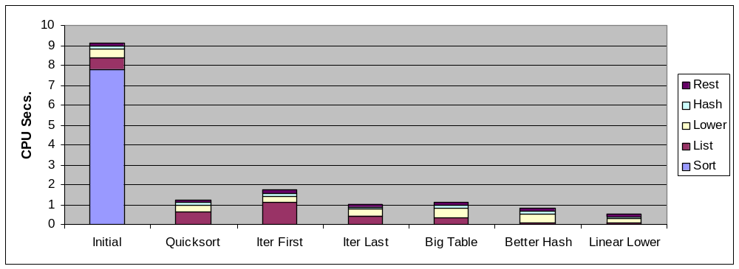
Code Optimizations
  First step: Use more efficient sorting function
  Library function qsort

Slide 33
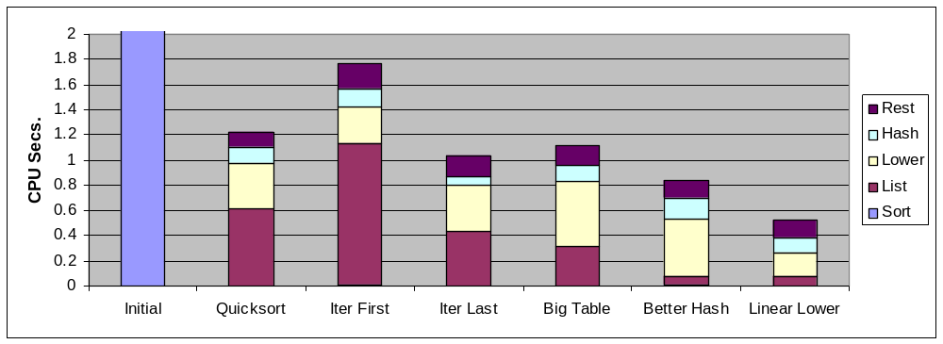
Further Optimizations
  Iter first: Use iterative function to insert elements into linked list
    Causes code to slow down
  Iter last: Iterative function, places new entry at end of list
    Tend to place most common words at front of list
  Big table: Increase number of hash buckets
  Better hash: Use more sophisticated hash function
  Linear lower: Move strlen out of loop

Slide 34
Profiling Observations
Benefits
  Helps identify performance bottlenecks
  Especially useful when have complex system with many components
Limitations
  Only shows performance for data tested
  E.g., linear lower did not show big gain, since words are short
    Quadratic inefficiency could remain lurking in code
  Timing mechanism fairly crude
    Only works for programs that run for > 3 seconds

