Slide 1
Code Optimization II:
Machine Dependent Optimizations
Oct. 1, 2002
15-213
“The course that gives CMU its Zip!”
Topics
  Machine-Dependent Optimizations
    Pointer code
    Unrolling
    Enabling instruction level parallelism
  Understanding Processor Operation
    Translation of instructions into operations
    Out-of-order execution of operations
  Branches and Branch Prediction
  Advice
class11.ppt

Slide 2
Previous Best Combining Code
void combine4(vec_ptr v, int *dest)
{
int i;
int length = vec_length(v);
int *data = get_vec_start(v);
int sum = 0;
for (i = 0; i < length; i++)
sum += data[i];
*dest = sum;
}
Task
  Compute sum of all elements in vector
  Vector represented by C-style abstract data type
  Achieved CPE of 2.00
    Cycles per element

Slide 3
General Forms of Combining
void abstract_combine4(vec_ptr v, data_t *dest)
{
int i;
int length = vec_length(v);
data_t *data = get_vec_start(v);
data_t t = IDENT;
for (i = 0; i < length; i++)
t = t OP data[i];
*dest = t;
}
Data Types
  Use different declarations for data_t
  int
  float
  double
Operations
  Use different definitions of OP and IDENT
  + / 0
  * / 1

Slide 4
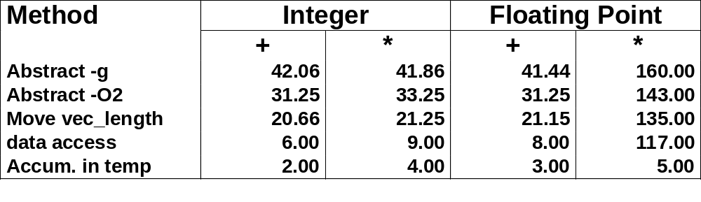
Machine Independent Opt. Results
Optimizations
  Reduce function calls and memory references within loop
Performance Anomaly
  Computing FP product of all elements exceptionally slow.
  Very large speedup when accumulate in temporary
  Caused by quirk of IA32 floating point
    Memory uses 64-bit format, register use 80
    Benchmark data caused overflow of 64 bits, but not 80

Slide 5
Pointer Code
void combine4p(vec_ptr v, int *dest)
{
int length = vec_length(v);
int *data = get_vec_start(v);
int *dend = data+length;
int sum = 0;
while (data < dend) {
sum += *data;
data++;
}
*dest = sum;
}
Optimization
  Use pointers rather than array references
  CPE: 3.00 (Compiled -O2)
    Oops! We’re not making progress here!
  Warning: Some compilers do better job optimizing array code

Slide 6
Pointer vs. Array Code Inner Loops
Array Code
Pointer Code
Performance
  Array Code: 4 instructions in 2 clock cycles
  Pointer Code: Almost same 4 instructions in 3 clock cycles
.L24: # Loop:
addl (%eax,%edx,4),%ecx # sum += data[i]
incl %edx # i++
cmpl %esi,%edx # i:length
jl .L24 # if < goto Loop
.L30: # Loop:
addl (%eax),%ecx # sum += *data
addl $4,%eax # data ++
cmpl %edx,%eax # data:dend
jb .L30 # if < goto Loop

Slide 7
Modern CPU Design
Instruction Control
Fetch
Control
Address
Retirement
Unit
Instruction
Cache
Register
File
Instruction
Decode
Instrs.
Operations
Register
Updates
Prediction
OK?
Execution
Functional
Units
Integer/
Branch
General
Integer
FP
Add
FP
Mult/Div
Load
Store
Operation Results
Addr.
Addr.
Data
Data
Data
Cache

Slide 8
CPU Capabilities of Pentium III
Multiple Instructions Can Execute in Parallel
  1 load
  1 store
  2 integer (one may be branch)
  1 FP Addition
  1 FP Multiplication or Division
Some Instructions Take > 1 Cycle, but Can be Pipelined
  Instruction Latency Cycles/Issue
  Load / Store 3 1
  Integer Multiply 4 1
  Integer Divide 36 36
  Double/Single FP Multiply 5 2
  Double/Single FP Add 3 1
  Double/Single FP Divide 38 38

Slide 9
Instruction Control
Instruction Control
Fetch
Control
Address
Retirement
Unit
Instruction
Cache
Register
File
Instruction
Decode
Instrs.
Operations
Grabs Instruction Bytes From Memory
  Based on current PC + predicted targets for predicted branches
  Hardware dynamically guesses whether branches taken/not taken and (possibly) branch target
Translates Instructions Into Operations
  Primitive steps required to perform instruction
  Typical instruction requires 1–3 operations
Converts Register References Into Tags
  Abstract identifier linking destination of one operation with sources of later operations

Slide 10
Translation Example
Version of Combine4
  Integer data, multiply operation
Translation of First Iteration
.L24: # Loop:
imull (%eax,%edx,4),%ecx # t *= data[i]
incl %edx # i++
cmpl %esi,%edx # i:length
jl .L24 # if < goto Loop
.L24:
imull (%eax,%edx,4),%ecx
incl %edx
cmpl %esi,%edx
jl .L24
load (%eax,%edx.0,4) ➔ t.1
imull t.1, %ecx.0 ➔ %ecx.1
incl %edx.0 ➔ %edx.1
cmpl %esi, %edx.1 ➔ cc.1
jl-taken cc.1

Slide 11
Translation Example #1
imull (%eax,%edx,4),%ecx
load (%eax,%edx.0,4) ➔ t.1
imull t.1, %ecx.0 ➔ %ecx.1
  Split into two operations
    load reads from memory to generate temporary result t.1
    Multiply operation just operates on registers
  Operands
    Registers %eax does not change in loop. Values will be retrieved from register file during decoding
    Register %ecx changes on every iteration. Uniquely identify different versions as %ecx.0, %ecx.1, %ecx.2, …
      Register renaming
      Values passed directly from producer to consumers

Slide 12
Translation Example #2
incl %edx
incl %edx.0 ➔ %edx.1
  Register %edx changes on each iteration. Rename as %edx.0, %edx.1, %edx.2, …

Slide 13
Translation Example #3
cmpl %esi,%edx
cmpl %esi, %edx.1 ➔ cc.1
  Condition codes are treated similar to registers
  Assign tag to define connection between producer and consumer

Slide 14
Translation Example #4
jl .L24
jl-taken cc.1
  Instruction control unit determines destination of jump
  Predicts whether will be taken and target
  Starts fetching instruction at predicted destination
  Execution unit simply checks whether or not prediction was OK
  If not, it signals instruction control
    Instruction control then “invalidates” any operations generated from misfetched instructions
    Begins fetching and decoding instructions at correct target

Slide 15
Visualizing Operations
%edx.0
load (%eax,%edx,4) ➔ t.1
imull t.1, %ecx.0 ➔ %ecx.1
incl %edx.0 ➔ %edx.1
cmpl %esi, %edx.1 ➔ cc.1
jl-taken cc.1
load
incl
%edx.1
cmpl
cc.1
%ecx.0
jl
t.1
imull
Time
Operations
  Vertical position denotes time at which executed
    Cannot begin operation until operands available
  Height denotes latency
Operands
  Arcs shown only for operands that are passed within execution unit
%ecx.1

Slide 16
Visualizing Operations (cont.)
load (%eax,%edx,4) ➔ t.1
iaddl t.1, %ecx.0 ➔ %ecx.1
incl %edx.0 ➔ %edx.1
cmpl %esi, %edx.1 ➔ cc.1
jl-taken cc.1
%edx.0
load
load
incl
%edx.1
%ecx.i +1
cmpl
cc.1
%ecx.0
jl
Time
t.1
addl
%ecx.1
Operations
  Same as before, except that add has latency of 1

Slide 17
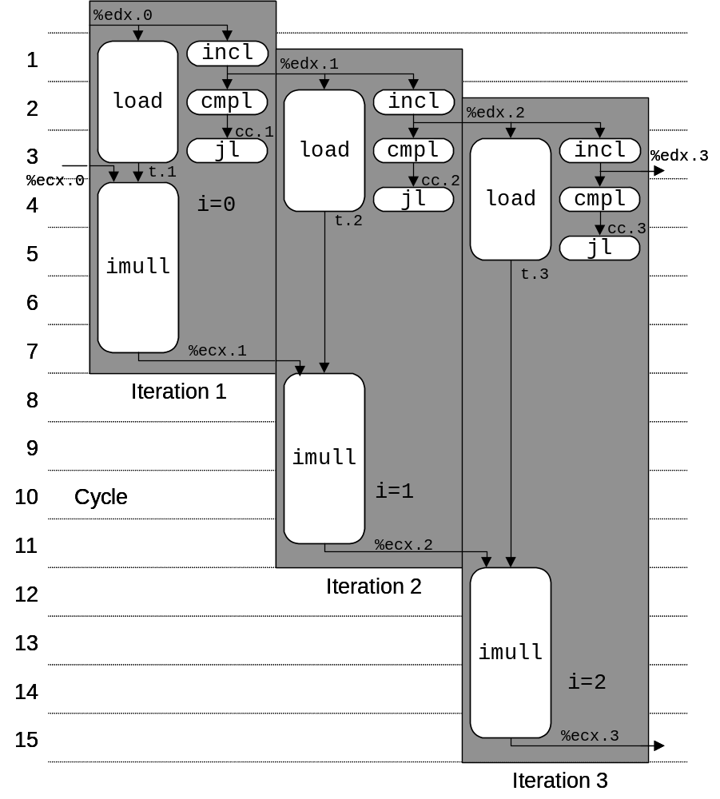
3 Iterations of Combining Product
Unlimited Resource Analysis
  Assume operation can start as soon as operands available
  Operations for multiple iterations overlap in time
Performance
  Limiting factor becomes latency of integer multiplier
  Gives CPE of 4.0

Slide 18
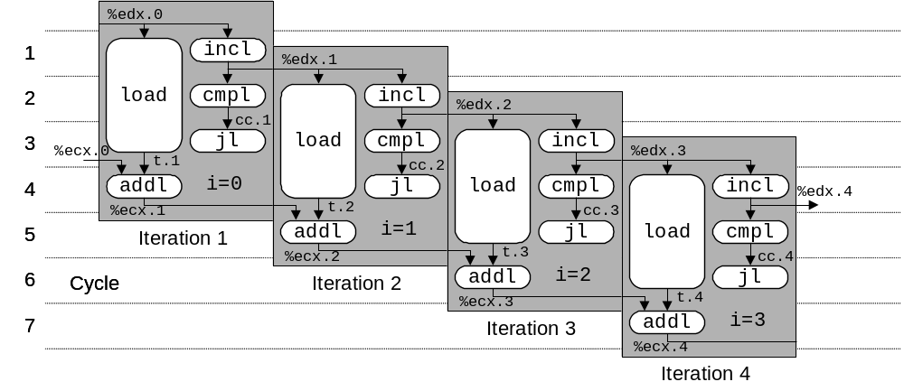
4 Iterations of Combining Sum
4 integer ops
Unlimited Resource Analysis
Performance
  Can begin a new iteration on each clock cycle
  Should give CPE of 1.0
  Would require executing 4 integer operations in parallel

Slide 19
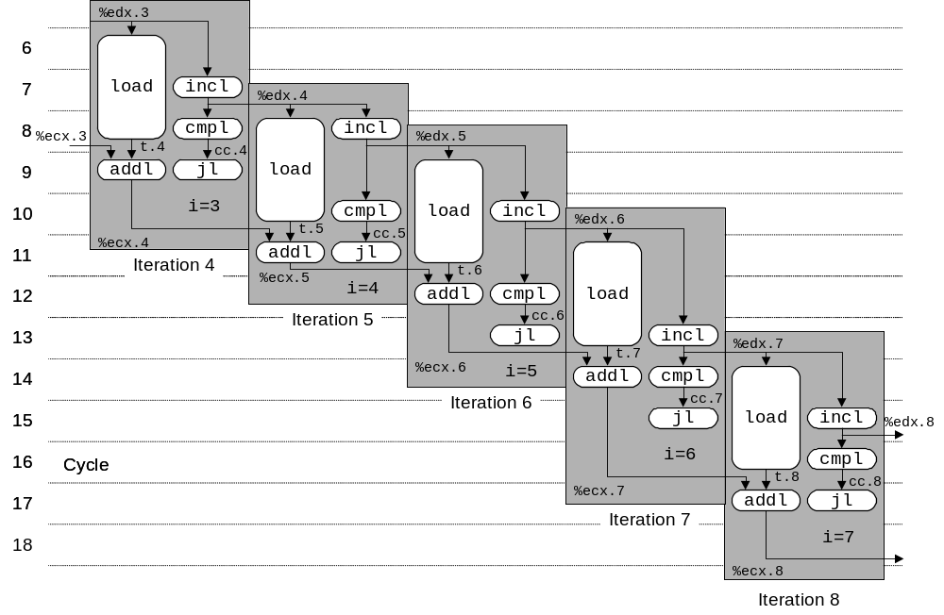
Combining Sum: Resource Constraints
  Only have two integer functional units
  Some operations delayed even though operands available
  Set priority based on program order
Performance
  Sustain CPE of 2.0

Slide 20
Loop Unrolling
void combine5(vec_ptr v, int *dest)
{
int length = vec_length(v);
int limit = length-2;
int *data = get_vec_start(v);
int sum = 0;
int i;
/* Combine 3 elements at a time */
for (i = 0; i < limit; i+=3) {
sum += data[i] + data[i+2]
+ data[i+1];
}
/* Finish any remaining elements */
for (; i < length; i++) {
sum += data[i];
}
*dest = sum;
}
Optimization
  Combine multiple iterations into single loop body
  Amortizes loop overhead across multiple iterations
  Finish extras at end
  Measured CPE = 1.33

Slide 21
Visualizing Unrolled Loop
  Loads can pipeline, since don’t have dependencies
  Only one set of loop control operations
%edx.0
load
addl
%edx.1
load
%ecx.i +1
cmpl
cc.1
load
jl
%ecx.0c
t.1a
addl
%ecx.1a
t.1b
Time
addl
%ecx.1b
t.1c
load (%eax,%edx.0,4) ➔ t.1a
iaddl t.1a, %ecx.0c ➔ %ecx.1a
load 4(%eax,%edx.0,4) ➔ t.1b
iaddl t.1b, %ecx.1a ➔ %ecx.1b
load 8(%eax,%edx.0,4) ➔ t.1c
iaddl t.1c, %ecx.1b ➔ %ecx.1c
iaddl $3,%edx.0 ➔ %edx.1
cmpl %esi, %edx.1 ➔ cc.1
jl-taken cc.1
addl
%ecx.1c

Slide 22
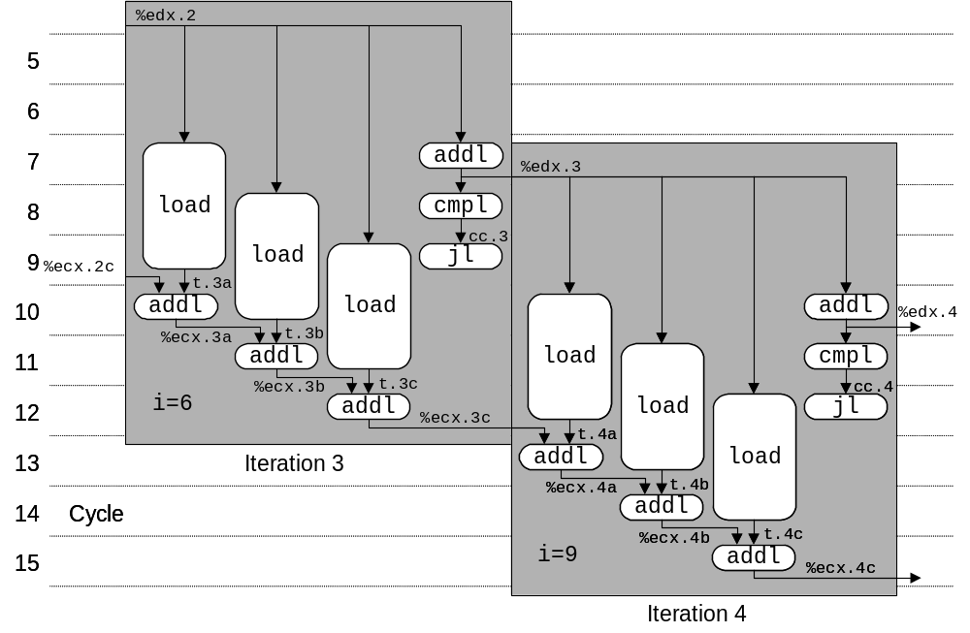
Executing with Loop Unrolling
  Predicted Performance
    Can complete iteration in 3 cycles
    Should give CPE of 1.0
  Measured Performance
    CPE of 1.33
    One iteration every 4 cycles

Slide 23
Effect of Unrolling
Unrolling Degree |  | 1 | 2 | 3 | 4 | 8 | 16
Integer | Sum | 2.00 | 1.50 | 1.33 | 1.50 | 1.25 | 1.06
Integer | Product | 4.00
FP | Sum | 3.00
FP | Product | 5.00
  Only helps integer sum for our examples
    Other cases constrained by functional unit latencies
  Effect is nonlinear with degree of unrolling
    Many subtle effects determine exact scheduling of operations

Slide 24
Serial Computation
1
x₀
*
x₁
Computation
  ((((((((((((1 * x₀) * x₁) * x₂) * x₃) * x₄) * x₅) * x₆) * x₇) * x₈) * x₉) * x₁₀) * x₁₁)
Performance
  N elements, D cycles/operation
  N*D cycles
*
x₂
*
x₃
*
x₄
*
x₅
*
x₆
*
x₇
*
x₈
*
x₉
*
x₁₀
*
x₁₁
*

Slide 25
Parallel Loop Unrolling
void combine6(vec_ptr v, int *dest)
{
int length = vec_length(v);
int limit = length-1;
int *data = get_vec_start(v);
int x0 = 1;
int x1 = 1;
int i;
/* Combine 2 elements at a time */
for (i = 0; i < limit; i+=2) {
x0 *= data[i];
x1 *= data[i+1];
}
/* Finish any remaining elements */
for (; i < length; i++) {
x0 *= data[i];
}
*dest = x0 * x1;
}
Code Version
  Integer product
Optimization
  Accumulate in two different products
    Can be performed simultaneously
  Combine at end
Performance
  CPE = 2.0
  2X performance

Slide 26
Dual Product Computation
Computation
  ((((((1 * x₀) * x₂) * x₄) * x₆) * x₈) * x₁₀) *
  ((((((1 * x₁) * x₃) * x₅) * x₇) * x₉) * x₁₁)
Performance
  N elements, D cycles/operation
  (N/2+1)*D cycles
  ~2X performance improvement
1
x₀
1
x₁
*
x₂
*
x₃
*
x₄
*
x₅
*
x₆
*
x₇
*
x₈
*
x₉
*
x₁₀
*
x₁₁
*
*
*

Slide 27
Requirements for Parallel Computation
Mathematical
  Combining operation must be associative & commutative
    OK for integer multiplication
    Not strictly true for floating point
      OK for most applications
Hardware
  Pipelined functional units
  Ability to dynamically extract parallelism from code

Slide 28
Visualizing Parallel Loop
  Two multiplies within loop no longer have data depency
  Allows them to pipeline
%edx.0
load
addl
%edx.1
load
cmpl
cc.1
%ecx.0
jl
t.1a
%ebx.0
imull
t.1b
imull
Time
load (%eax,%edx.0,4) ➔ t.1a
imull t.1a, %ecx.0 ➔ %ecx.1
load 4(%eax,%edx.0,4) ➔ t.1b
imull t.1b, %ebx.0 ➔ %ebx.1
iaddl $2,%edx.0 ➔ %edx.1
cmpl %esi, %edx.1 ➔ cc.1
jl-taken cc.1
%ecx.1
%ebx.1

Slide 29
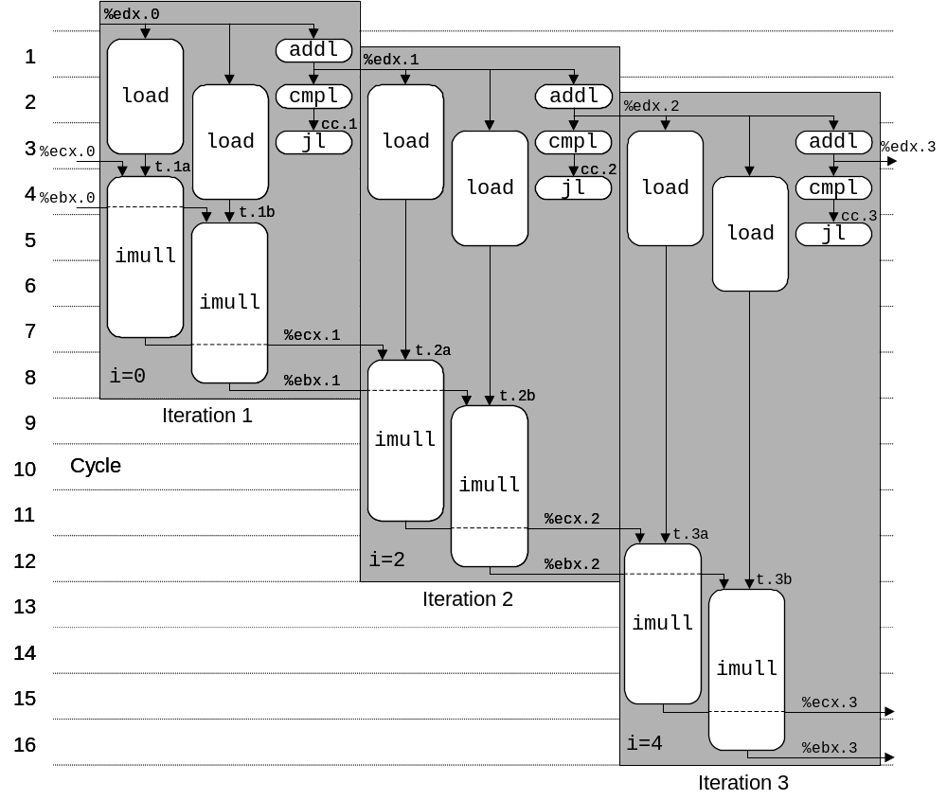
Executing with Parallel Loop
  Predicted Performance
    Can keep 4-cycle multiplier busy performing two simultaneous multiplications
    Gives CPE of 2.0

Slide 30
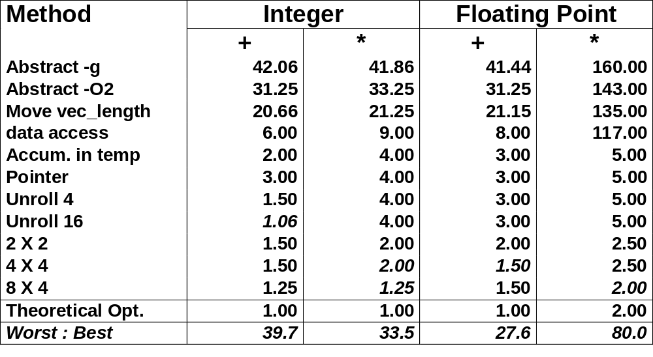
Optimization Results for Combining

Slide 31
Parallel Unrolling: Method #2
void combine6aa(vec_ptr v, int *dest)
{
int length = vec_length(v);
int limit = length-1;
int *data = get_vec_start(v);
int x = 1;
int i;
/* Combine 2 elements at a time */
for (i = 0; i < limit; i+=2) {
x *= (data[i] * data[i+1]);
}
/* Finish any remaining elements */
for (; i < length; i++) {
x *= data[i];
}
*dest = x;
}
Code Version
  Integer product
Optimization
  Multiply pairs of elements together
  And then update product
  “Tree height reduction”
Performance
  CPE = 2.5

Slide 32
Method #2 Computation
Computation
  ((((((1 * (x₀ * x₁)) * (x₂ * x₃)) * (x₄ * x₅)) * (x₆ * x₇)) * (x₈ * x₉)) * (x₁₀ * x₁₁))
Performance
  N elements, D cycles/operation
  Should be (N/2+1)*D cycles
    CPE = 2.0
  Measured CPE worse
x₀
x₁
1
*
x₂
x₃
*
*
x₄
x₅
*
*
x₆
x₇
Unrolling | CPE (measured) | CPE (theoretical)
2 | 2.50 | 2.00
3 | 1.67 | 1.33
4 | 1.50 | 1.00
6 | 1.78 | 1.00
*
*
x₈
x₉
*
*
x₁₀
x₁₁
*
*
*

Slide 33
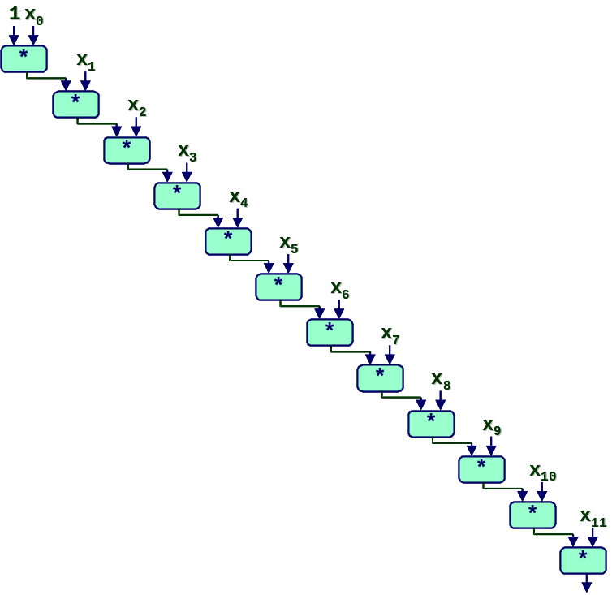
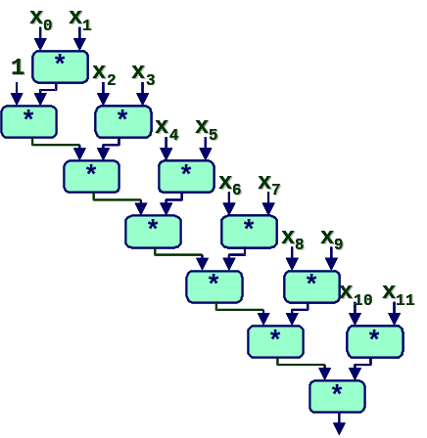
Understanding Parallelism
/* Combine 2 elements at a time */
for (i = 0; i < limit; i+=2) {
x = (x * data[i]) * data[i+1];
}
  CPE = 4.00
  All multiplies perfomed in sequence
/* Combine 2 elements at a time */
for (i = 0; i < limit; i+=2) {
x = x * (data[i] * data[i+1]);
}
  CPE = 2.50
  Multiplies overlap

Slide 34
Limitations of Parallel Execution
Need Lots of Registers
  To hold sums/products
  Only 6 usable integer registers
    Also needed for pointers, loop conditions
  8 FP registers
  When not enough registers, must spill temporaries onto stack
    Wipes out any performance gains
  Not helped by renaming
    Cannot reference more operands than instruction set allows
    Major drawback of IA32 instruction set

Slide 35
Register Spilling Example
.L165:
imull (%eax),%ecx
movl -4(%ebp),%edi
imull 4(%eax),%edi
movl %edi,-4(%ebp)
movl -8(%ebp),%edi
imull 8(%eax),%edi
movl %edi,-8(%ebp)
movl -12(%ebp),%edi
imull 12(%eax),%edi
movl %edi,-12(%ebp)
movl -16(%ebp),%edi
imull 16(%eax),%edi
movl %edi,-16(%ebp)
  …
addl $32,%eax
addl $8,%edx
cmpl -32(%ebp),%edx
jl .L165
Example
  8 X 8 integer product
  7 local variables share 1 register
  See that are storing locals on stack
  E.g., at -8(%ebp)

Slide 36
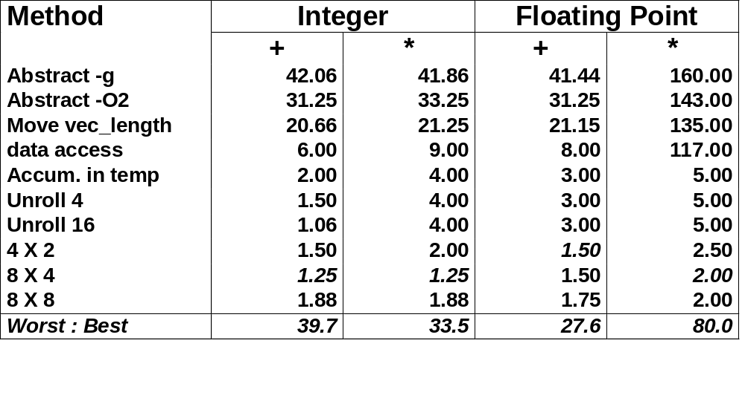
Summary: Results for Pentium III
  Biggest gain doing basic optimizations
  But, last little bit helps

Slide 37
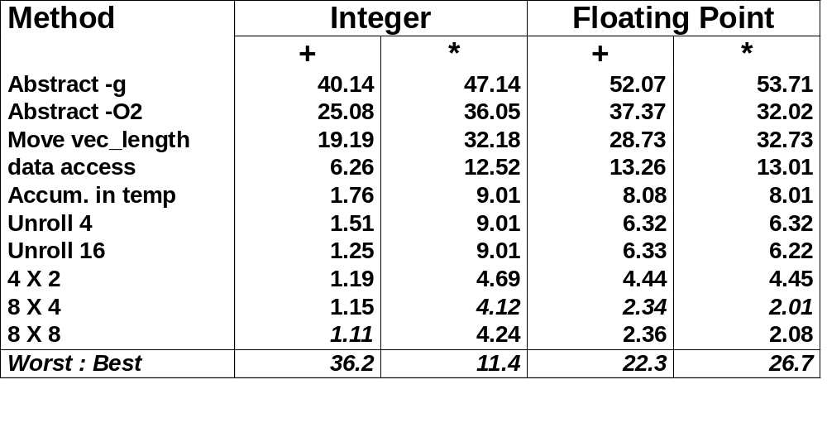
Results for Alpha Processor
  Overall trends very similar to those for Pentium III.
  Even though very different architecture and compiler

Slide 38

Results for Pentium 4
  Higher latencies (int * = 14, fp + = 5.0, fp * = 7.0)
    Clock runs at 2.0 GHz
    Not an improvement over 1.0 GHz P3 for integer *
  Avoids FP multiplication anomaly

Slide 39
What About Branches?
Challenge
  Instruction Control Unit must work well ahead of Exec. Unit
    To generate enough operations to keep EU busy
  When encounters conditional branch, cannot reliably determine where to continue fetching
80489f3: movl $0x1,%ecx
80489f8: xorl %edx,%edx
80489fa: cmpl %esi,%edx
80489fc: jnl 8048a25
80489fe: movl %esi,%esi
8048a00: imull (%eax,%edx,4),%ecx
Executing
Fetching &
Decoding

Slide 40
Branch Outcomes
  When encounter conditional branch, cannot determine where to continue fetching
    Branch Taken: Transfer control to branch target
    Branch Not-Taken: Continue with next instruction in sequence
  Cannot resolve until outcome determined by branch/integer unit
80489f3: movl $0x1,%ecx
80489f8: xorl %edx,%edx
80489fa: cmpl %esi,%edx
80489fc: jnl 8048a25
80489fe: movl %esi,%esi
8048a00: imull (%eax,%edx,4),%ecx
Branch Not-Taken
Branch Taken
8048a25: cmpl %edi,%edx
8048a27: jl 8048a20
8048a29: movl 0xc(%ebp),%eax
8048a2c: leal 0xffffffe8(%ebp),%esp
8048a2f: movl %ecx,(%eax)

Slide 41
Branch Prediction
Idea
  Guess which way branch will go
  Begin executing instructions at predicted position
    But don’t actually modify register or memory data
80489f3: movl $0x1,%ecx
80489f8: xorl %edx,%edx
80489fa: cmpl %esi,%edx
80489fc: jnl 8048a25
. . .
Predict Taken
8048a25: cmpl %edi,%edx
8048a27: jl 8048a20
8048a29: movl 0xc(%ebp),%eax
8048a2c: leal 0xffffffe8(%ebp),%esp
8048a2f: movl %ecx,(%eax)
Execute

Slide 42
Branch Prediction Through Loop
80488b1: movl (%ecx,%edx,4),%eax
80488b4: addl %eax,(%edi)
80488b6: incl %edx
80488b7: cmpl %esi,%edx
80488b9: jl 80488b1
Assume vector length = 100
i = 98
Predict Taken (OK)
80488b1: movl (%ecx,%edx,4),%eax
80488b4: addl %eax,(%edi)
80488b6: incl %edx
80488b7: cmpl %esi,%edx
80488b9: jl 80488b1
i = 99
Predict Taken
(Oops)
80488b1: movl (%ecx,%edx,4),%eax
80488b4: addl %eax,(%edi)
80488b6: incl %edx
80488b7: cmpl %esi,%edx
80488b9: jl 80488b1
Executed
Read invalid location
i = 100
Fetched
80488b1: movl (%ecx,%edx,4),%eax
80488b4: addl %eax,(%edi)
80488b6: incl %edx
80488b7: cmpl %esi,%edx
80488b9: jl 80488b1
i = 101

Slide 43
Branch Misprediction Invalidation
80488b1: movl (%ecx,%edx,4),%eax
80488b4: addl %eax,(%edi)
80488b6: incl %edx
80488b7: cmpl %esi,%edx
80488b9: jl 80488b1
Assume vector length = 100
i = 98
Predict Taken (OK)
80488b1: movl (%ecx,%edx,4),%eax
80488b4: addl %eax,(%edi)
80488b6: incl %edx
80488b7: cmpl %esi,%edx
80488b9: jl 80488b1
i = 99
Predict Taken (Oops)
80488b1: movl (%ecx,%edx,4),%eax
80488b4: addl %eax,(%edi)
80488b6: incl %edx
80488b7: cmpl %esi,%edx
80488b9: jl 80488b1
i = 100
Invalidate
80488b1: movl (%ecx,%edx,4),%eax
80488b4: addl %eax,(%edi)
80488b6: incl %edx
i = 101

Slide 44
Branch Misprediction Recovery
80488b1: movl (%ecx,%edx,4),%eax
80488b4: addl %eax,(%edi)
80488b6: incl %edx
80488b7: cmpl %esi,%edx
80488b9: jl 80488b1
Assume vector length = 100
i = 98
Predict Taken (OK)
80488b1: movl (%ecx,%edx,4),%eax
80488b4: addl %eax,(%edi)
80488b6: incl %edx
80488b7: cmpl %esi,%edx
80488b9: jl 80488b1
80488bb: leal 0xffffffe8(%ebp),%esp
80488be: popl %ebx
80488bf: popl %esi
80488c0: popl %edi
i = 99
Definitely not taken
Performance Cost
  Misprediction on Pentium III wastes ~14 clock cycles
  That’s a lot of time on a high performance processor

Slide 45
Avoiding Branches
On Modern Processor, Branches Very Expensive
  Unless prediction can be reliable
  When possible, best to avoid altogether
Example
  Compute maximum of two values
    14 cycles when prediction correct
    29 cycles when incorrect
movl 12(%ebp),%edx # Get y
movl 8(%ebp),%eax # rval=x
cmpl %edx,%eax # rval:y
jge L11 # skip when >=
movl %edx,%eax # rval=y
L11:
int max(int x, int y)
{
return (x < y) ? y : x;
}

Slide 46
Avoiding Branches with Bit Tricks
  In style of Lab #1
  Use masking rather than conditionals
  Compiler still uses conditional
    16 cycles when predict correctly
    32 cycles when mispredict
int bmax(int x, int y)
{
int mask = -(x>y);
return (mask & x) | (~mask & y);
}
xorl %edx,%edx # mask = 0
movl 8(%ebp),%eax
movl 12(%ebp),%ecx
cmpl %ecx,%eax
jle L13 # skip if x<=y
movl $-1,%edx # mask = -1
L13:

Slide 47
Avoiding Branches with Bit Tricks
  Force compiler to generate desired code
  volatile declaration forces value to be written to memory
    Compiler must therefore generate code to compute t
    Simplest way is setg/movzbl combination
  Not very elegant!
    A hack to get control over compiler
  22 clock cycles on all data
    Better than misprediction
int bvmax(int x, int y)
{
volatile int t = (x>y);
int mask = -t;
return (mask & x) |
(~mask & y);
}
movl 8(%ebp),%ecx # Get x
movl 12(%ebp),%edx # Get y
cmpl %edx,%ecx # x:y
setg %al # (x>y)
movzbl %al,%eax # Zero extend
movl %eax,-4(%ebp) # Save as t
movl -4(%ebp),%eax # Retrieve t

Slide 48
Conditional Move
  Added with P6 microarchitecture (PentiumPro onward)
  cmovXXl %edx, %eax
    If condition XX holds, copy %edx to %eax
    Doesn’t involve any branching
    Handled as operation within Execution Unit
  Current version of GCC won’t use this instruction
    Thinks it’s compiling for a 386
  Performance
    14 cycles on all data
movl 8(%ebp),%edx # Get x
movl 12(%ebp),%eax # rval=y
cmpl %edx, %eax # rval:x
cmovll %edx,%eax # If <, rval=x

Slide 49
Machine-Dependent Opt. Summary
Pointer Code
  Look carefully at generated code to see whether helpful
Loop Unrolling
  Some compilers do this automatically
  Generally not as clever as what can achieve by hand
Exposing Instruction-Level Parallelism
  Very machine dependent
Warning:
  Benefits depend heavily on particular machine
  Best if performed by compiler
    But GCC on IA32/Linux is not very good
  Do only for performance-critical parts of code

Slide 50
Role of Programmer
  How should I write my programs, given that I have a good, optimizing compiler?
Don’t: Smash Code into Oblivion
  Hard to read, maintain, & assure correctness
Do:
  Select best algorithm
  Write code that’s readable & maintainable
    Procedures, recursion, without built-in constant limits
    Even though these factors can slow down code
  Eliminate optimization blockers
    Allows compiler to do its job
Focus on Inner Loops
  Do detailed optimizations where code will be executed repeatedly
  Will get most performance gain here

