Slide 1
Time Measurement
Oct. 24, 2002
15-213
“The course that gives CMU its Zip!”
Topics
  Time scales
  Interval counting
  Cycle counters
  K-best measurement scheme
class18.ppt

Slide 2
Computer Time Scales
Microscopic
Time Scale (1 Ghz Machine)
Macroscopic
Integer Add
Disk Access
FP Multiply
Keystroke
Screen Refresh
FP Divide
Interrupt
Keystroke
Handler
1 ns
1
μ
s
1 ms
1 s
1.E-09
1.E-06
Time (seconds)
1.E-03
1.E+00
Two Fundamental Time Scales
  Processor: ~10^{–9} sec.
  External events: ~10^{–2} sec.
    Keyboard input
    Disk seek
    Screen refresh
Implication
  Can execute many instructions while waiting for external event to occur
  Can alternate among processes without anyone noticing

Slide 3
Measurement Challenge
How Much Time Does Program X Require?
  CPU time
    How many total seconds are used when executing X?
    Measure used for most applications
    Small dependence on other system activities
  Actual (“Wall”) Time
    How many seconds elapse between the start and the completion of X?
    Depends on system load, I/O times, etc.
Confounding Factors
  How does time get measured?
  Many processes share computing resources
    Transient effects when switching from one process to another
    Suddenly, the effects of alternating among processes become noticeable

Slide 4
“Time” on a Computer System
real (wall clock) time
= user time (time executing instructions in the user process)
= system time (time executing instructions in kernel on behalf of user process)
= some other user’s time (time executing instructions in different user’s process)
+
+
= real (wall clock) time
We will use the word “time” to refer to user time.
cumulative user time

Slide 5
Activity Periods: Light Load
Activity Periods, Load = 1
Active
1
Inactive
0
10
20
30
40
50
60
70
80
Time (ms)
  Most of the time spent executing one process
  Periodic interrupts every 10ms
    Interval timer
    Keep system from executing one process to exclusion of others
  Other interrupts
    Due to I/O activity
  Inactivity periods
    System time spent processing interrupts
    ~250,000 clock cycles

Slide 6
Activity Periods: Heavy Load
Activity Periods, Load = 2
Active
1
Inactive
0
10
20
30
40
50
60
70
80
Time (ms)
  Sharing processor with one other active process
  From perspective of this process, system appears to be “inactive” for ~50% of the time
    Other process is executing

Slide 7
Interval Counting
OS Measures Runtimes Using Interval Timer
  Maintain 2 counts per process
    User time
    System time
  Each time get timer interrupt, increment counter for executing process
    User time if running in user mode
    System time if running in kernel mode

Slide 8
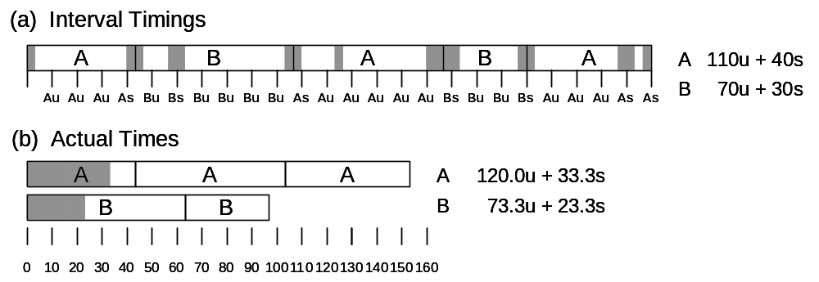
Interval Counting Example

Slide 9
Unix time Command
time make osevent
gcc -O2 -Wall -g -march=i486 -c clock.c
gcc -O2 -Wall -g -march=i486 -c options.c
gcc -O2 -Wall -g -march=i486 -c load.c
gcc -O2 -Wall -g -march=i486 -o osevent osevent.c . . .
0.820u 0.300s 0:01.32 84.8% 0+0k 0+0io 4049pf+0w
  0.82 seconds user time
    82 timer intervals
  0.30 seconds system time
    30 timer intervals
  1.32 seconds wall time
  84.8% of total was used running these processes
    (.82+0.3)/1.32 = .848

Slide 10
Accuracy of Interval Counting
A
Computed time = 70ms
Min Actual = 60 + ε
Max Actual = 80 – ε
A
Minimum
Minimum
Maximum
A
Maximum
A
0
0
10
10
20
20
30
30
40
40
50
50
60
60
70
70
80
80
Worst Case Analysis
  Timer Interval = δ
  Single process segment measurement can be off by ±δ
  No bound on error for multiple segments
    Could consistently underestimate, or consistently overestimate

Slide 11
Accuracy of Int. Cntg. (cont.)
A
Computed time = 70ms
Min Actual = 60 + ε
Max Actual = 80 – ε
A
Minimum
Minimum
Maximum
A
Maximum
A
0
0
10
10
20
20
30
30
40
40
50
50
60
60
70
70
80
80
Average Case Analysis
  Over/underestimates tend to balance out
  As long as total run time is sufficiently large
    Min run time ~1 second
    100 timer intervals
  Consistently miss 4% overhead due to timer interrupts

Slide 12
Cycle Counters
  Most modern systems have built in registers that are incremented every clock cycle
    Very fine grained
    Maintained as part of process state
      In Linux, counts elapsed global time
  Special assembly code instruction to access
  On (recent model) Intel machines:
    64 bit counter.
    RDTSC instruction sets %edx to high order 32-bits, %eax to low order 32-bits

Slide 13
Cycle Counter Period
Wrap Around Times for 550 MHz machine
  Low order 32 bits wrap around every 2³² / (550 * 10⁶) = 7.8 seconds
  High order 64 bits wrap around every 2⁶⁴ / (550 * 10⁶) = 33539534679 seconds
    1065 years
For 2 GHz machine
  Low order 32-bits every 2.1 seconds
  High order 64 bits every 293 years

Slide 14
Measuring with Cycle Counter
Idea
  Get current value of cycle counter
    store as pair of unsigned’s cyc_hi and cyc_lo
  Compute something
  Get new value of cycle counter
  Perform double precision subtraction to get elapsed cycles
/* Keep track of most recent reading of cycle counter */
static unsigned cyc_hi = 0;
static unsigned cyc_lo = 0;
void start_counter()
{
/* Get current value of cycle counter */
access_counter(&cyc_hi, &cyc_lo);
}

Slide 15
Accessing the Cycle Cntr.
  GCC allows inline assembly code with mechanism for matching registers with program variables
  Code only works on x86 machine compiling with GCC
  Emit assembly with rdtsc and two movl instructions
void access_counter(unsigned *hi, unsigned *lo)
{
/* Get cycle counter */
asm("rdtsc; movl %%edx,%0; movl %%eax,%1"
: "=r" (*hi), "=r" (*lo)
: /* No input */
: "%edx", "%eax");
}

Slide 16
Closer Look at Extended ASM
void access_counter
(unsigned *hi, unsigned *lo)
{
/* Get cycle counter */
asm("rdtsc; movl %%edx,%0; movl %%eax,%1"
: "=r" (*hi), "=r" (*lo)
: /* No input */
: "%edx", "%eax");
}
asm(“Instruction String"
: Output List
: Input List
: Clobbers List);
}
Instruction String
  Series of assembly commands
    Separated by “;” or “\n”
    Use “%%” where normally would use “%”

Slide 17
Closer Look at Extended ASM
void access_counter
(unsigned *hi, unsigned *lo)
{
/* Get cycle counter */
asm("rdtsc; movl %%edx,%0; movl %%eax,%1"
: "=r" (*hi), "=r" (*lo)
: /* No input */
: "%edx", "%eax");
}
asm(“Instruction String"
: Output List
: Input List
: Clobbers List);
}
Output List
  Expressions indicating destinations for values %0, %1, …, %j
    Enclosed in parentheses
    Must be lvalue
      Value that can appear on LHS of assignment
  Tag "=r" indicates that symbolic value (%0, etc.), should be replaced by register

Slide 18
Closer Look at Extended ASM
void access_counter
(unsigned *hi, unsigned *lo)
{
/* Get cycle counter */
asm("rdtsc; movl %%edx,%0; movl %%eax,%1"
: "=r" (*hi), "=r" (*lo)
: /* No input */
: "%edx", "%eax");
}
asm(“Instruction String"
: Output List
: Input List
: Clobbers List);
}
Input List
  Series of expressions indicating sources for values %j+1, %j+2, …
    Enclosed in parentheses
    Any expression returning value
  Tag "r" indicates that symbolic value (%0, etc.) will come from register

Slide 19
Closer Look at Extended ASM
void access_counter
(unsigned *hi, unsigned *lo)
{
/* Get cycle counter */
asm("rdtsc; movl %%edx,%0; movl %%eax,%1"
: "=r" (*hi), "=r" (*lo)
: /* No input */
: "%edx", "%eax");
}
asm(“Instruction String"
: Output List
: Input List
: Clobbers List);
}
Clobbers List
  List of register names that get altered by assembly instruction
  Compiler will make sure doesn’t store something in one of these registers that must be preserved across asm
    Value set before & used after

Slide 20
Accessing the Cycle Cntr. (cont.)
Emitted Assembly Code
  Used %ecx for *hi (replacing %0)
  Used %ebx for *lo (replacing %1)
  Does not use %eax or %edx for value that must be carried across inserted assembly code
movl 8(%ebp),%esi # hi
movl 12(%ebp),%edi # lo
#APP
rdtsc; movl %edx,%ecx; movl %eax,%ebx
#NO_APP
movl %ecx,(%esi) # Store high bits at *hi
movl %ebx,(%edi) # Store low bits at *lo

Slide 21
Completing Measurement
  Get new value of cycle counter
  Perform double precision subtraction to get elapsed cycles
  Express as double to avoid overflow problems
double get_counter()
{
unsigned ncyc_hi, ncyc_lo
unsigned hi, lo, borrow;
/* Get cycle counter */
access_counter(&ncyc_hi, &ncyc_lo);
/* Do double precision subtraction */
lo = ncyc_lo - cyc_lo;
borrow = lo > ncyc_lo;
hi = ncyc_hi - cyc_hi - borrow;
return (double) hi * (1 << 30) * 4 + lo;
}

Slide 22
Timing With Cycle Counter
Determine Clock Rate of Processor
  Count number of cycles required for some fixed number of seconds
Time Function P
  First attempt: Simply count cycles for one execution of P
double MHZ;
int sleep_time = 10;
start_counter();
sleep(sleep_time);
MHZ = get_counter()/(sleep_time * 1e6);
double tsecs;
start_counter();
P();
tsecs = get_counter() / (MHZ * 1e6);

Slide 23
Measurement Pitfalls
Overhead
  Calling get_counter() incurs small amount of overhead
  Want to measure long enough code sequence to compensate
Unexpected Cache Effects
  artificial hits or misses
  e.g., these measurements were taken with the Alpha cycle counter:
  foo1(array1, array2, array3); /* 68,829 cycles */
  foo2(array1, array2, array3); /* 23,337 cycles */
  vs.
  foo2(array1, array2, array3); /* 70,513 cycles */
  foo1(array1, array2, array3); /* 23,203 cycles */

Slide 24
Dealing with Overhead & Cache Effects
  Always execute function once to “warm up” cache
  Keep doubling number of times execute P() until reach some threshold
    Used CMIN = 50000
int cnt = 1;
double cmeas = 0;
double cycles;
do {
int c = cnt;
P(); /* Warm up cache */
get_counter();
while (c-- > 0)
P();
cmeas = get_counter();
cycles = cmeas / cnt;
cnt += cnt;
} while (cmeas < CMIN); /* Make sure have enough */
return cycles / (1e6 * MHZ);

Slide 25
Multitasking Effects
Cycle Counter Measures Elapsed Time
  Keeps accumulating during periods of inactivity
    System activity
    Running other processes
Key Observation
  Cycle counter never underestimates program run time
  Possibly overestimates by large amount
K-Best Measurement Scheme
  Perform up to N (e.g., 20) measurements of function
  See if fastest K (e.g., 3) within some relative factor ε (e.g., 0.001)
K

Slide 26
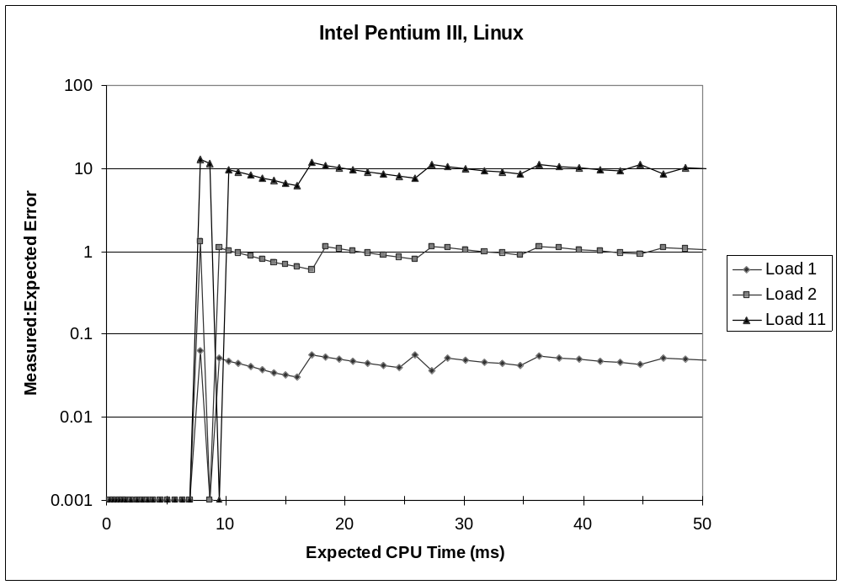
K-Best
Validation
  K = 3, ε = 0.001
Very good accuracy for < 8ms
  Within one timer interval
  Even when heavily loaded
Less accurate of > 10ms
  Light load: ~4% error
    Interval clock interrupt handling
  Heavy load: Very high error

Slide 27
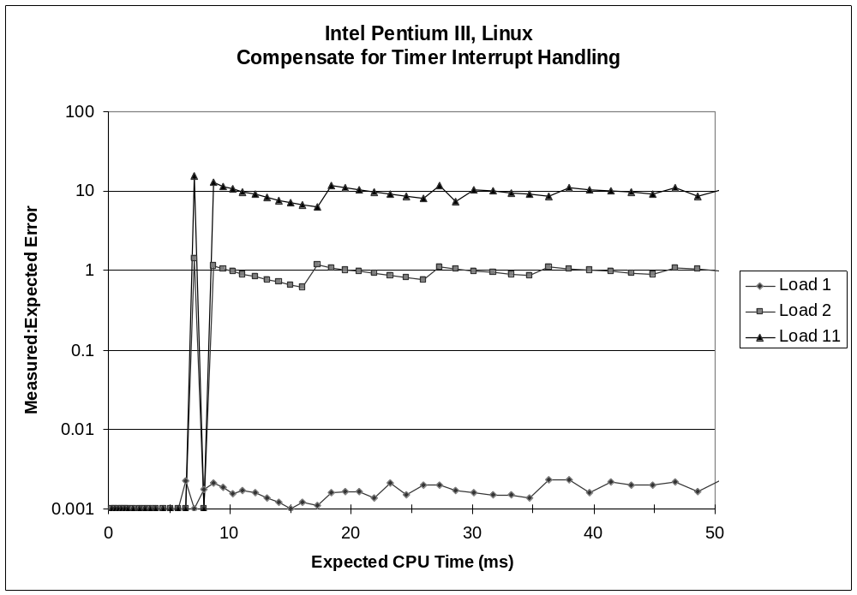
Compensate
For Timer
Overhead
  K = 3, ε = 0.001
Subtract Timer Overhead
  Estimate overhead of single interrupt by measuring periods of inactivity
  Call interval timer to determine number of interrupts that have occurred
Better Accuracy for > 10ms
  Light load: 0.2% error
  Heavy load: Still very high error

Slide 28
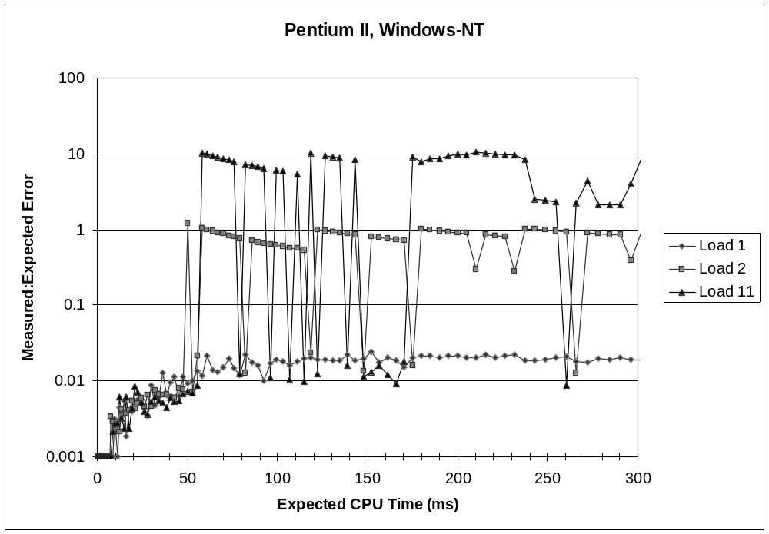
K-Best on NT
  K = 3, ε = 0.001
Acceptable accuracy for < 50ms
  Scheduler allows process to run multiple intervals
Less accurate of > 10ms
  Light load: 2% error
  Heavy load: Generally very high error

Slide 29
Time of Day Clock
  Unix gettimeofday() function
  Return elapsed time since reference time (Jan 1, 1970)
  Implementation
    Uses interval counting on some machines
      Coarse grained
    Uses cycle counter on others
      Fine grained, but significant overhead and only 1 microsecond resolution
#include <sys/time.h>
#include <unistd.h>
struct timeval tstart, tfinish;
double tsecs;
gettimeofday(&tstart, NULL);
P();
gettimeofday(&tfinish, NULL);
tsecs = (tfinish.tv_sec - tstart.tv_sec) +
1e6 * (tfinish.tv_usec - tstart.tv_usec);

Slide 30
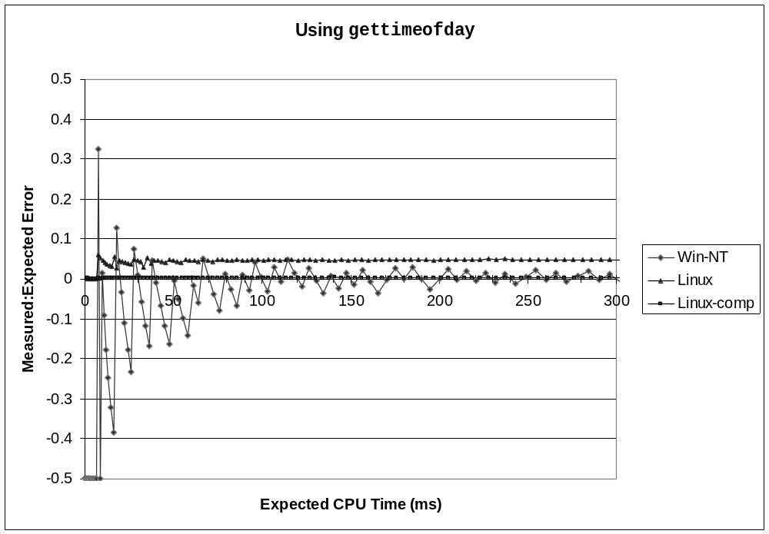
K-Best Using gettimeofday
Linux
  As good as using cycle counter
  For times > 10 microseconds
Windows
  Implemented by interval counting
  Too coarse-grained

Slide 31
Measurement Summary
Timing is highly case and system dependent
  What is overall duration being measured?
    > 1 second: interval counting is OK
    << 1 second: must use cycle counters
  On what hardware / OS / OS version?
    Accessing counters
      How gettimeofday is implemented
    Timer interrupt overhead
    Scheduling policy
Devising a Measurement Method
  Long durations: use Unix timing functions
  Short durations
    If possible, use gettimeofday
    Otherwise must work with cycle counters
    K-best scheme most successful

