Slide 1
Internetworking
Nov 19, 2002
15-213
“The course that gives CMU its Zip!”
Topics
  Client-server programming model
  Networks
  Internetworks
  Global IP Internet
    IP addresses
    Domain names
    Connections
class25.ppt

Slide 2
A Client-Server Transaction
Every network application is based on the client-server model:
  A server process and one or more client processes
  Server manages some resource.
  Server provides service by manipulating resource for clients.
1. Client sends request
Client
process
Server
process
Resource
4. Client
handles
response
3. Server sends response
2. Server
handles
request
Note: clients and servers are processes running on hosts
(can be the same or different hosts).

Slide 3
Hardware Org of a Network Host
CPU chip
register file
ALU
system bus
memory bus
main
memory
MI
I/O
bridge
Expansion slots
I/O bus
USB
controller
graphics
adapter
disk
controller
network
adapter
mouse
keyboard
monitor
disk
network

Slide 4
Computer Networks
A network is a hierarchical system of boxes and wires organized by geographical proximity
  LAN (local area network) spans a building or campus.
    Ethernet is most prominent example.
  WAN (wide-area network) spans country or world.
    Typically high-speed point-to-point phone lines.
An internetwork (internet) is an interconnected set of networks.
  The Gobal IP Internet (uppercase “I”) is the most famous example of an internet (lowercase “i”)
Let’s see how we would build an internet from the ground up.

Slide 5
Lowest Level: Ethernet Segment
Ethernet segment consists of a collection of hosts connected by wires (twisted pairs) to a hub.
Spans room or floor in a building.
Operation
  Each Ethernet adapter has a unique 48-bit address.
  Hosts send bits to any other host in chunks called frames.
  Hub slavishly copies each bit from each port to every other port.
    Every host sees every bit.
host
host
host
100 Mb/s
100 Mb/s
hub
ports

Slide 6
Next Level: Bridged Ethernet Segment
Spans building or campus.
Bridges cleverly learn which hosts are reachable from which ports and then selectively copy frames from port to port.
A
B
host
host
host
host
host
X
hub
bridge
hub
100 Mb/s
100 Mb/s
1 Gb/s
host
host
hub
100 Mb/s
bridge
100 Mb/s
hub
Y
host
host
host
host
host
C

Slide 7
Conceptual View of LANs
For simplicity, hubs, bridges, and wires are often shown as a collection of hosts attached to a single wire:
host
host
...
host

Slide 8
Next Level: internets
Multiple incompatible LANs can be physically connected by specialized computers called routers.
The connected networks are called an internet.
host
host
...
host
host
host
...
host
LAN 1
LAN 2
router
router
router
WAN
WAN
LAN 1 and LAN 2 might be completely different, totally incompatible LANs (e.g., Ethernet and ATM)

Slide 9
The Notion of an internet Protocol
How is it possible to send bits across incompatible LANs and WANs?
Solution: protocol software running on each host and router smoothes out the differences between the different networks.
Implements an internet protocol (i.e., set of rules) that governs how hosts and routers should cooperate when they transfer data from network to network.
  TCP/IP is the protocol for the global IP Internet.

Slide 10
What Does an internet Protocol Do?
1. Provides a naming scheme
  An internet protocol defines a uniform format for host addresses.
  Each host (and router) is assigned at least one of these internet addresses that uniquely identifies it.
2. Provides a delivery mechanism
  An internet protocol defines a standard transfer unit (packet)
  Packet consists of header and payload
    Header: contains info such as packet size, source and destination addresses.
    Payload: contains data bits sent from source host.

Slide 11
Transferring Data Over an internet
Host A
Host B
client
server
(1)
data
(8)
data
protocol
software
protocol
software
internet packet
(2)
data
PH
FH1
(7)
data
PH
FH2
LAN1 frame
LAN1
adapter
LAN2
adapter
Router
(3)
data
PH
FH1
(6)
data
PH
FH2
LAN1
adapter
LAN2
adapter
LAN1
LAN2 frame
LAN2
(4)
data
PH
FH1
(5)
data
PH
FH2
protocol
software

Slide 12
Other Issues
We are glossing over a number of important questions:
  What if different networks have different maximum frame sizes? (segmentation)
  How do routers know where to forward frames?
  How are routers informed when the network topology changes?
  What if packets get lost?
These (and other) questions are addressed by the area of systems known as computer networking.

Slide 13
Global IP Internet
Most famous example of an internet.
Based on the TCP/IP protocol family
  IP (Internet protocol) :
    Provides basic naming scheme and unreliable delivery capability of packets (datagrams) from host-to-host.
  UDP (Unreliable Datagram Protocol)
    Uses IP to provide unreliable datagram delivery from process-to-process.
  TCP (Transmission Control Protocol)
    Uses IP to provide reliable byte streams from process-to-process over connections.
Accessed via a mix of Unix file I/O and functions from the sockets interface.

Slide 14
Hardware and Software Org of an Internet Application
Internet client host
Internet server host
Client
User code
Server
Sockets interface
(system calls)
TCP/IP
Kernel code
TCP/IP
Hardware interface
(interrupts)
Network
adapter
Hardware
and firmware
Network
adapter
Global IP Internet

Slide 15
Basic Internet Components
An Internet backbone is a collection of routers (nationwide or worldwide) connected by high-speed point-to-point networks.
A Network Access Point (NAP) is a router that connects multiple backbones (sometimes referred to as peers).
Regional networks are smaller backbones that cover smaller geographical areas (e.g., cities or states)
A point of presence (POP) is a machine that is connected to the Internet.
Internet Service Providers (ISPs) provide dial-up or direct access to POPs.

Slide 16
The Internet Circa 1993
In 1993, the Internet consisted of one backbone (NSFNET) that connected 13 sites via 45 Mbs T3 links.
  Merit (Univ of Mich), NCSA (Illinois), Cornell Theory Center, Pittsburgh Supercomputing Center, San Diego Supercomputing Center, John von Neumann Center (Princeton), BARRNet (Palo Alto), MidNet (Lincoln, NE), WestNet (Salt Lake City), NorthwestNet (Seattle), SESQUINET (Rice), SURANET (Georgia Tech).
Connecting to the Internet involved connecting one of your routers to a router at a backbone site, or to a regional network that was already connected to the backbone.

Slide 17
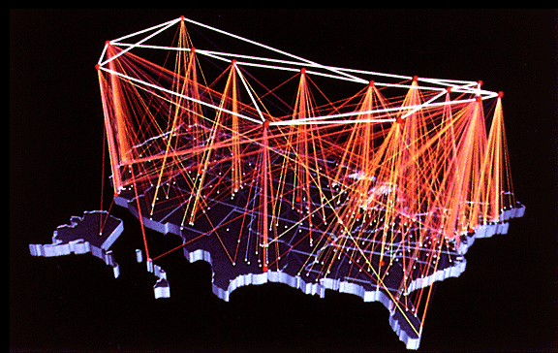
NSFNET Internet Backbone
source: www.eef.org

Slide 18
Current NAP-Based Internet Architecture
In the early 90’s commercial outfits were building their own high-speed backbones, connecting to NSFNET, and selling access to their POPs to companies, ISPs, and individuals.
In 1995, NSF decommissioned NSFNET, and fostered creation of a collection of NAPs to connect the commercial backbones.
Currently in the US there are about 50 commercial backbones connected by ~12 NAPs (peering points).
Similar architecture worldwide connects national networks to the Internet.

Slide 19
Internet Connection Hierarchy
Private
“peering”
agreements
between
two backbone
companies
often bypass
NAP
NAP
NAP
NAP
Colocation
sites
Backbone
Backbone
Backbone
Backbone
POP
POP
POP
POP
POP
POP
POP
T3
Regional net
ISP
Big Business
POP
POP
POP
POP
POP
POP
POP
T1
T1
dialup
dialup
ISP (for individuals)
Small Business
Pgh employee
DC employee

Slide 20
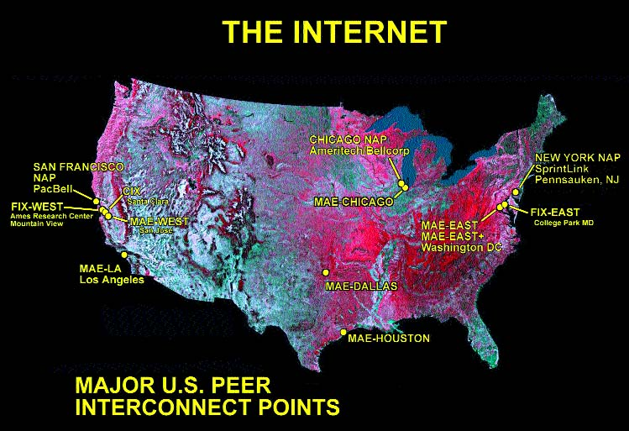
Network Access Points (NAPs)
Note: Peers in this context are
commercial backbones..droh
Source: Boardwatch.com

Slide 21
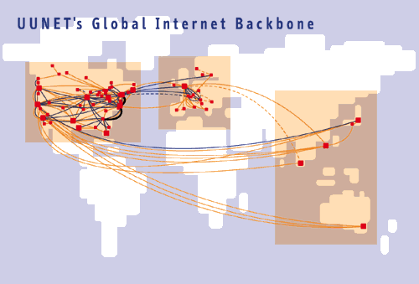
MCI/WorldCom/UUNET Global Backbone
Source: Boardwatch.com

Slide 22
A Programmer’s View of the Internet
1. Hosts are mapped to a set of 32-bit IP addresses.
  128.2.203.179
2. The set of IP addresses is mapped to a set of identifiers called Internet domain names.
  128.2.203.179 is mapped to www.cs.cmu.edu
3. A process on one Internet host can communicate with a process on another Internet host over a connection.

Slide 23
1. IP Addresses
32-bit IP addresses are stored in an IP address struct
  IP addresses are always stored in memory in network byte order (big-endian byte order)
  True in general for any integer transferred in a packet header from one machine to another.
    E.g., the port number used to identify an Internet connection.
/* Internet address structure */
struct in_addr {
unsigned int s_addr; /* network byte order (big-endian) */
};
Handy network byte-order conversion functions:
  htonl: convert long int from host to network byte order.
  htons: convert short int from host to network byte order.
  ntohl: convert long int from network to host byte order.
  ntohs: convert short int from network to host byte order.

Slide 24
Dotted Decimal Notation
By convention, each byte in a 32-bit IP address is represented by its decimal value and separated by a period
    IP address 0x8002C2F2 = 128.2.194.242
Functions for converting between binary IP addresses and dotted decimal strings:
  inet_aton: converts a dotted decimal string to an IP address in network byte order.
  inet_ntoa: converts an IP address in network by order to its corresponding dotted decimal string.
  “n” denotes network representation. “a” denotes application representation.

Slide 25
2. Internet Domain Names
unnamed root
mil
edu
gov
com
First-level domain names
mit
cmu
berkeley
amazon
Second-level domain names
cs
ece
www
208.216.181.15
Third-level domain names
cmcl
pdl
kittyhawk
128.2.194.242
imperial
128.2.189.40

Slide 26
Domain Naming System (DNS)
The Internet maintains a mapping between IP addresses and domain names in a huge worldwide distributed database called DNS.
  Conceptually, programmers can view the DNS database as a collection of millions of host entry structures:
Functions for retrieving host entries from DNS:
  gethostbyname: query key is a DNS domain name.
  gethostbyaddr: query key is an IP address.
/* DNS host entry structure */
struct hostent {
char *h_name; /* official domain name of host */
char **h_aliases; /* null-terminated array of domain names */
int h_addrtype; /* host address type (AF_INET) */
int h_length; /* length of an address, in bytes */
char **h_addr_list; /* null-terminated array of in_addr structs */
};

Slide 27
Properties of DNS Host Entries
Each host entry is an equivalence class of domain names and IP addresses.
Each host has a locally defined domain name localhost which always maps to the loopback address 127.0.0.1
Different kinds of mappings are possible:
  Simple case: 1-1 mapping between domain name and IP addr:
    kittyhawk.cmcl.cs.cmu.edu maps to 128.2.194.242
  Multiple domain names mapped to the same IP address:
    eecs.mit.edu and cs.mit.edu both map to 18.62.1.6
  Multiple domain names mapped to multiple IP addresses:
    aol.com and www.aol.com map to multiple IP addrs.
  Some valid domain names don’t map to any IP address:
    for example: cmcl.cs.cmu.edu

Slide 28
A Program That Queries DNS
int main(int argc, char **argv) { /* argv[1] is a domain name
char **pp; * or dotted decimal IP addr */
struct in_addr addr;
struct hostent *hostp;
if (inet_aton(argv[1], &addr) != 0)
hostp = Gethostbyaddr((const char *)&addr, sizeof(addr),
AF_INET);
else
hostp = Gethostbyname(argv[1]);
printf("official hostname: %s\n", hostp->h_name);
for (pp = hostp->h_aliases; *pp != NULL; pp++)
printf("alias: %s\n", *pp);
for (pp = hostp->h_addr_list; *pp != NULL; pp++) {
addr.s_addr = *((unsigned int *)*pp);
printf("address: %s\n", inet_ntoa(addr));
}
}

Slide 29
Querying DNS from the Command Line
Domain Information Groper (dig) provides a scriptable command line interface to DNS.
linux> dig +short kittyhawk.cmcl.cs.cmu.edu
128.2.194.242
linux> dig +short -x 128.2.194.242
KITTYHAWK.CMCL.CS.CMU.EDU.
linux> dig +short aol.com
205.188.145.215
205.188.160.121
64.12.149.24
64.12.187.25
linux> dig +short -x 64.12.187.25
aol-v5.websys.aol.com.

Slide 30
3. Internet Connections
Clients and servers communicate by sending streams of bytes over connections:
  Point-to-point, full-duplex (2-way communication), and reliable.
A socket is an endpoint of a connection
  Socket address is an IPaddress:port pair
A port is a 16-bit integer that identifies a process:
  Ephemeral port: Assigned automatically on client when client makes a connection request
  Well-known port: Associated with some service provided by a server (e.g., port 80 is associated with Web servers)
A connection is uniquely identified by the socket addresses of its endpoints (socket pair)
  (cliaddr:cliport, servaddr:servport)

Slide 31
Putting it all Together:
Anatomy of an Internet Connection
Client socket address
128.2.194.242:51213
Server socket address
208.216.181.15:80
Client
Server
(port 80)
Connection socket pair
(128.2.194.242:51213, 208.216.181.15:80)
Client host address
128.2.194.242
Server host address
208.216.181.15

Slide 32
Next Time
How to use the sockets interface to establish Internet connections between clients and servers
How to use Unix I/O to copy data from one host to another over an Internet connection.

