Slide 1





the
titanlift

Slide 2

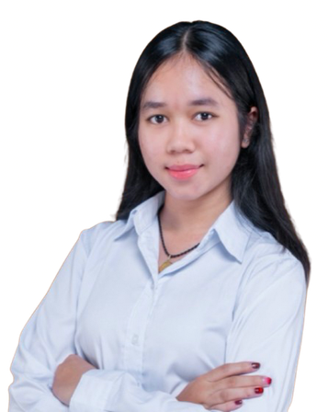


The TitanLift
Institute: Cambodia Academy of Digital Technology
Course: Algorithm & Computation Thinking
Lecturer: Han Leangsiv
Group: 5
Team: 9
Date: 3rd July 2026
Presented by:
Choeun Linda
Oeurn Meylih

Slide 3

Introduction & Overview
  TitanLift is a smart elevator system in 10-floor building where floor 9 is a VIP and 10 is a sky bar
  TitanLift got inspired by THE TITANIC which had 4 elevators, 3 reserved for first class and 1 for everyone else
  TitanLift got from "TITAN + LIFT" which TITAN means strength, scale and power ,with "LIFT" simply the elevator itself, the thing that carries us up and down

Slide 4

Key Features of System
01
Floor Request Queue(Priority-Based)
02
VIP Express Mode
03
Card Scan Authentication
04
Emergency Alarm Mode
05
Passenger Capacity Limit

Slide 5
Key Features of System
Features
Description
01
Floor Request Queue
Stores passengers, requests, processes highest priority first
02
VIP Express
moves directly to floor 9
03
Card Scan Authentication
scan VIP mode , VIP card IDs
04
Emergency Alarm Mode
the alarm requests the cabin to stop the current request
05
Passenger Capacity Limit
rejects entry when full of 8

Slide 6
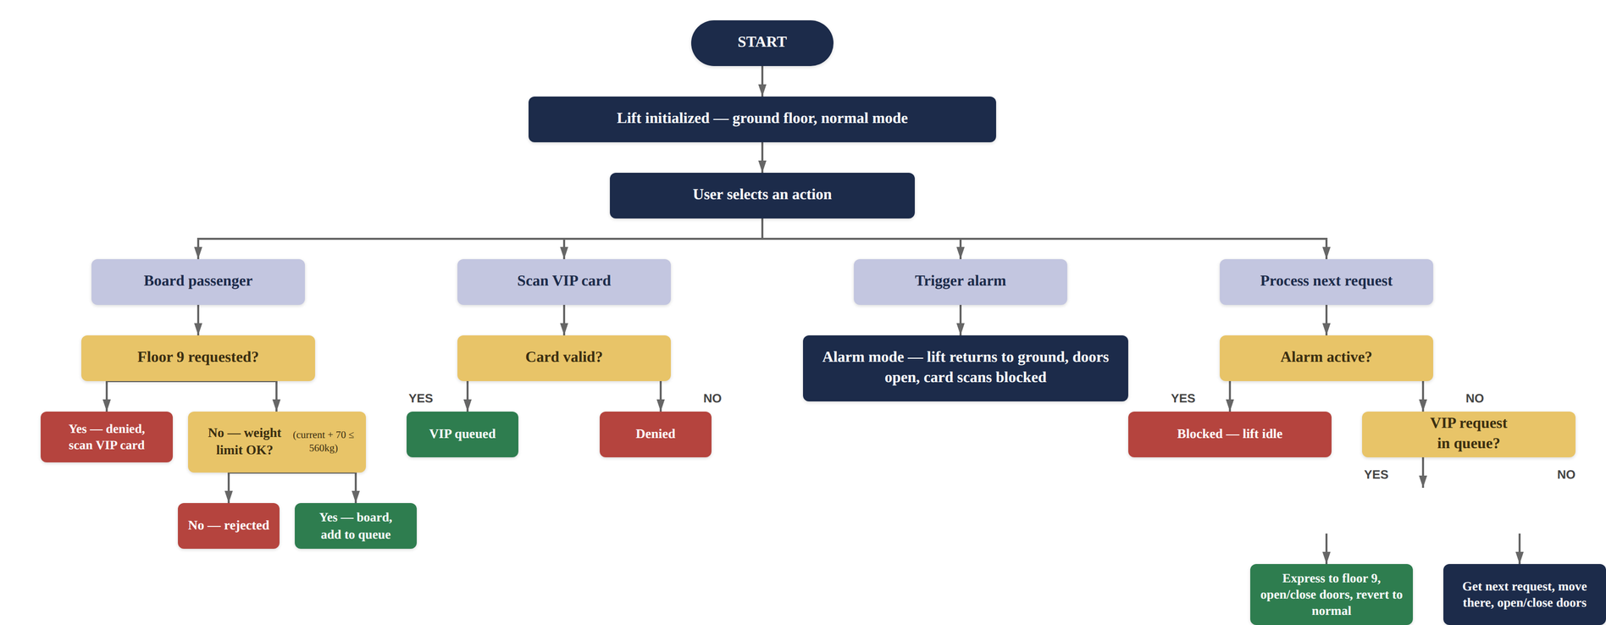
How It Works
  flowchart

Slide 7
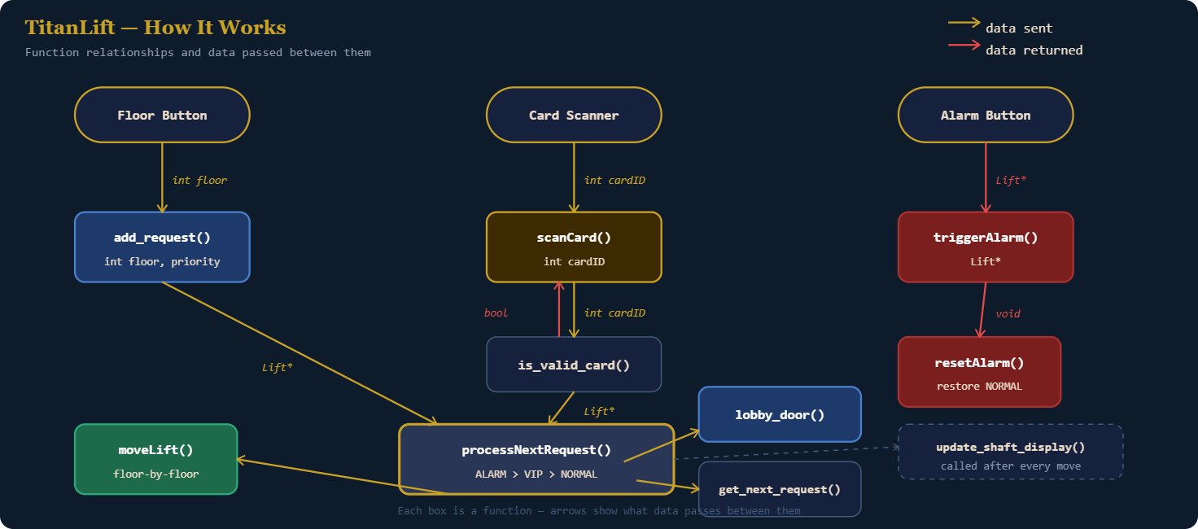

Slide 8
Key achievements of our system
01
VIP Express Override work end to end
02
Priority Queue handles mixed requests
03
Emergency alarm response
04
Secure card-based access control
05
Passenger capacity enforcement

Slide 9
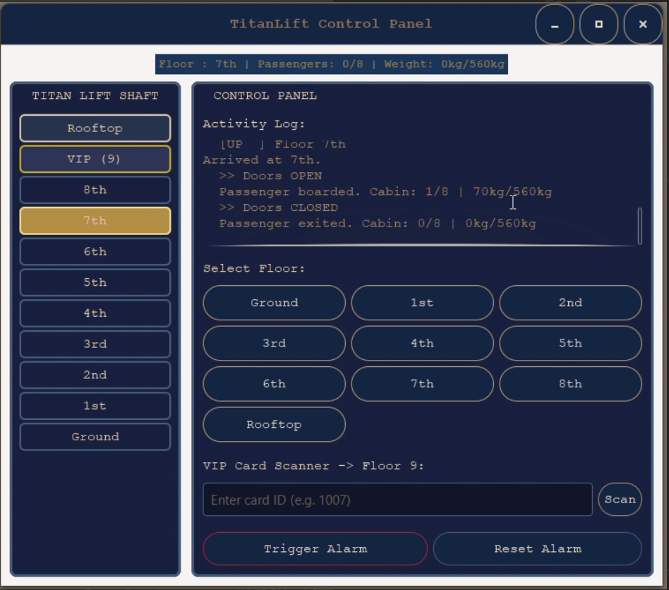
Resul
t

Slide 10
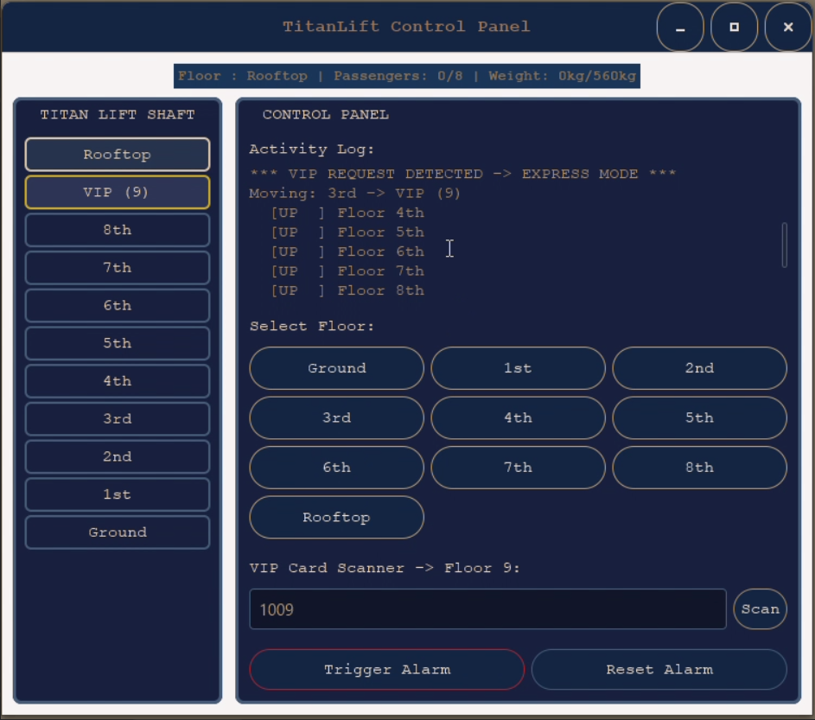
Resul
t

Slide 11
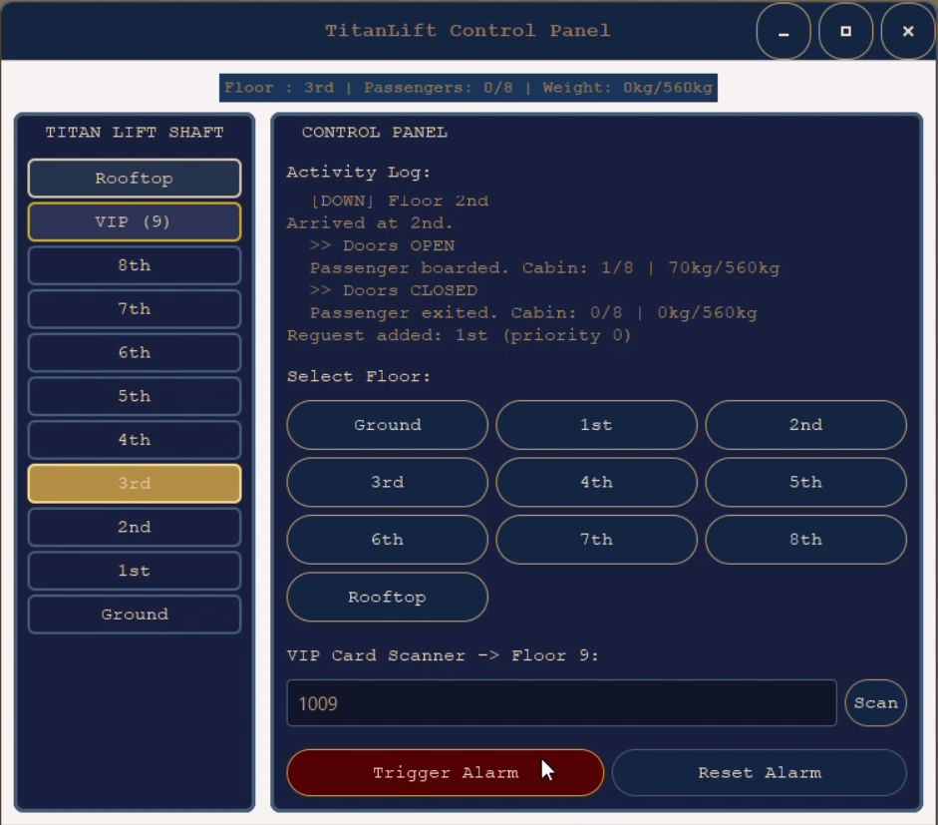
Resul
t

Slide 12
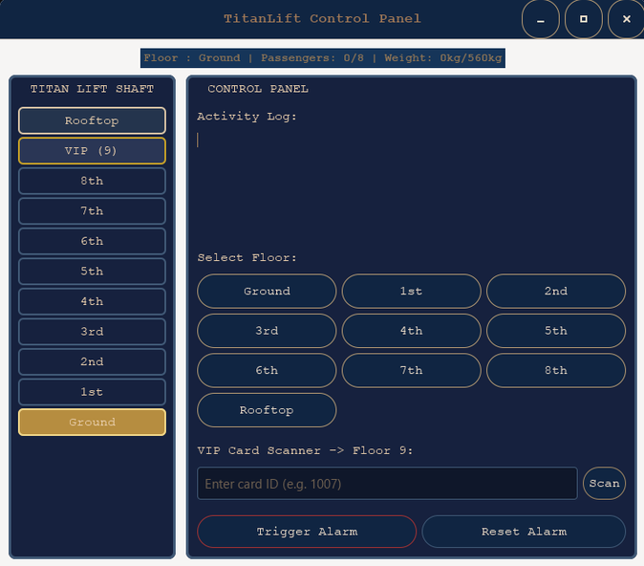
Demonstration
now let's give a try

Slide 13
Conclusion
  Summary:
TitanLift started from a problem everyone’s quietly felt nowsday, waiting in an elevator that stops at every floor when you’re already running late. We took the Titanic’s old idea of priority access and rebuilt it as something fair and temporary: a verified VIP card scan triggers Express Mode, sending the elevator straight to Floor 9, then automatically returning to normal service once that trip is done.

Slide 14


Challenges/Difficulty
  We face many problems about coding
  Our coding isn't good enough to build the whole things
  Never know about GUI
  Start doing GUI from Zero
  Spent almost 3days just to install GUI and we use GTK

Slide 15

Lesson learnt
  Improved our coding skills
  Understand well how to use struct, function and string
  Know how to sovle the real-problem
  Starting to know about GUI
  Learnt how to work as a team

Slide 16

By Group5 Team9
Thank
You

