Slide 1
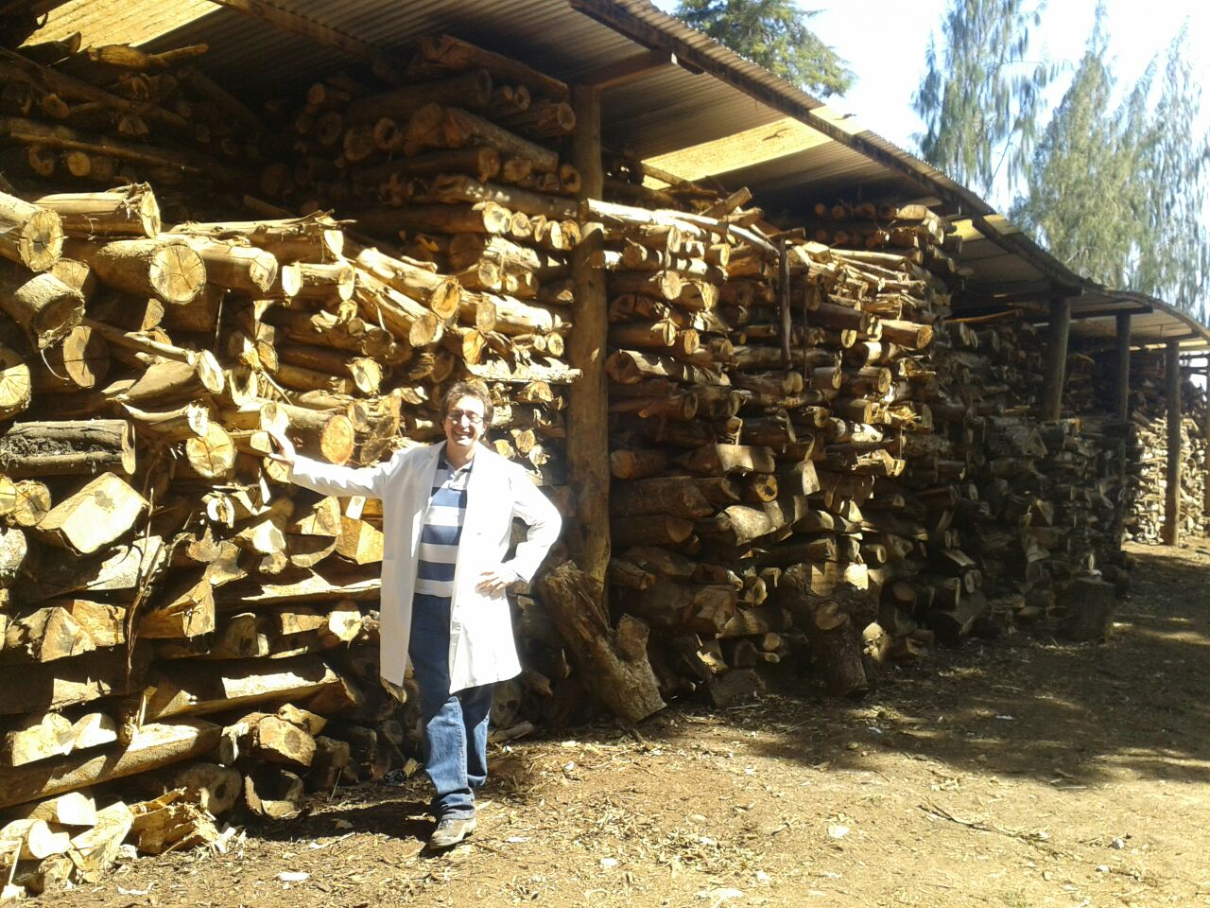
Almost there: PDF Report production pending…
It looks the ICS scenario is missing.
Be sure you run both scenarios: BaU and ICS, in order for the summary report in pdf to be properly built.
Remember to run ONLY THE LAST SCRIPT to generate alternative scenarios: 3_FW_dyn_lulcc.egoml. Otherwise you’ll start all over again.
Any doubts please email aghilardi@ciga.unam.mx
You can safely close this message.
Photo credit: Fuelwood from plantations and native forests used in the Tea industry in Kenya. © Rob Bailis 2015.

