Slide 1
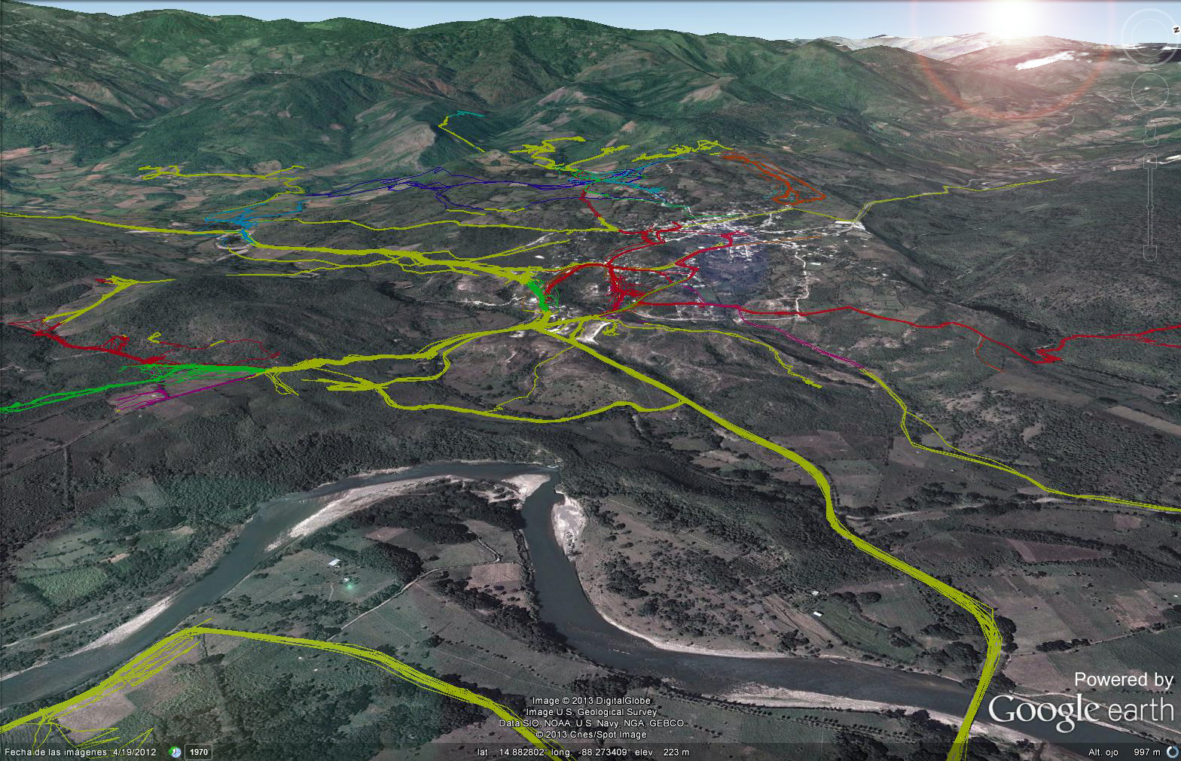
Installation in progress
Mofuss is now installing all R packages needed for the model to work properly.
This may take some 15 to 30 minutes depending on your internet connection and servers traffic.
Once all R packages are succesfully installed you will receive a confirmation message. The next time you run Mofuss on this computer this step will be jumped, but you should receive the confirmation message.
Regarding doubts or comments, please email aghilardi@ciga.unam.mx
You can safely close this message.
Photo credit: Tracks followed by fuelwood harvesters in Honduras. © Google Earth & Adrian Ghilardi.

