Slide 1
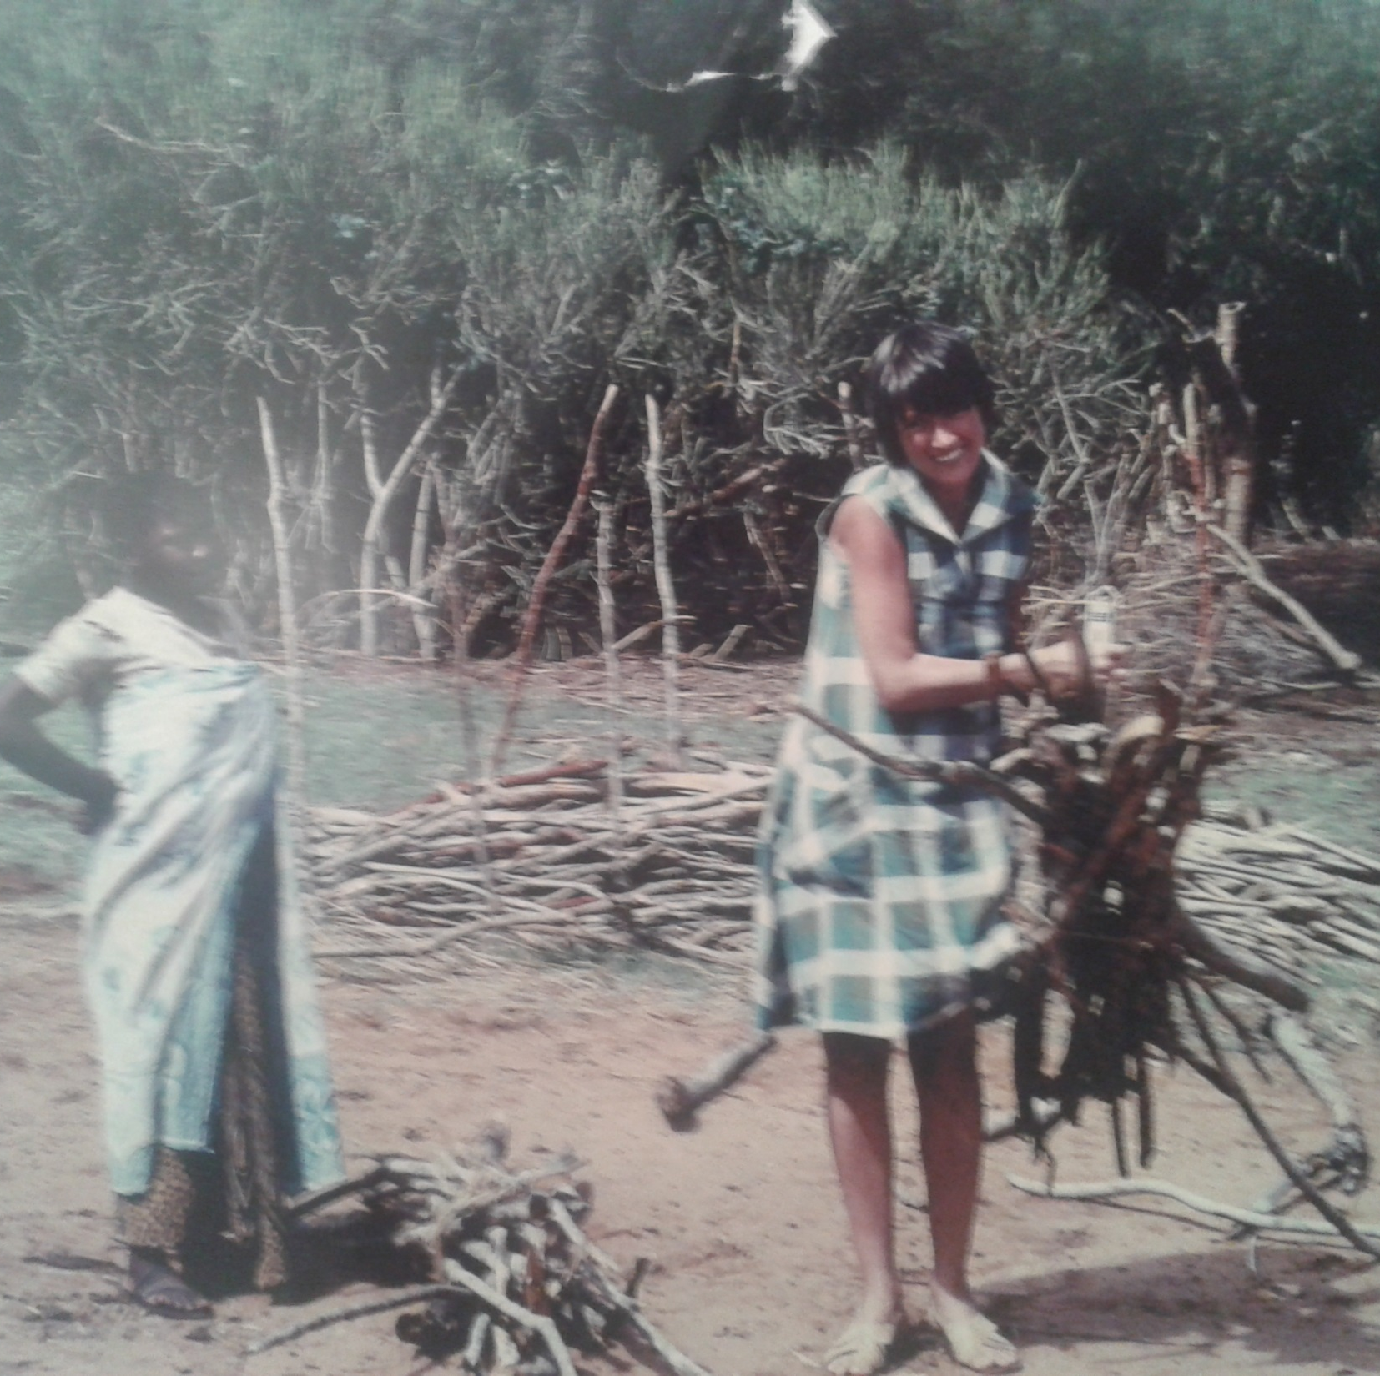
Mofuss was able to found all needed information in your computer.
In about 10 seconds you will be asked to select your country of interest.
After that, use Dinamica EGO Wizard Presenter to open and run …/LULCC/00_Map_Fix.egoml
Good!
Photo credit: Dr. Margaret Skutch, a pioneer in fuelwood studies,
weighting fuelwood in Tanzania. © M. Skutsch 1985.
You can safely close this message.

