Slide 1
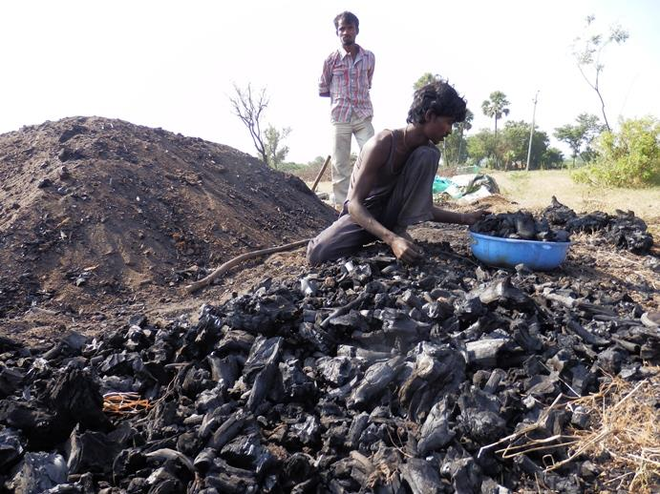
Warning! Your demand map is a ggridded distribution raster AND you are modeling outside produced scenarios. Be sure tooo
It looks the BaU scenario is missing.
Be sure you run both scenarios: BaU and ICS, in order for the summary report in pdf to be properly built.
Remember to run ONLY THE LAST SCRIPT to generate alternative scenarios: 3_FW_dyn_lulcc.egoml. Otherwise you’ll start all over again.
Any doubts please email aghilardi@ciga.unam.mx
You can safely close this message.
Photo credit: Marathi nomad charcoaler in south India. © Meiko John 2014.

