Slide 1
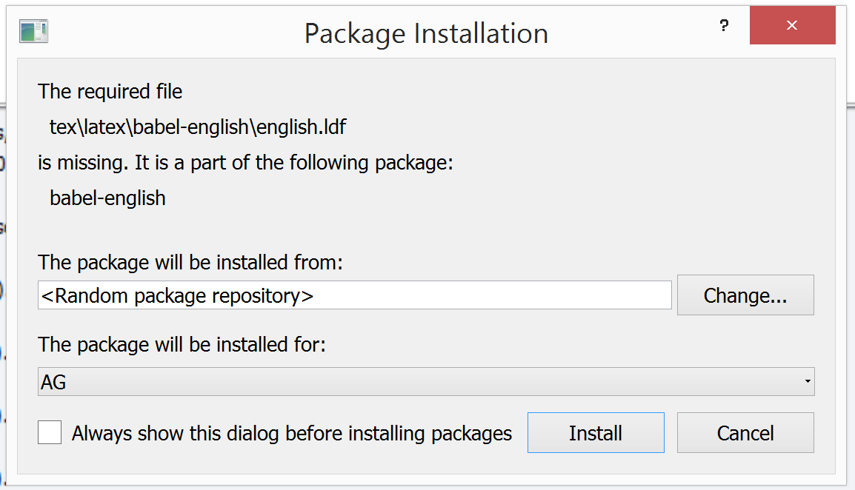
We are experiencing some issues
Apparently, some LaTeX packages were not properly installed during the first try.
The cause of this has generally to do with intermitent internet connectivity or firewalls preventing LaTeX packages installation. It is usually solved by re-trying the installation multiple times.
Mofuss will retry installing LaTeX packages up to 20 times. Remember to click «Install» if a pop-up messages appears:
You can click out the option “Always show this dialog before installing packages” if do not want to be asked each time a package need to be installed.
You can safely close this message.

