Slide 1
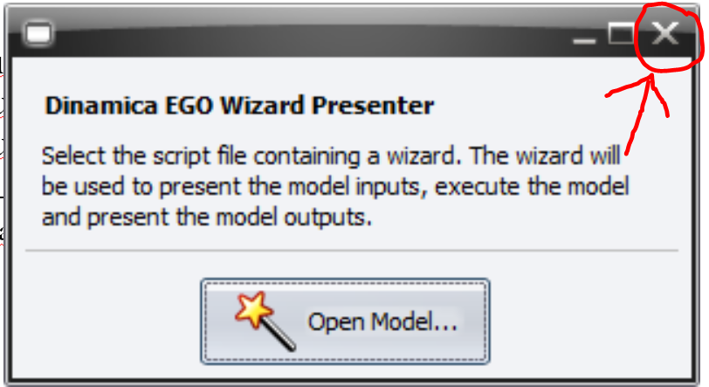
Watch Out!
Mofuss couldn’t find the compiler of TeX files to PDF inside your computer.
Did you download and install the Basic MikTEX?(32-bit or 64-bit depending on your system). Please do it even if you already have any working TeX/LaTeX system. Its important that you close the Wizard before installing MikTEX. Then, open the Wizard again and run the last script (e.g. ICS scenario).
Alternatively, try to compile the following file:
“…/Mofuss/LaTeX/Mofuss_Summary_Report.tex” using your TeX/LaTeX editor.
Ultimately, please email aghilardi@ciga.unam.mx
You can safely close this message.

