Slide 1

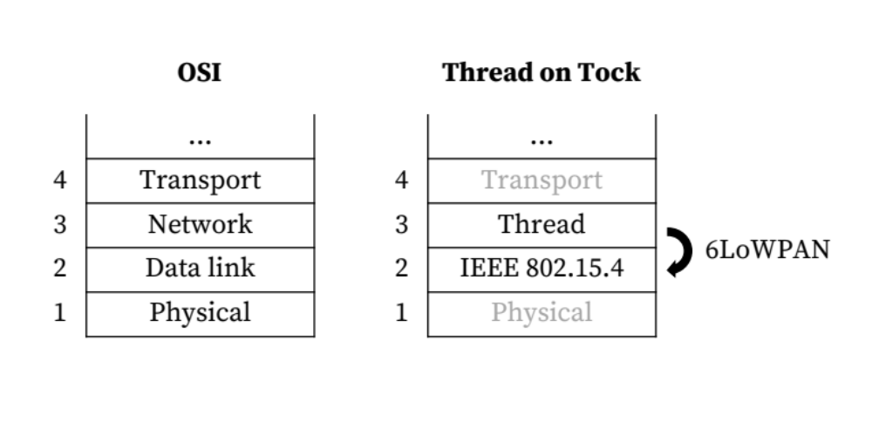
Bringing IP Networking to the Internet of Things
Mateo Garcia, Hubert Teo, Paul Crews
CURIS 2017
Motivation
Background on Mesh Link Establishment (MLE)
The goal of our CURIS project this summer was to add low-power wireless networking support to the Tock operating system. Tock is a secure embedded OS designed for the future of the Internet of Things (IoT), when embedded devices will run multiple concurrent, mutually distrustful applications on a single embedded device. While network (Layer 3) protocols for the IoT have been defined on paper, the IoT is still young, and a de facto L3 standard has not yet been set. We were tasked with enabling IPv6 packet transmission and reception over 802.15.4 radio using the 6LoWPAN packet compression scheme. To motivate the implementation of 6LoWPAN, we chose to follow the Thread networking protocol developed by Nest Labs, which defines a mesh network that uses 6LoWPAN and 802.15.4.
Mesh Link Establishment (MLE) is the process by which a Thread device joins a Thread mesh network.
MLE for network attaching comprises a four-step handshake that works as follows:
  A child device multicasts a Parent Request MLE command.
  Each potential parent device on the network unicasts a Parent Response MLE command.
  The child device selects a parent based on a hierarchy of connectivity metrics and unicasts a Child ID Request MLE command.
  The selected parent unicasts a Child ID Response MLE command.
MLE messages consist of a command type and a series of Type-Length-Value (TLV) parameters. TLVs are used to serialize information exchanged during mesh link establishment
Related Work
Findings on MLE Using Type-Length-Value (TLV) Structures
IEEE 802.15.4 standard
6LoWPAN standard
OpenThread
Rust, a systems programming language that lends itself to security with semantics like type and memory safety enforced at compile time
It’s possible to construct a packet that’s too long using TLVs
‘Hole’ in the specification
Jonathan Hui @ Nest, “Let's say the limit is 10 TLVs”

